Slide 1


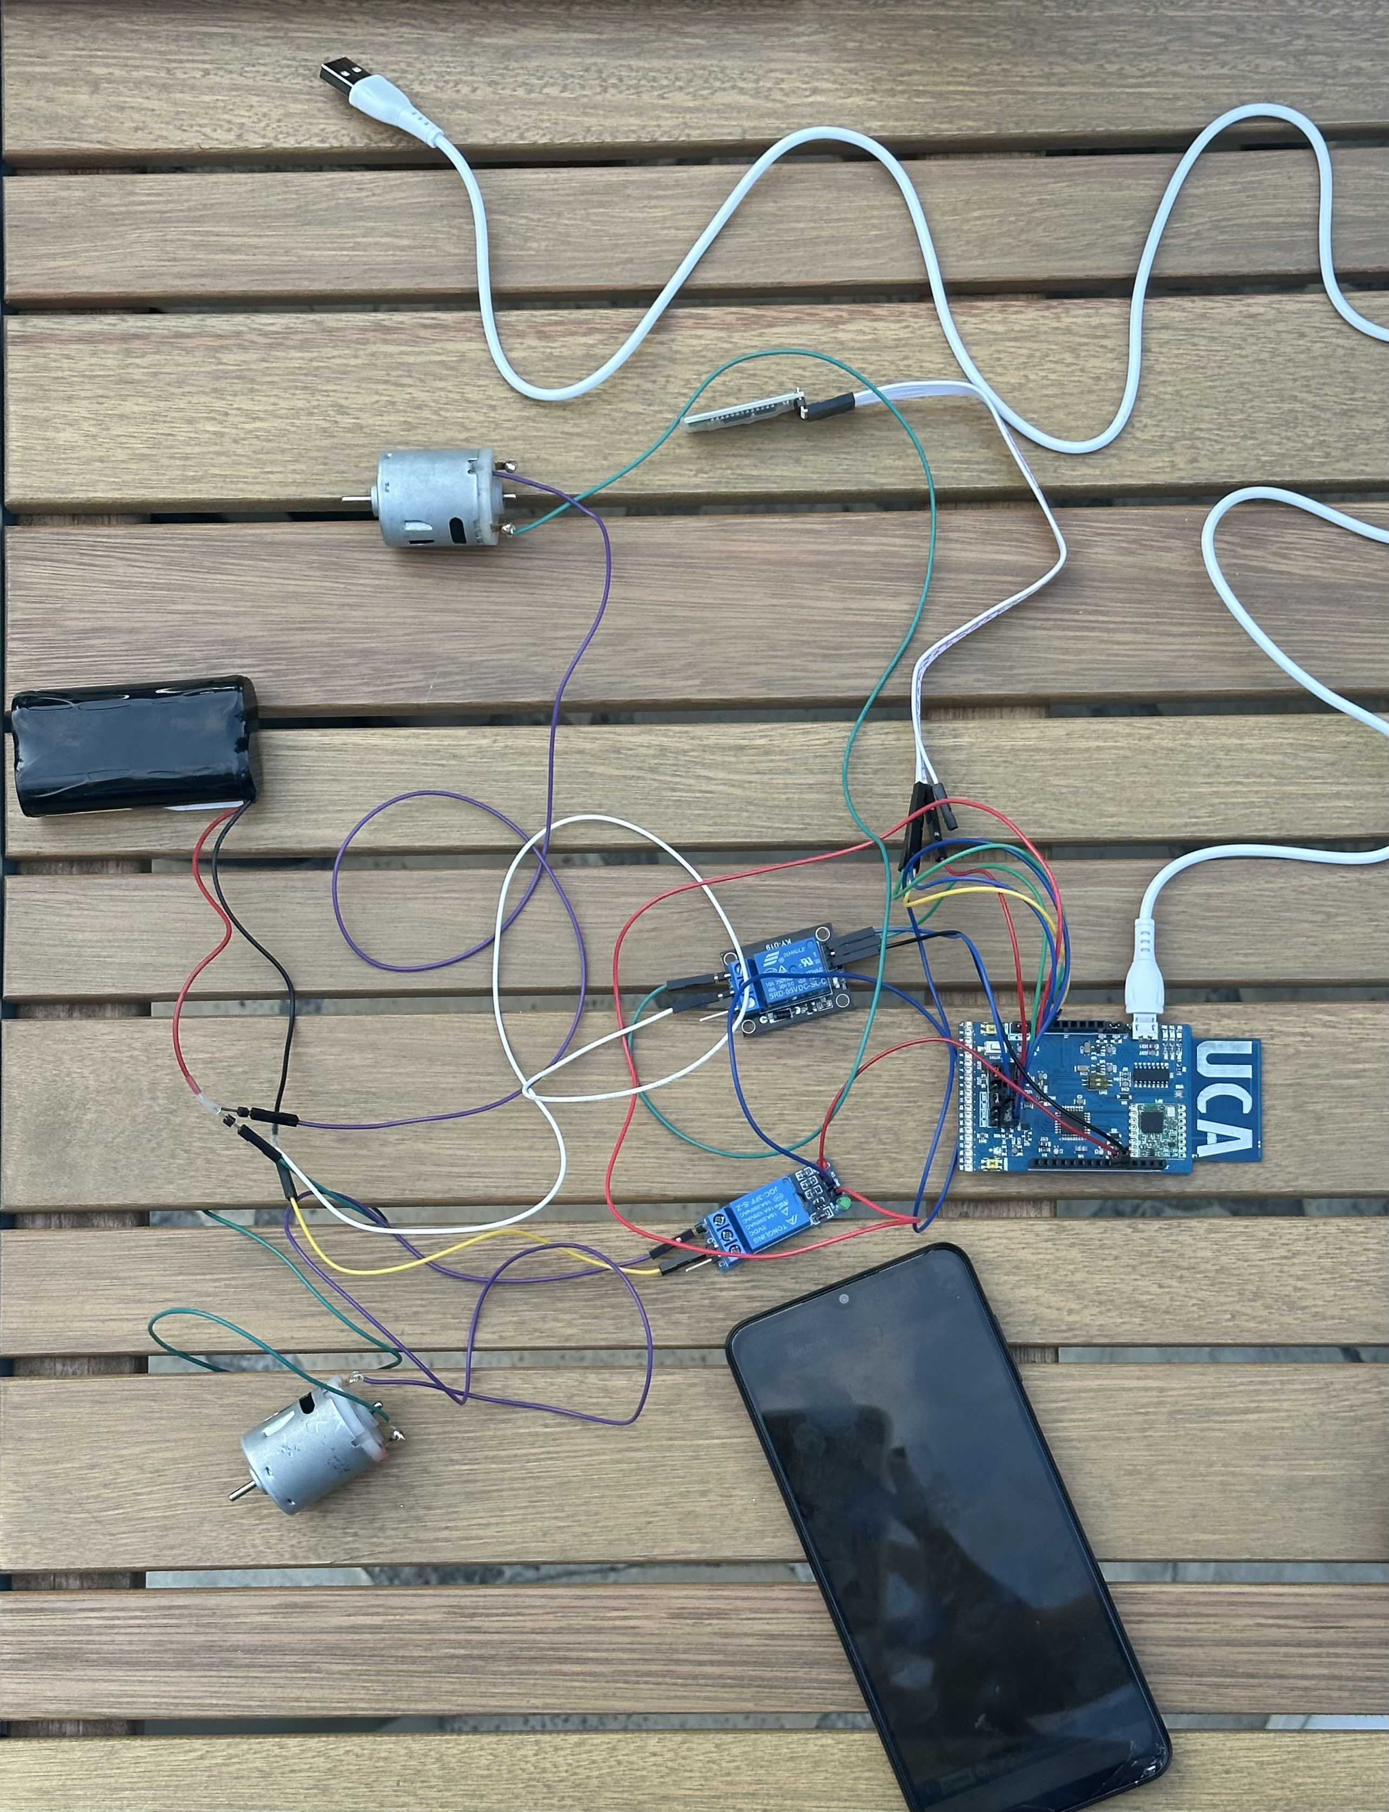
Titre du projet
Kabban Joe, Gasmi Nada
Objectifs
To build a connected, functional boat
- The boat should go straight, turn right, turn left via a mobile app
Contexte
Principe du projet
The project involves creating an Arduino
-based boat that can navigate and receive
commands via Bluetooth. The boat will be
fabricated using an Arduino board,
actuators, Relays and
wireless communication modules.
The principle behind the Arduino boat project lies in utilizing an Arduino
board, coupled with a series of actuators and Relays to create a self-propelled and
remotely-controlled vessel. The boat will be capable of receiving commands wirelessly
through a Bluetooth connection, allowing users to control its movements, direction,
and other functionalities remotely
Fabrication
Résultats
Arduino Board: Arduino UCA
Motors: two MOT3 to provide propulsion to the boat.
Relays: two relays to control the direction of the motors connect to the relays
to the Arduino board.
4.HC-05 Bluetooth Module: Connected to the Arduino board to establish a wireless
connection for remote control.
HC-05 VCC to Arduino 5V
HC-05 GND to Arduino GND
HC-05 TX to Arduino RX (digital pin)
HC-05 RX to Arduino TX (digital pin)
5.Power Supply: using Battery
6.Propellers: Attached to the 2 MOT3 to propel the boat efficiently.
7.Wiring: Connect the motors, relays, Bluetooth module, and power supply to the
Arduino board
Conclusions et perspectives
The Arduino boat project aims to create a watercraft that can navigate and receive commands via Bluetooth. By assembling the Arduino board, two motors, two relays, and an HC-05 Bluetooth module, and programming the Arduino accordingly, you can build a functional boat for autonomous and remote-controlled operations.

