Slide 1

Python for Work 2
Intermediate Python for Beginners
vehicle = Vehicle("VAN-204", tyres=4, fuel=72)
vehicle.start_engine()
vehicle.drive(km=18)
print(vehicle.status())
🚐
⚙️
📋
Main promise Build a small fleet maintenance system using try/except, modules, classes, methods and inheritance.
Workshop story A van has tyres, fuel, mileage and routes. The program checks readiness and creates a report.
Programming is huge, but we’ll keep it beginner-friendly and learn the useful basics first — enough to start self-learning and reading real code.
Notebook = guided practice Python script = same story as runnable code

Slide 2
Big picture: where Workshop 2 takes you
From simple code cells to reusable programs that model real-world things.
1
Handle problems
2
Organise code
3
Model things
4
Add behaviour
5
Reuse patterns
try/except keeps a bad input from crashing the program.
Modules keep related helper code in reusable files.
Classes and objects represent real things.
Methods make objects do useful work.
Inheritance shares common behaviour.
One story through the whole workshop
Fleet maintenance system vehicles have tyres + engines
trips change mileage + fuel
service rules prevent breakdowns
reports support work decisions
60% slides Understand the big picture, mental models and small examples.
40% demo Run the matching notebook and Python script in VS Code.
Goal: students can read, modify and extend a small practical Python program.

Slide 3
3-hour roadmap: what we cover
80/20 scope: useful topics first, advanced ideas only briefly.
0:00–0:10
Quick review
0:10–0:30
try/except
Variables, lists, dictionaries, functions
Make programs safer with simple validation
0:30–0:50
Modules
0:50–1:25
OOP core
Organise helpers into reusable files
Classes, objects, attributes and methods
1:25–1:50
Variable scope
1:50–2:15
Single inheritance
Global, local, class and instance variables
Reuse parent code and specialise child classes
2:15–2:35
Brief advanced ideas
2:35–3:00
Practical project
*args, **kwargs, multiple inheritance
Build a fleet readiness report
Leave for later Decorators, abstract classes, complex Method Resolution Order, package publishing and advanced OOP design.

Slide 4
[Quick review] One consistent story: Fleet maintenance system
Same variables and data context from examples to final project.
vehicle_id = "VAN-204"
vehicle_type = "Delivery van"
tyres = 4
fuel_level = 72
current_km = 18600
service_due_km = 20000
route = ["Depot", "Library", "Lab"]
🚐 Why a fleet story helps Vehicles are easy to imagine: they have parts, move on routes and need service checks.
📊 Final project output A readiness report that checks each vehicle, calculates trip distance and flags service needs.
Topic mapping
Errors Validate km, tyre count, fuel level
Modules Move reusable checks into a helper file
Classes Vehicle as a blueprint
Attributes tyres, fuel, mileage, route
Methods start_engine(), drive(), status()
Inheritance DeliveryVan and ServiceTruck

Slide 5
[try/except] Errors and try/except
Use try/except when something might fail, especially user input or files.
raw_km = "eighteen"
try:
trip_km = float(raw_km)
print("Trip distance:", trip_km)
except ValueError:
print("Please enter a number, e.g. 18")
🧯 Mental model Try a risky action. If it fails, run a safe backup plan.
🐞 Common beginner errors ValueError, TypeError, NameError and FileNotFoundError.
✅ 80/20 rule Teach simple validation. Do not go deep into custom exceptions yet.
Student activity: change "eighteen" to "18" and run again.

Slide 6
[try/except] Reusable validation pattern
Put try/except into a helper function so you can reuse it many times.
def get_positive_number(value, field_name):
try:
number = float(value)
if number <= 0:
raise ValueError
return number
except ValueError:
print(f"Invalid {field_name}")
return 0
trip_km = get_positive_number("18", "trip km")
tyres = get_positive_number("4", "tyres")
🛡️ Why this matters A fleet report should not crash because one vehicle has bad input.
🔁 Reusable thinking One function can validate distance, fuel, tyres or service mileage.
🧪 Demo instruction Run the notebook cell, then try "abc", -5 and 0.
Input → validate → safe number
Bad input → message → 0

Slide 7
[Modules] Modules, packages and pip
Modules help organise code. pip installs external packages.
# Built-in modules
from datetime import date
import math
print(date.today())
print(math.ceil(18.2))
# Custom module
from fleet_tools import calculate_service_gap
📄 Module A Python file you can import, such as fleet_tools.py.
📦 Package A folder or installed library containing modules.
⬇️ pip Tool used to install packages from Python Package Index.
80/20 Priority Know import + pip install. Package publishing comes later.
py -m pip install pandas matplotlib
python -m pip install pandas matplotlib

Slide 8
[arg & kwarg] Brief: *args and **kwargs
Useful for flexible inputs, but do not overuse them in beginner code.
def add_trip_stops(*stops):
for stop in stops:
print("Stop:", stop)
add_trip_stops("Depot", "Library", "Lab")
*args Many positional values:
stop1, stop2, stop3...
**kwargs Many named values:
driver="Mia", route="North"
def show_vehicle_details(**details):
for key, value in details.items():
print(key, value)
show_vehicle_details(driver="Mia", route="North")
Project use: *args adds route stops. **kwargs stores optional vehicle details.

Slide 9
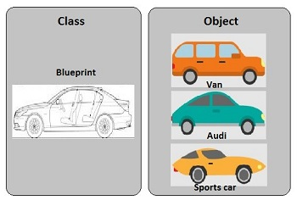
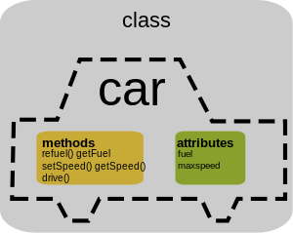
[OOP] Classes and objects
A class is a blueprint. An object is one real item made from it.
class Vehicle:
pass
van = Vehicle()
truck = Vehicle()
print(type(van))
CLASS BLUEPRINT Vehicle has attributes
and methods
OBJECTS MADE FROM CLASS 🚐 van: VAN-204
🚚 truck: TRK-091
📐 Class Blueprint: defines what a vehicle should have and do.
🚐 Object Real instance: van and truck are different vehicles.
🔁 Use when The program has repeated real-world things.
Workshop fit Fleet has repeated vehicle records.

Slide 10
Attributes and __init__
Attributes store object information. __init__ runs when the object is created.
class Vehicle:
def __init__(self, vehicle_id, tyres, fuel_level):
self.vehicle_id = vehicle_id
self.tyres = tyres
self.fuel_level = fuel_level
van = Vehicle("VAN-204", 4, 72)
print(van.vehicle_id)
print(van.tyres)
van object vehicle_id = "VAN-204"
tyres = 4
fuel_level = 72
self Means this specific object. van and truck can have different values.
⚡ __init__ Runs automatically when a new object is created.
🏷️ Attribute A named piece of data stored inside the object.
Beginner image Class creates objects. Objects keep their own information.

Slide 11
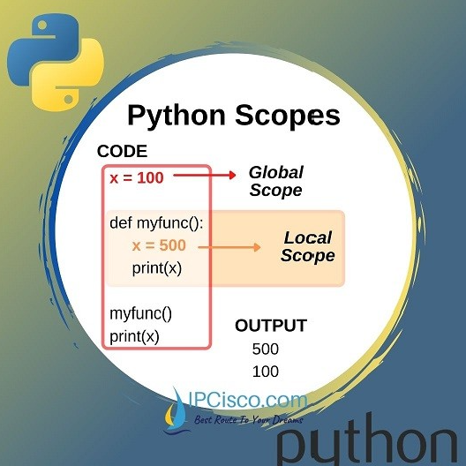
[Variable scope] Variable scope: debug it with print()
Scope answers: where can this variable be used, and when is it created?
DEPOT_NAME = "CDU Casuarina Depot"
print("GLOBAL:", DEPOT_NAME)
class Vehicle:
fleet_type = "training fleet"
def __init__(self, vehicle_id):
self.vehicle_id = vehicle_id
print("INIT object:", self.vehicle_id)
def label(self):
status = "ready"
print("METHOD local:", status)
print("METHOD global:", DEPOT_NAME)
print("METHOD class:", Vehicle.fleet_type)
print("METHOD instance:", self.vehicle_id)
return f"{self.vehicle_id} is {status}"
Scope map 🌍 global → 🏢 class → 🚐 instance → ⚙️ method/local
Expected debug output:
GLOBAL: CDU Casuarina Depot
INIT object: VAN-204
METHOD local: ready
METHOD global: CDU Casuarina Depot
METHOD class: training fleet
METHOD instance: VAN-204
VAN-204 is ready
🌍 Global Outside functions/classes; available widely, but do not overuse.
📍 Local Inside a function/method; usually disappears after it finishes.
🏢 Class variable Shared by all objects from the same class.
🚐 Instance attribute Belongs to one object: van can differ from truck.

Slide 12
Methods: functions inside objects
Methods add behaviour to an object. Data + behaviour = useful model.
class Vehicle:
def __init__(self, vehicle_id, fuel_level):
self.vehicle_id = vehicle_id
self.fuel_level = fuel_level
self.engine_on = False
def start_engine(self):
self.engine_on = True
def drive(self, km):
self.fuel_level -= km * 0.08
return f"{self.vehicle_id} drove {km} km"
van = Vehicle("VAN-204", 72)
van.start_engine()
print(van.drive(18))
Object = data + actions 🚐 van
fuel_level = 72 → 70.56
🏷️ Attribute What the vehicle knows: ID, fuel level and engine state.
⚙️ Method What the vehicle can do: start engine, drive, update fuel.
🧩 Story connection A trip changes vehicle state, so a method is better than a loose function.
Mental model: Object = information + actions

Slide 13
Single inheritance
A child class reuses parent code and adds something specific.
class Vehicle:
def __init__(self, vehicle_id, tyres):
self.vehicle_id = vehicle_id
self.tyres = tyres
def basic_status(self):
return f"{self.vehicle_id}: {self.tyres} tyres"
class DeliveryVan(Vehicle):
def __init__(self, vehicle_id, tyres, cargo_capacity):
super().__init__(vehicle_id, tyres)
self.cargo_capacity = cargo_capacity
def load_cargo(self, kg):
return kg <= self.cargo_capacity
Vehicle common data +
basic_status()
DeliveryVan adds cargo_capacity
and load_cargo()
👪 Parent class Vehicle keeps common vehicle attributes and status logic.
🧒 Child class DeliveryVan adds cargo capacity and loading behaviour.
↩️ super() Calls the parent version instead of rewriting everything.
80/20: single inheritance is useful. Complex inheritance can wait.

Slide 14
Brief: multiple inheritance
One class can inherit from more than one parent. Keep it simple and careful.
class Vehicle:
def basic_status(self):
print("Vehicle is active")
class ServiceToolMixin:
def inspect_tyres(self):
print("Checking tyre pressure")
class ServiceVan(Vehicle, ServiceToolMixin):
pass
van = ServiceVan()
van.basic_status()
van.inspect_tyres()
Vehicle basic_status()
ServiceToolMixin inspect_tyres()
ServiceVan inherits from both
👀 Why show it briefly? Students may see this syntax in real code or tutorials.
✅ Beginner rule Use single inheritance first. Use multiple inheritance only when the design is clean.

Slide 15
Practical project: fleet readiness report
Build a small program that combines the main topics.
1 Validate Use try/except to clean km, fuel and tyre input.
2 Model Create vehicle objects from classes.
vehicles = [van, truck]
total_km = 0
for vehicle in vehicles:
print(vehicle.status())
total_km += vehicle.current_km
if vehicle.needs_service():
print("Service required:", vehicle.vehicle_id)
print("Fleet mileage:", total_km)
3 Specialise Use child classes for DeliveryVan and ServiceTruck.
4 Report Loop through vehicles and print readiness report.
Project story Turn messy vehicle data into a simple, useful operational report.
What students practise try/except → modules → classes → methods → inheritance → loop report

Slide 16
Project file map
The same course story appears in the slides, notebook and Python script.
🖥️ PowerPoint Concept, mental model and tiny examples for explanation.
📓 Jupyter Notebook Run note cell → code cell → observe output → modify values.
🐍 Python script Run as a program in VS Code to show how a .py file works.
py python_workshop_2_fleet.py
python python_workshop_2_fleet.py
python3 python_workshop_2_fleet.py
Demo flow
Explain on slide → run notebook cell → show matching code in the .py script
Smart teaching rhythm: concept first, tiny code second, practical change third.

Slide 17
Workshop 2 recap
What students should remember after three hours.
try/except Handle input and file problems safely.
Modules Split reusable helper code into files.
Classes Create blueprints for real-world things.
Objects Create specific vehicles from a class.
Methods Put useful actions inside objects.
Inheritance Reuse common code and specialise child classes.
*args / **kwargs Recognise flexible function inputs.
Multiple inheritance Know the idea; use carefully later.
Thank you

