Slide 1

Python for Work
Beginner Seminar for CDU Students
2-hour practical workshop
⬇️
▶️
⌨️
📊
📋
install
run
code
data
report
Programming is huge, but we’ll keep it beginner-friendly and learn the useful basics first — enough to start self-learning and reading real code.
💡
Idea
⌨️
Code
📺
Output
🔁
Improve
Slide ↔ Notebook ↔ Python script
Kevin Pham - 390791

Slide 2
Big picture: what you will be able to do
The workshop moves from zero setup to a small practical report.
1
▶️
2
🧺
3
🔀
4
🔁
5
📋
Run Python
Store data
Make decisions
Repeat work
Make a report
Install, verify and run code
Variables, types and collections
Boolean logic and if statements
Loops and functions
pandas + chart + summary
Plain-English goal
Simple mental model
Students can read, run, change and explain a simple Python program.
Input data → Python steps → useful output for a work task.

Slide 3
How the workshop will work
Use the slide for the idea, then VS Code / Notebook for the hands-on demo.
🧠
slides
💻
VS Code demo
Big picture, simple rules, visual mental models and tiny examples.
Run the same idea in Jupyter Notebook and a .py script.
1
See the idea
2
Run it
3
Reuse it
4
Change it
Slide concept
Notebook cell
.py script
Student modifies
One story context: Maya prepares a CDU class progress report. Every code example connects to that story.

Slide 4
Workshop topics
The 80/20 Python path for complete beginners.
⬇️
Setup
▶️
Run code
⌨️
Core syntax
🔀
Logic
Install Python, VS Code, packages
.py script, Python shell, Jupyter Notebook
print(), variables, type(), strings, numbers
comparisons, and/or/not, if/elif/else
🧱
Data structures
🔁
Automation basics
📦
Libraries
📊
Mini project
list, tuple, dictionary, set
for loops, while loops, functions
pip install, import, pandas, matplotlib
student score report + chart
Workshop pattern: concept → tiny code → run → change → explain

Slide 5
What is Python?
A readable language for giving clear instructions to a computer.
📝
Plain-language idea
🤖
What the computer does
💼
Why work uses it
Python is like writing a clear recipe: step 1, step 2, step 3.
It follows your instructions exactly and shows the result.
Automate repeated work, process data, build reports and test ideas quickly.
price = 120 discount = 0.20 final_price = price * (1 - discount) print(final_price)
Input
Output
price + discount
96.0
Beginner rule: do not memorise everything. Learn how to run, read errors, change small parts and test again.

Slide 6
Python is clean compared with many languages
Less ceremony means beginners can focus on the idea, not punctuation.
Python
Typical C-style syntax
if score >= 50: print("Pass") else: print("Review")
if (score >= 50) { print("Pass"); } else { print("Review"); }
✅
Python uses indentation
🚫
No braces needed
🧩
Less punctuation
Spaces show which lines belong together.
No { } for simple code blocks.
Semicolons are normally unnecessary.
Data processing
AI / ML
Web tools
Automation scripts
Reports

Slide 7
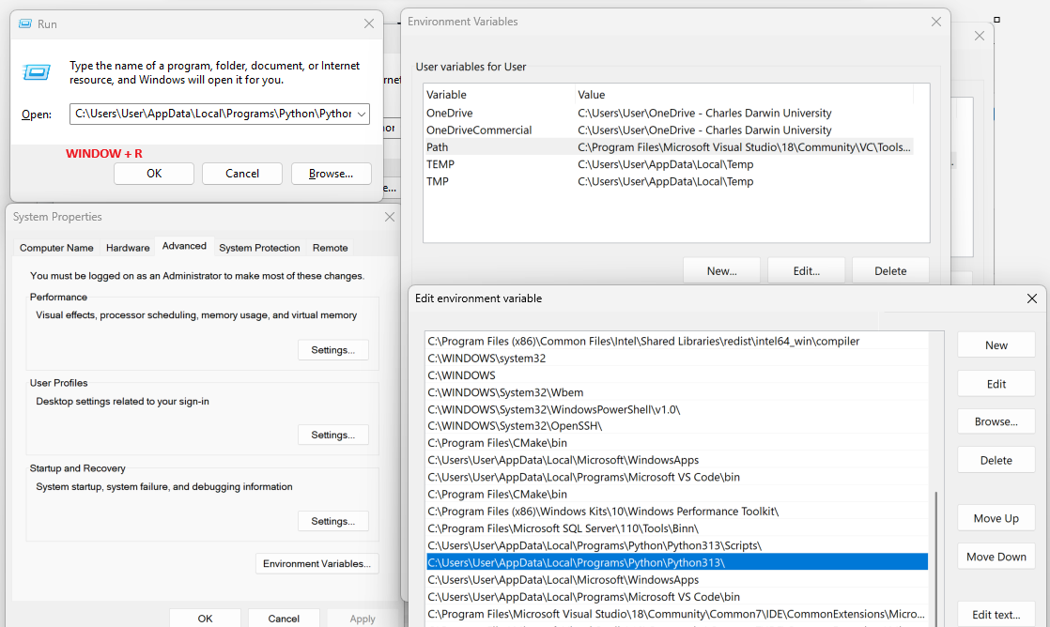
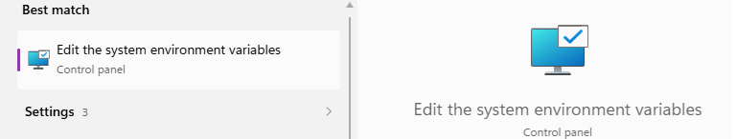
Install Python + VS Code quickly
Beginner setup for Windows laptops.
🧰
2. Install VS Code
1. Install Python 3
🐍
Install Visual Studio Code. Open Extensions and install the Python extension.
Download Python 3
Add Python to PATH for window
WINDOW_KEY + R : %localappdata%\Programs\Python
WINDOW_KEY + S: env
VS code first:
Open terminal: Ctrl + ~
Comment: Ctrl + /
C:\Users\<YourName>\AppData\Local\Programs\Python\Python311
C:\Users\<YourName>\AppData\Local\Programs\Python\Python311\Scripts
✅
3. Verify
Open Terminal in VS Code. Check Python version and install learning packages.
py --version
python --version
py -m pip install notebook pandas matplotlib
use py on Windows; python3 is common on Mac/Linux.

Slide 8
Optional: project environment + Jupyter
Keep this brief. Use it when students are ready.
🌍
Global Python
📁
Virtual environment
📓
Jupyter Notebook
Packages are installed for the general Python installation. Simple for a first workshop.
A project-specific space for packages. Useful when projects need different versions.
Interactive document: explanation + code + output + charts in one place.
python -m venv .venv .venv\Scripts\activate py -m pip install notebook jupyter notebook
80/20 advice
Start simple. Use global Python for the first workshop, then learn virtual environments as projects grow.

Slide 9
How to run Python code
Three beginner-friendly ways.
📄
.py script
⚡
Python shell
📓
Jupyter Notebook
Best for reusable programs and automation.
Best for very quick experiments.
Best for learning, explaining and prototyping.
py hello.py python hello.py python3 hello.py
py >>> 2 + 3 5 >>> exit()
jupyter notebook # run code cell by cell # output appears below
Today: slides explain the idea → Notebook shows it live → .py script shows reusable workflow.

Slide 10
Script or Notebook?
Choose the right tool for the task.
📄
Use .py file when…
📓
Use Jupyter Notebook when…
You want a reusable program, an automation script, or a file that runs from top to bottom.
You are learning, exploring, documenting steps, showing output and creating charts.
# hello.py student_name = "Maya" print("Hello", student_name)
# Notebook cell student_name = "Maya" print("Hello", student_name) # output appears below the cell
Beginner decision: learning/explaining/charting → Notebook repeating/automation/sharing code → .py script

Slide 11
First Python program
Make the computer display a result.
print("Hello, CDU!")
studentName = "Maya Chen"
print("Welcome", studentName)
What print() does
Displays information so you can see the result of your code.
Beginner habit
Run code often. If something breaks, read the last error line first.
Try this
Change the name and message, then run the cell again.

Slide 12
Variables & data types
Variables store information. type() tells you what kind.
studentName = "Maya Chen" # str
studentAge = 22 # int
hoursStudied = 6.5 # float
isCduStudent = True # bool
weeklyScores = [80, 90, 75] # list
campus = ("Darwin", "NT") # tuple
profile = {"name": studentName, "score": 90} # dict
tags = {"Python", "Data", "AI"} # set
print(type(studentName))
str
text
int
whole number
float
decimal
bool
True/False
list
many values
tuple
fixed group
dict
key-value
set
unique values

Slide 13
Working with strings
Strings are text values: names, labels, messages and categories.
studentName = "maya chen"
courseName = "Python for Work"
print(studentName.upper())
print(studentName.title())
print(len(studentName))
message = f"Welcome {studentName.title()} to {courseName}"
print(message)
Common actions
.upper() · .lower() · .title() · len() · f"...{value}..."
Practical use
Clean names, prepare labels, build report messages and format outputs.
Try this
Change the student name. Add campus or degree.

Slide 14
Working with numbers
Numbers are used for calculations, totals, rates and measurements.
labHours = 6
assistantRate = 32.5
pay = labHours * assistantRate
print(pay)
print(round(pay, 2))
print(10 / 3) # division
print(10 // 3) # whole-number division
print(10 % 3) # remainder
print(2 ** 3) # power
+
add
-
subtract
*
multiply
/
divide
//
whole divide
%
remainder
**
power

Slide 15
Boolean logic & comparisons
Conditions produce True or False, then code can decide what to do.
score = 72
attendance = 0.85
print(score > 50)
print(score == 72)
print(score != 100)
canPass = score >= 50 and attendance >= 0.8
needsSupport = score < 50 or attendance < 0.8
print("Can pass:", canPass)
Comparison operators
> < >= <= == !=
Logic words
and · or · not
Mental model
Condition → True/False → Action

Slide 16
If statements
Use if / elif / else when Python needs to make a decision.
score = 72
if score >= 85:
print("Excellent progress")
elif score >= 50:
print("Pass — keep practising")
else:
print("Review needed")
1
Use : after condition
2
Indent action lines
3
First True branch runs
Try this: change score to 95, 72 and 40. What changes?

Slide 17
Collections: list, tuple, dictionary, set
Most practical Python work means storing many values.
Collection
Example
Use it for
List
[80, 90, 75]
Ordered, changeable data
Tuple
("Darwin", "NT")
Small fixed groups
Dictionary
{"name": "Maya", "score": 90}
Labelled records
Set
{"AI", "Data"}
Unique values / remove duplicates
80/20 priority
Practise lists and dictionaries the most. Learn tuples and sets enough to recognise them.

Slide 18
Lists & tuples
Use lists for data that can change. Use tuples for simple fixed groups.
scores = [80, 90, 75]
print(scores[0]) # first item
scores.append(88) # add item
print(scores)
location = ("Darwin", "NT")
city, state = location
print(city, state)
List
Ordered + changeable. Good for scores, readings, tasks and rows of data.
Tuple
Ordered + usually fixed. Good for locations, coordinates or simple pairs.
Beginner tip
Python indexes start at 0, so the first item is scores[0].

Slide 19
Dictionaries & sets
Use dictionaries for labelled records. Use sets for unique values.
student = {
"name": "Maya",
"degree": "Engineering",
"score": 90
}
print(student["name"])
student["score"] = 95
interests = ["AI", "Data", "AI", "Business"]
uniqueInterests = set(interests)
print(uniqueInterests)
Dictionary
Key → value. This is the most useful beginner structure for real-world records.
Set
Keeps only unique values. Great for duplicate removal.
Try this
Add campus, email or pass_status to the dictionary.

Slide 20
For loops
Repeat the same action for each item in a collection.
scores = [80, 90, 75]
for score in scores:
print("Score:", score)
for score in scores:
if score >= 50:
print(score, "Pass")
else:
print(score, "Review")
1
Take first item
2
Run indented code
3
Move to next item
80/20 rule
Practise for loops first. They are more common for beginner data work than while loops.

Slide 21
Loop iterable with list and dictionary
This is one of the most useful beginner patterns.
List loop
Dictionary loop
tasks = ["install Python", "run notebook", "write first loop"]
for task in tasks:
print("Next task:", task)
student = {"name": "Maya", "score": 90, "degree": "Engineering"}
for key, value in student.items():
print(key, "=", value)
List loop
Use when you need to do the same thing to every item.
Dictionary loop
Use .items() when you want both label and value.

Slide 22
While loop — brief introduction
Repeat while a condition stays True. Use carefully.
practiceDay = 1
while practiceDay <= 5:
print("Practice day", practiceDay)
practiceDay = practiceDay + 1
print("Practice streak complete")
When to use
When you do not know exactly how many repeats are needed.
Beginner risk
If the condition never becomes False, the loop may run forever.
Workshop priority
Teach while briefly. Spend most loop practice on for loops.

Slide 23
Functions
Package steps into reusable code.
def calculatePay(hours, rate):
pay = hours * rate
return pay
def labelScore(score):
if score >= 85:
return "Excellent"
elif score >= 50:
return "Pass"
else:
return "Review"
print(labelScore(72))
Input → Function → Output
Example: score goes in, label comes out.
def
Starts a function definition.
parameters
Values the function receives.
return
Sends the answer back.

Slide 24
Libraries: pip install → import → use
Libraries give Python extra powers.
py -m pip install pandas matplotlib
import pandas as pd
import matplotlib.pyplot as plt
# install once, import in each project/notebook
pandas
Tables, CSV files, data cleaning and simple analysis.
matplotlib
Charts, trends and visualisation.
NumPy
Arrays and numerical computing. Learn more after basics.
80/20 library habit
Install package → import package → use package.

Slide 25
Small data workflow
A practical pattern students can reuse at work.
import pandas as pd
records = [
{"name": "Maya", "score": 90},
{"name": "Leo", "score": 72},
{"name": "Ava", "score": 48}
]
df = pd.DataFrame(records)
print(df)
print(df["score"].mean())
Data
list / dict / CSV
pandas
table
Analyse
mean / max / filter
Chart
matplotlib
Mini project
Student score report: store records, label status, calculate average, show a chart.

Slide 26
Final mini-project 1: create a CSV report
Use everything from the workshop: variables, if/else, loop, function, pandas, matplotlib and CSV output.
data
→
function
→
loop
→
DataFrame
→
CSV
→
chart
import pandas as pd import matplotlib.pyplot as plt students = [ {"name":"Maya", "score":85}, {"name":"Leo", "score":62}, {"name":"Ava", "score":45}, ]
def get_status(score): if score >= 50: return "Pass" else: return "Review" for student in students: student["status"] = get_status(student["score"])
df = pd.DataFrame(students) df.to_csv("student_scores.csv", index=False) print(df) print("Average:", df["score"].mean()) df.plot(x="name", y="score", kind="bar") plt.title("Student Score Report") plt.show()
1
What students see
2
What students practise
3
Small change task
The program creates student data, labels each result, saves a CSV file, prints a summary and shows a simple bar chart.
Reading code from top to bottom and explaining what each step does in plain English.
Add one more student, change a score and run the program again.

Slide 27
Final mini-project 2: read, process and visualise data
Read the CSV created by project 1, then use pandas and matplotlib to answer simple questions.
1
Question 1
2
Question 2
3
Question 3
4
Question 4
What does the file contain?
How many passed or need review?
What is the average and highest score?
Can we show it visually?
import pandas as pd import matplotlib.pyplot as plt df = pd.read_csv("student_scores.csv") print(df.head()) print(df["status"].value_counts()) average_score = df["score"].mean() highest_score = df["score"].max() print("Average:", average_score) print("Highest:", highest_score)
passed_students = df[df["status"] == "Pass"] print(passed_students) df.plot(x="name", y="score", kind="bar") plt.axhline(y=50, linestyle="--") plt.title("Pass Line and Student Scores") plt.xlabel("Student") plt.ylabel("Score") plt.show()
Plain-English pattern: read file → inspect data → calculate summary → filter rows → visualize result

Slide 28
What to learn next
After this beginner workshop, keep growing in the most useful direction.
OOP
Classes, objects, attributes, methods and inheritance. Model real things in code.
Thank you

