Slide 1

Predicting customer buying behaviour
01/10/2025

Slide 2
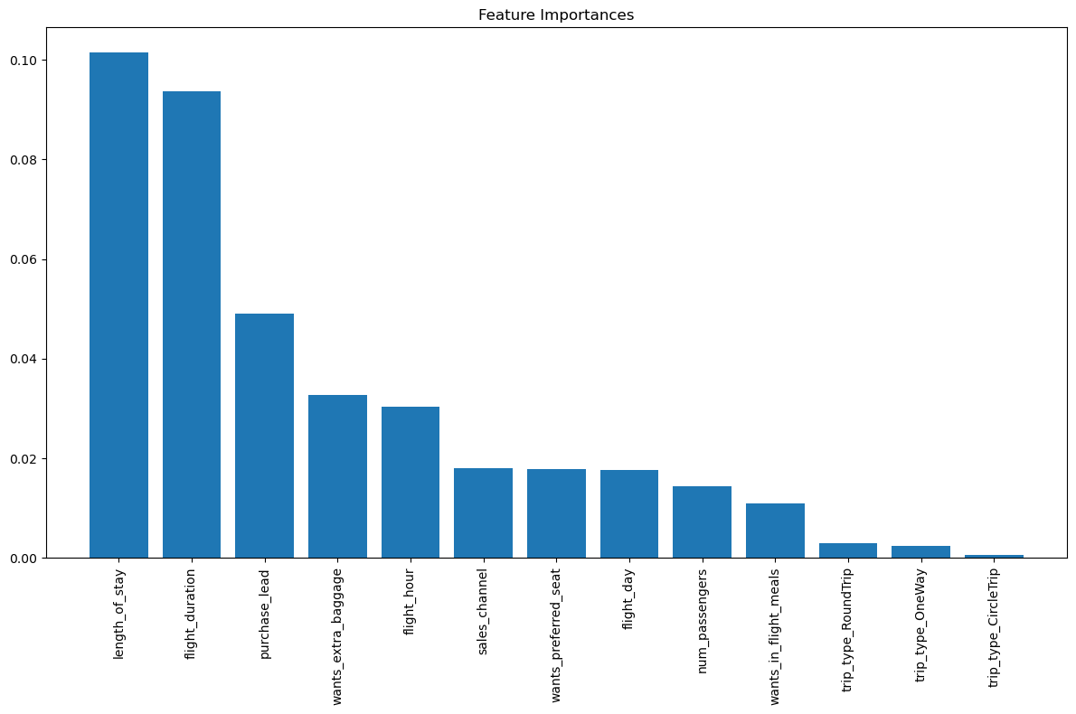
RESULTS
DATA PREPERATION
All metrics were recorded from a separate test split representing 10% of the data.
Accuracy: 0.688
Precision: 0.293
Recall: 0.754
AUC: 0.715
F1 score: 0.422
Route feature was dropped due to complexity of deriving meaningful feature from data
One-hot encoded categorical variables to be more well understood by machine learning models
Data imbalance of booking_complete feature, employed SMOTE to balance data
MODEL
Random forests – chosen for interpretability and performance
Tuned hyperparameters using grid search
max_depth: 10
max_features: sqrt
min_samples_leaf: 4
min_samples_split: 2
n_estimators: 500
Other models weren’t explored due to long compute time of grid search

