Slide 1
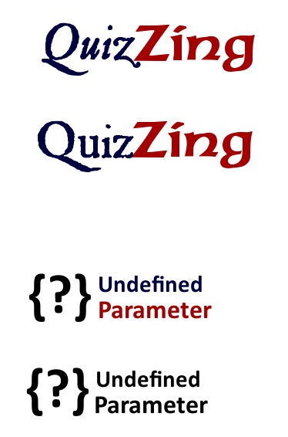
Blake Bartlett
Braeden Bodily
Melynda Lindhorst
Joseph Lee
1/6

Slide 2
How is it Helpful
Time Saving
Used as a study guide
Easy to Use
Clean UI
User controlled content
Identify Areas of Trouble
Trends and graphs can indicate areas that need improvement.
Auto Quiz Generation
User Optimized
User Ratings
Joseph Lee
2/6

Slide 3
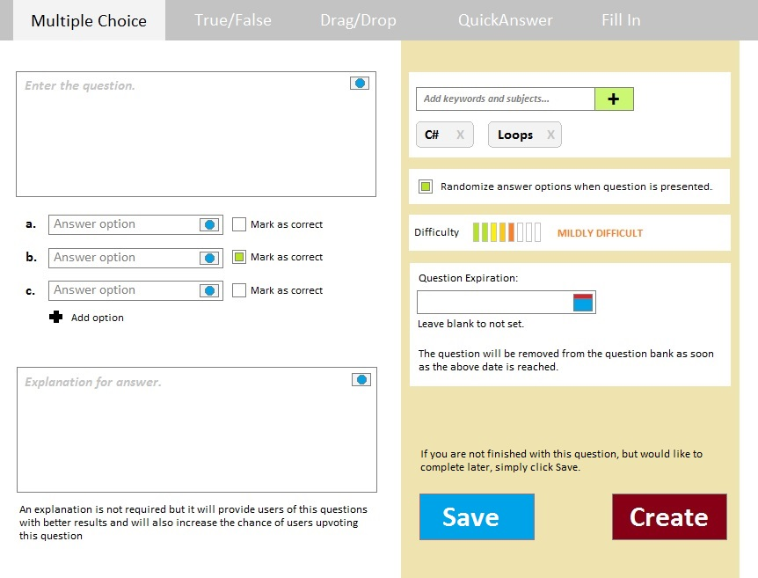
Melynda Lindhorst
3/6

Slide 4
Blake Bartlett
4/6
Notes:
*Random Generation -Have the site select questions that others have made for you. -Make a quiz that has a variety of subjects. -And save it. *Custom Generation -Select your own questions or select others questions, or both. -Make a quiz that has a variety of subjects. -And save it. *Shared Group Quizzes -Share the Quizzes that you have made with others, or if you are shy, look at the quizzes others have made. -Do you want them to compete against you? You better, because you can! *Editing Shared -You can make it so while you are adding questions to your quizzes, others can join in too, if you let them

Slide 5
Braeden Bodily
5/6

Slide 6
Much Much More…
Future Features
Equation Editor
Customizable Avatars
Group Essay Evaluation
Android / iOS App
Editable Diagrams
Customizable Profile Pages
Intuitive customized quiz types
6/6

Slide 7
Questions?
Thank You!

