Slide 1
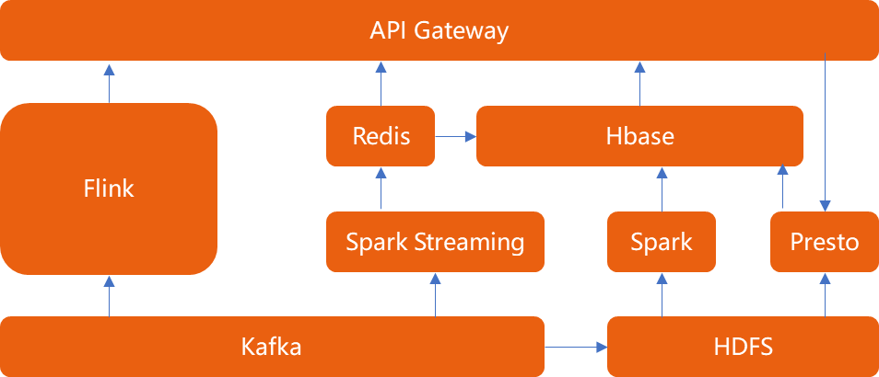
API Gateway
Flink
Redis
Hbase
Spark Streaming
Spark
Presto
Kafka
HDFS

