Slide 1
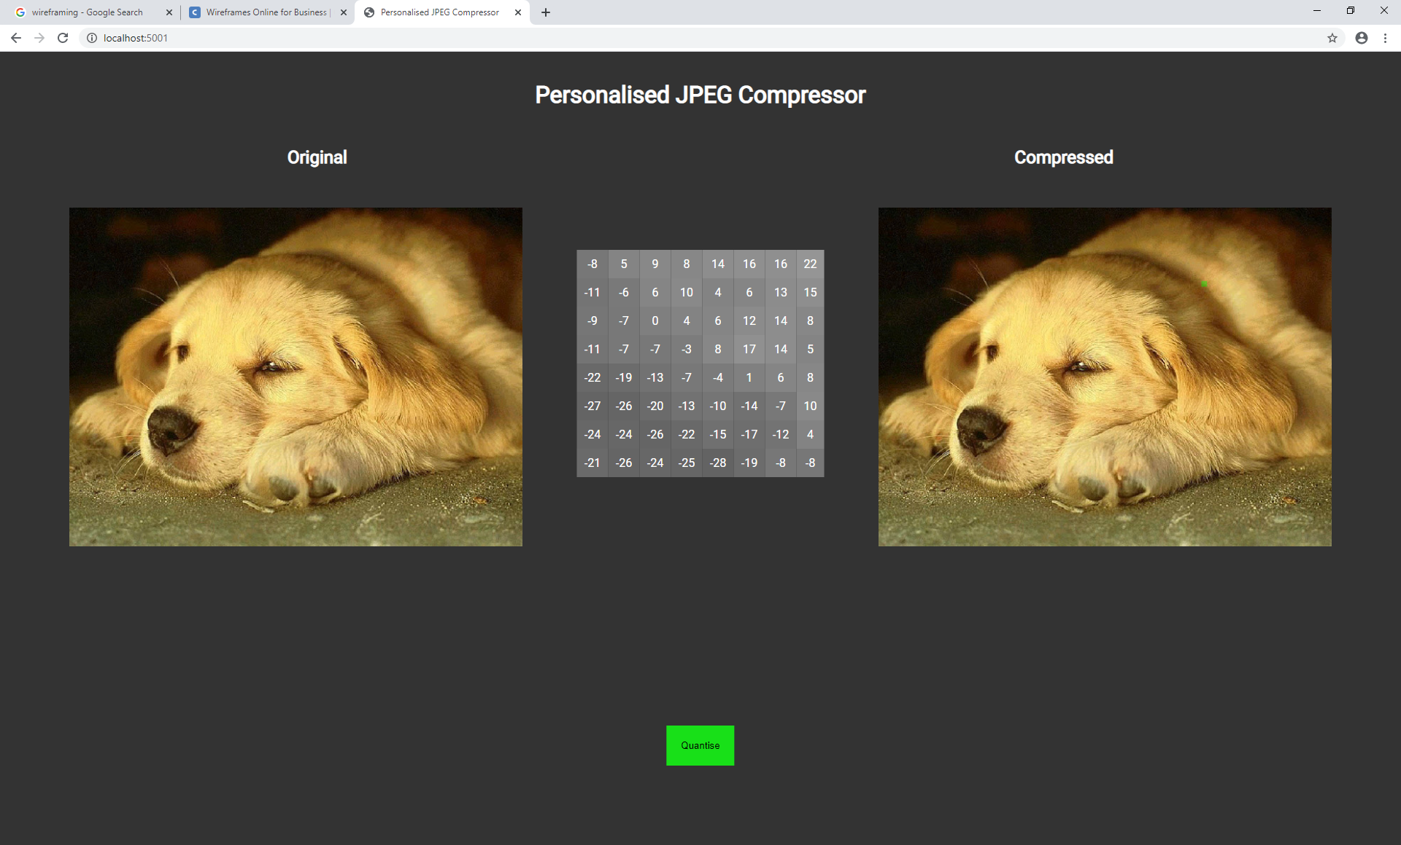
This is the navigation block to see the impact of the compression on the image on a closer level.
User can hover over the image to select a block.
This also has a click functionality
This is a button that could be used to update the image manually. Although the script could handle everything live.

Slide 2
This matrix is now used to edit the DCT matrix or the coefficients of a block. This will allow the user to see the impact of the matrix on the Image
The intractability of the page should make it more interesting for a new user to pick up and enjoy, even if they don’t know anything about JPEG.
This will be a slider to edit the amount of compression on the image. This should influence the quantisation of the image data to see the effect more clearly
This is the navigation block to see the impact of the compression on the image on a closer level.
101KB
30KB
Coefficient Threshold
0%
100%
These can give a live update on the file sizes.

Slide 3
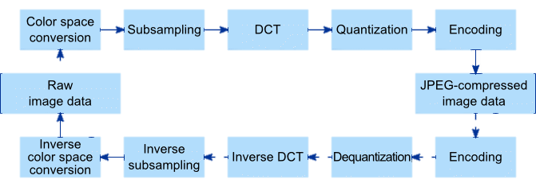
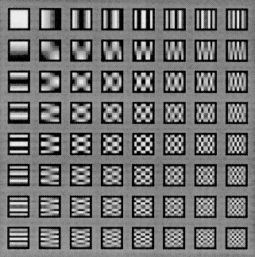
The steps of JPEG Compression
Raw image Data…
YCbCr, RGB Colour conversion and Shifting data…
What is DCT? What does it represent…
What are Coefficients and what do they mean…
Quantisation…
Decompression…

Slide 4
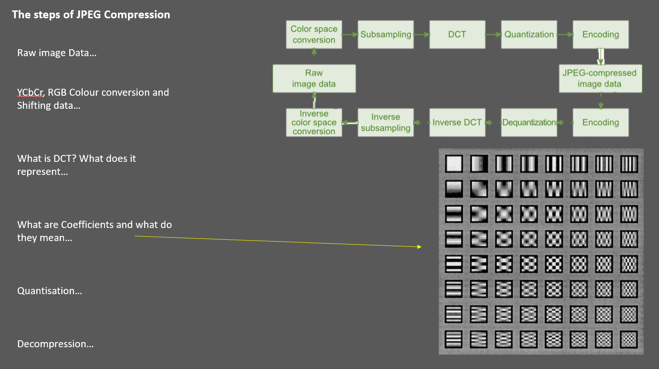
Scrolling downwards of the site should give you a more in depth view on what the application is and what it does.
The aim for this page is to make the compression understandable and easy to consume for the average user.
I will split the steps of the algorithm into multiple parts. Explaining how each of them work and pointing out what that does in the application of that page

