Slide 1
CS 301 Project
By Joseph Middleton Jr.

Slide 2

Data Background
Data I am using:
Heart Attack Dataset
Collected at Zheen hospital in Erbil, Iraq, from January 2019 to May 2019.
Dataset Contains general categories like:
Age, Sex, Heart Rate, and more…
I’m going to use this dataset to help me determine if an individual has or is gonig to have a heart attack

Slide 3
Category backgrounds
Systolic blood pressure
Diastolic blood pressure
Pressure in your arteries when the heart beats
Pressure in your arteries when your heart rests between beats
CK-MB
Troponin
A blood test that looks for a specifc enzyme
The protean released into the blood stream during a heart attack

Slide 4
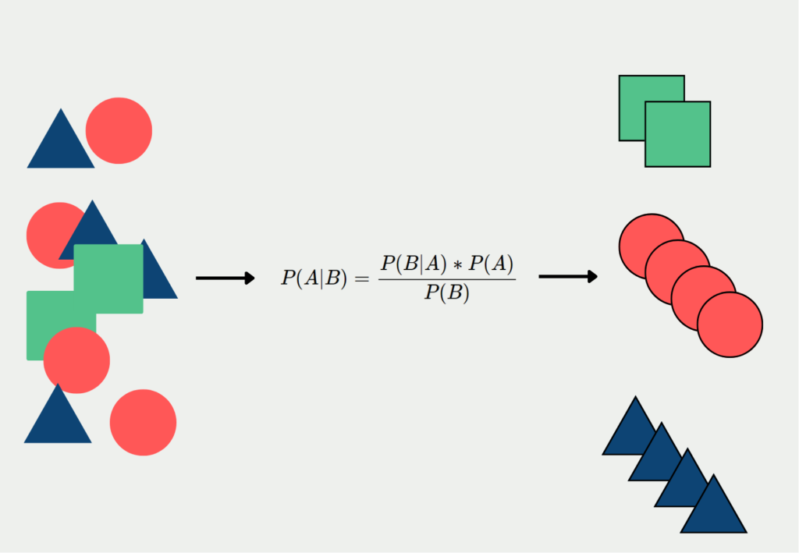
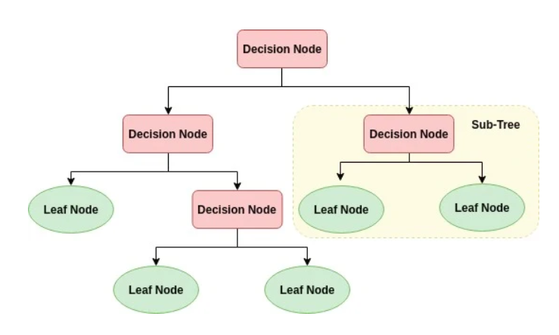
Algorithms Used
Naive Bayes
Decision Tree
A machine learning algorithm that seeks to model the distribution of inputs of a given class or category
A machine learning algorithm that uses a decision tree to make predictions

Slide 5
Data Preprocessing
Both algorithms required encoding the categorical features and the target variables to be useable

Slide 6
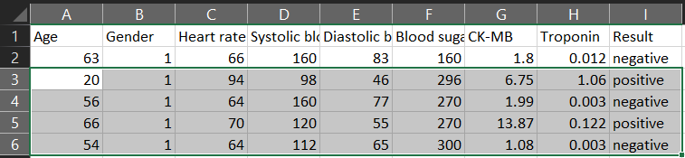
Naive Bayes Algorithm
I’ve used some examples from the dataset to test the effectiveness of how well Naive Bayes Algorithm works.
Example:
Prediction for Test (Age: 20, Gender: Male (1), Heart rate: 94, S Blood pressure: 98, D Blood pressure: 46, Blood Sugar: 296, CK-MB: 6.75, Troponin: 1.06) = positive (CORRECT)
Prediction for Test (Age: 52, Gender: Male (0), Heart rate: 61, S Blood pressure: 112, D Blood pressure: 58, Blood Sugar: 87, CK-MB: 1.83, Troponin: 0.004) = positive
(INCORRECT WITH THE TEST DATA EXAMPLE)

Slide 7
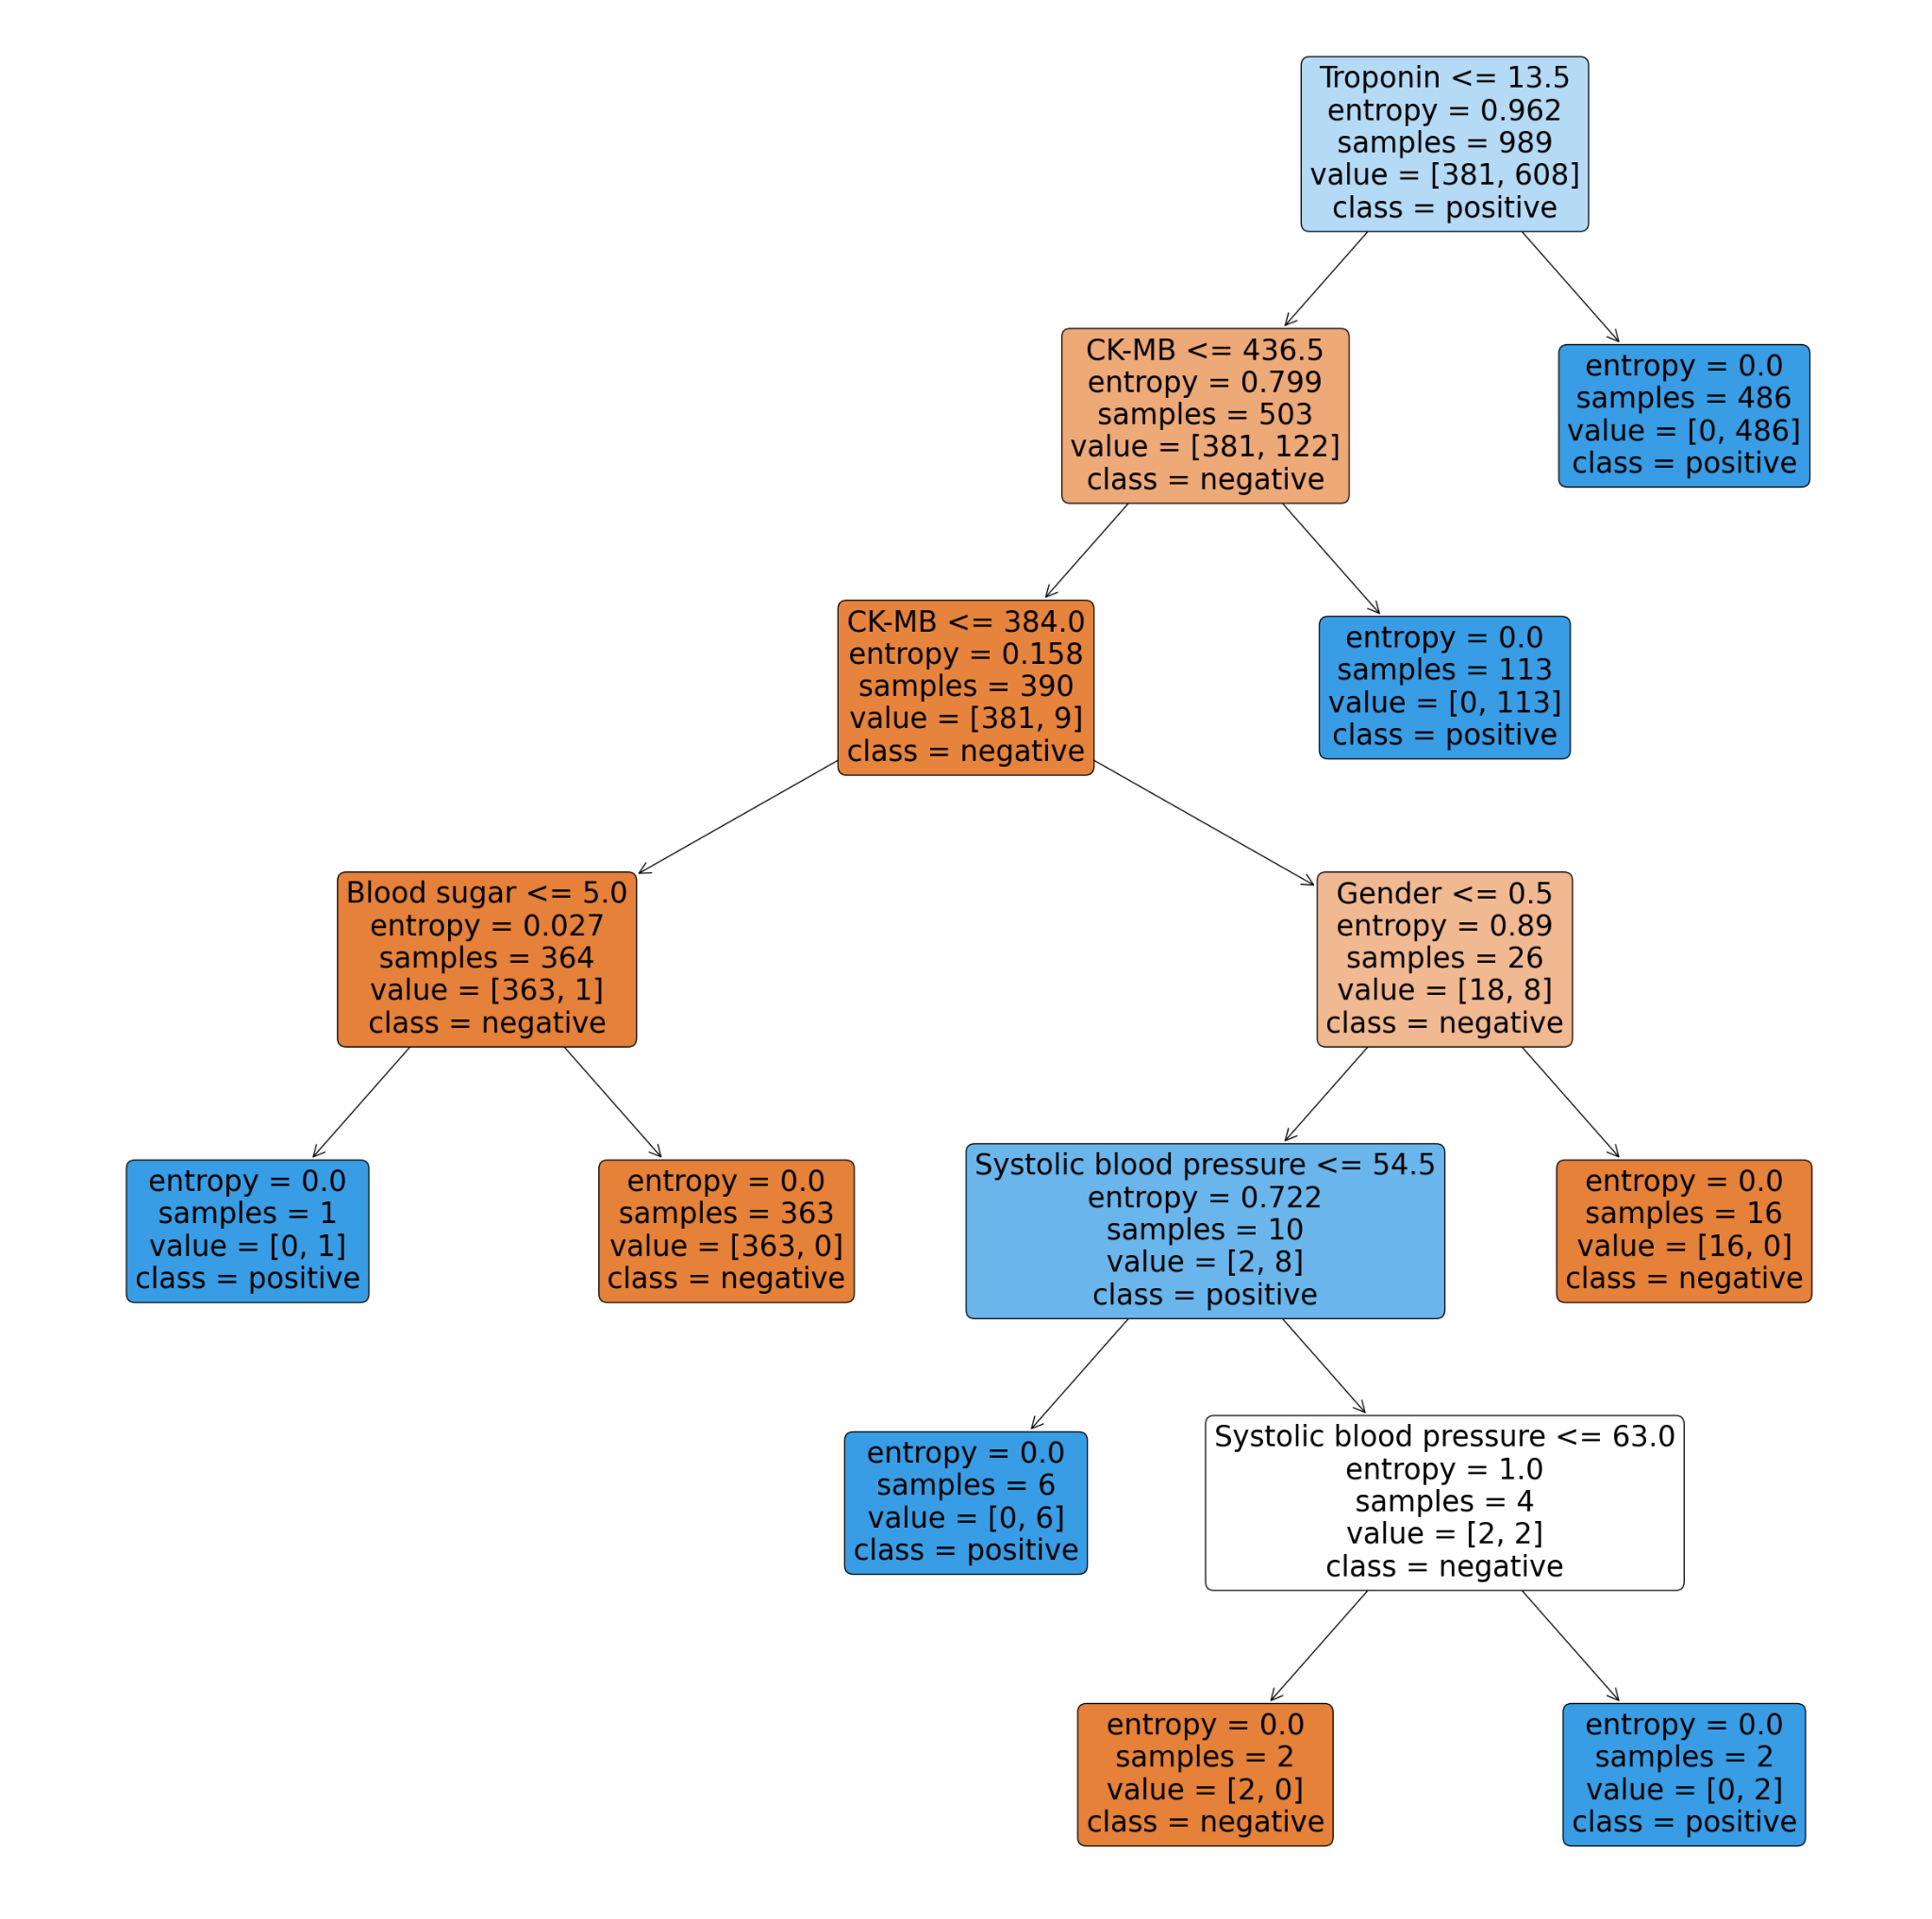
Decision Tree Algorithm

Slide 8
Decision Tree breakdown
If (Troponin <= 13.50) AND (CK-MB <= 436.50) AND (CK-MB <= 384.00) AND (Blood sugar <= 5.00) THEN Heart Attack = Yes
If (Troponin <= 13.50) AND (CK-MB <= 436.50) AND (CK-MB > 384.00) AND (Gender <= 0.50) AND (Systolic blood pressure <= 54.50) THEN Heart Attack = Yes
If (Troponin <= 13.50) AND (CK-MB <= 436.50) AND (CK-MB > 384.00) AND (Gender <= 0.50) AND (Systolic blood pressure > 54.50) AND (Systolic blood pressure > 63.00) THEN Heart Attack = Yes
If (Troponin <= 13.50) AND (CK-MB > 436.50) THEN Heart Attack = Yes
If (Troponin > 13.50) THEN Heart Attack = Yes
If (Troponin <= 13.50) AND (CK-MB <= 436.50) AND (CK-MB <= 384.00) AND (Blood sugar > 5.00) THEN Heart Attack = No
If (Troponin <= 13.50) AND (CK-MB <= 436.50) AND (CK-MB > 384.00) AND (Gender <= 0.50) AND (Systolic blood pressure > 54.50) AND (Systolic blood pressure <= 63.00) THEN Heart Attack = No
If (Troponin <= 13.50) AND (CK-MB <= 436.50) AND (CK-MB > 384.00) AND (Gender > 0.50) THEN Heart Attack = No

Slide 9
What can be taken way from this?
Troponin plays a massive role in detecting heart attacks
CK-MB is the second major factor in determining the out of a heart attack
Heart rate didn’t have a significant effect on whether an individual would have a heart attack

Slide 10
Results
(Accuracy and Error wise)
How did they compare Accuracy and Error wise?

Slide 11
Accuracy & Error
Naive Bayes
Decision Tree
Accuracy: 92.12%
Accuracy: 97.58%
Mean Square Error: 0.07878…
Mean Square Error: 0.02424…
R² score: 0.6682
R² score: 0.8979

Slide 12
Decision Tree is the better Algorithm
Due to the Algorithm taking into account the existing categories to yield better results.

Slide 13
Reflecting on the Project
Things that could have improved:
I could have done a better job at pre processing the dataset before hand
I could have found a better way to analyze the data after processing
What went well:
The high accuracy and low error
The Algorithms chosen

Slide 14
The End
Any Questions?

