Slide 1
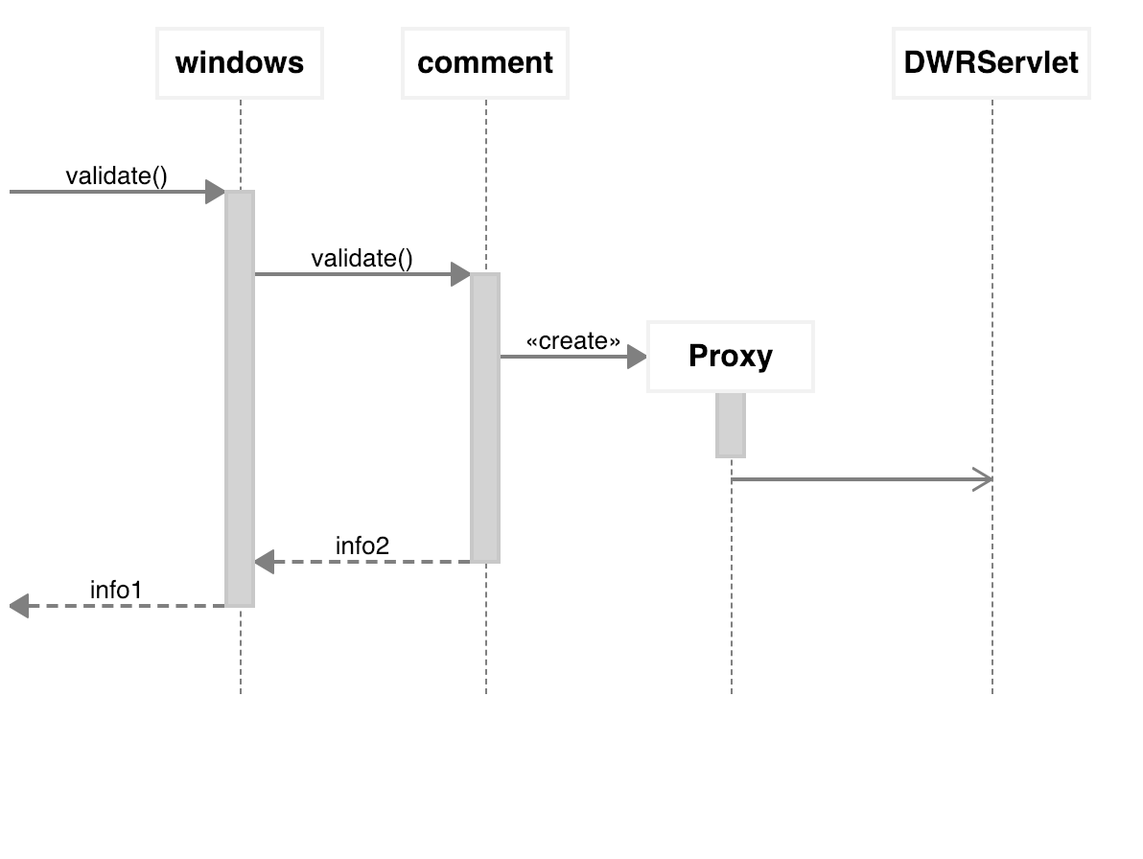
lifeline
synchronous
message
object creation
message
execution
specification
occurrence
specification
return message

