Slide 1
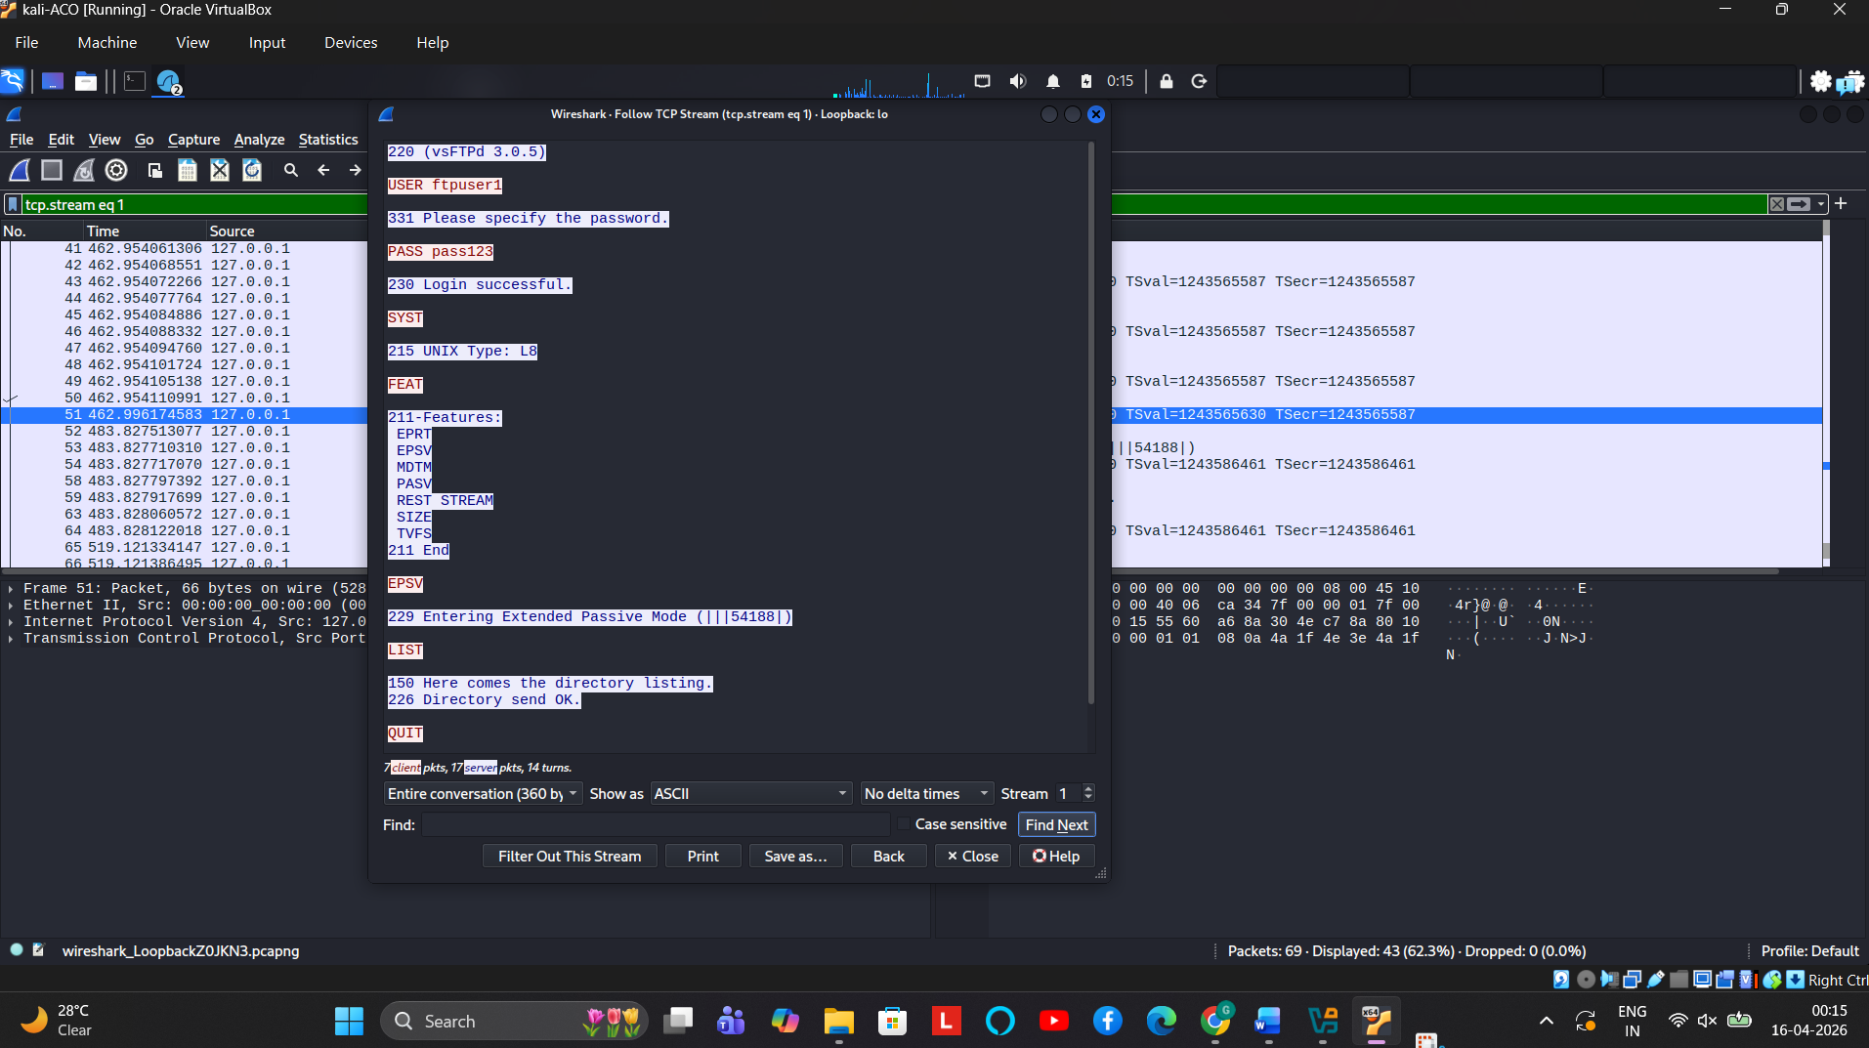
PH2- FTP- SUCCESSFUL CAPTURE OF FTPUSER AND PASSWORD

Slide 2
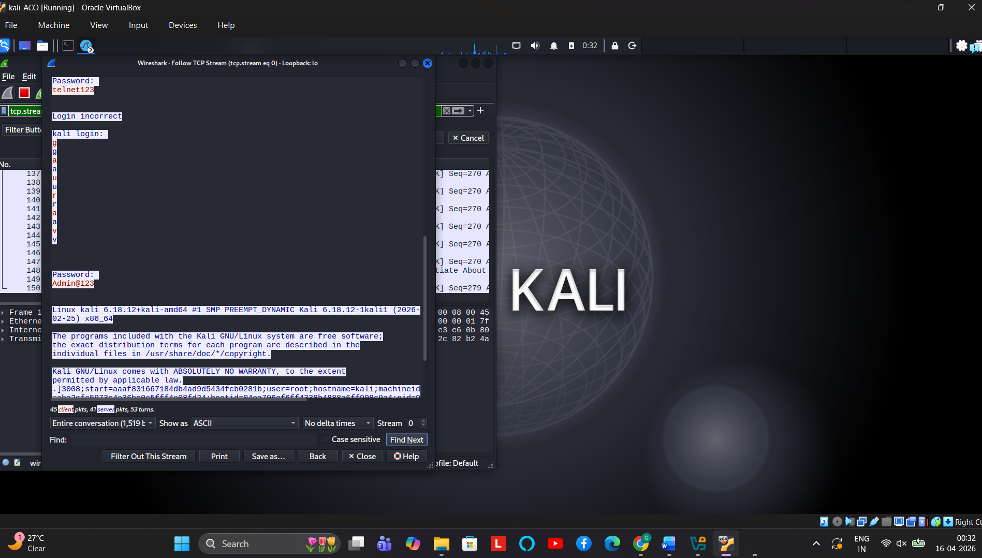
PH2- TELNET - CAPTURE OF TELNET USER AND PASSWORD

Slide 3
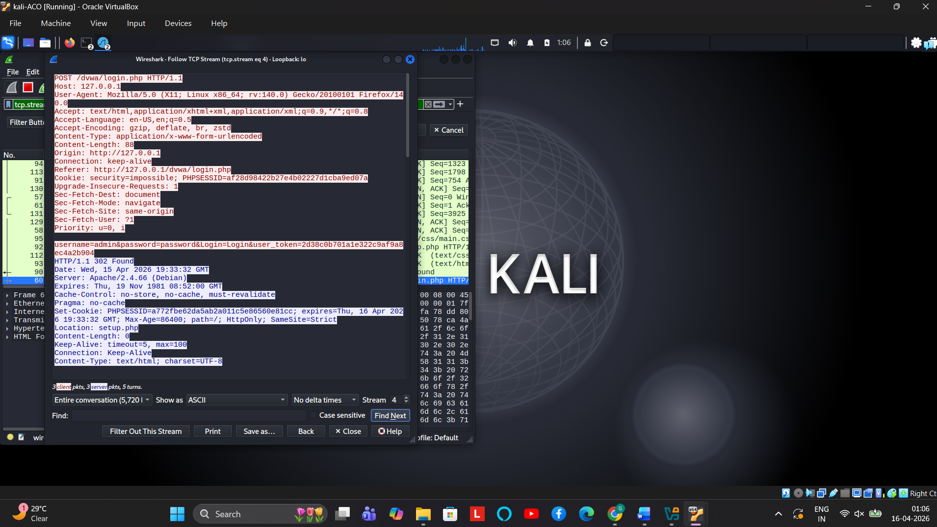
PH2- DVWA: SUCCESSFUL GENERATION OF LOGIN ID AND PASSWORD

