Slide 1
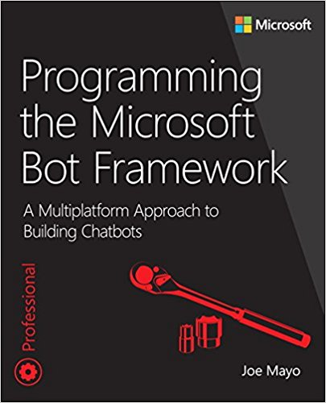
Introduction to the Microsoft bot framework
Twitter: @JoeMayo
Email: jmayo@mayosoftware.com

Slide 2
Overview
What is a Chatbot?
A Chatbot From 0 to Deployment
Inside the Bot Builder SDK
Natural Language Understanding
Botiquette

Slide 3
What is a ChatBot?
A chatbot is an application, often available via messaging platforms and using some form of intelligence, that interacts with a user via a conversational user interface (CUI).

Slide 4
Why Conversational User Interfaces (CUI’s)?
Conversation is natural
Available on any platform
Fits any device
Overcomes convention and UI fragmentation

Slide 5
Why you Might not choose cui?
Comfortable where they’re at (don’t see a need to change)
Other UI more efficient, e.g. panning maps or augmented reality
Human interaction is more appropriate (e.g. 911)
Conceptually, you want to use the right tool for the right job

Slide 6
Technical characteristics of a bot
Bots guide and manage a conversation.
Architecturally, a bot is a user interface layer.
The Bot Framework helps you manage the conversation dialog.
You write logic that responds to user dialog results.

Slide 7
Bot Framework Architecture
Channel
Your Bot
Channel
Bot Connector
REST Service
Bot Buidler
Channel
Cognitive Services
Channel
Other Services
Channel

Slide 8
Channels
SMS
Email
Web Chat
Skype
Messenger
Slack
A growing list …

Slide 9
Bot connector
Connects channels to your bot
Message routing
Multiple channels
Manages conversation state
Conversation and Users
Bot or channel specific data

Slide 10
Your Bot
ASP.NET Web API Post Endpoint
Can use the Bot Builder SDK
Can use Microsoft Cognitive Services
Can use any other service you choose

Slide 11
A Bot From 0 to Deployment
Download Template
Create Project
Code Chatbot
Test with Emulator
Deploy
Publish

Slide 12
Getting Started Demo

Slide 13
Inside the Bot Builder SDK
Dialogs
Manage conversation navigation
Built-in types to facilitate interaction
Nice LUIS Integration
FormFlow
Defined conversation template with a class
Declarative customization through attributes
Can customize flow and chain conversations

Slide 14
Dialog Demo

Slide 15
Form Flow Demo

Slide 16
Natural Language Understanding
Language Understanding Intelligence Service (LUIS)
Part of Microsoft Cognitive Services
Makes Bots more conversational
Uses Machine Learning to train a model
Can continuously Improve the model

Slide 17
LUIS Demo

Slide 18
Botiquette
Botiquette (http://bit.ly/1TWQ0Tp)
The customary code of polite behavior among bots and humans - often in social media, but also in apps, the enterprise, or any device where bot to bot and bot to human communication occur.
Tay and You (social luring attack)
Conversational Commerce (#ConvComm)
Bot or Not? (trying to act human)
Spam (notifications)

Slide 19
Resources
Programming the Microsoft Bot Framework: A Multiplatform Approach to Building Chatbots/MS Press: https://aka.ms/botbook
Programming the Microsoft Bot Framework (Video):
Microsoft Bot Framework: https://dev.botframework.com/
Chatbots Magazine: https://chatbotsmagazine.com/
VentureBeat Bots: http://venturebeat.com/category/bots/
Facebook Chatbot group: http://bit.ly/1rCWzkS
Twitter: #botframework, #chatbots, and #convcomm

Slide 20
JoeBot>Do you have any Questions?
Twitter: @JoeMayo
Email: jmayo@mayosoftware.com
Code: https://github.com/JoeMayo/BotDemos
Blog: http://blog.botcontext.com/

