Slide 1

Group 8 Oscar Award Winning Directors & Actor Bias
Carlos Cisneros
Joe Mota
Joshua Flores
Brayan Mendoza
Alvaro Mendoza

Slide 2

Goal of the Project
The Goal of the project is to predict Best Director Oscar using characteristics of the Directors movie such as
Certificate, genre, rate, metascore, synopsis, votes, gross, critic_reviews, popularity, awards_wins, Oscar_Best_Director_won, Oscar_Best_Actor_won, Oscar_Best_Actress_won, metascore, awards_nominations, Oscar_Best_Picture_won

Slide 3
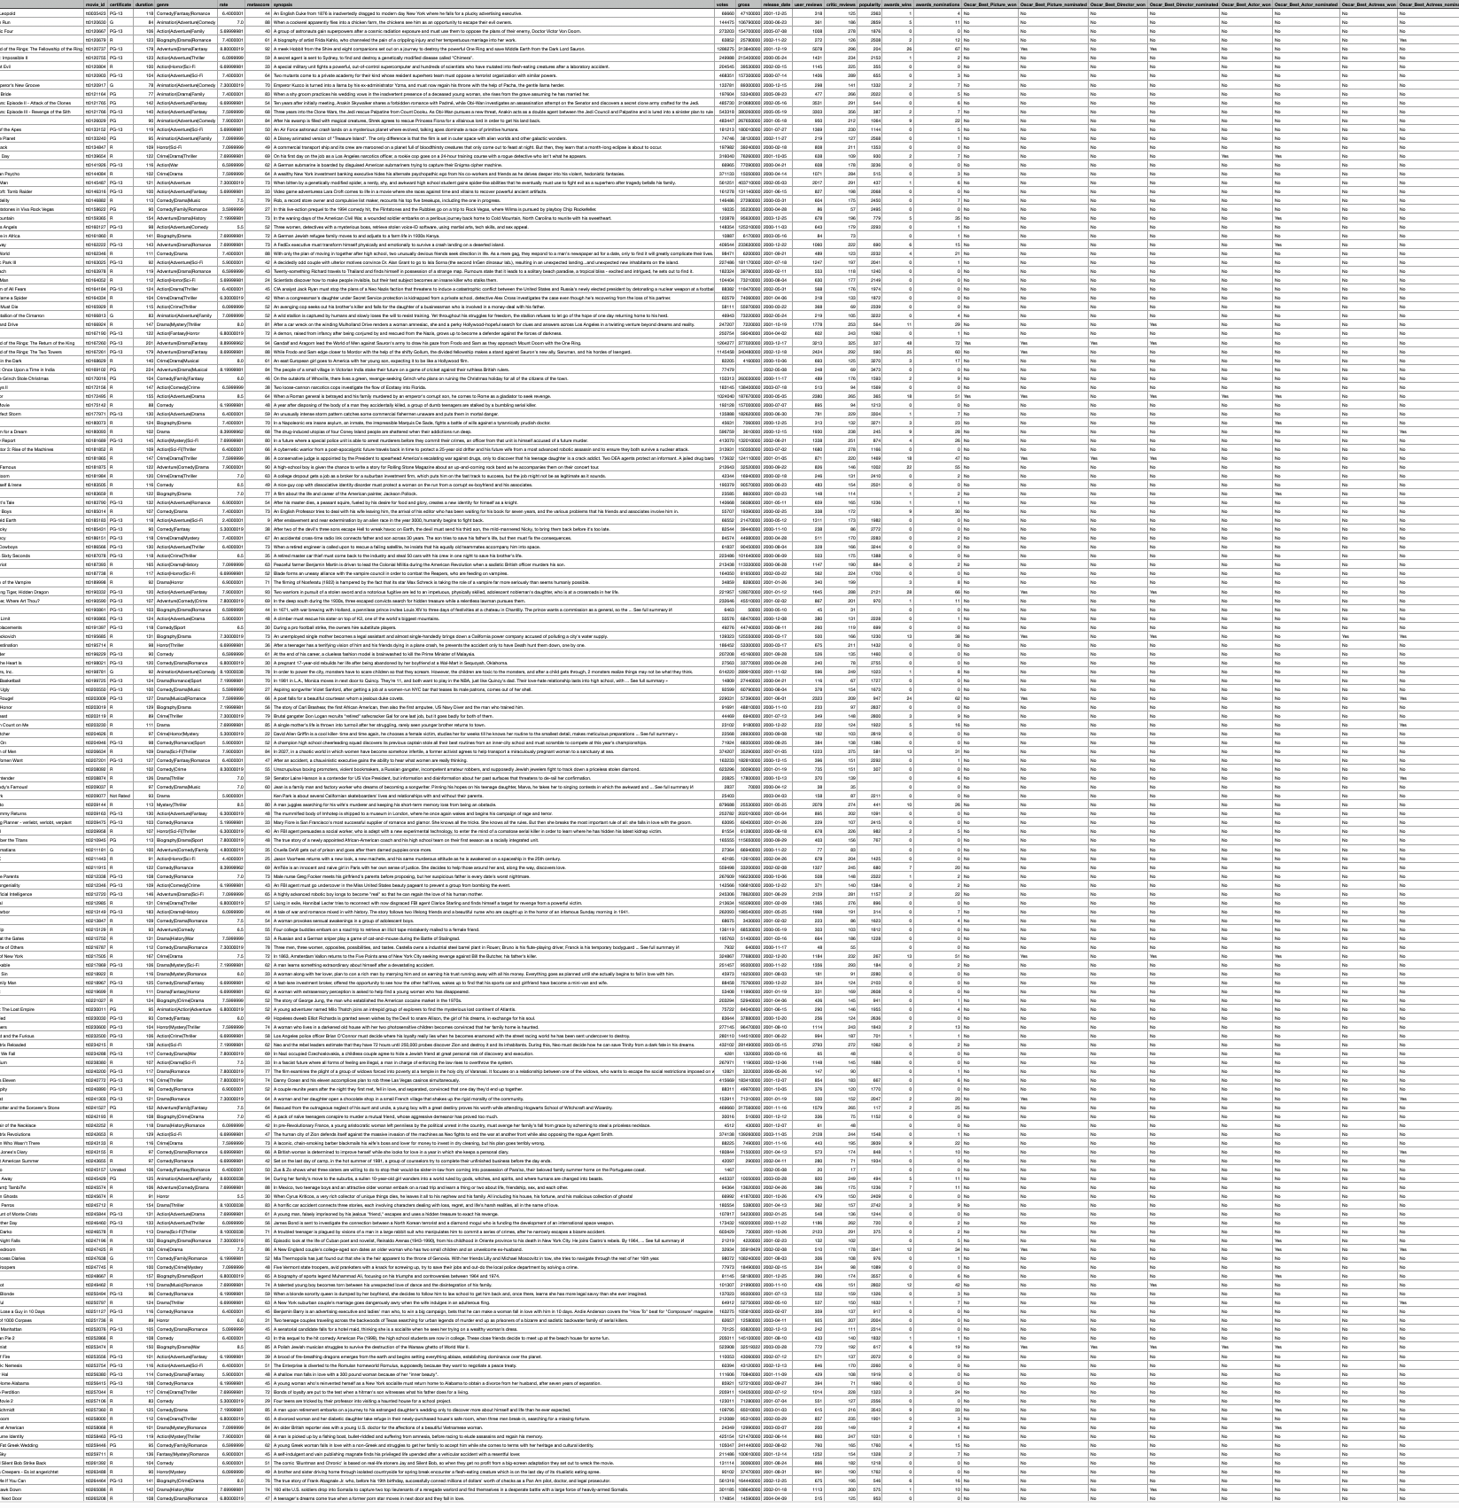
Our Data Set/Bias
Our Data Set demonstrates which movies won Best Director Awards (Oscars) from 2000-2017
We chose this data as we believed it would be great for predicting winners using non-bias characteristics of the movie.
The winners arent listed with any identification(race, gender, sexuality or age)

Slide 4
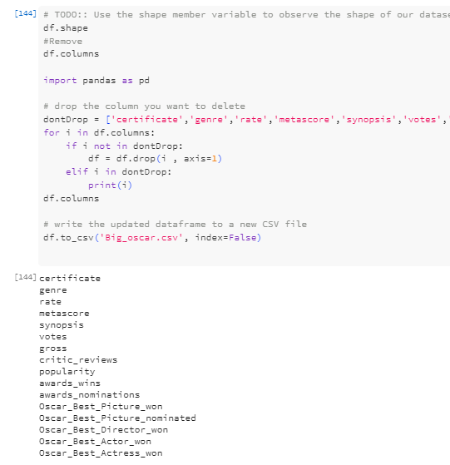
Cleaning Data
For the data cleaning process, we dropped all the unnecessary columns in the dataset as it contained 119 columns, which we only needed 16.
We kept the ones that would help us with the project as it contained valuable data that would facilitate the prediction process such as metascore, votes, gross income, whether it won best director, actor, picture, etc.

Slide 5
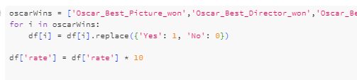
Cleaning Data Continued
Another useful process that helped with
both the readability and coding segment
converting data of Object type that
was represented with a 'No' and 'Yes',
such as Oscar_Best_Director_won, and
Oscar_Best_Actor_won, among others,
which represented if the movie had won
Best Director/Actor to 0 for 'No' and 1 for
'Yes'.

Slide 6
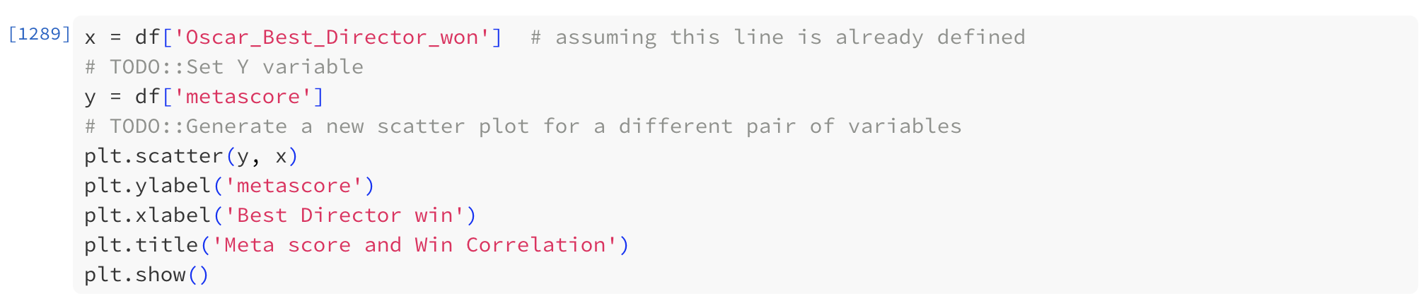
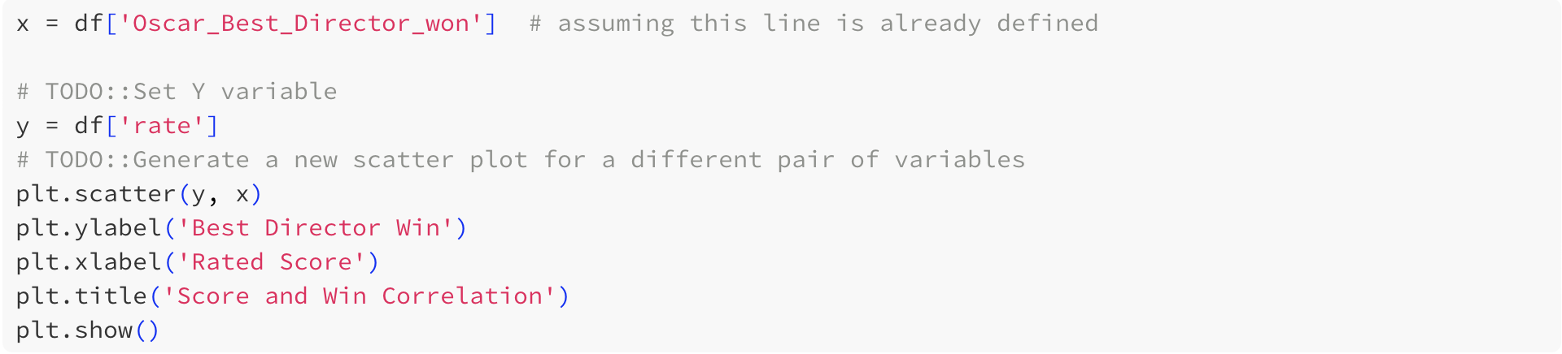
Data Analysis Scatterplot on 'Meta score' and 'Rate'
In our effort to conduct a comprehensive analysis of a sizable dataset, we aimed to obtain a nuanced understanding of the key factors contributing to the attainment of an Academy Award. Through our research, we discovered that two crucial variables - namely, the meta score and rate - appear to strongly influence the likelihood of winning an Oscar for Best Director. To visually represent this relationship, we plotted these two variables on the x-axis of two separate graphs and compared their values against the occurrence of Best Director wins on the y-axis. This was achieved by generating a scatter plot through the implementation of the code above.

Slide 7
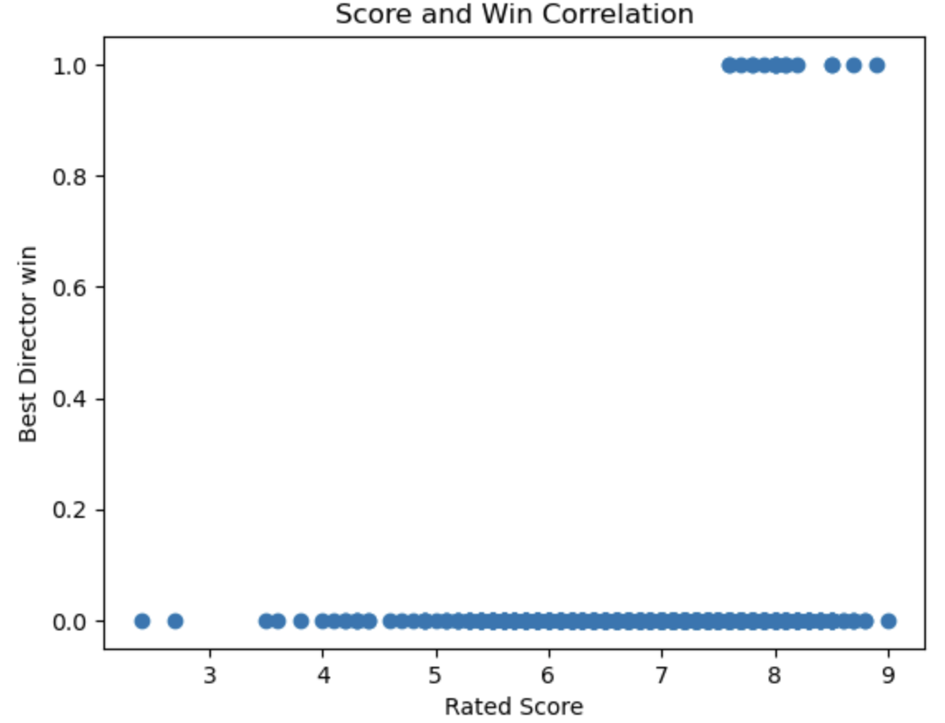
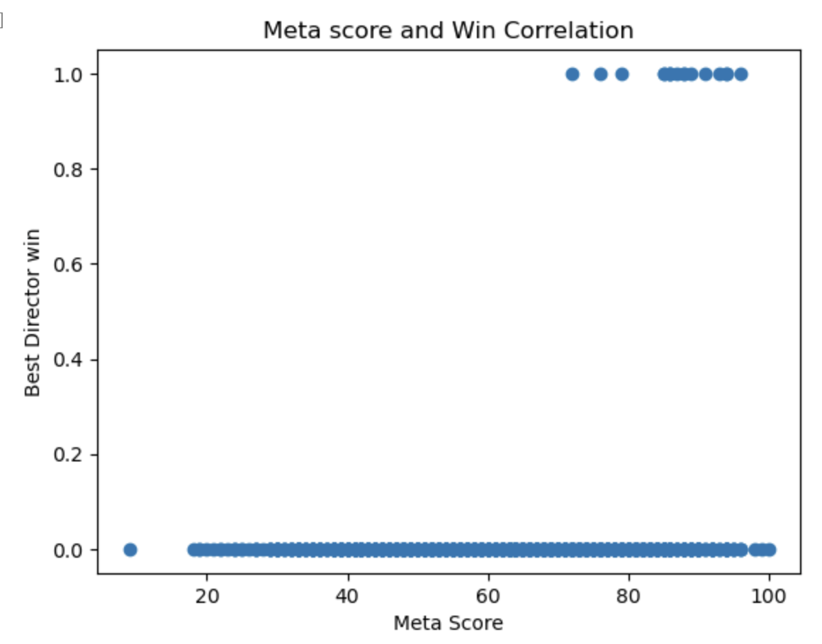
Data/analysis Scatterplot
We developed two scatter plots, one that displayed Oscar best director won with rate (rating score) and Oscar best director won with meta score (critic rating). We saw a significant correlation between in both scatter plots and what we interpreted from these two plots is that the higher the rating/meta score is that the higher rating/meta score the more it influenced the chances of winning. However, the was a low standard deviation and the cluster formed around 7 to 8 for our rated score/best director win scatter plot and 80 to 100 for our meta score/best director win scatter plot. After evaluating this data, the meta score has more of an influence on best actor winning, but the rating didn’t necessary have as much of an influence.

Slide 8
Gross Income And Winners/Losers Data Analysis
Filtered table for 'Oscar_Best_Director_won' 'YES'
 | Oscar_Best_Director_won | gross | Average
 |  |  | 125722142.17
 | Yes | 377020000
 | Yes | 124110000
 | Yes | 32519322
 | Yes | 170710000
 | Yes | 83030000
 | Yes | 100420000
 | Yes | 132370000
 | Yes | 124980000
 | Yes | 74270000
 | Yes | 15700000
 | Yes | 141320000
 | Yes | 274080000
 | Yes | 138800000
 | Yes | 44667095
 | Yes | 183640000
 | Yes | 42340000
 | Yes | 77300000
 | 'gross' for 'Oscar_Best_Director_won' 'No'
Over a 1000 rows of losers |  | Average is 89186387.56
 |  | Oscar_Best_Director_won | No
 |  | gross
 |  | 936630000
 |  | 760510000
 |  | 652180000
 |  | 623280000
 |  | 610800000
 |  | 533320000
 |  | 504010000
 |  | 501900000
 |  | 458990000
 |  | 448130000
 |  | 436470000
 |  | 424650000
 |  | 423030000
 |  | 414980000
 |  | 408990000
 |  | 408080000
 |  | 408000000
With this data we can show the average of the gross income of all the movies that won is $125,722,142.17
Compare this to the data of the average gross income of the all the movies that didn’t win is $89,186,387.56
Showing that if your gross income is higher than $100,000,000 you will have a <0% chance of winning Best Director Oscar

Slide 9
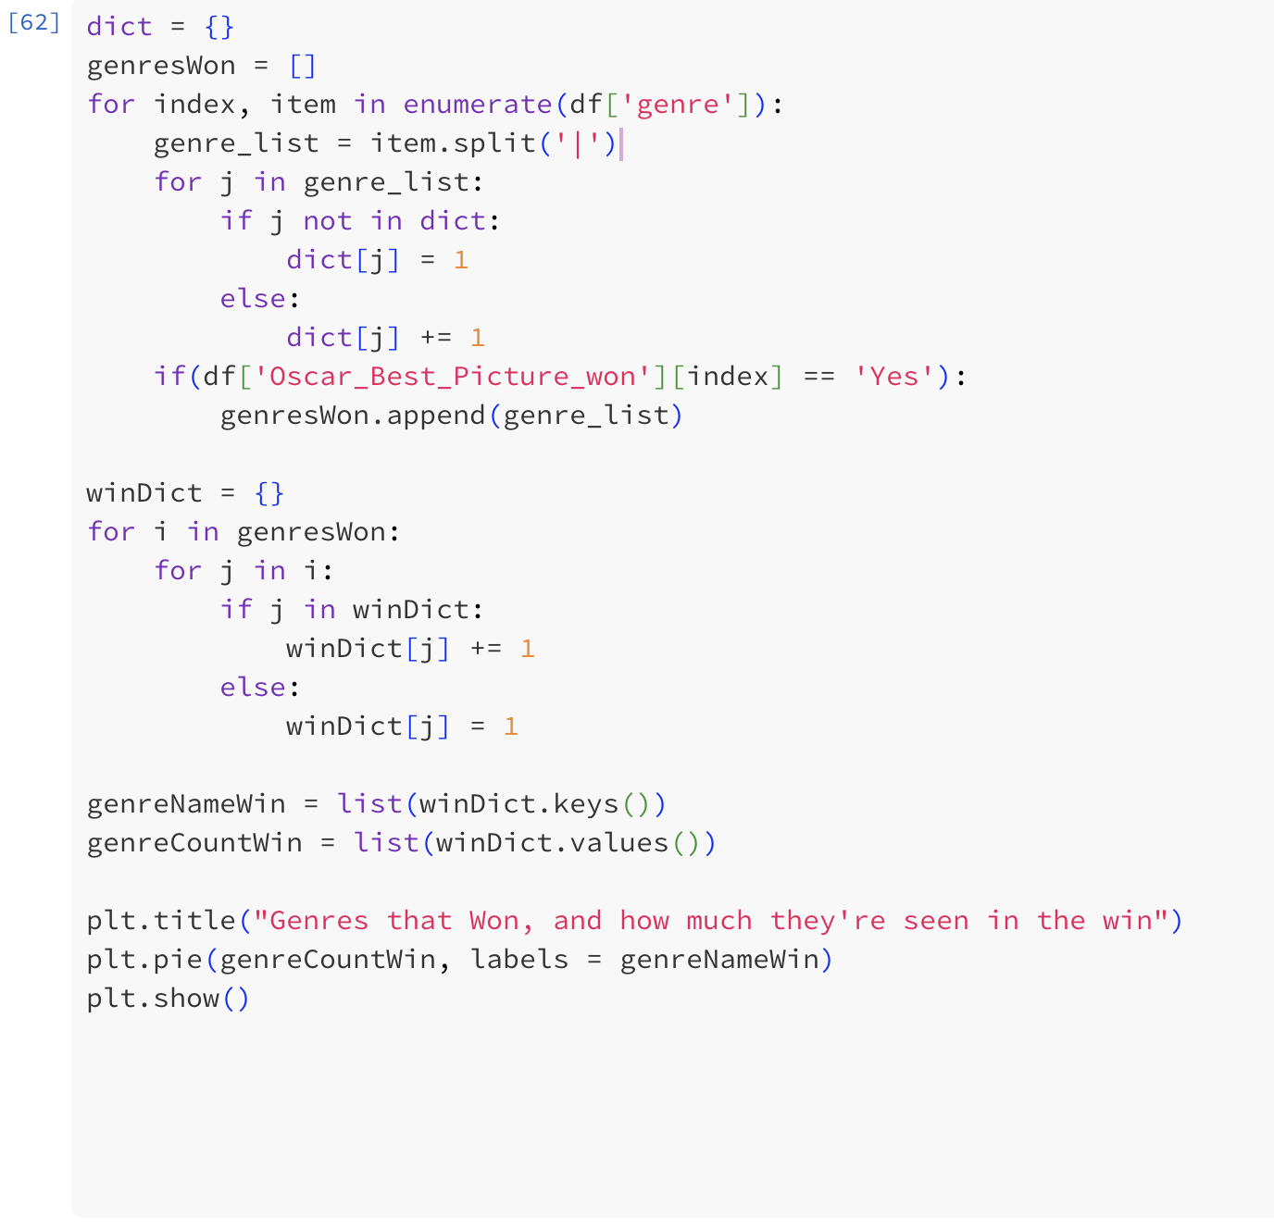
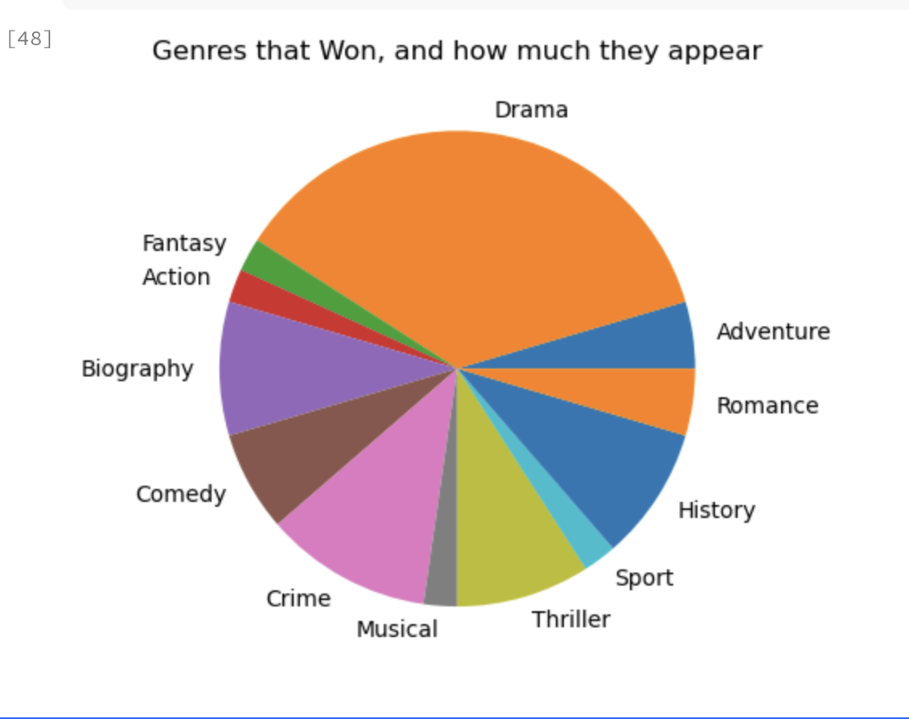
Genre Data Analysis/ with Plot
Looking at the pie chart, we can separate winning titles into 4 chunks, being Drama, Bio, Crime, and History.
The chances of winning an Oscar is significantly higher, if the movie genre is based of those 4 categories

Slide 10
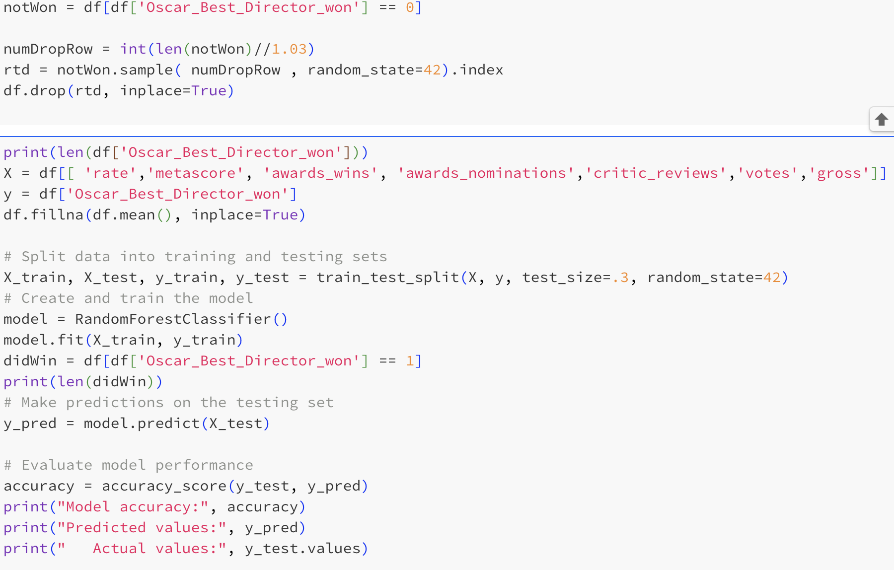
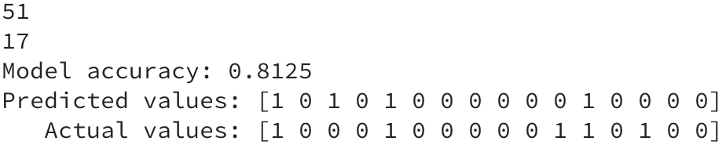
Machine Learning Model (Supervised)
We trained our machine learning model on data such as the number of previous awards the movie had won, the number of awards it was nominated for, the metascore (weighted average of top critic reviews), the average movie rating, and the gross amount of money it made. All our data was converted to numbers.
The main issue we faced was that our dataset consisted only of specific Oscar wins from 2000-2017. This meant that we had only 17 wins to train our data on, while we had another 1,077 movies in our dataset to train on. We needed more winning examples. To address this issue, we tried adding a few random duplicates of the winning data while also reducing the losing data. This led to better outcomes. On the left, we have an example of training the data on 51 random nominated movies, where 17 won best director in this case.

Slide 11

Conclusion (What we learned)
(Data Cleaning)We learned that big data sets like ours need to be cleaned and how it is important to compare same data types to make things easier.
(Analyzing)We learned how to analyze data and see which characteristics affect the probability of the winner.
(Machine Learning Model)We learned how to manipulate the model and train on to create greater accuracy on the tested dataset using (Supervised Learning).

Slide 12

Citations
DATASET (BELOW)
Oscars nominated Movies 2000-2017(Movies) 119 columns: https://www.kaggle.com/datasets/vipulgote4/oscars-nominated-movies-from-2000-to-2017
ARTICALS (BELOW)
How does a film win an Oscar?: https://www.euronews.com/2019/02/21/how-does-a-film-win-an-oscar
How does Oscar voting work?: https://variety.com/feature/who-votes-on-oscars-academy-awards-how-voting-works-1203490944/
How to win an Oscar?: https://www.vogue.in/culture-and-living/content/how-to-win-an-oscar-award

Slide 13

Any Questions???

