Slide 1

ChurchClerk
CHURCH MANAGEMENT, SIMPLIFIED
Everything your church needs to stay organized.
Members, branches, attendance, giving, communication and reports — managed from one secure platform built for how churches actually operate.
Business presentation
Notes:
Welcome and thank them for their time. Introduce ChurchClerk in one sentence: a church management platform that brings members, branches, attendance, giving, communication and reports into one secure system.

Slide 2
TODAY
What we'll cover
01
The challenge
02
The platform
How church administration works today — and where it breaks down.
What ChurchClerk is and how it is organized.
03
Core capabilities
04
Who it serves
People, finance, communication, branches and reports.
Every level of church leadership, each with the right access.
05
Trust & accountability
06
Getting started
Permissions, audit history and data protection.
Onboarding, plans and next steps.
ChurchClerk · Agenda
02 / 16
Notes:
Walk through the flow: the problem, the product, who it is for, why it can be trusted, and how to get started.

Slide 3

THE CHALLENGE
Church administration shouldn't feel scattered.
Member records live everywhere
Branch updates travel by phone call
Contact details and membership status are split across notebooks, spreadsheets and individual phones.
Headquarters learns what happened at each branch days later, through calls and chat threads.
Attendance and giving on paper
Reports are assembled by hand
Service attendance, tithes and offerings are recorded by hand, so trends and errors go unnoticed.
Before every leadership meeting, someone gathers figures from multiple places and hopes they agree.
Members are hard to reach
Follow-up depends on memory
Announcements depend on word of mouth, or someone texting every member one by one.
Visitors and absent members are only remembered if someone thinks of them.
ChurchClerk · The challenge
03 / 16
Notes:
Ask the audience if any of these sound familiar. These are the day-to-day problems ChurchClerk was built to solve: scattered records, slow branch reporting, paper-based attendance and giving, manual reports, difficult communication and forgotten follow-ups.

Slide 4
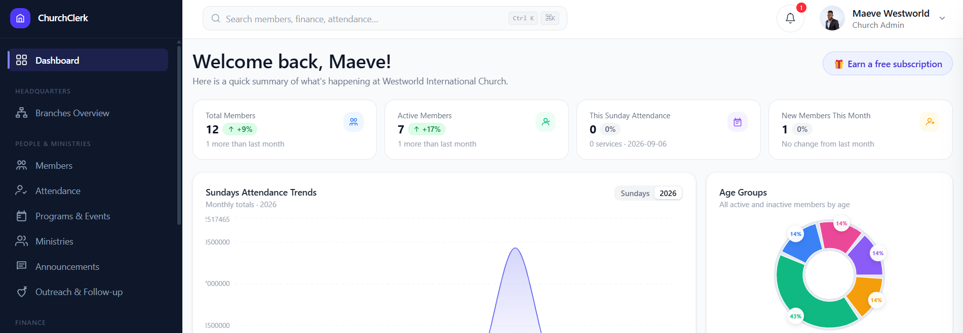
THE PLATFORM
One system for the work behind the ministry.
ChurchClerk is a multi-tenant church management platform. Every module works on the same member record — so attendance, giving, messages and reports all stay connected.
ChurchClerk · The platform
04 / 16
Notes:
This is the real ChurchClerk dashboard. Point out: global search across members, finance and attendance; key membership and attendance figures at a glance; attendance trends and demographic breakdowns; and the sidebar organized into Headquarters, People & Ministries and Finance.

Slide 5
PRODUCT OVERVIEW
23 modules, four connected areas.
Churches use what they need today and grow into the rest — every module shares the same records.
05
08
04
06
People & Ministries
Finance
Communication
Administration
Members
Attendance
Programs
Organisations
Outreach & Follow-up
Tithe
Offering & Funds
Welfare
Fundraising
Budgeting
General Expenses
Business Ventures
Financial Overview
Announcements
SMS Messaging
Message Targeting
Delivery Tracking
HQ & Branches
Reports
Billing
Referrals
Settings & Roles
Support & Help
ChurchClerk · Product overview
05 / 16
Notes:
Give the big picture before going into detail. Four areas: People & Ministries, Finance, Communication and Administration. A church can start small and switch on more as it grows.

Slide 6
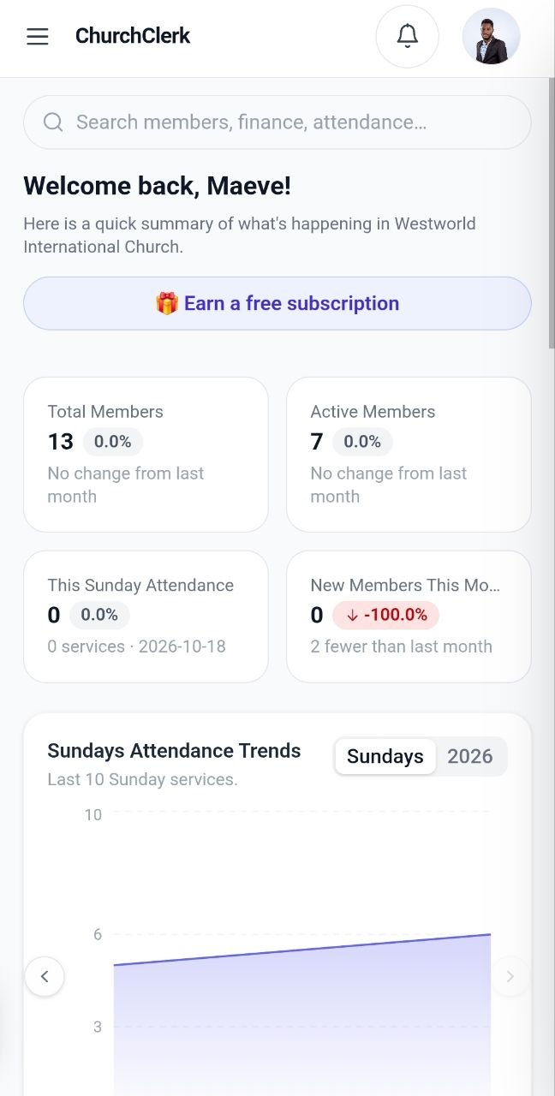
PEOPLE & MINISTRIES
Every person, one complete record.
Who your people are, where they serve, and how they grow — searchable, organized and always up to date.
Members
Attendance
Full profiles with contact details, family links, ministry roles, membership status and history.
Record services manually or share a check-in link so members register themselves. Trends appear automatically.
Programs & Events
Organisations
Conferences, crusades and regular services — each with its own attendance record.
Choir, ushering, fellowships: ministries per branch with members and leaders assigned.
Outreach & Follow-up
Record visitors and first-timers, assign follow-ups, and convert prospects into members.
ChurchClerk · People & Ministries
06 / 16
ChurchClerk on mobile — dashboard view
Notes:
Emphasize the single member record: everything else (attendance, giving, ministries, messages) attaches to it. Highlight self check-in links and visitor follow-up as practical time-savers.

Slide 7

FINANCE
Every cedi accounted for.
Contributions, spending, budgets and statements in one auditable system — each entry linked to a member and a date.
Tithe
Offering & Special Funds
Member-linked records with per-branch and per-member totals.
Per-service recording; building and harvest funds kept separate and auditable.
Welfare
Fundraising & Pledges
Contributions and disbursements with reasons and a transparent history.
Church projects with member pledges tracked to fulfillment.
Budgeting & Expenses
Financial Overview
Budgets per category or period, compared against categorized actual spending.
Consolidated income and expenses with branch breakdowns, exportable for audits.
ChurchClerk · Finance
07 / 16
Notes:
Finance is often the biggest pain point. Stress traceability: every tithe, offering, expense and disbursement is tied to a record, which makes leadership reviews and audits straightforward. Business venture income is tracked separately from giving.

Slide 8
COMMUNICATION
Reach members from the same system that holds their records.
No exported lists and no separate tools. The member data that powers attendance and giving also powers every message.
Compose
→
Target
→
Schedule
→
Deliver
→
Track
Announcements
SMS Messaging
Message Targeting
Delivery Tracking
Whole church, one branch, or a single ministry. Templates for recurring notices.
Text members directly. Paid plans include monthly SMS credits, with top-ups.
Filter by branch, ministry, department, visitors or custom groups.
Sent vs delivered status per message; failures flagged for retry.
ChurchClerk · Communication
08 / 16
Notes:
Walk through the messaging flow: compose, choose who receives it, optionally schedule it ahead, send by announcement or SMS, then confirm delivery. Delivery tracking means problems surface immediately rather than on Sunday.

Slide 9
MULTI-BRANCH
One headquarters. Every branch in view.
Headquarters
Consolidated view
Register your headquarters and link every branch to it. Each location manages its own members, attendance and finances, while HQ sees the consolidated picture.
Branch A
Branch B
Branch C
✓
Branch records managed locally
Members
Members
Members
✓
Consolidated view and reports at headquarters
Attendance
Attendance
Attendance
✓
Branch-level access control for staff
Finances
Finances
Finances
✓
One subscription covers the whole church
Reports roll up to headquarters ↑
ChurchClerk · Multi-branch
09 / 16
Notes:
Multi-branch support is core to the product, not an add-on. Each branch keeps its own records; headquarters gets a consolidated view without phoning around. Branch staff can be restricted to their own branch's data.

Slide 10
REPORTS & ADMINISTRATION
Reports leadership can actually use.
Generated from the data your team already records — no separate spreadsheets before every meeting.
Administration
Reports
Settings & Roles
Role-based permissions per admin, scoped to a branch where needed.
Attendance
Trends across services, weeks and branches
Billing
Finance
Giving summaries and the consolidated financial overview
Current plan, renewal date and SMS credit balance in one place.
Referrals
Growth
Membership, new members and visitors over time
Invite other churches; a free month is added when they subscribe.
Filter by branch and period
PDF
Excel
Print
Support & Help
Built-in help resources and direct access to the support team.
ChurchClerk · Reports & administration
10 / 16
Notes:
Reports come straight from day-to-day records, filterable by branch and period, and export to PDF or Excel or print directly. On the administration side, mention roles and permissions, transparent billing with SMS credit balance, the referral programme and built-in support.

Slide 11
WHO IT SERVES
Built for every level of church leadership.
Everyone works from the same records — each seeing exactly what their role requires.
Pastors & Leadership
Church Administrators
Treasurers & Financial Secretaries
Oversight without the chasing — reports, branch views and the whole church's picture in one place.
Run the full system — people, branches, finances, messaging and settings.
Keep the books — tithes, offerings, funds, expenses and consolidated statements.
Youth & Ministry Leaders
Cell & Group Leaders
Evangelism Coordinators
Manage their own ministry — members, attendance, programs and announcements.
Look after their people — member records, meeting attendance and follow-ups.
Track outreach — visitor records, converts and follow-up after services.
ChurchClerk · Who it serves
11 / 16
Notes:
ChurchClerk is not only for the church administrator. Each role gets a view that fits its responsibilities, controlled by permissions.

Slide 12
TRUST & ACCOUNTABILITY
Church administration runs on trust.
01
02
Role-based permissions
Branch-level access control
Each admin sees and changes only what their role allows.
Branch teams work inside their own records while HQ keeps the wider view.
Permissions, audit history and clear financial records are built into the foundation — not added later.
03
04
Restricted finance access
Permanent activity history
Financial records are visible only to people whose role grants access.
Sensitive actions are logged against the person who made them.
“No hidden fees, no locked-in data. Your church's information belongs to your church, always.”
05
06
Complete financial audit trail
Church-scoped data isolation
Every transaction is traceable from entry to report.
Multi-tenant architecture keeps each church's data separate. Your data belongs to your church.
ChurchClerk · Trust & accountability
12 / 16
Notes:
Keep this understated and factual. Highlight role-based permissions, branch-scoped access, restricted finance visibility, the activity log, and per-church data isolation in the multi-tenant architecture.

Slide 13
GETTING STARTED
Up and running in four steps.
Start on the free plan, add members and branches gradually, and upgrade when the church needs more capacity.
1
2
3
4
Create your account
Register your church
Add members & ministries
Run the work
Sign up free and register your church — no credit card needed to get started.
Set up headquarters and link every branch, so each location gets its own space.
Build member profiles, assign departments and ministries, and organize your people.
Track attendance, record giving, message members and pull reports — from one place.
Growing later? Upgrade at any point — every record you've entered carries over. Your church never starts over.
ChurchClerk · Getting started
13 / 16
Notes:
Onboarding is self-service and free to start. Headquarters and branches are set up first so every location has its own space, then members and ministries are added.

Slide 14
PLANS
Clear plans that grow with your church.
One subscription covers the whole church account — all branches included. Billed monthly, every 6 months, or yearly.
Free Lite
Basic
Standard
Premium
Ministry Plus
Free
Paid plan
Paid plan
Paid plan
Custom
Start at no cost. No card required.
For growing churches that need more members and features.
Broader module access and higher limits.
The full platform for larger churches and networks.
A customized solution shaped around your workflows and scale.
Member & admin limits
Monthly SMS credits
Local currency
Each plan sets how many members and admin accounts are included.
Plans include an SMS allowance; top up anytime from Billing.
Pricing is shown in your local currency on the pricing page.
ChurchClerk · Plans · current pricing at churchclerkapp.com
14 / 16
Notes:
Prices are managed live in the platform and shown in local currency, so quote current figures from the pricing page during the meeting. Key messages: free to start, one subscription for all branches, flexible billing intervals, SMS credits included, and Ministry Plus for custom needs.

Slide 15

WHY CHURCHCLERK
Purpose-built for how churches actually work.
✓
One record for every member
No duplicate lists or outdated spreadsheets — everything lives on a single profile.
✓
Finances leadership can trust
Tithes, offerings, welfare and expenses reconcile into one auditable overview.
✓
Every branch in view
Headquarters sees the network; each branch keeps its own records and people.
✓
Follow-up that doesn't rely on memory
Visitors and absent members surface, so someone always reaches out.
✓
Simple enough for volunteers
Designed for users of any technical level — no training course required.
ChurchClerk · Why ChurchClerk
15 / 16
Notes:
Summarize the value in five points before moving to next steps. Keep it concrete: one member record, trustworthy finances, multi-branch visibility, reliable follow-up, and simplicity for volunteers.

Slide 16

ChurchClerk
NEXT STEPS
Better tools for the work behind the scenes.
1
Live product walkthrough with your team
2
Set up your church on the free plan
3
Choose the plan that fits as you grow
Web
churchclerkapp.com
Email
support@churchclerkapp.com
Phone / WhatsApp
+233 54 602 2758 · +233 54 859 2769
Notes:
Close by proposing a concrete next step: a live walkthrough with their team, or setting up their church on the free plan today. Leave the contact details on screen during Q&A.

