Slide 1
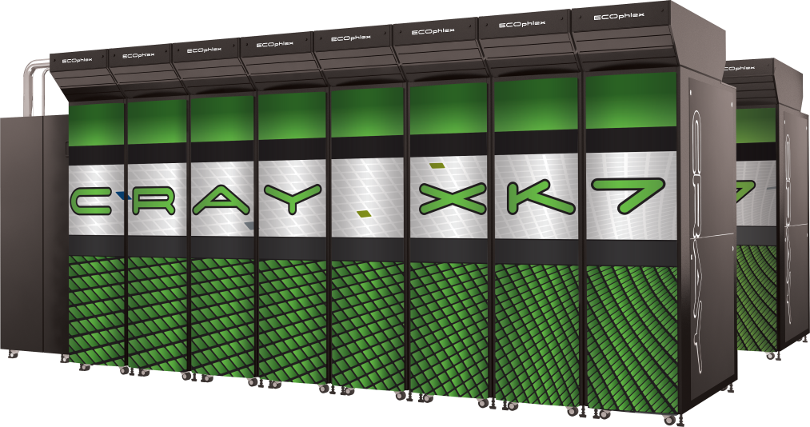
Using the Cray Programming Environment
Alistair Hart
Cray Exascale Research Initiative Europe

Slide 2
Purpose of this talk
How to compile and run jobs
If you have already used tödi, you may know some of this already
The practical exercises automate a lot of this
The practicals are about learning OpenACC,
not remembering system-specific details
The Makefiles, jobscripts etc. can be used as templates for your projects

Slide 3
The system
You are using a small Cray system called "tödi"
it is a Cray XK7 system
you log in and compile on a front end node
these nodes have no GPU, so you can't run jobs here
jobs run on the compute nodes
each node has one AMD Interlagos CPU and one Nvidia GPU
268 nodes contain Nvidia Kepler K20x GPUs
(4 nodes contain older Nvidia Fermi X2090 GPUs)
you run the jobs by submitting a jobscript to the SLURM batch system
compute jobs can't be run from the front end command line
there are two filesystems
home directories; yours is $HOME
the lustre filesystem; your directory is /scratch/todi/$USER
you should submit jobs from a directory on the lustre filesystem
home directories are backed up; the lustre filesystem is not and old files are periodically purged

Slide 4
Getting started
Cray uses a linux-based environment on the login nodes
You will have a bash login shell by default
All the usual linux commands are available
Software versions are loaded and unloaded using the Gnu module command (see man module)
To see which modules are currently loaded, type: module list
To see which modules are available, type: module avail
You can wildcard the end of the names, e.g.: module avail PrgEnv*
For more complicated grepping, you need to redirect stderr to stdout, e.g.
module avail 2>&1 | grep "Env"
You load a new module by typing: module load <module name>
Some modules (e.g. different compiler versions) conflict, so you should first "module unload" the old version (or use "module swap")

Slide 5
Programming Environments
A number of different compilers are supported
You select these by loading a Programming Environment module
PrgEnv-cray for CCE (the default)
PrgEnv-pgi for PGI
PrgEnv-gnu for gcc, gfortran
Once one of these is loaded, you can then select a compiler version
CCE: module avail cce
PGI: module avail pgi
Gnu: module avail gcc
Swap to the most up to date version in each case
e.g. "module avail cce" to see the versions available
then "module swap cce cce/<whatever>"
For any GPU programming (CUDA, OpenCL, OpenACC...)
make sure you always: "module load craype-accel-nvidia35"
it is not loaded by default

Slide 6
Using the compilers
You use the compilers via wrapper functions
ftn for Fortran; cc for C; CC for C++
it doesn't matter which PrgEnv is loaded (same wrapper name)
the wrappers add optimisation options, architecture-specific stuff and all the important library paths
make sure module xtpe-interlagos is loaded so these are correct
in many cases, you don't need any other compiler options
if you really want unoptimised code, you must use option -O0
Further information
man pages for the wrapper commands give you general information
For more detail see the compiler-specific man pages
CCE: crayftn, craycc, crayCC
PGI: pgfortran, pgcc
GNU: gfortran, gcc
You will need the appropriate PrgEnv module loaded to see these

Slide 7
Some Cray Compilation Environment basics
CCE-specific features:
Optimisation: -O2 is the default and you should usually use this
-O3 activates more aggressive options; could be faster or slower
OpenMP: is supported by default.
if you don't want it, use -hnoomp compiler flag
CCE only gives minimal information to stderr when compiling
to see more information, you should request a compiler listing file
flag -hlist=a for ftn and cc
writes a file with extension .lst
contains annotated source listing, followed by explanatory messages
each message is tagged with an identifier, e.g.: ftn-6430
to get more information on this, type: explain <identifier>
For a full description of the Cray compilers, see the reference manuals at http://docs.cray.com.

Slide 8
Submitting jobs and the lustre filesystem
You should submit jobs from the lustre filesystem
you can compile there as well if you wish
Create a unique directory for yourself: mkdir -p /scratch/todi/$USER
and subdirectories if you want
To submit a job, create a SLURM jobscript
there is a skeleton script provided as part of the tutorial materials
just rename the executable
note that command aprun is used within the jobscript to run the executable
submit the job using command: sbatch <jobscript name>
other options are specified in the jobscript header
a job number is returned
to view the queued and running jobs: squeue
to see just your jobs: squeue -u $USER
to stop a queued or running job: scancel <job number>

Slide 9
A sample SLURM script
SLURM parameters:
nodes is the total number of nodes required
ntasks is the number of MPI ranks
ntasks-per-node is the number of ranks per node
Could be up to 32 for XE6
Usually set to 1 for XK7 GPU jobs (unless you are using CUDA_PROXY)
cpus-per-task is number of threads per rank (usually 1 for GPU jobs)
ntasks-per-node*cpus-per-task <= 32 for XE6
See "man sbatch" for more details
Within the script:
you must manually set OMP_NUM_THREADS to cpus-per-task value
if you are using OpenMP
run job using aprun command
"aprun -B <executable>" is a good shortcut
avoids need to specify "-n", "-N", "-d" options
-n should match ntasks
-N should match ntasks-per-node
-d should match cpus-per-task

Slide 10
A sample script
#!/bin/bash
#SBATCH --job-name="myjob"
#SBATCH --nodes=1
#SBATCH --ntasks=1
#SBATCH --cpus-per-task=1
#SBATCH --ntasks-per-node=1
#SBATCH --time=00:01:00
#SBATCH --output="myjob.log"
# If you are using OpenMP, set the number of threads here
#export OMP_NUM_THREADS=<whatever>
# Now run the job with aprun
# aprun -B uses the same parameters (-N -n -d) as specified in PBS
# As an example, we'll run the PGI pgaccelinfo program to give
# information about the GPU. To access this, we need to load
# PrgEnv-pgi:
module swap PrgEnv-cray PrgEnv-pgi
# In general, you don't need to do this.
# Run the command:
aprun -B pgaccelinfo

Slide 11
For information: Compiling CUDA
Compilation:
module load craype-accel-nvidia35
Main CPU code compiled with PrgEnv "cc" wrapper
either PrgEnv-gnu for gcc; or PrgEnv-cray for craycc
GPU CUDA-C kernels compiled with nvcc
nvcc -O3 -arch=sm_35
PrgEnv "cc" wrapper used for linking
Only GPU flag needed: -lcudart
e.g. no CUDA -L flags needed (added in cc wrapper)

Slide 12
For information: Compiling OpenCL
Compilation:
module load craype-accel-nvidia35
Main CPU code compiled with PrgEnv "cc" wrapper
either PrgEnv-gnu for gcc; or PrgEnv-cray for craycc
GPU OpenCL kernels compiled with nvcc
PrgEnv "cc" wrapper used for linking
Only GPU flag needed: -lOpenCL
Alternatively:
Use PrgEnv-gnu for all compilation
still need -lOpenCL at linktime

