Slide 1
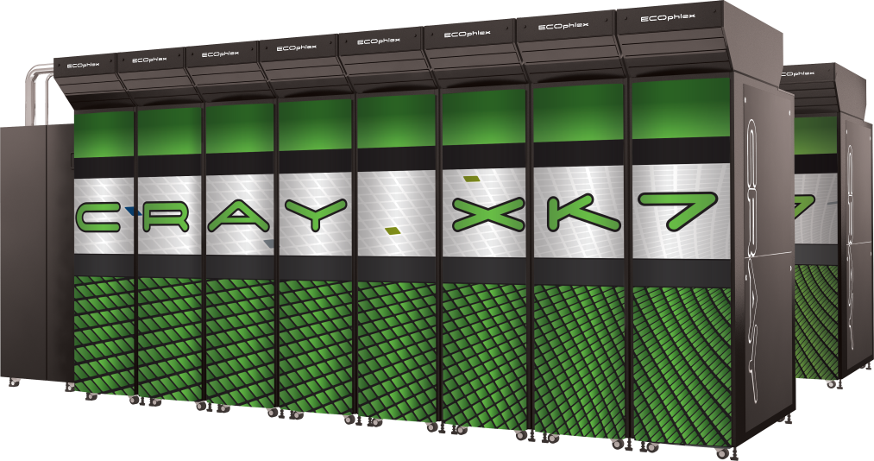
The OpenACC programming model
Alistair Hart
Cray Exascale Research Initiative Europe

Slide 2
Contents
What is OpenACC?
How does it work?
The execution and memory models
What does it looks like?
How do I use it?
Basic directives
Enough to do the first two practicals
Advanced topics will follow in another lecture
Where can I learn more?
Plus a few hints, tips, tricks and gotchas along the way
Not all guaranteed to be relevant, useful (or even true)

Slide 3

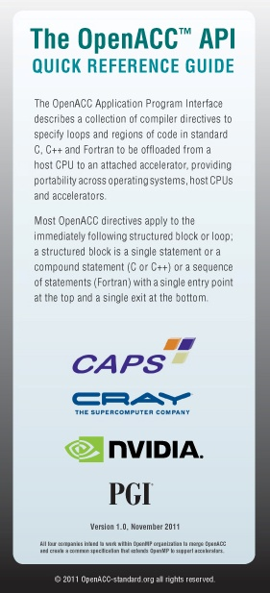

A common directive programming model for today’s GPUs
Announced at SC11 conference
Offers portability between compilers
Drawn up by: NVIDIA, Cray, PGI, CAPS
Multiple compilers offer:
portability, debugging, permanence
Works for Fortran, C, C++
Standard available at openacc.org
Initially implementations targeted at NVIDIA GPUs
Current version: 1.0 (November 2011)
v2.0 expected in 1H 2013
Compiler support: all now complete
Cray CCE: complete in 8.1 release
PGI Accelerator: version 12.6 onwards
CAPS: Full support in v1.3
(accULL: research compiler, C only)

Slide 4

accelerator directives
A common programming model for tomorrow’s accelerators
An established open standard is the most attractive
portability; multiple compilers for debugging; permanence
Currently with subcommittee of OpenMP ARB
includes most major vendors + others (e.g. EPCC)
co-chaired by Cray (James Beyer) and TI (Eric Stotzer)
aiming for OpenMP 4.0
Targets Fortran, C, C++
Current version: draft
OpenACC will continue to be supported
Developers can transition to OpenMP if they wish
Converting OpenACC to OpenMP will be straightforward

Slide 5
OpenACC Execution model
In short:
It's just like CUDA

Slide 6
OpenACC Execution model
In detail:
Host-directed execution with attached GPU accelerator
Main program executes on “host” (i.e. CPU)
Compute intensive regions offloaded to the accelerator device
under control of the host.
“device” (i.e. GPU) executes parallel regions
typically contain “kernels” (i.e. work-sharing loops), or
kernels regions, containing one or more loops which are executed as kernels.
Host must orchestrate the execution by:
allocating memory on the accelerator device,
initiating data transfer,
sending the code to the accelerator,
passing arguments to the parallel region,
queuing the device code,
waiting for completion,
transferring results back to the host, and
deallocating memory.
Host can usually queue a sequence of operations
to be executed on the device, one after the other.

Slide 7
OpenACC Memory model
In short:
it's just like CUDA

Slide 8
OpenACC Memory model
In detail:
Memory spaces on the host and device distinct
Different locations, different address space
Data movement performed by host using runtime library calls that explicitly move data between the separate
GPUs have a weak memory model
No synchronisation between different execution units (SMs)
Unless explicit memory barrier
Can write OpenACC kernels with race conditions
Giving inconsistent execution results
Compiler will catch most errors, but not all (no user-managed barriers)
OpenACC
data movement between the memories implicit
managed by the compiler,
based on directives from the programmer.
Device memory caches are managed by the compiler
with hints from the programmer in the form of directives.

Slide 9
Accelerator directives
Modify original source code with directives
Non-executable statements (comments, pragmas)
Can be ignored by non-accelerating compiler
CCE -hnoacc (or -xacc) also supresses compilation
Sentinel: acc
C/C++: preceded by #pragma
Structured block {...} avoids need for end directives
Fortran: preceded by !$ (or c$ for FORTRAN77)
Usually paired with !$acc end *
Directives can be capitalised
Continuation to extra lines allowed
C/C++: \ (at end of line to be continued)
Fortran:
Fixed form: c$acc& or !$acc& on continuation line
Free form: & at end of line to be continued
continuation lines can start with either !$acc or !$acc&
// C/C++ example
#pragma acc *
{structured block}
! Fortran example
!$acc *
<structured block>
!$acc end *

Slide 10
Conditional compilation
In theory, OpenACC code should be identical to CPU
only difference are the directives (i.e. comments)
In practise, you may need slightly different code
E.g.
around calls to OpenACC runtime API functions
where you need to recode for OpenACC, e.g. for performance reasons
try to minimise this; usually better OpenACC code is better CPU code
CPP macro defined to allow conditional compilation
_OPENACC == yyyymm (currently 201111)

Slide 11
A first example
!$acc parallel loop
DO i = 2,N-1
c(i,j) = a(i,j) + b(i,j)
ENDDO
ENDDO
!$acc end parallel loop
Execute a loop nest on the GPU
Compiler does the work:
Data movement
allocates/frees GPU memory at
start/end of region
moves of data to/from GPU
Loop schedule: spreading loop iterations over PEs of GPU
OpenACC CUDA
gang: a threadblock
worker: warp (group of 32 threads)
vector: threads within a warp
Compiler takes care of cases where iterations doesn't divide threadblock size
Caching (explicitly use GPU shared memory for reused data)
automatic caching (e.g. NVIDIA Fermi, Kepler) important
Tune default behaviour with optional clauses on directives
write-only
read-only

Slide 12
A first full OpenACC program: "Hello World"
PROGRAM main
INTEGER :: a(N)
<stuff>
!$acc parallel loop
DO i = 1,N
a(i) = i
ENDDO
!$acc end parallel loop
!$acc parallel loop
DO i = 1,N
a(i) = 2*a(i)
ENDDO
!$acc end parallel loop
<stuff>
END PROGRAM main
Two accelerator parallel regions
Compiler creates two kernels
Loop iterations automatically divided across gangs, workers, vectors
Breaking parallel region acts as barrier
First kernel initialises array
Compiler will determine copyout(a)
Second kernel updates array
Compiler will determine copy(a)
Breaking parallel region=barrier
No barrier directive (global or within SM)
Array a(:) unnecessarily moved from and to GPU between kernels
"data sloshing"
Code still compile-able for CPU

Slide 13
A second version
Now added a data region
Specified arrays only moved at boundaries of data region
Unspecified arrays moved by each kernel
No compiler-determined movements for data regions
Data region can contain host code and accelerator regions
Copies of arrays independent
PROGRAM main
INTEGER :: a(N)
<stuff>
!$acc data copyout(a)
!$acc parallel loop
DO i = 1,N
a(i) = i
ENDDO
!$acc end parallel loop
!$acc parallel loop
DO i = 1,N
a(i) = 2*a(i)
ENDDO
!$acc end parallel loop
!$acc end data
<stuff>
END PROGRAM main
No automatic synchronisation of copies within data region
User-directed synchronisation via update directive

Slide 14
Sharing GPU data between subprograms
PROGRAM main
INTEGER :: a(N)
<stuff>
!$acc data copyout(a)
!$acc parallel loop
DO i = 1,N
a(i) = i
ENDDO
!$acc end parallel loop
CALL double_array(a)
!$acc end data
<stuff>
END PROGRAM main
SUBROUTINE double_array(b)
INTEGER :: b(N)
!$acc parallel loop present(b)
DO i = 1,N
b(i) = double_scalar(b(i))
ENDDO
!$acc end parallel loop
END SUBROUTINE double_array
INTEGER FUNCTION double_scalar(c)
INTEGER :: c
double_scalar = 2*c
END FUNCTION double_scalar
One of the kernels now in subroutine (maybe in separate file)
CCE supports function calls inside parallel regions
Fermi: Compiler will inline (maybe need -Oipafrom or program library)
present clause uses version of b on GPU without data copy
Can also call double_array() from outside a data region
Replace present with present_or_copy
Original calltree structure of program can be preserved

Slide 15
Data clauses
Applied to: data, parallel [loop], kernels [loop]
copy, copyin, copyout
copy moves data "in" to GPU at start of region and/or "out" to CPU at end
supply list of arrays or array sections (using ":" notation)
N.B. Fortran uses start:end; C/C++ uses start:length
e.g. first N elements: Fortran 1:N (familiar); C/C++ 0:N (less familiar)
Advice: be careful and don't make mistakes!
Use profiler and/or runtime commentary to see how much data moved
Avoid non-contiguous array slices for performance
create
No copyin/out – useful for shared temporary arrays in loopnests
Host copy still exists
private, firstprivate: as per OpenMP
scalars private by default (not just loop variables)
Advice: declare them anyway, for clarity

Slide 16
More data clauses
present, present_or_copy*, present_or_create
pcopy*, pcreate for short
Checks if data is already on the device
if it is, it uses that version
no data copying will be carried out for that data
if not, it does the prescribed data copying
Advice: only use present_or_* if you really have to
"not present" runtime errors are a useful development tool for most codes
In both cases, the data is processed on the GPU
Advanced topic: what if I want to call routine either:
with data on the GPU, to be processed on the GPU, or...
with data on the CPU, to be processed on the CPU?
Either:
Explicitly call one of two versions of the routine, one with OpenACC, or...
Use the Cray OpenACC runtime to check if data present and branch code

Slide 17
And take a breath...
You now know everything you need to start accelerating
This is all you need to do Practical 1 and Practical 2
Just using what you know, the code in Practical 2:
is fully ported to the GPU
runs faster on the GPU than it does across 16 cores of the CPU
So what do we do for the rest of the lecture (let alone the rest of the day)?
Not all codes are as simple as Practical 2
OpenACC has a lot more functionality to cover
And we want to be able to tune the performance

Slide 18
Clauses for !$acc parallel loop
Tuning clauses:
!$acc loop [gang] [worker] [vector]
Targets specific loop (or loops with collapse) at specific level of hardware
gang ↔ CUDA threadblock (scheduled on a single SM)
worker ↔ CUDA warp of 32 threads (scheduled on vector unit)
vector ↔ CUDA threads in warp executing in SIMT lockstep
You can specify more than one
!$acc loop gang worker vector schedules loop iteration over all hardware
We'll discuss loop scheduling in much more detail later

Slide 19
More clauses for !$acc parallel loop
More tuning clauses:
num_gangs, num_workers, vector_length
Tunes the amount of parallelism used (threadblocks, threads/block...)
To set the number of threads per block (fixed at compile time for CCE)
vector_length(NTHREADS) or num_workers(NTHREADS/32)
NTHREADS must be one of: 1, 64, 128 (default), 256, 512, 1024
NTHREADS > 32 automatically decomposed into warps of length 32
Don't need to specify number of threadblocks (unless you want to)
Handy tip: To debug a kernel by running on a single GPU thread, use:
!$acc parallel [loop] gang vector num_gangs(1) vector_length(1)
Useful for checking race conditions in parallelised loopnests (but very slow)

Slide 20
More OpenACC directives
Other !$acc parallel loop clauses:
seq: loop executed sequentially
independent: compiler hint, if it isn't partitioning (parallelising) a loop
if(logical)
Executes on GPU if .TRUE. at runtime, otherwise on CPU
reduction: as in OpenMP
cache: specified data held in software-managed data cache
e.g. explicit blocking to shared memory on NVIDIA GPUs
CCE-specific tuning:
can also use !dir$ directives to adjust loop scheduling
e.g. concurrent, blockable
see man intro_directives (with PrgEnv-cray loaded) for details

Slide 21
More OpenACC directives
!$acc update [host|device]
Copy specified arrays (slices) within data region
Useful if you only need to send a small subset of data to/from GPU
e.g. halo exchange for domain-decomposed parallel code
or sending a few array elements to the CPU for printing/debugging
Remember slicing syntax differs between Fortran and C/C++
The array sections should be contiguous
a(2:N-1,1:N) is OK, but a(1:N,2:N-1) is not
!$acc declare
Makes a variable resident in accelerator memory
persists for the duration of the implicit data region
Other directives
We'll cover these in detail later:
!$acc cache
async clause and !$acc wait
!$acc host_data

Slide 22
parallel vs. kernels
parallel and kernels regions look very similar
both define a region to be accelerated
different heritage; different levels of obligation for the compiler
parallel
prescriptive (like OpenMP programming model)
uses a single accelerator kernel to accelerate region
compiler will accelerate region (even if this leads to incorrect results)
kernels
descriptive (like PGI Accelerator programming model)
uses one or more accelerator kernels to accelerate region
compiler may accelerate region (if decides loop iterations are independent)
For more info: http://www.pgroup.com/lit/articles/insider/v4n2a1.htm
Which to use (my opinion)
parallel (or parallel loop) offers greater control
fits better with the OpenMP model
kernels (or kernels loop) better for initially exploring parallelism
not knowing if loopnest is accelerated could be a problem

Slide 23
parallel loop vs. parallel and loop
parallel region can span multiple code blocks
i.e. sections of serial code statements and/or loopnests
loopnests in parallel region are not automatically partitioned
need to explicitly use loop directive for this to happen
scalar code (serial code, loopnests without loop directive)
executed redundantly, i.e. identically by every thread
or maybe just by one thread per block (its implementation dependent)
There is no synchronisation between redundant code or kernels
offers potential for overlap of execution on GPU
also offers potential (and likelihood) of race conditions and incorrect code
There is no mechanism for a barrier inside a parallel region
after all, CUDA offers no barrier on GPU across threadblocks
to effect a barrier, end the parallel region and start a new one
also use wait directive outside parallel region for extra safety

Slide 24
parallel loop vs. parallel and loop
My advice: don't...
GPU threads are very lightweight (unlike OpenMP)
so don't worry about having extra parallel regions
explicit use of async clause may achieve same results
as using one parallel region
but with greater code clarity and better control over overlap
... but if you feel you must
begin with composite parallel loop and get correct code
separate directives with care only as a later performance tuning
when you are sure the kernels are independent and no race conditions
this is similar to using OpenMP on the CPU
if you have multiple do/for directives inside omp parallel region
only introduce nowait clause when you are sure the code is working
and watch out for race conditions

Slide 25
parallel gotchas
No loop directive
The code will (or may) run redundantly
Every thread does every loop iteration
Not usually what we want
!$acc parallel
DO i = 1,N
a(i) = b(i) + c(i)
ENDDO
!$acc end parallel
Serial code in parallel region
avoids copyin(t), but a good idea?
No! Every thread sets t=0
asynchronicity: no guarantee this finishes before loop kernel starts
race condition, unstable answers.
!$acc parallel
t = 0
!$acc loop reduction(+:t)
DO i = 1,N
t = t + a(i)
ENDDO
!$acc end parallel
Multiple kernels
Again, potential race condition
Treat OpenACC "end loop" like OpenMP "enddo nowait"
!$acc parallel
!$acc loop
DO i = 1,N
a(i) = 2*a(i)
ENDDO
!$acc loop
DO i = 1,N
a(i) = a(i) + 1
ENDDO
!$acc end parallel

Slide 26
parallel loop vs. parallel and loop
My advice: when you actually might want to
You might split the directive if:
you have a single loopnest, and
you need explicit control over the loop scheduling
you do this with multiple loop directives inside parallel region
or you could use parallel loop for the outermost loop, and loop for the others
But beware of reduction variables
With separate loop directives, you need a reduction clause on every loop directive that includes a reduction:
t = 0
!$acc parallel loop &
!$acc reduction(+:t)
DO j = 1,N
DO i = 1,N
t = t + a(i,j)
ENDDO
ENDDO
!$acc end parallel loop
t = 0
!$acc parallel &
!$acc reduction(+:t)
!$acc loop
DO j = 1,N
!$acc loop
DO i = 1,N
t = t + a(i,j)
ENDDO
ENDDO
!$acc end parallel
t = 0
!$acc parallel
!$acc loop reduction(+:t)
DO j = 1,N
!$acc loop
DO i = 1,N
t = t + a(i,j)
ENDDO
ENDDO
!$acc end parallel
t = 0
!$acc parallel
!$acc loop reduction(+:t)
DO j = 1,N
!$acc loop reduction(+:t)
DO i = 1,N
t = t + a(i,j)
ENDDO
ENDDO
!$acc end parallel
Correct!
Wrong!
Wrong!
Correct!

Slide 27
The OpenACC runtime API
Directives are comments in the code
automatically ignored by non-accelerating compiler
OpenACC also offers a runtime API
set of library calls, names starting acc_
set, get and control accelerator properties
offer finer-grained control of asynchronicity
OpenACC specific
will need pre-processing away for CPU execution
#ifdef _OPENACC
CCE offers an extended runtime API
set of library calls, names starting with cray_acc_
will need preprocessing away if not using OpenACC with CCE
#if defined(_OPENACC) && PE_ENV==CRAY
Advice: you do not need the API for most codes.
Start without it, only introduce it where it is really needed.
I almost never use it; we'll talk about it later.

Slide 28
Sources of further information
OpenACC standard web page:
OpenACC.org
documents: full standard and quick reference guide PDFs
links to other documents, tutorials etc.
Discussion lists:
Cray users: openacc-users@cray.com
automatic subscription if you have a raven account
OpenACC forum: openacc.org/forum
CCE man pages (with PrgEnv-cray loaded):
programming model and Cray extensions: intro_openacc
examples of use: openacc.examples
also compiler-specific man pages: crayftn, craycc, crayCC
CrayPAT man pages (with perftools loaded):
intro_craypat, pat_build, pat_report
also command: pat_help
accpc (for accelerator performance counters)

Slide 29

More sources of further information
PGI Accelerator, including PGI Insider newsletter articles
http://www.pgroup.com/lit/articles/insider/v4n1a1.htm (overview of support)
http://www.pgroup.com/lit/articles/insider/v4n2a1.htm (parallel vs. kernels)
CAPS
Recent ORNL workshop
http://www.olcf.ornl.gov/event/cray-technical-workshop-on-xk6-programming/
Recent training courses
PRACE, Cray:
http://www.epcc.ed.ac.uk/training-education/course-programme/gpu-programming-workshop/
SC12 tutorials:
Cray:
Productive, Portable Performance on Accelerators Using OpenACC Compilers and Tools
PGI:
Introduction to GPU Computing with OpenACC
Advanced GPU Computing with OpenACC

Slide 30
Any questions?
!$acc end data

