Slide 1

Advanced OpenACC: topics and performance tuning
Alistair Hart
Cray Exascale Research Initiative Europe

Slide 2
Contents
Some more advanced OpenACC topics
the async and cache clauses
Then we talk about a few tuning tips for OpenACC
The Golden Rules of Tuning
information sources
Tuning data locality
Tuning kernels
correcting obvious scheduling errors
advanced schedule tuning (collapse, worker, vector_length clauses)
use scalar Himeno code as an example
Extreme tuning
source code changes, reordering data structures, using CUDA
Where to learn more
Notes:
How long is a piece of string?
optimisation tends to be a case-by-case process
OpenACC makes it easier; e.g. changing loop schedules, caching...
the same general rules apply as for CPUs
there is still some trial and error

Slide 3
OpenACC async clause
async[(handle)] clause for parallel, update directives
Launch accelerator region/data transfer asynchronously
Operations with same handle guaranteed to execute sequentially
as for CUDA streams
Operations with different handles can overlap
if the hardware permits it and runtime chooses to schedule it:
can potentially overlap:
PCIe transfers in both directions
Plus multiple kernels
can overlap up to 16 parallel streams with Fermi
streams identified by handle (integer-valued)
tasks with same handle execute sequentially
can wait on one, more or all tasks
!$acc wait: waits for completion of all streams of tasks
!$acc wait(handle) waits for a specified stream to complete
Runtime API library functions
can also be used to wait or test for completion

Slide 4
OpenACC async clause
REAL(kind=dp) :: a(Nvec,Nchunks),b(Nvec,Nchunks)
!$acc data create(a,b)
DO j = 1,Nchunks
!$acc update device(a(:,j)) async(j)
!$acc parallel loop async(j)
DO i = 1,Nvec
b(i,j) = <function of a(i,j)>
ENDDO
!$acc update host(b(:,j)) async(j)
ENDDO
!$acc wait
!$acc end data
First attempt
a simple pipeline:
processes array, slice by slice
copy data to GPU,
process on GPU,
bring back to CPU
can overlap 3 streams at once
use slice number as stream handle
don't worry if number gets too large
OpenACC runtime maps it back into allowable range (using MOD function)

Slide 5
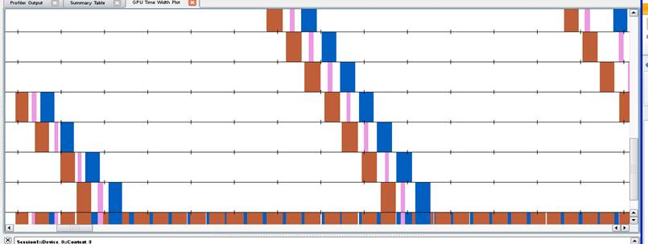
OpenACC async results
Execution times (on Cray XK6):
CPU: 3.76s
OpenACC, blocking: 1.10s
OpenACC, async: 0.34s
NVIDIA Visual profiler:
time flows left to right
streams stacked vertically
only 7 of 16 streams fit in window
red: data transfer to GPU
pink: computational on GPU
blue: data transfer from GPU
vertical slice shows what is overlapping
collapsed view at bottom
async handle modded by number of streams
so see multiple coloured bars per stream (looking horizontally)
Alternative to pipelining is task-based overlap
Harder to arrange; needs knowledge of data flow in specific application
May (probably will) require application restructuring (maybe helps CPU)
Some results later in Himeno Case Study

Slide 6
Using the cache clause
Performance-tuning clause
Don't worry about this when first accelerating a code
Apply it later to the slowest kernels of working OpenACC port
Suggests that compiler could place data into software-managed cache
e.g. threadblock-specific "shared" memory on Nvidia GPU
No guarantee it makes the code faster
could conflict with automatic caching done by hardware and/or runtime
Clause inserted inside kernel
i.e. inside all the accelerated loops
Written from perspective of a single thread
Compiler pools statements together for threadblock
Limited resource: use sparingly and only specify what's needed
Any non-loop variables should be compile-time parameters (CCE)

Slide 7
cache clause examples
Example 1:
loop-based stencil
inner loop sequential
RADIUS should be known at compile time (parameter or cpp)
!$acc parallel loop copyin(c)
DO i = 1,N
result = 0
!$acc cache(in(i-RADIUS,i+RADIUS),c)
!$acc loop seq
DO j = -RADIUS,RADIUS
result = result + c(j)*in(i+j)
ENDDO
out(i) = result
ENDDO

Slide 8
cache clause examples
Example 2
from "man openacc.examples"
multidimensional loopnest
stencil only in i,j directions
same principle, but...
you need to tile the loopnest
two options currently:
do it explicitly
DO jb = 1,N,JBS
DO j = jb,MIN(jb+JBS-1,N)
and similarly for i
use CCE directives, as right
OpenACC v2.0 will ease this:
tile clause for loop directive
more on this later in course
!$acc loop gang
DO k = 1,N
!dir$ blockable( i, j )
!$acc loop worker
!dir$ blockingsize ( 16 )
DO j = 1,N
!$acc loop vector
!dir$ blockingsize ( 64 )
DO i = 1,N
!$acc cache( A(i,j,k), &
!$acc B(i-1:i+1,j-1:j+1,k) )
A(i,j,k) = B(i, j, k) - &
( B(i-1,j-1,k) &
+ B(i-1,j+1,k) &
+ B(i+1,j-1,k) &
+ B(i+1,j+1,k) ) / 5
ENDDO
ENDDO
ENDDO
!$acc end parallel

Slide 9
Tuning code performance
Remember the Golden Rules of performance tuning:
always profile the code yourself
always verify claims like "this is always the slow routine";
codes/computers change
optimise the real problem running on the production system
a small testcase running on a laptop will have a very different profile
optimise the right parts of the code
the bits that take the most time
even if these are not the exciting bits of the code
e.g. it might not be GPU compute; it might be comms (MPI), I/O...
keep on profiling
the balance of CPU/GPU/comms/IO will change as you go
refocus your efforts appropriately
Keep on checking for correctness
Know when to stop (and when to start again)

Slide 10
Tuning OpenACC performance
Tuning needs input:
There are three main sources of information; make sure you use them:
Compiler feedback (static analysis)
loopmark files (-hlist=a) for CCE; -Minfo=accel for PGI
Runtime commentary (CCE only: CRAY_ACC_DEBUG=1 or 2 or 3)
Code profiling
CrayPAT
Nvidia compute profiler
pgprof for PGI

Slide 11
Tuning OpenACC codes
The main optimisation is minimising data movements
How can I tell if data locality is important?
CrayPAT will show the proportion of time spent in data transfers
May need to compile CCE with -hacc_model=auto_async_none to see this
Loopmark comments will tell you which arrays might be transferred
Compile CCE with -hlist=a and look at .lst files
Runtime commentary will tell you which arrays actually moved
and how often and when in the code
Compile as usual, export/setenv CRAY_ACC_DEBUG=2 at runtime
use the runtime API to control the amount of information produced

Slide 12
Tuning OpenACC data locality
What can I do?
Use data regions to keep data resident on the accelerator
Understanding how data flows in application call tree is crucial, but tricky
Only transfer the data you need
if only need to transfer some of an array (e.g. halo data, debugging values),
rather than use copy* clause, use create and explicit update directives
packing/sending a buffer may be faster than sending strided array section
Overlap data transfers with other, independent activities
use async clause on update directive; then wait for completion later
typical situations:
pipelining; send one chunk while another processes on the GPU
task-based overlap; can be hard to arrange
typical use case: pack halo buffer and transfer to CPU while GPU updates bulk
Beware of GPU memory allocation overheads
if a routine using big temporary arrays is called many times, even create clause can have a big overhead
maybe keep array(s) allocated between calls (add to higher data region)
add it to a higher data region as create and use present clause in subprogram
(not good for a memory-bound code, of course)

Slide 13
Kernel optimisation
Next optimisation: make sure all the kernels vectorise
How can I tell if this is a problem?
if a kernel is surprisingly slow on accelerator
in a wildly different place in the the profile compared to running on CPU
examine the loopmark compiler commentary files
loop iterations should be divided over both the threads in a threadblock (vector) and over the threadblocks (gang)
CCE: you should see either:
If a single loop is divided over both levels of parallelism, look for: Gg
If two different loops divided, look for G and 2 g-s (maybe with numbers between)
generally want to vectorise the innermost loop
usually fastest-moving array index, for coalescing
if not, can the inner loop be vectorised?
i.e. can loop iterations be computed in any order?
if not, rewrite code
avoid loop-carried dependencies
e.g. buffer packing: calculate rather than increment
these rewrites will probably perform better on CPU also
Replace:
i = 0
DO y = 2,N-1
i = i+1
buffer(i) = a(2,y)
ENDDO
buffsize = i
By:
DO y = 2,N-1
buffer(y-1) = a(2,y)
ENDDO
buffsize = N-2

Slide 14
Forcing compiler to vectorise
If the loop is vectorisable, guide the compiler
a gentle hint:
put "acc loop independent" directive above this loop
could also use CCE directive "!dir$ concurrent"
see "man intro_directives" for details
a direct order:
put "acc loop vector" directive above this loop
check the code is still correct and running faster, though:
the compiler might not be vectorising for a good reason
If the inner loop is vectorising but performance is still bad
is the inner loop really the one to vectorise in this case?
in this example, we should vectorise the i-loop
because we happen to know mmax is small here
put "acc loop seq" directive above m-loop
then executed redundantly by every thread
also t is now an i-loop private scalar
rather than a reduction variable (which is slower)
probably also want to reorder array c for speed
c(i,m) gives much coalesced memory accesses
want vector index to be fastest-moving index
!$acc parallel loop
DO i = 1,N
t = 0
!$acc loop seq
DO m = 1,mmax
t = t + c(m,i)
ENDDO
a(i) = t
ENDDO
!$acc end parallel loop
Notes:
You are allowed to put extra loop directives inside a "parallel loop" (or "kernels loop") directive

Slide 15
It's all vectorising, but still performing badly
Profile the code and start "whacking moles"
optimise the thing that is taking the time
if it really is a GPU compute kernels...
GPUs need lots of parallel tasks to work well
First look at loop scheduling using OpenACC clauses
Then might need to consider more extreme measures
source code changes
handcoding CUDA kernels

Slide 16
Advanced loop scheduling
OpenACC loop schedules are limited by the loop bounds
at least with the current implementation in CCE
one loop's iterations are divided over gangs
another loop's iterations are divided over threads in a threadblock
So...
"tall, skinny" loopnests (j=1:big; i=1:small) won't schedule well
if less than 32 iterations won't even fill a warp, so wasted SIMT
"short, fat" loopnests (j=1:small; i=1:big) also not good
want lots of threadblocks to swap amongst SMs
What can we do?
collapse clause is way of increasing flexibility
the compiler may use this automatically (look for C in loopmark)
no guarantee that it is faster
e.g. index rediscovery requires expensive integer divisions
need perfectly nested loops for this to work
worker clause can also do this

Slide 17
Using the collapse clause
Consider a three-level loopnest (i inside j inside k)
needs to be perfectly nested to use collapse
Collapse all three loops and schedule across GPU
"acc parallel loop collapse(3) gang worker vector" above k-loop
probably don't need "gang worker vector" here
Schedule inner two loops over threads in threadblock
"acc parallel loop gang" above k-loop
"acc loop collapse(2) vector" above j-loop
don't need "gang"; enough warps are used to cover all the iterations
Schedule outer two loops over the threadblocks
"acc parallel loop collapse(2) gang" above k-loop
"acc loop vector" above i-loop
Schedule outer two loops together over entire GPU
"acc loop collapse(2) gang worker vector" above k-loop
"acc loop seq" above i-loop
Schedule k-loop and i-loop together over entire GPU
collapsed loops must be perfectly nested; you'll need to reorder the code

Slide 18
workers or vectors?
kernel threadblocks are scheduled on SMs
executed as "warps" i.e. vector instructions of length 32
threads-per-threadblock>32 automatically decomposed into warps
OpenACC makes distinction explicit
worker refers to whole warps (i.e. sets of vector instructions)
can be generated explicitly by the user using "!$acc loop worker"
vector refers to threads within a warp
can be generated automatically by the compiler/runtime
vector_length > 32 automatically decomposes into (vector_length/32) workers
CCE: only allows one of the above
If you don't specify "!$acc loop worker"
vector_length (default 128) automatically partitioned into workers
num_workers works the same
If you specify "!$acc loop worker"
default, or vector_length explicitly set
num_workers implicitly set to (vector_length/32)
vector_length implicitly set to 32 (see loopmark for information)
num_workers explicitly set
vector_length set to 32
num_workers and vector_length>32 explicitly set
Compiler warning that vector_length value is being overridden and set to 32

Slide 19
Scheduling with and without the worker clause
The default scheduling
k-loop iterations divided over threadblocks
i-loop iterations divided within a threadblock
round-robin distribution
first thread does i=1, V+1, 2*V+1, ...
V is vector_length value (default 128 with CCE)
threads automatically grouped into warps
first warp does i=1:32, V+1:V+32, ...
each thread does all the j-loop iterations
With explicit loop worker directive
k-loop divided as before
i-loop iterations are divided within a warp
first thread does i=1, 33, 65, ...
each warp does all values: i=1:32, 33:64, ...
j-loop iterations divided over warps
number of warps, W (see previous):
either: num_workers value
or: vector_length value divided by 32
round-robin distribution
first warp does j=1, W+1, 2*W+1, ...
!$acc parallel
!$acc loop gang
DO k = 1,N
!$acc loop seq
DO j = 1,N
!$acc loop vector
DO i = 1,N
!$acc parallel
!$acc loop gang
DO k = 1,N
!$acc loop worker
DO j = 1,N
!$acc loop vector
DO i = 1,N
Notes:
The top box reproduces the default scheduling with explicit loop directives

Slide 20
workers or vectors (contd)?
So when might we use "!$acc loop worker"?
Perfectly nested loops with one or more low tripcounts
probably better to use the collapse clause
e.g. "!$acc loop collapse(2) vector"
we'll see this for scalar Himeno shortly
Imperfectly nested loops with one or more low tripcounts
may benefit to put "!$acc loop worker" on the middle loop
collapse won't work here

Slide 21
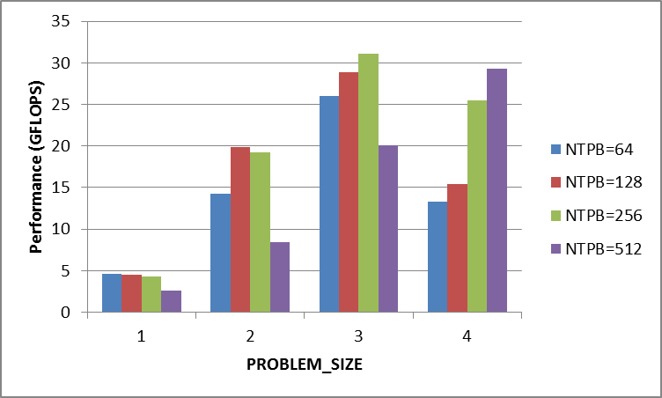
Scalar Himeno performance
PROBLEM_SIZE=1,2,3,4
For a parallel problem, this simulates strong scaling choices
Here we look at all 4 options (all double precision)
vector_length choices: NTPB=64,128,256,512
Easy tuning choice, but needs a recompile with CCE
but you need to put in vector_length(NTPB) clauses
and compile with -DNTPB=<value>
CCE defaults to 128
This has a BIG effect
best NTPB relative to default:
PROBLEM_SIZE=1: + 2%
PROBLEM_SIZE=2: default
PROBLEM_SIZE=3: + 8%
PROBLEM_SIZE=4: +90%

Slide 22
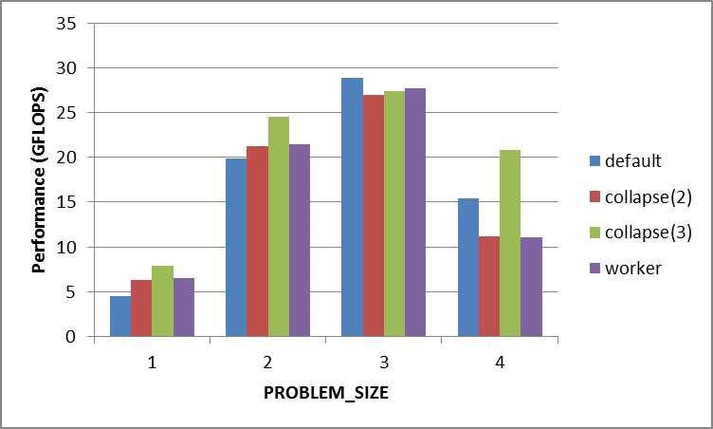
Scalar Himeno performance
PROBLEM_SIZE=1,2,3,4
4 algorithm choices for jacobi stencil kernel
default scheduling
collapse(2) inner i,j-loops
collapse(3) all loops
worker schedule for j-loop
vector_length: default
Effect also quite big
best NTPB relative to default:
PROBLEM_SIZE=1: +76%
PROBLEM_SIZE=2: +23%
PROBLEM_SIZE=3: default
PROBLEM_SIZE=4: +35%

Slide 23
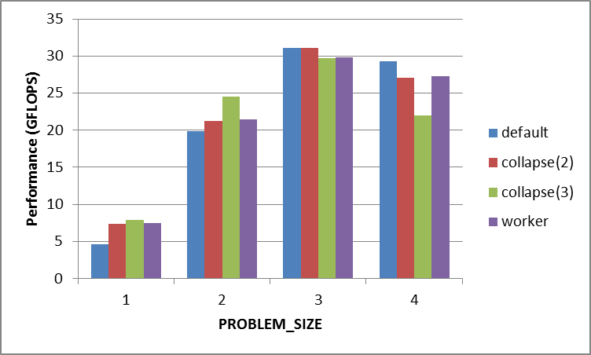
Scalar Himeno performance
PROBLEM_SIZE=1,2,3,4
4 algorithm choices for jacobi stencil kernel
default scheduling
collapse(2) inner i,j-loops
collapse(3) all loops
worker schedule for j-loop
vector_length: best for each
Final improvements
compared to default
scheduling and vector_length:
PROBLEM_SIZE=1: +76%
PROBLEM_SIZE=2: +23%
PROBLEM_SIZE=3: + 8%
PROBLEM_SIZE=4: +90%

Slide 24
Scalar Himeno tuning conclusions
Tuning can have a big effect, relative to default
It is worth doing, but only after you optimise the data locality
data region gave 44x speedup; kernel tuning gave less than 2x
We gained something at every problem size (don't reject a mere 2x!)
Only explored vector_length and basic scheduling (collapse, worker)
The only change was OpenACC directives; CPU version same
General conclusions for scalar Himeno:
Larger vector_length suited larger problem sizes
64 best for PS1; 128 best for PS2; 256 best for PS3; 512 best for PS4
Once we had optimised vector_length
collapse(3) was best for small problems (PS1, PS2)
default scheduling was best for large problems (PS3, PS4)
What else could we try?
cache clause: could have benefits for the expensive stencil kernel
async clause: scalar Himeno is too simple for task-based overlap
async is important in the parallel case

Slide 25
Scalar Himeno tuning conclusions
Best choice tuning choices (parameters/algorithms)
hard to predict and depends on problem size
GPU occupancy (e.g. from COMPUTE_PROFILE=1) guides (but not perfect)
you should do the tuning for the production problem, not a test case
you should redo the problem for each change in local problem size
e.g. when strong scaling a problem
you might benefit from using an autotuning framework
General conclusions for scalar Himeno:
Larger vector_length suited larger problem sizes
64 best for PS1; 128 best for PS2; 256 best for PS3; 512 best for PS4
Once we had optimised vector_length
collapse(3) was best for small problems (PS1, PS2)
default scheduling was best for large problems (PS3, PS4)

Slide 26
Extreme tuning
You've tried tuning with OpenACC clauses
but you think kernel performance can still be improved
(and this kernel is the performance-limiter in your application)
Now (and only now) you may need... extreme tuning
Some examples:
main source code changes
What changes will work?
There is no definitive guide
Following slides give two cases
mixed languages
You could handtune the slow kernel in CUDA
OpenACC allows interoperability with CUDA (i.e. sharing data)
Following slides give a very simple example

Slide 27
Avoiding temporary arrays
Perfect loop nests often perform better than imperfect
Imperfect loopnests often use temporary arrays
e.g. in a stencil like MultiGrid, to avoid additional duplicated computation
With OpenACC, these arrays are privatised; too big for shared memory
Imperfect loop nest also means scheduling decisions are restricted
Try two approaches; which (if any) faster depends on code
Remove temporary arrays by manually inlining (eliminate array b)
one perfect loop nest; cache clause can use shared mem/regs where needed
Manually privatise arrays and fission the loopnest (b(i)→b(i,j))
DO j = 1,N
DO i = 1,M
c(i,j) = a(i+1,j+1) + a(i+1,j-1) &
+ a(i-1,j+1) + a(i-1,j-1)
ENDDO
ENDDO
DO j = 1,N
DO i = 0,M+1
b(i) = a(i,j+1) + a(i,j-1)
ENDDO
DO i = 1,M
c(i,j) = b(i+1) + b(i-1)
ENDDO
ENDDO
DO j = 1,N
DO i = 0,M+1
b(i,j) = a(i,j+1) + a(i,j-1)
ENDDO
ENDDO
DO j = 1,N
DO i = 1,M
c(i,j) = b(i+1,j) + b(i-1,j)
ENDDO
ENDDO
Notes:
The red approach (manual inlining) was faster for the MG code.

Slide 28
More drastic performance optimisations
Would reordering your data structures help?
For instance:
Nmax particles each have Smax internal properties
code separately combines the internal properties together for each particle
CPU code usually stores data as f(Smax,Nmax) or f[Nmax][Smax]
good cache reuse when we access all the properties of a particle
GPU code would normally parallelise over the particles
each thread processes the internal properties of a single particle
first warp would attempt vector load of s^{th} prop. of first 32 particles: f(s,1:32)
no coalescing (vector load needs contiguous block of memory)
very poor performance (even if Smax is small)
Better to reorder data so site index fastest: fgpu(Nmax,Smax)
vector load of fgpu(1:32,s) now stride-1 in memory
if code memory-bandwidth-bound, you will see a big speed-up
Quite an effort to reorder data structures in the code
but... may also see benefits on CPU
especially with AVX (and longer vectors in future CPU processors)
Notes:
This was done for the ludwig code from EPCC/University of Edinburgh.
This was a CUDA port, but the hardware is the same.

Slide 29
host_data directive
OpenACC runtime manages GPU memory implicitly
user does not need to worry about memory allocation/free-ing
Sometimes it can be useful to know where data is held in device memory, e.g.:
so a hand-optimised CUDA kernel can be used to process data already held on the device
so a third-party GPU library can be used to process data already held on the device (Cray libsci_acc, cuBLAS, cuFFT etc.)
so optimised communication libraries can be used to streamline data transfer from one GPU to another
host_data directive provides mechanism for this
nested inside OpenACC data region
subprogram calls within host_data region then pass pointer in device memory rather than in host memory

Slide 30
Interoperability with CUDA
PROGRAM main
INTEGER :: a(N)
<stuff>
!$acc data copy(a)
! <Populate a(:) on device
! as before>
!$acc host_data use_device(a)
CALL dbl_cuda(a)
!$acc end host_data
!$acc end data
<stuff>
END PROGRAM main
__global__ void dbl_knl(int *c) {
int i = \
blockIdx.x*blockDim.x+threadIdx.x;
if (i < N) c[i] *= 2;
}
extern "C" void dbl_cuda_(int *b_d) {
cudaThreadSynchronize();
dbl_knl<<<NBLOCKS,BSIZE>>>(b_d);
cudaThreadSynchronize();
}
host_data region exposes accelerator memory address on host
nested inside data region
Call CUDA-C wrapper (compiled with nvcc; linked with CCE)
must include cudaThreadSynchronize()
Before: so asynchronous accelerator kernels definitely finished
After: so CUDA kernel definitely finished before we return to the OpenACC
CUDA kernel written as usual
Or use same mechanism to call existing CUDA library

Slide 31
More information
The standard and quick reference
manual pages
general information: man intro_openacc
includes Cray-specific API extensions
example programs: man openacc.examples
some common usage cases
CCE compiler-specific information
Fortran: man crayftn
C: man craycc
C++: man crayCC
You'll need module PrgEnv-cray loaded to see these
Nvidia Compute Profiler
PGI Insider magazine articles
support
OpenACC forum
Cray email list: openacc-users
us!

Slide 32
What's next?
OpenACC v1.0 released in November 2011
Cray, PGI and CAPS now offer full support
OpenACC v2.0 now being finalised
proposed additions document on OpenACC website
discussions and decisions at February's face-to-face meeting
expect announcement in next few months
We are always interested to hear from you:
bugs (functionality and performance)
feature requests
Further questions after the course ends?
Please feel free to email me: ahart@cray.com

Slide 33
Any questions?
call acc_init(you)

