Slide 1
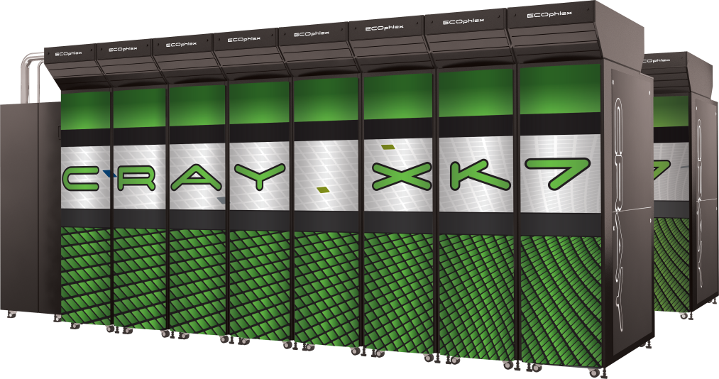
Case study: the parallel Himeno code
Alistair Hart
Cray Exascale Research Initiative Europe

Slide 2
Contents
A parallel code is a scalar code with data transfers
We have looked at how to port a scalar code
Here we look at the parallel version of the same code
The new feature is the data transfer between processors
which means local data transfers between CPU and GPU
This talk looks at the extra things we need to consider
First at a conceptual level
the OpenACC part
Then some specific points for two different comm models
MPI
Fortran coarrays

Slide 3
The Himeno Benchmark
Parallel 3D Poisson equation solver
Iterative loop evaluating 19-point stencil
Memory intensive, memory bandwidth bound
Fortran, C, MPI and OpenMP implementations available from http://accc.riken.jp/2444.htm
Fortran Coarray (CAF) version developed
~600 lines of Fortran
Fully ported to accelerator using 27 directive pairs
Strong scaling benchmark
XL configuration: 1024 x 512 x 512 global volume
Expect halo exchanges to become significant as we scale
Async. GPU data transfers and kernel launches to help avoid this

Slide 4
Overall program structure
Like scalar case:
initmt() initialises data
jacobi(nn,gosa)
does nn iterations
stencil update to data
called twice:
once for calibration
once for measurement
differences:
initcomm() routine
sets up processor grid
PROGRAM himeno
CALL initcomm ! Set up processor grid
CALL initmt ! Initialise local matrices
cpu0 = gettime() ! Wraps SYSTEM_CLOCK
CALL jacobi(3,gosa)
cpu1 = gettime()
cpu = cpu1 - cpu0
! nn = INT(ttarget/(cpu/3.0)) ! Fixed runtime
nn = 1000 ! Hardwired for testing
cpu0 = gettime()
CALL jacobi(nn,gosa)
cpu1 = gettime()
cpu = cpu1 - cpu0
xmflops2 = flop*1.0d-6/cpu*nn
PRINT *,' Loop executed ',nn,' times'
PRINT *,' Gosa :',gosa
PRINT *,' MFLOPS:',xmflops2,' time(s):',cpu
END PROGRAM himeno

Slide 5
The distributed jacobi routine
iteration loop:
fixed tripcount
jacobi kernel:
new pressure array wrk2
local residual wgosa
halo exchange
between neighbours
uses send, receive buffers
Allreduce
global residual gosa
wgosa summed over PEs
second kernel:
p array updated from wrk2
DO loop = 1, nn
compute Jacobi: wrk2, wgosa
pack halos from wrk2 into send bufs
exchange halos with neighbour PEs
Allreduce to sum wgosa across Pes
copy back wrk2 into p
unpack halos into p from recv bufs
ENDDO

Slide 6
The Jacobi computational kernel (serial)
DO K=2,kmax-1
DO J=2,jmax-1
DO I=2,imax-1
s0=a(I,J,K,1)* p(I+1,J, K )
+a(I,J,K,2)* p(I, J+1,K ) &
+a(I,J,K,3)* p(I, J, K+1) &
+b(I,J,K,1)*(p(I+1,J+1,K )-p(I+1,J-1,K ) &
-p(I-1,J+1,K )+p(I-1,J-1,K )) &
+b(I,J,K,2)*(p(I, J+1,K+1)-p(I, J-1,K+1) &
-p(I, J+1,K-1)+p(I, J-1,K-1)) &
+b(I,J,K,3)*(p(I+1,J, K+1)-p(I-1,J, K+1) &
-p(I+1,J, K-1)+p(I-1,J, K-1)) &
+c(I,J,K,1)* p(I-1,J, K ) &
+c(I,J,K,2)* p(I, J-1,K ) &
+c(I,J,K,3)* p(I, J, K-1) &
+ wrk1(I,J,K)
s = (s0*a(I,J,K,4)-p(I,J,K))*bnd(I,J,K)
wgosa = wgosa + ss*ss
wrk2(I,J,K) = p(I,J,K) + omega * ss
ENDDO
ENDDO
ENDDO
The stencil is applied to pressure array p
Updated pressure values are saved to temporary array wrk2
Local control value wgosa is computed
fwd n.n.
n.n.n.
bwd n.n.

Slide 7
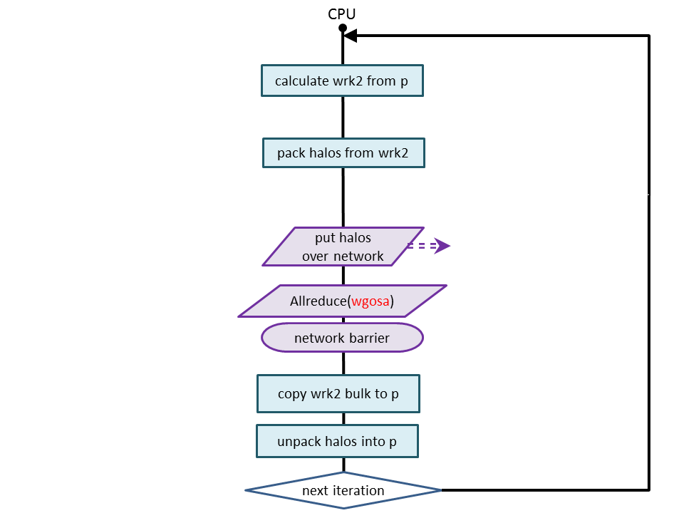
Distributed jacobi routine as a flowchart
tasks reorganised
take advantage of overlap
just network at this point
still some freedom:
barrier can move relative to
Allreduce
wrk2→bulk
Which is best order?
depends on:
hardware
comms library
kernel details
local problem size

Slide 8
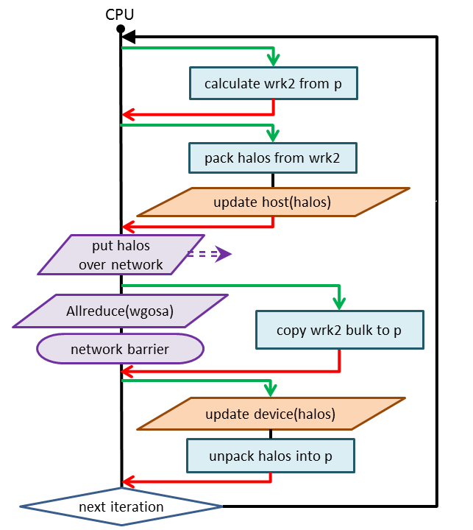
First OpenACC port
Loopnest kernels
stencil
pack halos
wrk2→bulk
unpack halos
acc updates
Some additional overlap
GPU kernels asynchronous
wrk2→bulk
can overlap comms

Slide 9
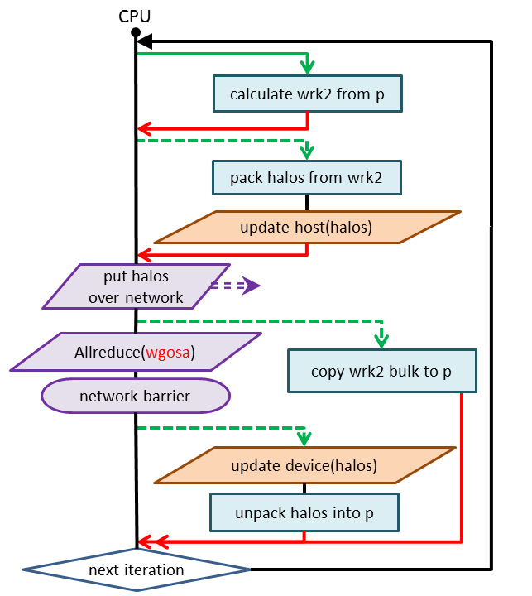
Asynchronicity
async handle
allows task overlap on GPU
Dotted lines are async
halo pack
can overlap x, y, z directions
halo unpack
can overlap x, y, z directions
also overlap with wrk2→bulk
Red lines are sync points

Slide 10
Packing and transferring send buffers
!$acc parallel loop async(xstrm)
DO k = 2,kmax-1
DO j = 2,jmax-1
sendbuffx_dn(j,k)=wrk2(2,j,k)
sendbuffx_up(j,k)=wrk2(imax-1,j,k)
ENDDO
ENDDO
!$acc end parallel loop
!$acc update host &
!$acc (sendbuffx_dn,sendbuffx_up) &
!$acc async(xstrm)
! same for y with async(ystrm)
! same for z with async(zstrm)
!$acc wait
<send the 6 buffers>
Use async clause
separate handles for overlap
one per direction
three in total
integers, e.g. 1, 2, 3
what about six?
one each for up and down
not as efficient
but this is a tuning option
global wait
all 3 streams completed

Slide 11
Packing and transferring send buffers (better)
The biggest bottleneck
PCIe link serialises:
one buffer at a time
So:
as soon as one direction done
send these buffers over network
Ordering:
Can we guarantee x ready first?
No, but likely
OpenACC does not have waitany directive
so go with most likely ordering
!$acc parallel loop async(xstrm)
<pack the two x buffers>
!$acc end parallel loop
!$acc update host &
!$acc (sendbuffx_dn,sendbuffx_up) &
!$acc async(xstrm)
! same for y with async(ystrm)
! same for z with async(zstrm)
!$acc wait(xstrm)
<send the two x buffers>
!$acc wait(ystrm)
<send the two y buffers>
!$acc wait(zstrm)
<send the two z buffers>

Slide 12
Transferring and unpacking recv buffers
Copying wrk2 into p
very quick
but can overlap network
When messages complete
copy and unpack recv buffers
three parallel streams
wait
ensures all 4 streams complete
!$acc parallel loop async(bstrm)
<wrk2 -> p>
!$acc end parallel loop
<network barrier>
!$acc update device &
!$acc (recvbuffx_dn,recvbuffx_up) &
!$acc async(xstrm)
!$acc parallel loop async(xstrm)
<unpack the two x buffers>
!$acc end parallel loop
! same for y with async(ystrm)
! same for z with async(zstrm)
!$acc wait
<end iteration loop>

Slide 13
Data region considerations
Twelve extra buffers
3 physical dimensions: x, y, z
2 directions of transfer: up, down
Separate buffers for send and receive
These buffers need to be added to the data region(s)
if just in jacobi() data region
they should be create
allocated each time jacobi() is called, no data transfer (except explicit updates)
or in outer data region
create in main data region
present in jacobi() data region
if jacobi() routine was called a lot, better to allocate once in parent

Slide 14
Communications models
Two domain decompositions strategies
Both message passing:
MPI
Fortran coarrays (CAF)
A lot of similarities
a few subtle differences

Slide 15
MPI
Use nonblocking MPI calls
MPI_IRECV
post these receives early; first thing in iteration loop
MPI_ISEND
call these in 3 sets (x, y, z) of two (up, down)
after each of async streams xstrm, ystrm, zstrm separately completes
network barrier:
MPI_WAITALL(12,send_handles,recv_handles)
ensures all buffers arrive (and send buffers can be reused)
But, PCIe transfer of recv buffers is a bottleneck
better to start transfer of messages to GPU as soon as they arrive
don't know which order 6 message will arrive in
MPI_WAITANY(6,recv_handles)
As each arrives, start async stream of: update, then unpack kernel
After all recvs completed:
MPI_WAITALL(6, send_handles)
Could investigate use of nonblocking collective for gosa
MPI 3.0

Slide 16
Fortran coarrays
Introduced in Fortran2008
previously known as Co-array Fortran (CAF) language extension
PGAS feature
single-sided communication model
Simplifies the code
e.g. to send a buffer:
recvbuffx_up(:,:)[myx-1,myy,myz] = sendbuffx_dn(:,:)
send buffer is a (local) array, but a (global) co-scalar
recv buffer is a (local) array and a (global) coarray
no acknowledgement, receipt etc. for message being sent
RDMA put: remote "image" doesn't know when data arrives
user has to handle all synchronisation points
gives great potential for overlapping comms with compute etc.

Slide 17
CAF and Himeno
"put" operations are more efficient than "get"
i.e. put remote coarray on the left of the "="
recvbuffx_up(:,:)[myx-1,myy,myz] = sendbuffx_dn(:,:)
But, Fortran standard says that:
Not only should this guarantee z = x:
y = x
z = y
But also, so should this:
y[remote] = x
z = y[remote]
So compiler forced to add a lot of (usually unnecessary) sync points
To avoid these, need CCE directive above CAF statements
!$pgas defer_sync

Slide 18
Using CAF for parallel Himeno with OpenACC
send buffers
co-scalars, no problem using them in OpenACC directives
recv buffers
co-arrays, forbidden from being in OpenACC directives
to prevent race conditions
so we need to:
copy local recv (coarray) buffer into temporary (co-scalar) array on CPU
use the temporary array in the update, parallel loop kernels
additional CPU buffer copy potentially affects performance/scalability
data region
send buffers and temporary buffers (all co-scalars) go in data region
using create or present clause

Slide 19
CAF synchronisation
Network synchronisation
needed to guarantee the halo buffers have arrived
sync all
but we are also globally summing the residual
scalar wgosa needs to be a co-scalar (as used in OpenACC reduction)
copy wgosa to local part of coarray cgosa
gosa = cosum(cgosa)
cosum partially synchronises the images
sync all would now be overkill
sync memory instead completes the synchronisation
this guarantees all messages have completed
no equivalent of MPI_WAITANY to relieve PCIe recv buffer congestion

Slide 20
Final CAF implementation
CPU
GPU

Slide 21
OpenACC / CAF version
Total number of lines in the original Himeno MPI-Fortran code: 629
Total number lines in the modified version with coarrays and accelerator directives: 554
don't need MPI_CART_CREATE and the like
Total number of accelerator directives: 27
plus 18 "end" directives

Slide 22
Benchmarking the code
Cray XK6 configuration:
Single AMD IL-16 2.1GHz nodes, 16 cores per node
Nvidia Tesla X2090 GPU, 1 GPU per node
Running with 1 PE (GPU) per node
Himeno case XL needs at least 16 XK6 nodes
Testing blocking and asynchronous GPU implementations
Cray XE6 configuration:
Dual AMD IL-16 2.1 GHz nodes, 32 cores per node
Running on fully packed nodes: all cores used
Depending on the number of nodes, 1-4 OpenMP threads per PE are used
All comparisons are for strong scaling on case XL

Slide 23
Himeno performance
XK6 GPU is about 1.6x faster than XE6
OpenACC async implementation is ~ 8% faster than OpenACC blocking

Slide 24
Himeno code breakdown
Host/GPU transfers take more time than the halo exchange (network)
this code would benefit from an efficient direct GPU-GPU communication
On 128 nodes, ~55% of the time is spent in the GPU compute kernel

