Slide 1
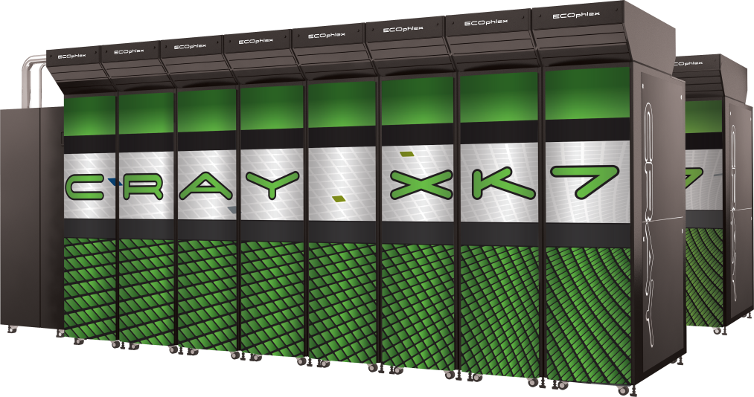
OpenACC: extra topics and roadmap
Alistair Hart
Cray Exascale Research Initiative Europe

Slide 2
Contents of Talk
OpenACC interoperability
Debugging OpenACC applications
Using Scientific Libraries with OpenACC
OpenACC Roadmap

Slide 3
Interoperability
OpenACC is a complete programming model
But there are still situations where it is useful to interface OpenACC code with other GPU programming models
Why might this be useful?
You want to call accelerated scientific libraries from your code
without having to transfer data back and forth between the host
You want to call CUDA kernels from your code
also without unnecessary data transfers
You want to exploit Nvidia GPUdirect (or similar) to streamline communication of data between accelerators.
Interfacing requires access to the lower-level information
Typically the GPU memory locations of OpenACC-created data arrays
The compiler normally hides this information from the user.

Slide 4
host_data directive
OpenACC runtime manages GPU memory implicitly
user does not need to worry about memory allocation/free-ing
Sometimes it can be useful to know where data is held in device memory, e.g.:
so a hand-optimised CUDA kernel can be used to process data already held on the device
so a third-party GPU library can be used to process data already held on the device (Cray libsci_acc, cuBLAS, cuFFT etc.)
so optimised communication libraries can be used to streamline data transfer from one GPU to another
host_data directive provides mechanism for this
nested inside OpenACC data region
subprogram calls within host_data region then pass pointer in device memory rather than in host memory

Slide 5
Interoperability with CUDA
Why would you want to do this?
Two situations:
You have already ported an application to OpenACC
A few key kernels get improved performance using hand-tuned CUDA
(performance at the cost of reduced portability)
These CUDA kernels should process data that was already placed in GPU memory using OpenACC
Or, you have ported a few key kernels to the GPU using CUDA
but data movement costs outweigh the performance gain
OpenACC provides an efficient way of porting the remainder of the application

Slide 6
CUDA Interoperability
PROGRAM main
INTEGER :: a(N)
<stuff>
!$acc data copy(a)
! <Populate a(:) on device
! as before>
!$acc host_data use_device(a)
CALL dbl_cuda(a)
!$acc end host_data
!$acc end data
<stuff>
END PROGRAM main
__global__ void dbl_knl(int *c) {
int i = \
blockIdx.x*blockDim.x+threadIdx.x;
if (i < N) c[i] *= 2;
}
extern "C" void dbl_cuda_(int *b_d) {
cudaThreadSynchronize();
dbl_knl<<<NBLOCKS,BSIZE>>>(b_d);
cudaThreadSynchronize();
}
host_data region exposes accelerator memory address on host
Nested inside data region
Call CUDA-C wrapper (compiled with nvcc; linked with CCE)
Must include cudaThreadSynchronize()
Before: so asynchronous accelerator kernels definitely finished
After: so CUDA kernel definitely finished
CUDA kernel written as usual
Or use same mechanism to call existing CUDA library

Slide 7
Interoperability with Libraries
Why would you want to do this?
You should always use libraries if they are available
A lot of effort goes into optimizing them
They are likely to use a lot more tricks that you have time/inclination to try
Examples of libraries:
Cray libsci_acc
cuBLAS
cuFFT
...
To use these with OpenACC code
Place calls to the library inside host_data regions

Slide 8
Streamlined Communications
To transfer data between GPUs typically means:
"acc update host" to move data to local CPU memory
Plus implicit or explicit "acc wait" to ensure completion
transfer to remote CPU memory e.g. with MPI
Plus communications barrier to ensure completion
"acc update device" to move received data to GPU memory
Plus associated "acc wait"
A lot of synchronisation points
User code has to manage these
Limits the scope for overlapping communications with computation
Some communications libraries can bypass this
e.g. using Nvidia GPUDirect
Require a pointer to GPU memory to be passed to library
host_data provides a mechanism for doing this

Slide 9
The OpenACC runtime API
Alistair Hart
Cray Exascale Research Initiative Europe

Slide 10
The OpenACC runtime API
Directives are comments in the code
automatically ignored by non-accelerating compiler
OpenACC also offers a runtime API
set of library calls, names starting acc_
set, get and control accelerator properties
offer finer-grained control of asynchronicity
OpenACC-specific
will need pre-processing away for CPU execution
#ifdef _OPENACC
CCE also offers an extended runtime API
set of library calls, names starting with cray_acc_
will need preprocessing away if not using OpenACC and CCE
#if defined(_OPENACC) && PE_ENV==CRAY
Advice: you do not need the API for most codes.
Start without it, only introduce it where it is really needed.
I almost never use it

Slide 11
Runtime API for device selection and control
About the OpenACC-supporting accelerators
What type of device will I use next? acc_get_device_type()
default from environment variable ACC_DEVICE_TYPE
What type of device should I use next? acc_set_device_type()
How many accelerators of specified type? acc_get_num_devices()
Which device of specified type will I use next? acc_get_device_num()
default from environment variable ACC_DEVICE_NUM
Which device of specified type should I use next? acc_set_device_num()
Am I executing on device of specified type? acc_on_device()
Initialising/shutting down accelerators:
Initialise (e.g. to isolate time taken): acc_init()
Shut down (e.g. before switching devices): acc_shutdown()

Slide 12
OpenACC runtime API
Device selection and control API calls
Advice:
Don't use these runtime calls unless you really need to
The defaults are all sensible
All you need on a host with one accelerator (e.g. Cray XK family)
Maybe acc_init() to isolate device initialisation from performance timing
not needed for CCE anyway: automatically initialises at program launch

Slide 13
Runtime API for advanced memory control
These are for very advanced users
Offer method to allocate and free device memory
C/C++ only:
void* acc_malloc ( size_t );
void acc_free ( void* );
Advice:
If you just need to know the address of the memory used by OpenACC (to pass, for instance, to CUDA)
then you don't need these
just use host_data directive instead (we'll talk about this later)

Slide 14
Runtime API for asynchronicity
Runtime API can be used to control asynchronicity
Advice: this is probably the part of the API you are most likely to use
Waiting for stream of operations to complete
acc_async_wait(handle)
duplicates functionality of !$acc wait(handle) directive
Waiting for all operations to complete
acc_async_wait_all()
duplicates functionality of !$acc wait directive
Can also test for completion without waiting
a single stream of operations: acc_async_test(handle)
all operations: acc_async_test_all()
no directive equivalent for these

Slide 15
Cray extended runtime API
These go beyond the current OpenACC standard
only currently supported by CCE
using these can make the code non-functioning for pure CPU
so you will almost certainly need to pre-process the code
Include library calls to:
enquire if an array or slice is present on the device
similar to present clause, but can be used in user-code control flow
expose location of data in device memory
similar to host_device directive
allocate and deallocate device memory
similar to data directive
move data to and from device memory
similar to copy* and create clauses
also similar to update directive
but additionally offer transfers not in-place
a(GPU, possibly strided) ↔ b(CPU, possibly strided)
useful for packing halo buffers
see man intro_openacc (with PrgEnv-cray loaded) for details
and man openacc.examples

Slide 16
An advanced aside, using the runtime API
Dynamic arrays in C
multidimensional hard
common method right:
uses pointer chain
maybe not contiguous
OpenACC harder
must redo pointer chain
"deep copying"
Currently not automatic
manual workaround
data region replaced by
Cray extended API calls
man openacc.examples
Practical1, Cdynamic
Automatic is coming...
#include <openacc.h>
#define SET_ACC_PTR(acc_ptr, acc_target) ( \
cray_acc_memcpy_to_device( &(acc_ptr), \
&(acc_target), sizeof(void*) ))
/* allocate the array in CPU memory */
int **a = (int **)malloc(N*sizeof(int *));
for (j=0; j<N; j++)
a[j] = (int *)malloc(N*sizeof(int));
#ifdef _OPENACC
/* allocate the array in GPU memory, without copying */
int **acc_a = (int **)cray_acc_create(a,N*sizeof(int *));
for (j=0; j<N; j++) {
int *acc_aj = (int *)cray_acc_create(a[j],N*sizeof(int));
/* fix acc pointer acc_a[j] */
SET_ACC_PTR(acc_a[j], acc_aj);
}
#endif /* _OPENACC */
/* initialise the array on the accelerator */
#pragma acc parallel loop present(a[0:N])
for (j=0; j<N; j++)
for (i=0; i<N; i++)
a[j][i] = (i+1)*(j+1);
/* Finish with a manual deep delete of GPU array */

Slide 17


Debugging OpenACC Applications with DDT or TotalView
Courtesy from
David Lecomber Chris Gottbrath
Allinea Software Rogue Wave Software

Slide 18
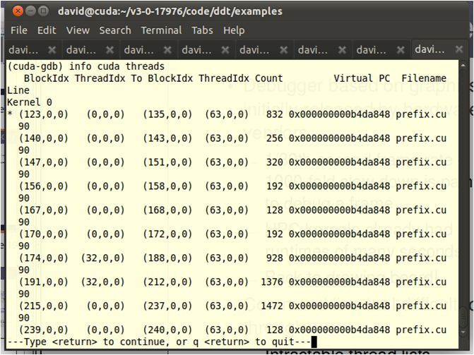
How Do We Fix GPU Bugs?
Print statements
Too intrusive
Command line debugger?
A good start:
Variables, source code
Large thread counts overwhelming
Too complex
A graphical debugger...

Slide 19
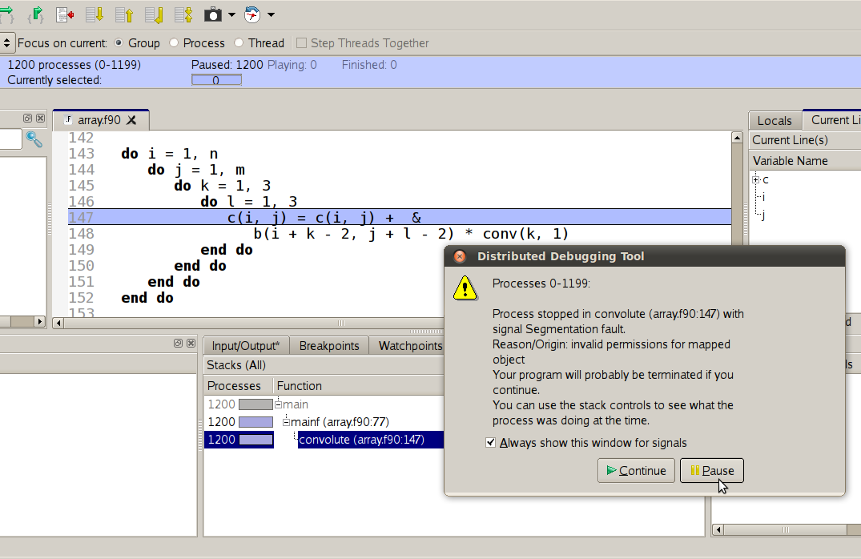
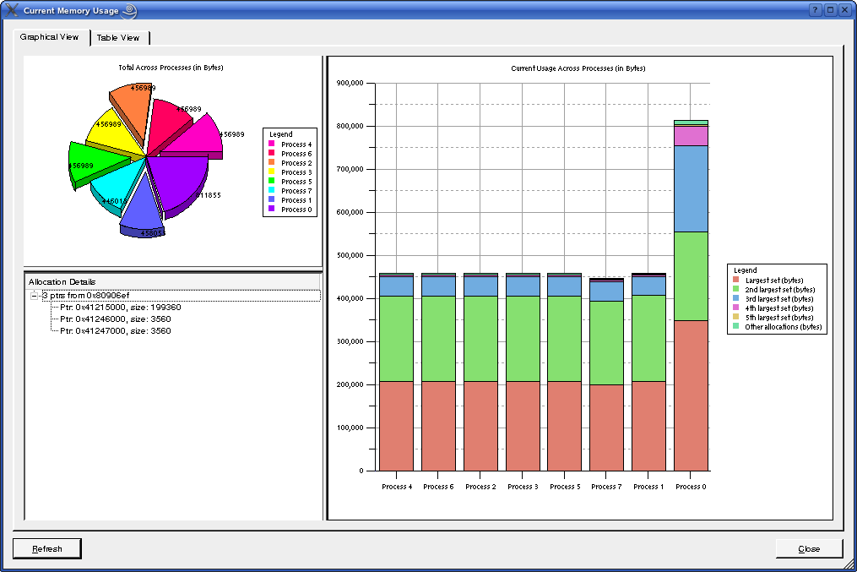
Allinea DDT in a Nutshell
Graphical source level debugger for
Parallel, multi-threaded, scalar or hybrid code
C, C++, F90, Co-Array Fortran, UPC
Strong feature set
Memory debugging
Data analysis
Managing concurrency
Emphasizing differences
Collective control

Slide 20
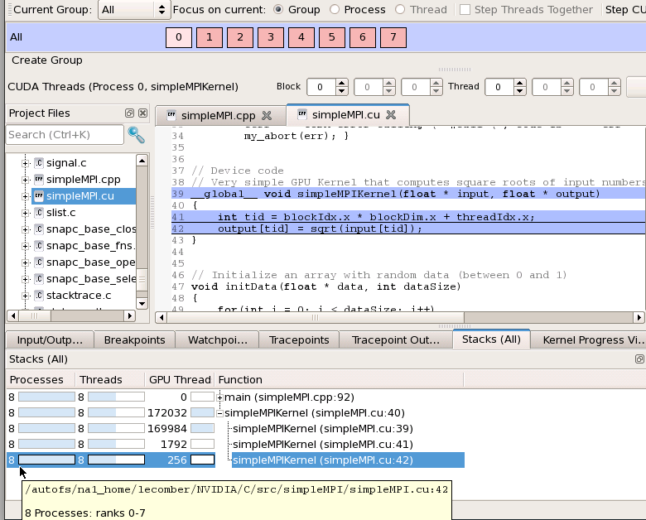
GPU Debugging with Allinea DDT
Almost like debugging a CPU – you can still:
Run through to a crash
Step through and observe
CPU-like debugging features
Double click to set breakpoints
Hover the mouse for more information
Step a warp, block or kernel
Follow threads through the kernel
Simultaneously debugs CPU code
CUDA Memcheck feature detects read/write errors

Slide 21
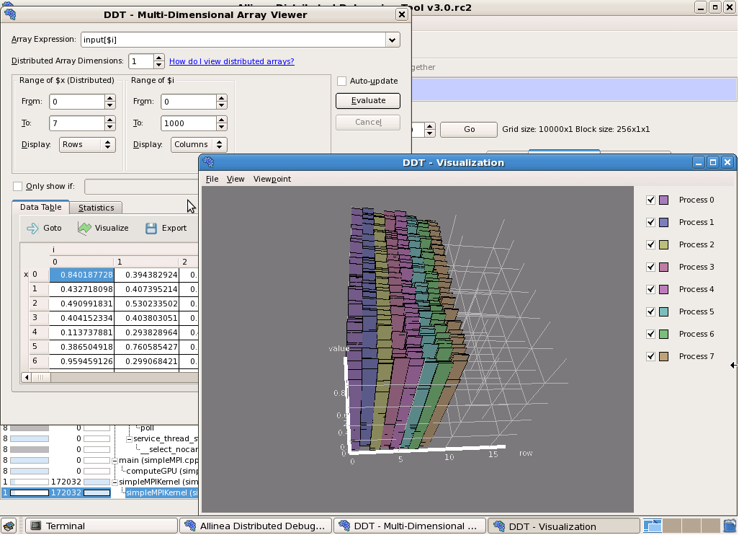
Examining GPU data
Debugger reads host and device memory
Shows all memory classes: shared, constant, local, global, register..
Able to examine variables
… or plot larger arrays directly from device memory

Slide 22
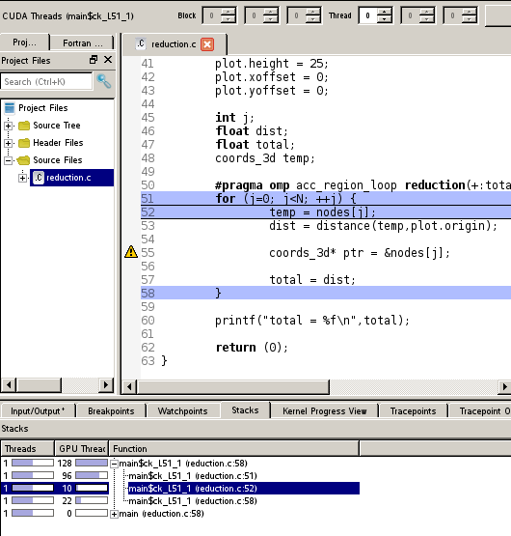
OpenACC Debugging
On device debugging with Allinea DDT
Variables – arrays, pointers, full F90 and C support
Set breakpoints and step warps and blocks
Requires Cray compiler for on-device debugging
Other compilers to follow
Identical to CUDA
Full warp/block/kernel controls

Slide 23
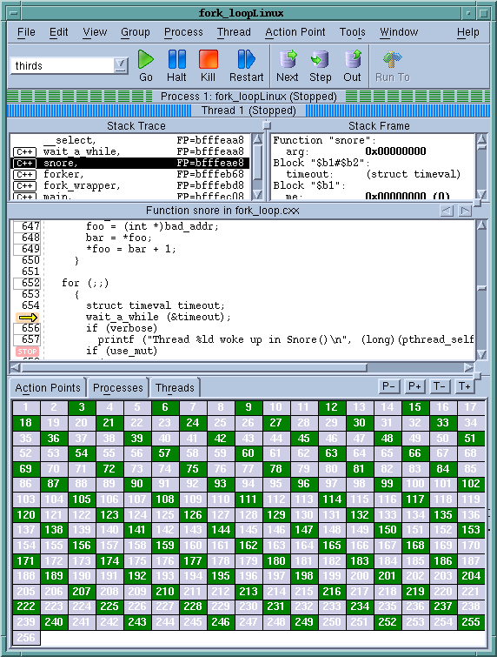
What is TotalView?
Application Analysis and Debugging Tool: Code Confidently
Debug and Analyze C/C++ and Fortran on Linux, Unix or Mac OS X
Laptops to supercomputers such as the Cray XE or XK
Makes developing, maintaining and supporting critical apps easier and less risky
Major Features include
Easy to learn graphical user interface with data visualization
Parallel debugging with
MPI
OpenMP
Accelerator debugging of apps that use
CUDA
OpenACC
Memory Debugging with MemoryScape
Deterministic Replay Capability Included on Linux/x86-64

Slide 24
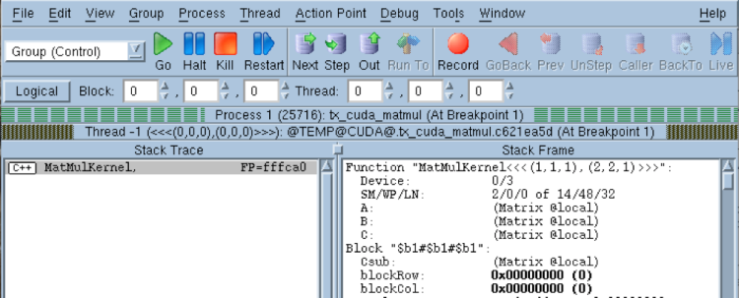
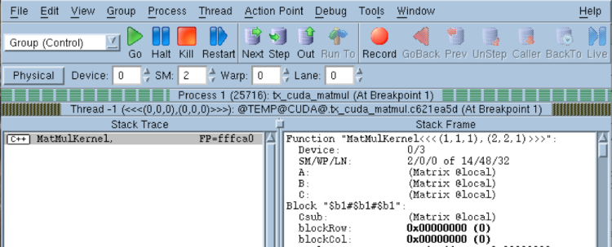
Debugging CUDA with Totalview
Navigate freely through your code
Reference
by
Logical
or
Physical
attributes
Negative IDs indicate
CUDA Threads
Full Thread and Device information
in Stack Frame Pane

Slide 25
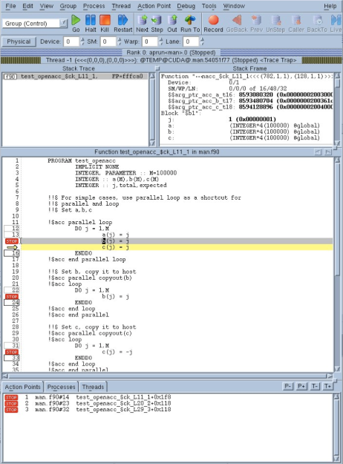
TotalView for OpenACC
OpenACC® DIRECTIVES FOR ACCELERATORS
Step host & device
View variables
Set breakpoints
Compatibility with Cray CCE 8.x OpenACC

Slide 26
What is Cray Libsci_acc?
Provide basic scientific libraries optimized for hybrid CPU and accelerator systems
Independent to, but fully compatible with OpenACC
Multiple use case support
Get the base use of accelerators with no code change
Get extreme performance of GPU with or without code change
Extra tools for support of complex code
Incorporate the existing GPU libraries into Cray libsci
Provide additional performance and usability

Slide 27
Libsci_acc Interface
libsci_acc simple interface
Base performance of GPU with minimal (or no) code change
Target for anybody
Non-GPU users and non-GPU expert
libsci_acc expert interface
Advanced performance of the GPU with controls for data movement
Skip auto-adaptation
Special tuning options are planned
Target for CUDA, OpenACC, and GPU expert
Does not imply that always need expert interfaces to get great performance

Slide 28
Simple Interface
Supports the standard API in the original form
Will perform all GPU dirty-work for you
Initialize data structures on GPU
Split your problem into a CPU portion and GPU portion
Copy data to the GPU memory from CPU memory
Perform GPU and CPU operations
Copy data back to CPU memory
Library-heavy codes can use GPUs with no code change
Is not only a tool for simple usage
If you don’t need the data on the GPU afterwards, use the simple interface
Simple API has automatic adaptation

Slide 29
Expert Device & CPU Interface
Allow users to explicitly specify the execution
Every routine in libsci has a version with _acc and _cpu suffix
E.g. dgetrf_acc, dgetrf_cpu
Simple API for device memory and _acc API are the same
Future _acc API will have more options to allow more execution control and parameter passing and return value location

Slide 30
Adaptation in Simple interface
You can pass either host pointers or device pointers to simple interface
A is host memory
dgetrf(M, N, A, lda, ipiv, &info)
Performs hybrid operation on GPU
if problem is too small, performs host operation
Pass Device memory
dgetrf(M, N, d_A, lda, ipiv, &info)
Performs hybrid operation on GPU
BLAS 1 and 2 performs computation local to the data location
CPU-GPU data transfer is too expensive to exploit hybrid execution

Slide 31
Libsci_acc: Simple Interface for BLAS1 and BLAS2
User Application
dgemv_();
where is the data?
On Host
Libsci DGEMV
On GPU
Libsci_acc
DGEMV_ACC
Notes:
User is responsible for the data transfer.

Slide 32
Libsci_acc: Simple Interface for BLAS3 and LAPACK
User Application
dgemm_();
where is the data?
Large enough?
Libsci DGEMM
On Host
On GPU
Libsci_acc
DGEMM_ACC
Libsci_acc
Hybrid DGEMM

Slide 33
Libsci_acc Example
Starting with a code that relies on dgemm.
The library will check the parameters at runtime.
If the size of the matrix multiply is large enough, the library will run it on the GPU, handling all data movement behind the scenes.
NOTE: Input and Output data are in CPU memory.
call dgemm('n','n',m,n,k,alpha,&
a,lda,b,ldb,beta,c,ldc)

Slide 34
Libsci_acc Example
If the rest of the code uses OpenACC, it’s possible to use the library with directives
All data management performed by OpenACC
Calls the device version of dgemm
All data is in CPU memory before and after data region
!$acc data copy(a,b,c)
!$acc parallel
!Do Something
!$acc end parallel
!$acc host_data use_device(a,b,c)
call dgemm_acc('n','n',m,n,k,&
alpha,a,lda,&
b,ldb,beta,c,ldc)
!$acc end host_data
!$acc end data

Slide 35
Libsci_acc Example
Libsci_acc is a bit smarter that this
Since ‘a,’ ‘b’, and ‘c’ are device arrays, the library knows it should run on the device
So just dgemm is sufficient
!$acc data copy(a,b,c)
!$acc parallel
!Do Something
!$acc end parallel
!$acc host_data use_device(a,b,c)
call dgemm_acc('n','n',m,n,k,&
alpha,a,lda,&
b,ldb,beta,c,ldc)
!$acc end host_data
!$acc end data
!$acc data copy(a,b,c)
!$acc parallel
!Do Something
!$acc end parallel
!$acc host_data use_device(a,b,c)
call dgemm ('n','n',m,n,k,&
alpha,a,lda,&
b,ldb,beta,c,ldc)
!$acc end host_data
!$acc end data

Slide 36
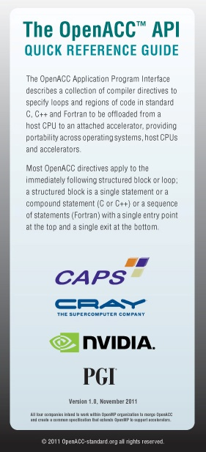
OpenACC v2.0

Slide 37
OpenACC v2.0
Progress report
Technical report issued last November
OpenACC committee now finalising v2.0 of the standard
Expected to be formally launched shortly
Here we summarise the proposed additions:
default(none) for parallel or kernels directives
so the programmer must be explicit about all data movements
unstructured data lifetimes
call support
async clause for wait directive
nested parallelism
data API routines
tile clause for loop directive

Slide 38
Unstructured data lifetimes
To keep data on the accelerator between two routines
currently need a data region in a parent routine common to both
the arrays must be scope for that parent routine
This can be inconvenient...
e.g. Fortran module is not currently USEd in the parent routine
... or impossible
data is created/destroyed by separate constructor/destructor methods
Two new directives proposed:
enter data
clauses: [present_or_]copyin, [present_or_]create, if
data then persists on the accelerator until code reaches a matching:
exit data
clauses: [present_or_]copyout, [present_or_]delete, if

Slide 39
Call support
v1.0 does not support calls within accelerator regions
either compiler has to inline
makes it hard to understand and control the scheduling
or the user has to do it
destroying their application's calltree structure
it also limits the use of third-party libraries
New directive proposed:
routine
clauses include:
bind: useful for cross-compiler linking
type: describes what partitioning has been used so far and what is available
nohost: the routine will never be called outside an accelerator region

Slide 40
async clause for wait directive
"When you have finished updating this array, separately pack halo buffers in the x and y directions"
two kernels should start in separate async streams
but only after one async kernel finishes
Only way to do this in v1.0 is for host to wait on the first kernel
introduces extra (unwanted) synchronisation point
Proposed change:
async clause for wait directive
async stream won't progress until
wait stream has completed
better task dependency tree
more scope for overlap
example:
after wait directive, know:
bulk updated on GPU
then halo buffers packed on GPU
then buffers transferred to CPU
!$acc parallel loop async(Sbulk)
<update bulk>
!$acc wait(Sbulk) async(Sxhalo)
!$acc parallel loop async(Sxhalo)
<pack xhalo>
!$acc update host(xhalo) async(Sxhalo)
!$acc wait(Sbulk) async(Syhalo)
!$acc parallel loop async(Syhalo)
<pack yhalo>
!$acc update host(yhalo) async(Syhalo)
<independent host code>
!$acc wait

Slide 41
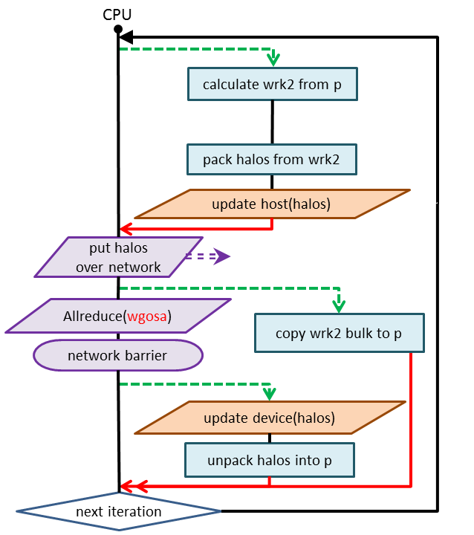
async clause for wait directive
Parallel Himeno code
removes need for sync after first stencil kernel
host has greater freedom to do other things
unfortunately, code too simple
no other tasks to overlap with

Slide 42
Nested parallelism
Currently can't have a parallel region inside another one
or kernels
nested parallelism offers potential speed-up
if the hardware supports it (e.g. "dynamic parallelism" on Kepler)
Proposed change
allow nested parallel and kernels regions
limited range of clauses for the nested regions:
present, private, firstprivate
because outermost one handles all the data movement etc.
if the hardware doesn't support nested parallelism
inner regions executed sequentially

Slide 43
Data API routines
A set of API calls that are equivalent to directives
update
acc_update_device(), acc_update_host()
enter data
acc_[p]copyin, acc_[p]create
exit data
acc_[p]copyout, acc_[p]delete
for those that prefer API calls

Slide 44
tile clause
v1.0 offers no way to tile loopnests
to take advantage of multidimensional (2D/3D) partitioning
and/or use the cache clause
users have to do it by hand, or use vendor-specific directives
Proposed tile(n) clause
applied to loop directive
tiles the following n (tightly-nested) loops
optionally, can specify tile sizes: tile(n:size1,size2,...,sizen)
scheduling optionally controlled using gang, worker, vector clauses on associated loop directive
default scheduling options are implementation dependent

Slide 45
OpenACC Roadmap – Areas for Improvement
Deep copy
Similar to MPI system
Self describing structures
Multiple “images of structure”
Separate compilation units
True calls, not call-site flattening
Orphaned loops
Dynamic Parallelism
Not OpenMP style nested parallelism
C / C++ Multidimensional arrays
VLAs
float f_array[10][10]
Ragged arrays
float **f_array
Better async system
Noncontiguous memory
Directive versions of extended runtime routines
Multiple devices

Slide 46
Finally...
Now you know as much as anyone about OpenACC
Remember the Three Acc-s:
accurate:
make sure you have correctness measures (checksums)
and check them at every stage of the port
accessible:
keeping the data in the right place is the biggest performance boost
accelerate:
kernel optimisations come after this
Please ask for help if you need it
CSCS has some of the most expert users of OpenACC in the world
Cray can help you as well

Slide 47
Any questions?

Slide 48
!$acc exit data
delete copyout

