Slide 1
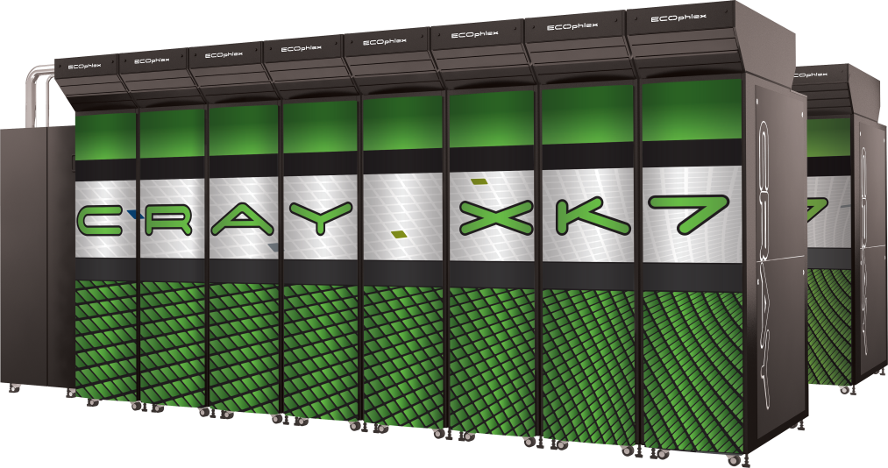
Practical: a sample code
Alistair Hart
Cray Exascale Research Initiative Europe

Slide 2
Aims
The aim of this practical is to examine, compile and run a simple, pre-prepared OpenACC code

Slide 3
The sample code
The sample code
Designed to demonstrate functionality
not interested in performance at this stage
Implements the simple example from the lectures
A 3d array a is initialised
It's values are doubled and stored in a new array b
A checksum is calculated and compared with the expected result
These are implemented as 3 OpenACC kernels
There are three versions of the code
Version 00 has all 3 kernels in same main program.
There is no attempt to keep data on the GPU between the kernels.
Version 01 uses a data region to avoid data sloshing.
Version 02 has more complicated calltree
calls a subroutine that contains an OpenACC kernel.
This kernel also contains a function call.

Slide 4
Code versions and building them
There are versions for 4 different programming models
C or Fortran, with
static or dynamic allocation of arrays
N.B. there is no version00 for dynamic arrays with C (see note in version01)
source filename based on these, e.g. first_example_Fstatic_v00.f90
Get your environment right
make sure you have the right PrgEnv loaded (cray or pgi)
make sure you have loaded the correct compiler version module
make sure you have loaded module craype-accel-nvidia20
Build the code
PrgEnv-cray:
ftn -hlist=a <Fortran source file>
cc -hlist=a <C source file>
PrgEnv-pgi:
ftn -Minfo=all <Fortran source file>
cc -Minfo=all <C source file>

Slide 5
Automation
You can do it all by hand if you wish, or use automation
There's nothing magic being done here
Automated building:
can just type: make VERSION=[00|01|02] [F|C][static|dynamic]
Makefile will echo commands it uses to build the code
automatically detects which PrgEnv you are using (uses PE_ENV env. var.)
remember to type "make clean" if you switch PrgEnv modules
Automated building and job submission
type: bash build_submit.bash MYPE TARGET VERSION
MYPE should be cray or pgi
TARGET should be Fstatic or Fdynamic or Cstatic or Cdynamic
VERSION should be 00 or 01 or 02
This will:
load the correct modules using script ../XK_setup.bash
build the code using the Makefile
create directory: /lus/scratch/$USER/Cray_OpenACC_training/Practical1/TARGET_VERSION_DATE_TIME
write and submit a PBS jobscript
You can then cd to this directory and look at the output

Slide 6
What to check
Check correctness
Did the code compile correctly?
Did the job execute?
Was the answer correct?
Next, understand what did the compiler did
examine and understand the compiler feedback
CCE: open the .lst file
PGI: read the output to stdout
did it compile for the accelerator?
what data did it plan to move and when?
how were the loop iterations scheduled?

Slide 7
What actually ran?
Did we actually run on the accelerator?
We can ask the runtime for some feedback
cd to run directory, edit jobscript, uncomment appropriate line
CCE: set CRAY_ACC_DEBUG to 1 (least detailed) to 3 (most detailed)
PGI: set ACC_NOTIFY
Resubmit the job: qsub <jobscript name>
Examine commentary (in the log file) and make sure you understand it
Profiling the code
A quick way of profiling is to use the Nvidia compute profiler
CCE and PGI compile to PTX (as does nvcc), so this will work for all
Edit the jobscript and uncomment the profiling line
Resubmit the job
Examine the profile (in file cuda_profile_0.log)
Can change location with env. var. COMPUTE_PROFILE_LOG
This is a "blow-by-blow" account
Larger codes need a more aggregated report
We will cover profiling in more detail later

Slide 8
Further work
Choose a target and repeat this for all three versions
Start with the Cray compiler
Then either:
repeat for a different programming model target, or
try the PGI compiler

Slide 9
Getting the examples
On raven:
change to a directory where you want to work
either in your home directory or under /lus/scratch/$USER
type: tar zxvf ~tr99/cray_OpenACC_training.tgz
This creates a new directory ./Cray_OpenACC_training
please note the file LICENCE.txt
The codes for Practical 1 are in:
Cray_OpenACC_training/Practical1
There is a README file that summarises these slides
~tr99/Slides/* contains PDFs of the slides supporting the practicals

