Slide 1
Anomaly detection on financial data
SM and OST project
Anar Sultani, Daniel Grimm, Gayrat Rakhimov, Zhang Yinghong, Suchith Shetty

Slide 2
Datasets
balance_hist_anon.csv
EBIZ_BALANCE_ID
VALID_FROM
VALID_TO
GIRONUMBER
AMOUNT
CURRENCY
6427316 rows

Slide 3
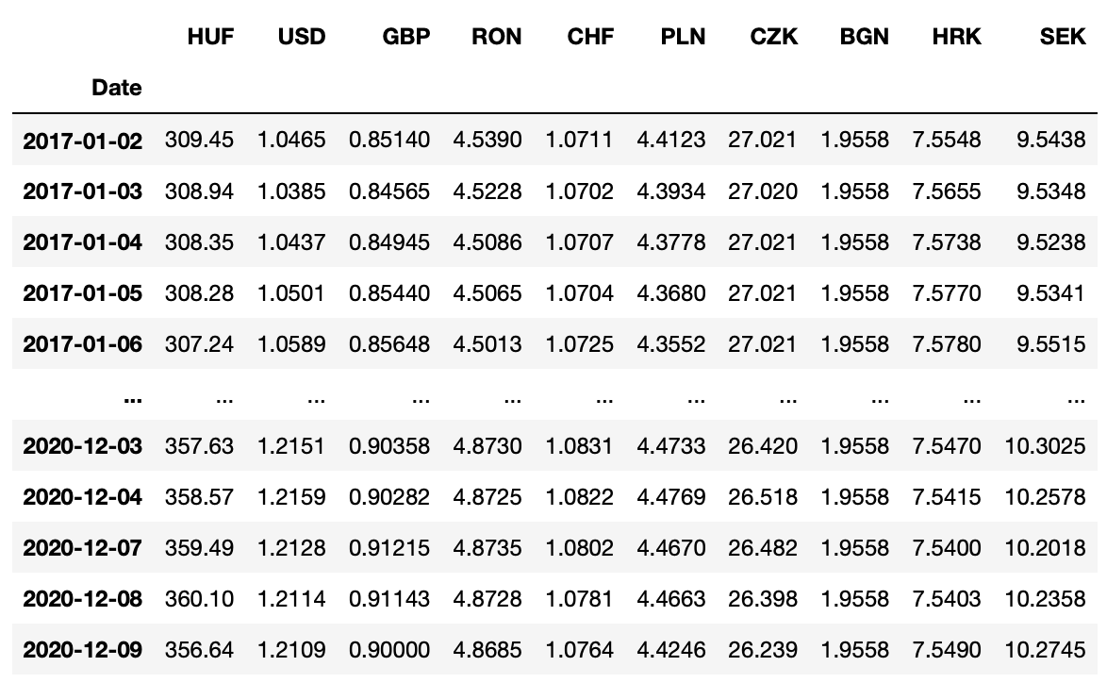
Datasets
eurofxref-hist.csv

Slide 4
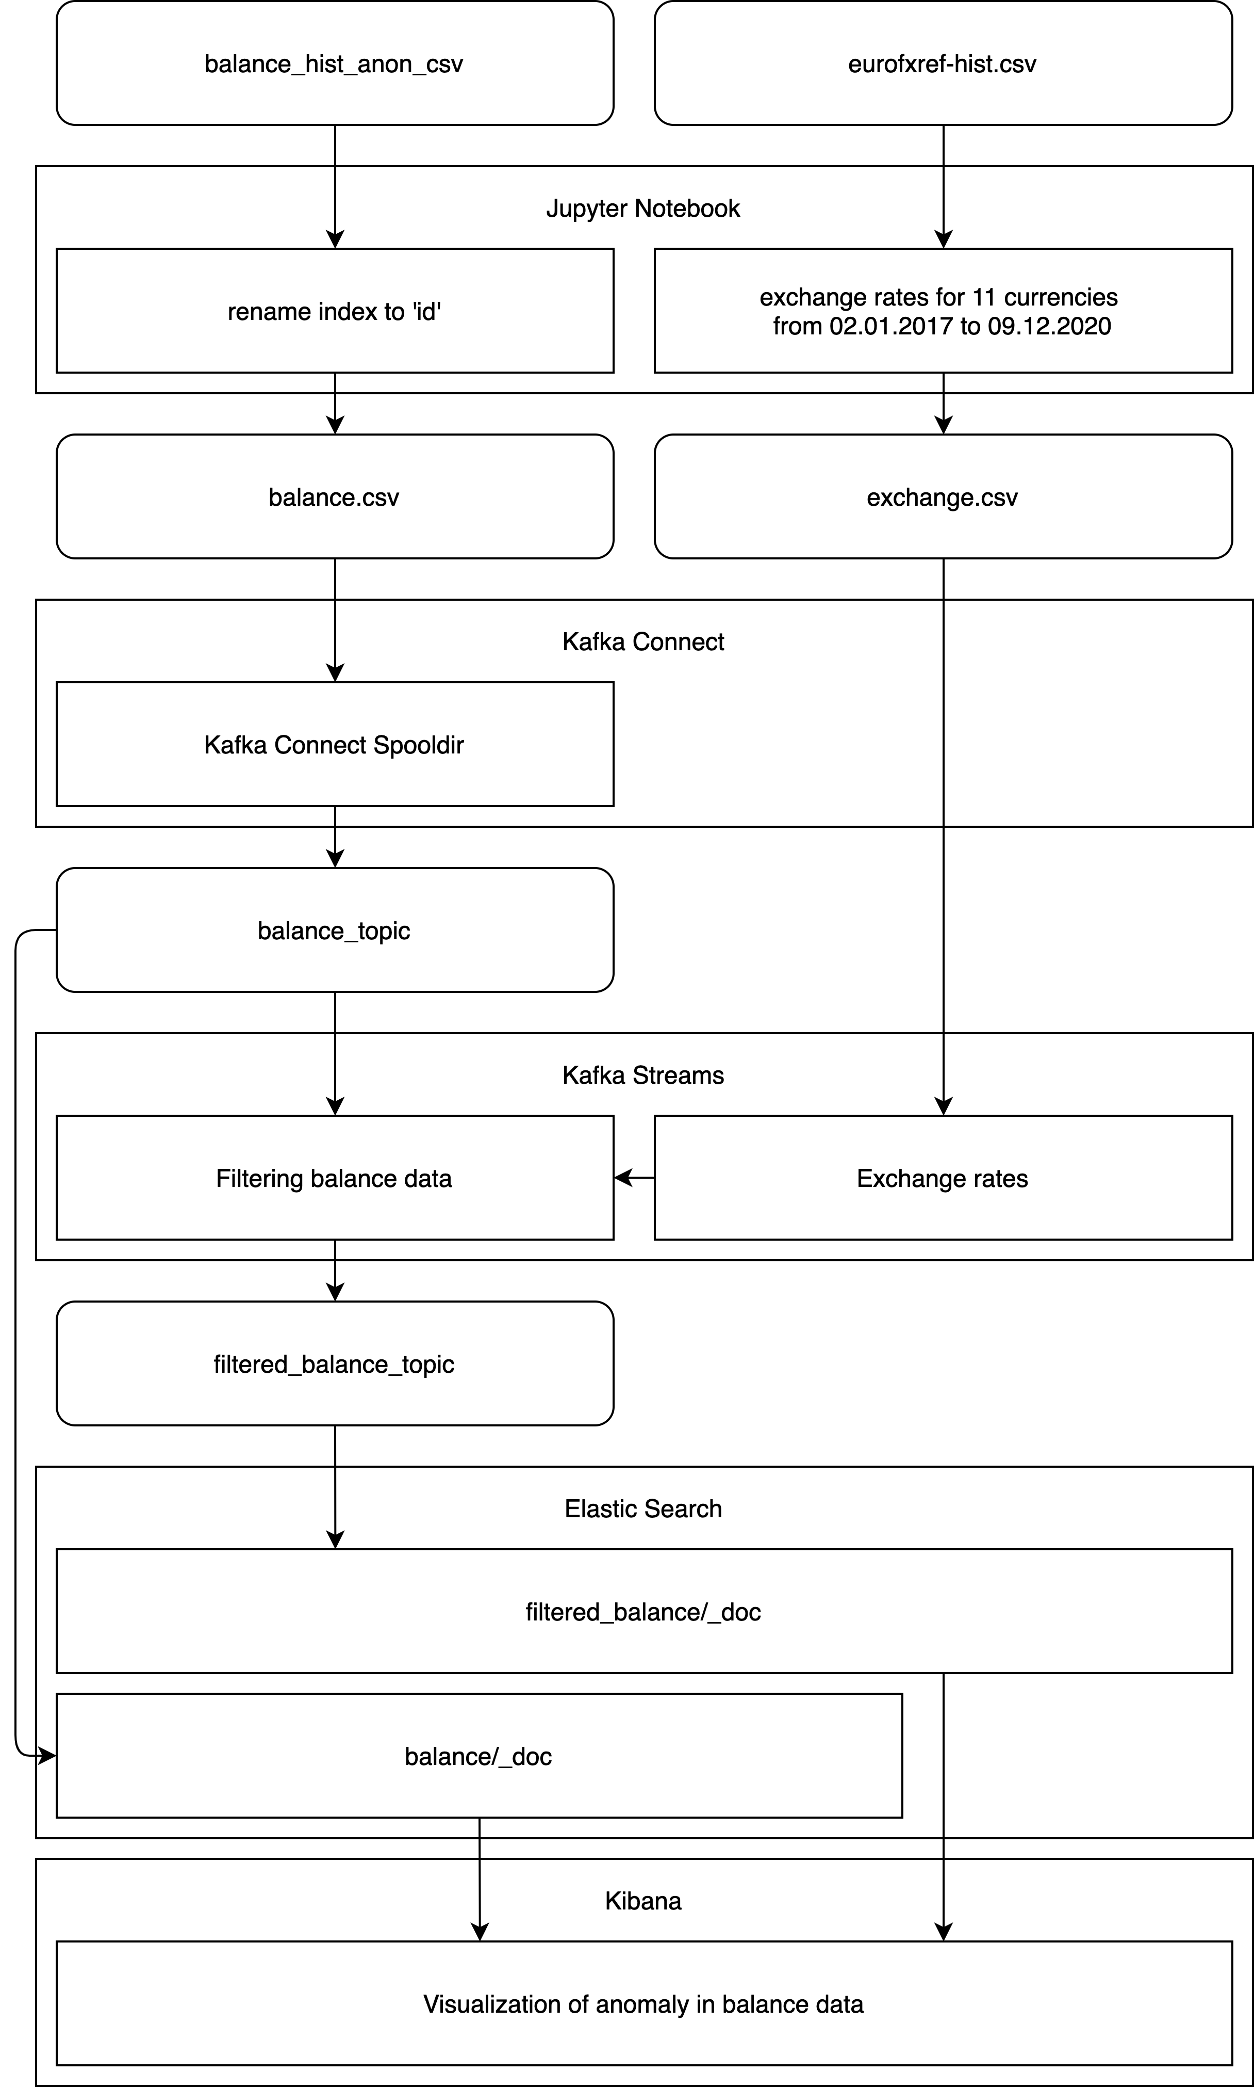
Overall system architecture
System architecture
Jupyter Notebook
Kafka Connect
Kafka Streams
Elastic Search
Kibana

Slide 5
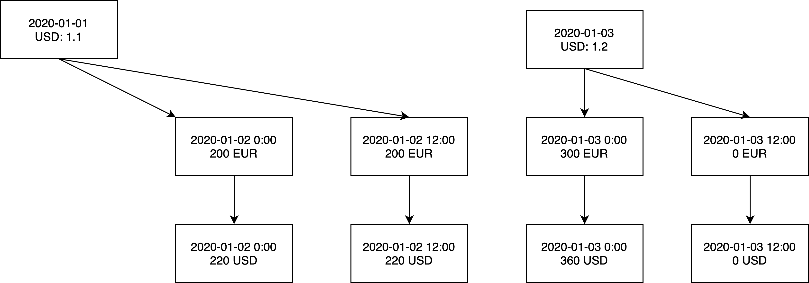
Kafka Streams
Merging datasets

Slide 6
Kafka Streams
Filtering according to balance difference
Previous account balance
Current account balance
Difference
Anomalous: 1000+ EUR

