Slide 1
Anomaly detection on financial data
SM and OST project
Daniel Grimm, Gayrat Rakhimov, Suchith Shetty

Slide 2
Datasets
balance_hist_anon.csv
EBIZ_BALANCE_ID
VALID_FROM
VALID_TO
GIRONUMBER
AMOUNT
CURRENCY
6427316 rows

Slide 3
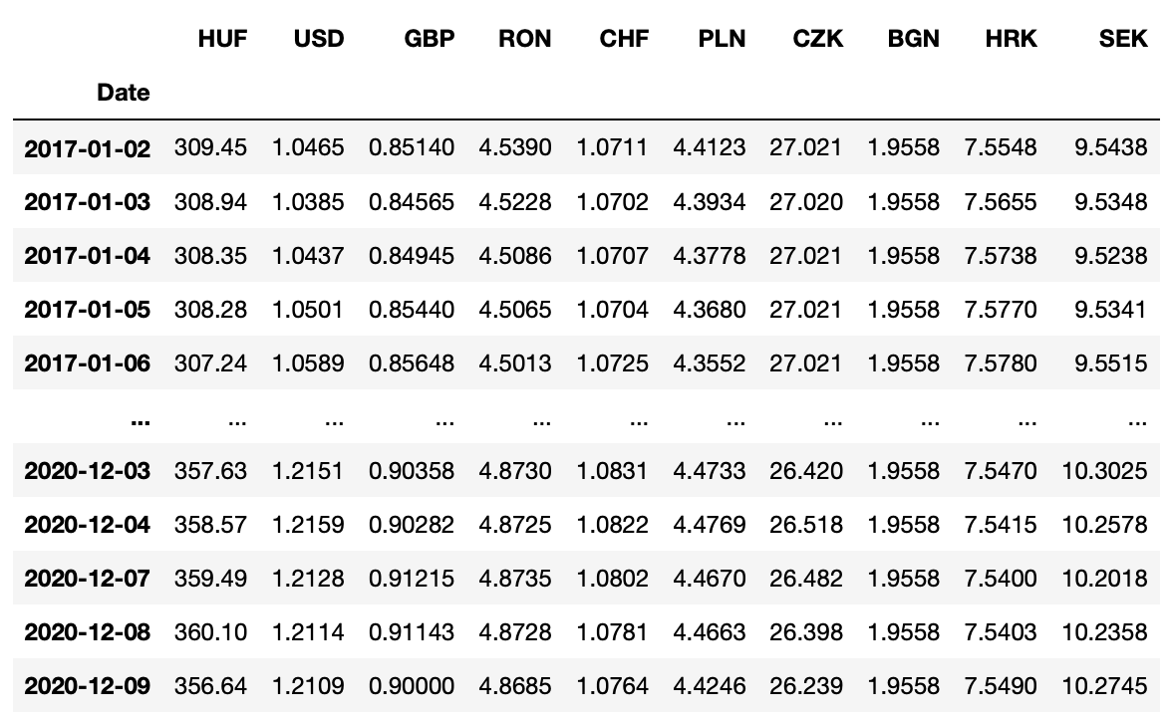
Datasets
eurofxref-hist.csv

Slide 4
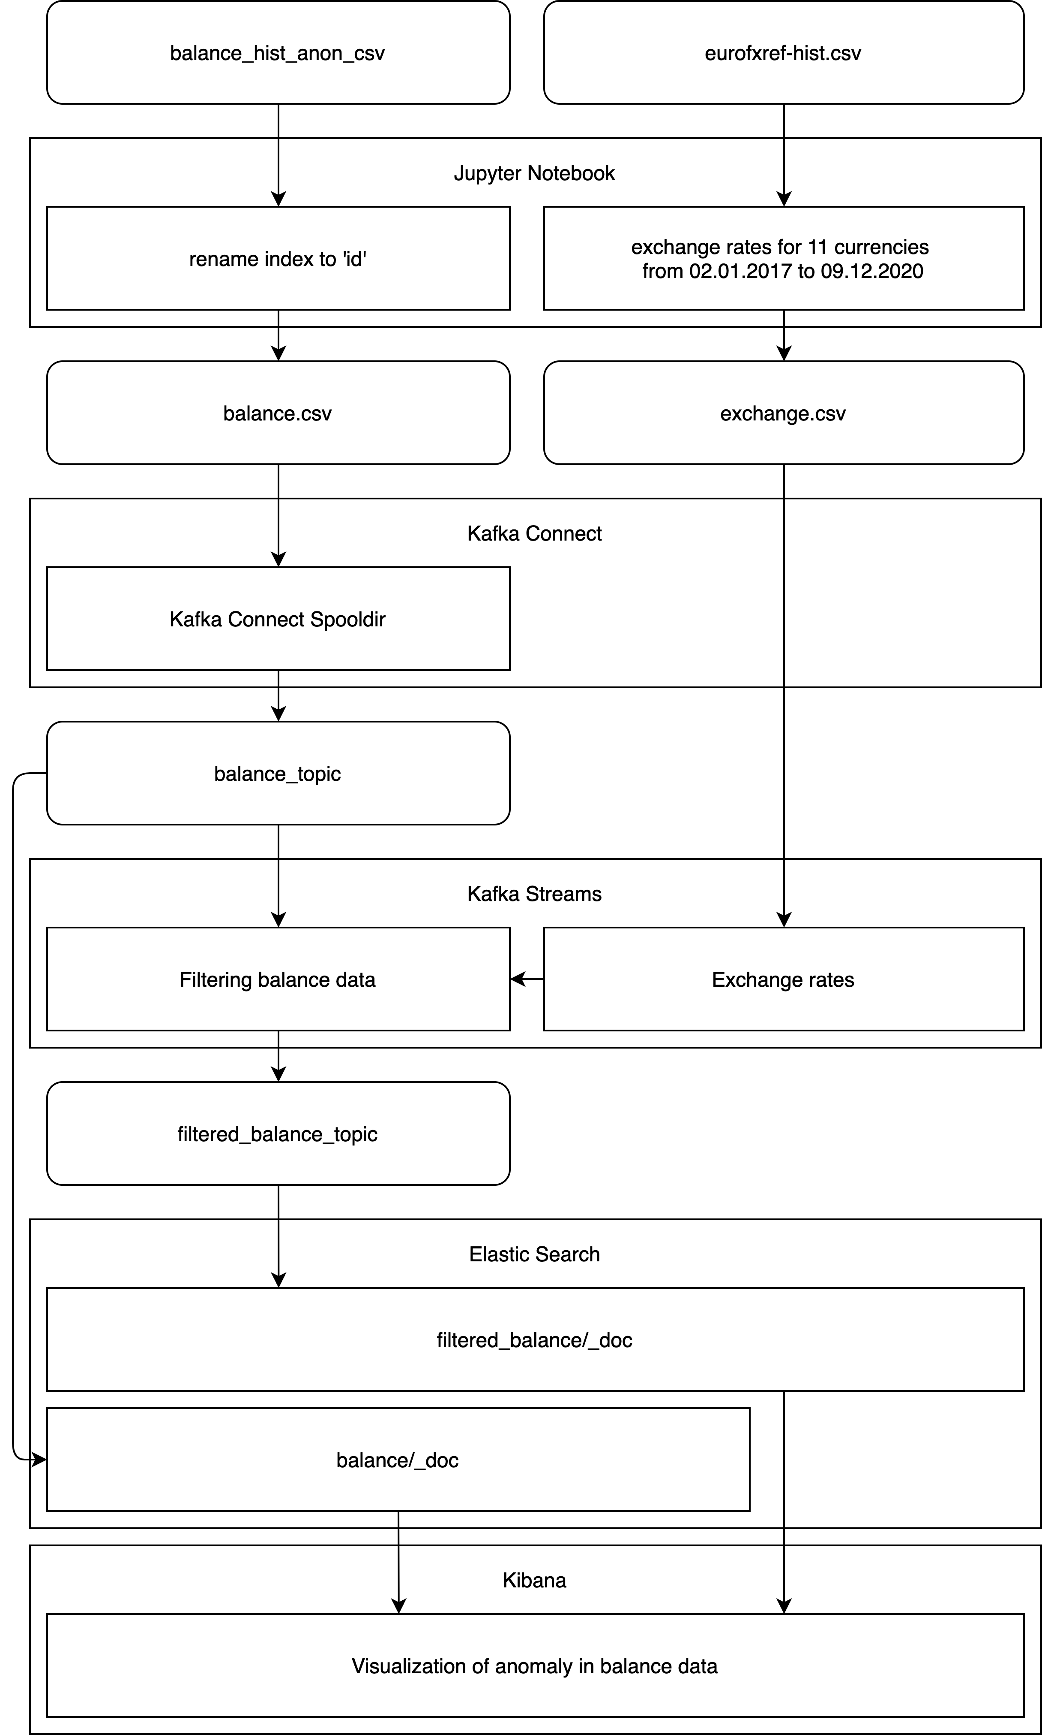
Overall system architecture
System architecture
Jupyter Notebook
Kafka Connect
Kafka Streams
Elastic Search
Kibana

Slide 5
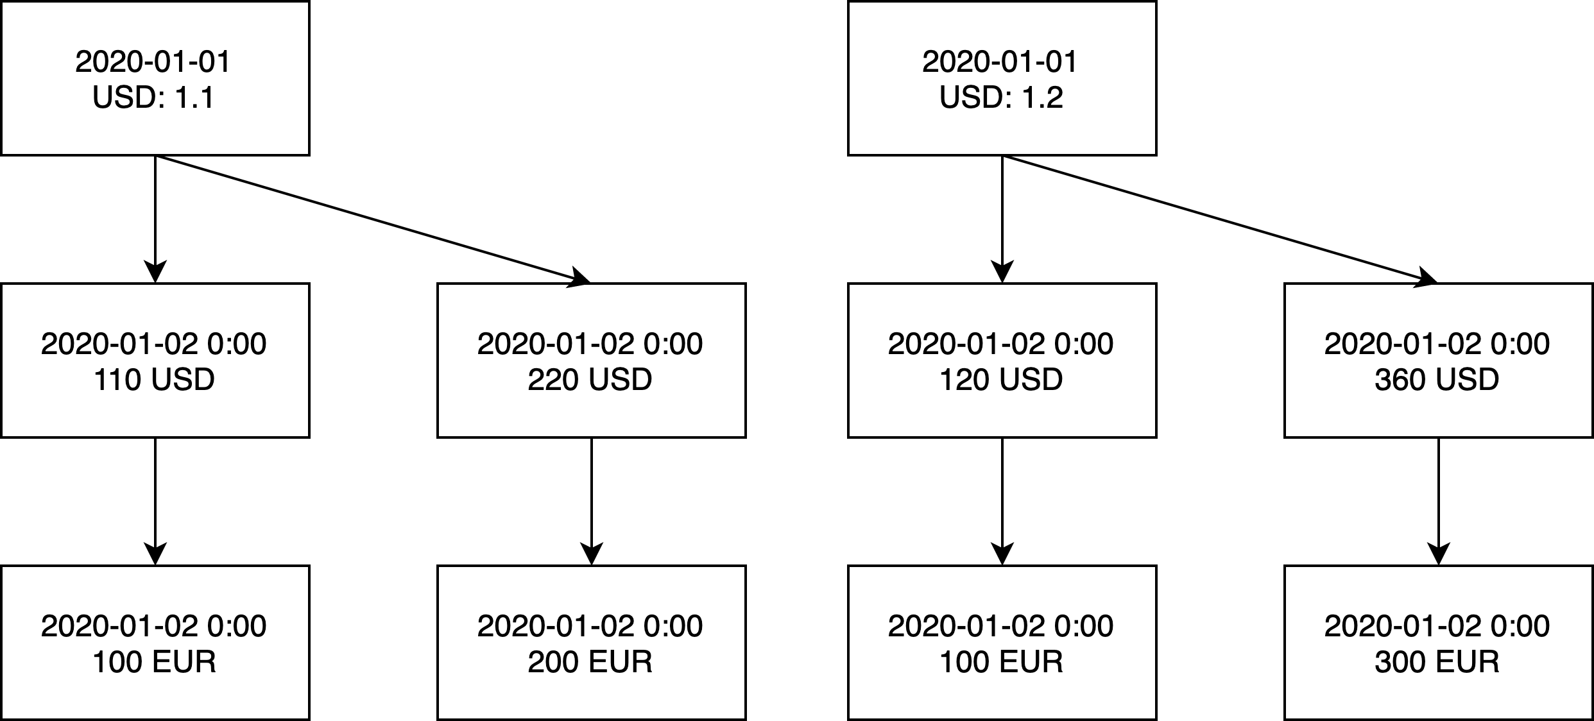
Kafka Streams
Merging datasets

Slide 6
Kafka Streams
Filtering according to balance difference
Previous account balance
Current account balance
Difference
Anomalous: 1000+ EUR

Slide 7
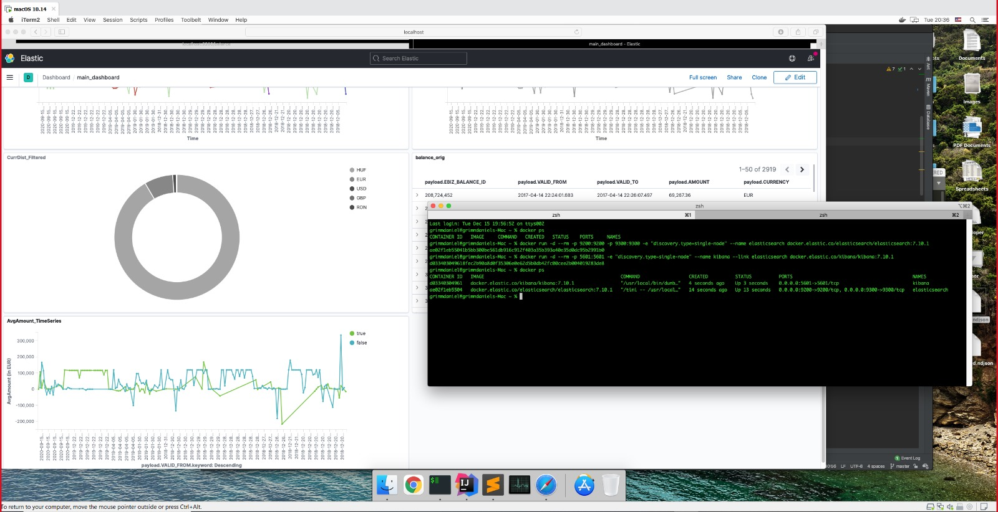
Docker

Slide 8
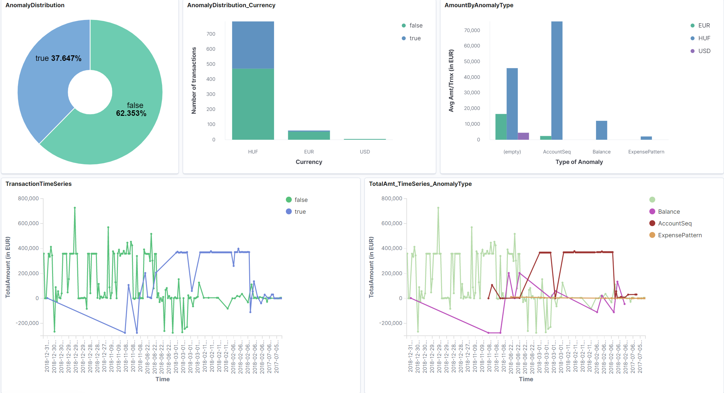
Visualization
Kibana

Slide 9
Contributions
Rakhimov Gayrat - IGMQ0T
Data preprocessing on Jupyter Notebook: modifying balance and exchange rates data
Setting up Kafka Connect to read balance data into 'balance\_topic' stream
Reading Twitter tweets feed from Twitter API
Merging balance data and exchange data
Filtering balance data according to balance differences
Setting up remote ElasticSearch on a third-party host (Bonsai)
Storing Twitter data on ElasticSearch
Code repository management on Github: creating repository, reviewing pull requests and access management
Participating in project team's meetings
Writing report
Preparing presentation material

Slide 10
Contributions
Daniel Grimm - BU44BJ
Configuring and setting up Docker containers for Elasticsearch and Kibana
Connecting pipeline: local installation + docker
Parsing data from balance.csv
Creating multiple anomaly detector functions
Creating kibana visualizations
Code repository management on Github: reviewing and creating pull requests
Participating in project team’s meetings

Slide 11
Contributions
Suchith Shetty - HIUH69
Initial exploration of shared data to understand the fields and get some summary statistics
Kafka producer module to load data from csv to Kafka topic using Python
Setting up ElasticSearch and Kibana on a third-party host (Bonsai) and in local machine
Kafka consumer module to stream data from Kafka to Elastic Search
Explore, create visualization charts and compile them to create output dashboard in Kibana
Contribute in stream transformations for anomaly detection and data engineering to make output streams compatible for easy visualization
Contribute in report writing and preparing presentation material

Slide 12
Thank you for your attention!

