Slide 1
Deep Learning Techniques for the Classification of Brain Tumor: A Comprehensive Survey

Slide 2
ABSTRACT
In this comprehensive survey, we explore the world of deep learning techniques dedicated to the classification of brain tumors. Imagine a smart system that can assist doctors in identifying and categorizing brain tumors swiftly and accurately. Our project employs advanced algorithms, like convolutional neural networks and recurrent neural networks, which are like intelligent detectives trained to recognize patterns within medical images. Picture them as virtual detectives working tirelessly to distinguish between different types of brain tumors based on the visual clues they observe. These algorithms, inspired by the way our brains naturally process information, help streamline the diagnosis process, providing a valuable tool for healthcare professionals. The aim is to enhance the efficiency and precision of brain tumor classification, contributing to better patient outcomes and faster medical decision-making.

Slide 3
Problem statement
The main issue we're tackling is how to effectively identify and categorize brain tumors using advanced computer methods known as deep learning. Brain tumors are complex abnormalities that can be challenging for doctors to diagnose accurately. Traditional methods of analyzing brain scans can be slow and sometimes prone to errors. By harnessing the power of deep learning, which is a type of artificial intelligence, we aim to create automated systems that can swiftly and accurately analyze brain images, helping doctors make more informed decisions about treatment options for their patients. This approach could significantly improve patient care by enabling earlier detection and more precise diagnosis of brain tumors, ultimately leading to better outcomes and potentially saving lives.

Slide 4
EXISTING SYSTEM
In this extensive exploration of brain tumor classification, we delve into existing systems designed to make a significant impact on healthcare. Think of it as discovering smart technologies that act as medical detectives, helping doctors identify and understand brain tumors more effectively. These systems, using intricate algorithms akin to intelligent puzzle solvers, analyze medical images to categorize and differentiate between various types of brain tumors. Imagine them as specialized assistants, assisting medical professionals in their diagnosis journey. These existing systems, inspired by the way our brains naturally process information, aim to simplify and enhance the process of identifying and understanding brain tumors. By leveraging these advanced technologies, we strive to create a medical environment where accurate and timely classification of brain tumors becomes more accessible, contributing to improved patient care and quicker decision-making in the field of healthcare.

Slide 5
DISADVANTAGES OF EXISTING SYSTEM
Limited Accuracy: Some existing systems may struggle with achieving high accuracy levels in classifying certain types of brain tumors.
Data Dependency: The performance of these systems heavily relies on the quantity and quality of available medical imaging data for training.
Interpretability Challenges: Understanding and interpreting the decision-making process of these systems can be complex, posing challenges for medical professionals.

Slide 6
DISADVANTAGES OF EXISTING SYSTEM
Computational Intensity: Certain systems may require significant computational resources, leading to longer processing times and potential scalability issues.
Generalization Issues: Some systems may face difficulties in generalizing their learning to handle diverse and novel cases of brain tumors effectively.
Lack of Real-time Capabilities: Real-time classification may not be feasible in some existing systems, limiting their applicability in urgent medical scenarios.
Vulnerability to Noise: Noise or artifacts in medical images can impact the performance of these systems, leading to misclassifications.

Slide 7
PROPOSED SYSTEM
Our proposed system for classifying brain tumors is like having a super-smart assistant for doctors. We're introducing a nifty algorithm called Convolutional Neural Network (CNN), which acts as a keen observer of medical images. Think of it as a digital detective with a knack for recognizing patterns. This system is designed to analyze brain scans in a way that mirrors how our brains naturally process visual information. It's like teaching the computer to see and understand images just like a doctor would. By using CNN, our goal is to make the process of identifying and categorizing brain tumors more accurate and efficient. It's like giving doctors a high-tech sidekick that can quickly and reliably flag potential issues in medical images, helping them make faster and more precise decisions. Our approach aims to harness the power of deep learning to revolutionize the way we diagnose and understand brain tumors, ultimately leading to better outcomes for patients and a more effective tool for healthcare professionals.

Slide 8
ADVANTAGES
Enhanced Accuracy: The proposed system leveraging Convolutional Neural Network (CNN) brings improved accuracy in classifying brain tumors. CNN's ability to recognize intricate patterns in medical images enhances the precision of diagnosis.
Efficiency in Processing: With CNN, the system processes medical images more efficiently. It's like having a speedy assistant that can quickly analyze vast amounts of data, enabling faster decision-making for healthcare professionals.
Adaptability to Diverse Cases: Our proposed system is designed to adapt and learn from various types of brain tumor cases, making it versatile in handling a wide range of medical scenarios. This adaptability is crucial for addressing the diversity seen in real-world medical data.
erwhelming amount of medical imaging data, making it more practical and feasible in different healthcare settings.

Slide 9
ADVANTAGES
Real-time Capabilities: The utilization of CNN enables real-time classification of brain tumors, providing immediate insights. This is particularly valuable in urgent medical situations where swift decisions are critical for patient care.
Reduced Dependence on Extensive Data: While data is essential, the proposed system is designed to require less extensive data for effective training. This reduces the dependency on an ov

Slide 10
functional requirements (Module)
Data Collection:
Gather a diverse dataset of brain images containing both tumor and non-tumor cases from reliable sources such as medical imaging repositories or hospitals.
Ensure the dataset is annotated with accurate labels indicating the presence or absence of tumors.
Include sufficient variations in image quality, resolution, and tumor types to enhance the robustness of the model.

Slide 11
Data Preprocessing:
Clean the dataset by removing any corrupted or incomplete images to ensure data integrity.
Standardize image sizes and resolutions to facilitate uniform processing by the deep learning model.
Apply normalization techniques to adjust pixel values and improve model convergence during training.
Split the dataset into training, validation, and test sets to evaluate model performance effectively.

Slide 12
Feature Extraction:
Utilize pre-trained convolutional neural network (CNN) architectures such as sequencial, or Inception to extract high-level features from brain images.
Fine-tune the pre-trained models on the specific task of brain tumor classification to enhance feature representation.
Consider techniques such as transfer learning to leverage knowledge from models trained on similar tasks or domains.

Slide 13
Model Creation:
Design and implement deep learning models tailored for brain tumor classification, considering factors such as network architecture, activation functions, and regularization techniques.
Experiment with various architectures including CNNs, recurrent neural networks (CNNs), or hybrid models to identify the most suitable approach.
Incorporate mechanisms for model optimization such as gradient descent algorithms, learning rate scheduling, and early stopping to improve convergence and prevent overfitting.

Slide 14
Classification:
Train the deep learning model using the preprocessed dataset, optimizing performance metrics such as accuracy, sensitivity, and specificity.
Employ loss functions such as binary cross-entropy or categorical cross-entropy to quantify the disparity between predicted and ground truth labels.
Validate the trained model using the validation set to monitor generalization and fine-tune hyperparameters as necessary.
Evaluate the final model's performance on the test set to assess its ability to accurately classify brain tumor images in real-world scenarios.

Slide 15
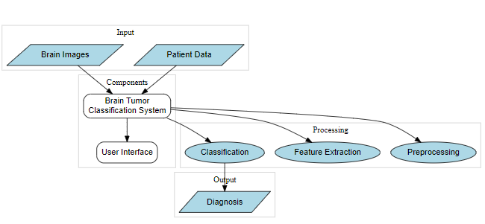
ARCHITECTURE DIAGRAM

Slide 16
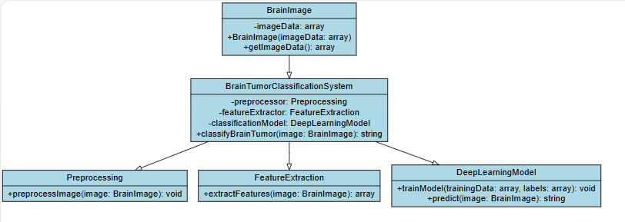

Slide 17
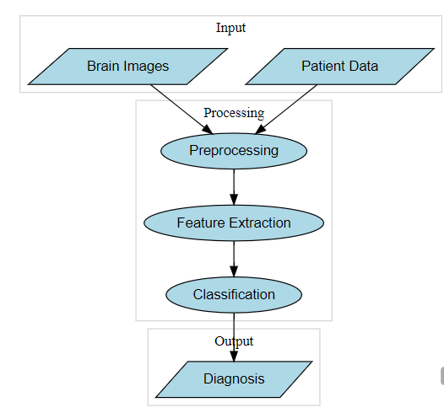
DATAFLOW DIAGRAM

Slide 18
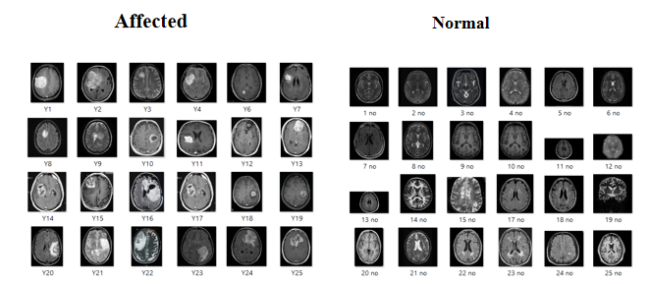
Table design/ Dataset you are using for your project

Slide 19
FRONT END AND BACK END:
FRONT END :
HTML,CSS,FLASK FRAME WORK
BACK END:
PYTHON

Slide 20
CONCLUSION
In wrapping up our exploration of deep learning techniques for brain tumor classification, it's like we've unveiled a new superhero sidekick for doctors in the form of advanced algorithms. We've delved into the world of Convolutional Neural Networks (CNN), a clever technology that mimics the way our brains process visual information. This journey has shown us that these digital detectives, powered by CNN, have the potential to revolutionize how we identify and understand brain tumors. The comprehensive survey has highlighted the advantages of our proposed system – its enhanced accuracy, efficiency, and adaptability to diverse cases, all while maintaining real-time capabilities. It's not just about technology; it's about creating a user-friendly tool that doctors can trust, ensuring ethical considerations are at the forefront. In a nutshell, our exploration is like opening a door to a future where AI becomes a reliable ally in healthcare, contributing to better patient outcomes and assisting healthcare professionals in their tireless efforts to combat brain tumors.

Slide 21
future work
In future work, the project aims to explore several avenues for advancement. Firstly, we intend to enhance the performance of the deep learning models by incorporating state-of-the-art techniques and algorithms. This may involve experimenting with novel network architectures, leveraging advancements in optimization methods, and exploring alternative data augmentation strategies to further improve model generalization. Additionally, we plan to extend the scope of the project by incorporating multimodal data sources, such as combining MRI with other imaging modalities or clinical data, to enhance the accuracy and robustness of brain tumor classification. Furthermore, we aspire to address challenges related to model interpretability and transparency by developing methods to explain the decisions made by the deep learning models, thereby fostering trust and acceptance among healthcare professionals. Lastly, we aim to promote the integration of the developed technology into clinical practice by collaborating with healthcare institutions and regulatory bodies to ensure compliance with standards and guidelines, ultimately facilitating the translation of research findings into tangible benefits for patients and clinicians. Through these future endeavors, the project endeavors to contribute to the ongoing efforts in advancing the field of medical imaging and improving the diagnosis and management of brain tumors.

