Slide 1
Hard Drive, SSD, NVMe Troubleshooting Flowchart
A guide to help you diagnose drive problems and recommended actions
By Joe Schmuck
23 March 2025 (Version 4)

Slide 2
How to use / Disclaimer
Use at your own risk! Do not blindly follow instructions. If you are not familiar with these types of commands in the Appendix, then do not perform them without understanding the risks. Not entering the command properly can cause data loss.
This is a troubleshooting guide for the most common problems. It is NOT a guide to fix every little problem that can arise from a file system issue, this is focused on physical drive issues. I did include some basic ZFS troubleshooting because many people think these problems are drive failures and this will identify if it is a drive failure or not. Pay attention to the little things that catch your eye, as said, not everything is in these flowcharts but I tried to include the most common seen problems.
You MUST be a privileged user such as `root` or you may need to use `sudo`. If you enter a command and get the response that the command cannot be found, then you do not have the privileges to run that command.
Refer to Appendix A for examples of Self-Monitoring, Analysis, and Reporting Technology (SMART) and Field Access Reliability Metrics (FARM) screen outputs and Appendix A also has Amplifying Information for the Chart questions.
Refer to Appendix B when an operation is requested, such as reading SMART data or performing a SCRUB, for what the command is and how to use the command. If you are uncomfortable executing any of the commands, then seek additional help.
Seagate drives may (generally do) report Error Rates differently, it looks like a wild rapidly changing number. Be aware of this for Seagate drives.
Often people see an error and jump to an incorrect conclusion, especially when experiencing ZFS errors. This guide will help reduce going down the wrong path by using a more systematic approach.
Values I used for Good/Bad evaluations are my personal values that I go by, not some industry standard. Example: “ID5 < 5” means this is my personal value where I allow a few reallocated sectors but when it becomes greater than 5, I replace the drive before complete failure. Some people may prefer a value of 1 as a failure, a value of 1 to me means to keep a watch on the value, if it starts to increase then that is a problem.
There are four flowcharts:
ZFS ERRORS
CRITICAL DRIVE ERRORS - This flowchart is for what the author considers critical errors.
NON-CRITICAL DRIVE ERRORS – This flowchart is for what the author considers are non-critical errors, however that doesn’t mean they are to be ignored and pushed off. You still need to take action.
SUSPECT FOUL PLAY (ALTERED DRIVE DATA) – The Seagate Drive Issue Saga (Not only a Seagate issue)

Slide 3
Hey Doc, How do I do something?
This set of flowcharts is not designed to hold your hand and take you step by step to perform the troubleshooting, drive replacements, etc. These flowcharts are very easy to follow. ANSWER THE QUESTIONS AS WRITTEN. Do not assume I meant something different or you might do down the wrong path.
Use the TrueNAS Guide to perform things like “How to replace a drive”. It is there and is well written.
To check if you have an SMR drive, you need to play Detective on the internet and find out if your drive is SMR or CMR. If you have SMR, this could be your problem.
These flowcharts will not help you put your pool back ONLINE. If your pool is ONLINE, then it will help with correcting the common ZFS problems seen, which many people attribute to a drive failure.
If you need help, post the entire output of `smartctl –x /dev/???` for interpretation. Do not hold back any data (serial number exception), thinking you know better. No one like to ask for data more than once.
If you have recommended changes, reach out to me. I will evaluate it and update if I agree.
Thank you @Alexey for your recommended changes.
Disclaimer Again: All of the commands in these flowcharts are safe “if” you use them as prescribed. If you find yourself not sure what you should do, STOP! Ask the forum members. No one wants to see a person lose data. That could one of us in the future, it certainly was us in the past. Pain, lots of pain.

Slide 4
ZFS Errors
How To Use:
Read each block carefully and answer each question. If you need to perform a task such as “Run a Scrub”, refer to Appendix B for the command(s) required to perform the action.
Note: If you get stuck in a loop more than 2 times, exit the loop and seek additional help. Use your brain, repeating the same operation over and over again without any change is a waste of your time.
Is your pool state “ONLINE” or “DEGRADED”?
This Flowchart does not assist in getting a ZFS Pool back ONLINE. It can be very involved and you should seek additional help.
NO
YES
Troubleshoot the drive error using the Critical and Non-Critical Flow Charts.
Is Repaired Data > “0” or do you have SCRUB Errors?
Restore any corrupt files from a backup.
Problem Corrected
YES
Have you been through this loop more than twice?
Are the errors associated ONLY with one drive?
NO
YES
You have a serious problem, backup your data and seek additional help.
Do you still have errors?
NO
NO
YES
YES
NO
Do you have Read, Write, or Cksum Errors?
Have you been through this loop more than twice?
YES
Do you still have Repaired Data errors?
NO
You have a serious problem, backup your data and seek additional help.
NO
NO
Run a Scrub
Run a Scrub
YES
YES
Did the Read, Write, or Cksum Errors increase? Note any corrupt files
YES
Record the names of the corrupt files and delete them.
Run a Scrub
Run a Zpool Clear on your pool
NO
ZFS Errors Sheet 1 of 2

Slide 5
ZFS Slow Pool
(The pool is so slow today, what happened?)
How To Use:
Read each block carefully and answer each question. If you need to perform a task such as “Run a Scrub”, refer to Appendix B for the command(s) required to perform the action.
This flowchart is for pools which previously worked faster and have a noticeable slowdown.
Is your Used Space Over 80%?
The pool has limited space to write data and it slows everything down. Typically, when it hits 90% full, it slows down considerably. Reduce your pool capacity below 80%
YES
NO
Do you have SMR drives?
ZFS does not work well with SMR drives during the write operations. Replace with CMR type drives.
YES
NO
Did you Reboot?
Check to see if your NAS is just Busy
Check SNAPSHOTS
Check SWAP SPACE
Seek Additional Help
ZFS Errors Sheet 2 of 2

Slide 6
Critical Drive Errors
NOTE:
NA = Not Applicable
Media Wear Level – Can be reported as ‘Wear Level’ or ‘Percent Used’. Wear level value typically starts at 100 and decreases, Percent Used value typically starts at 0 and increases. Examine the ‘Thresh’, if it is below 50 then a value of 100=new, 0=worn out. If ‘Thresh’ is above 50 then 0=new, 100=worn out.
* Refer to Appendix A for amplifying information on SMART attributes and values.
Back up your data, then consider replacing the drive.
Can you obtain SMART data from the drive?
Is Reallocated Sectors (ID 5) raw < 5?
NO
NO
You likely have a serious problem; this kind of error generally means media damage or wear has occurred. Seek additional help. The drive should be replaced.
These errors alone are generally not considered “Critical”. You do Not have a Critical Problem. Refer to Non-Critical Flowchart
YES
YES
Is SMART STATUS – FAIL. Media Error, or Critical Warning?
Run a SMART Long Test
YES
Did the SMART Long test PASS or FAIL?
Is Spin Retry Count (ID 10) raw > 0
Current Pending (ID 197) raw > 0
-- or --Uncorrectable Sector (ID 198) raw > 0?
NO
FAIL
PASS
NO
Did a SMART Short or Long test fail?
YES
FAIL
Run a SMART Long Test.
Did it PASS or FAIL?
YES
YES
NO
You have a serious problem
Does the drive sound like it is spinning up and down?
You do Not have a Critical Problem. Refer to Non-Critical Flowchart
NO
NO
For SSD/NVMe, Is Wear Level value ‘0’ Zero or for HDD is Helium value Low?
PASS
Problem Corrected. Monitor for reoccurrence. Another failure means the drive is bad.
NO or NA
This could be a drive or PSU failure. Check the power before replacing the drive.
YES
Critical Drive Errors Sheet 1 of 1
YES

Slide 7
Non-Critical Drive Errors
Non-Critical Drive Errors Sheet 1 of 2
This is not an immediate issue, monitor for increasing counts. Hardware ECC Recovered (ID 195) raw count does not indicate a typical drive failure.
You have a serious problem, seek additional help.
Can you obtain SMART data from the drive?
Replace the suspect Data Cable. Does the UDMA CRC Errors (ID 199) raw continue to increase?
NO
YES
Move the data cable to another port on the MB or HBA. Does the UDMA CRC Errors (ID 199) raw continue to increase?
YES
NO
* Are Hardware ECC Recovered or MultiZone Errors increasing and the ONLY errors?
Is UDMA CRC Errors (ID 199) raw increasing?
NO
NO
YES
You have an odd problem. Seek additional help.
Consider replacing the HBA / MB.
YES
NO
YES
Typically, this type of error is caused by a drive data cable issue.
Note the drive serial number.
Physically swap just the drive with a known good drive. Does the problem follow the suspect drive?
Proceed to
SHEET 2
Are there any other errors?
YES
New drive has UDMA errors now
Power off, disconnect and reconnect the drive data cable, power on. Does UDMA CRC (ID 199) raw continue to increase?
NO
Hardware ECC Recovered (ID 195) is the drive hardware automatically correcting the data read, as it should. MultiZone Error (ID 200) sometimes is an indicator of a problem, if associated errors exist, otherwise usually not an issue.
YES
Stays with suspect drive
Problem Corrected.
The raw count will never decrease, it lives with the drive for life.
Monitor for reoccurrence. If problem returns, skip to previous question and answer Yes.
The drive appears to be faulty. This is generally not the typical outcome. Replace the drive.
NO

Slide 8
Non-Critical Drive Errors
Non-Critical Drive Errors Sheet 2 of 2
After completing
SHEET 1
Run SMART Long Test. Does it pass?
This is fine.
Monitor Current Pending Sectors (ID 197) raw.
If it continues to increase, replace the drive.
Seek additional advice if you desire but provide the full SMARTCTL output for evaluation.
YES
Is Current Pending Sectors (ID 197) raw > 5?
NO
YES
NO
Seagate does things differently. If you see wildly changing numbers, this may be normal for your drive.
Take the Number, subtract 4294967295 (FFFFFFFF Hex), if there was a whole number remainder then you have a real failure.
You have a serious drive problem. Replace the drive.
Is ID 1 Raw Read Error rate or ID 7 Seek Error Rate your concern?
Do you have a Seagate Drive?
YES
YES
NO
NO
Seek additional advice.
Ensure you post the complete output of `smartctl –x /dev/xxx` when asking for help.
This indicates a failure of the armature/head mechanism.
Replace the drive.

Slide 9
Suspect Foul Play (Altered Drive Data)
With the flood of used Seagate and other brand hard drives in the market in 2024/2025, if you bought a new drive, you should verify that it is actually new. The steps to do that are here and I Highly Recommend you do this check.
Unfortunately, only Seagate at this time has this FARM data so this will not work for other drive manufacturers.
Western Digital has WDDA however that may not be more than exactly what is in SMART already and is not covered here as it required additional software that is not installed on TrueNAS.
(Shameless Plug -- Multi-Report V3.15 (and later) has this check built-in.)
Procedure:
Check which version of smartmontools is installed. `smartctl`
Procedure:
OBTAIN SMART DRIVE DATA `smartctl –a /dev/driveid`
OBTAIN FARM DATA `smartctl –l /dev/driveid` (-l is a lower case L)
From both pieces of data, write down the following data:
Serial Number
Power On Hours
Spindle Power On Hours
Head Flight Hours
LBAs Read and Written
Is smartmontools version 7.4 or greater?
NO
YES
You will need smartmontools 7.4 or later to read the FARM data.
Compare the data between the two reports, is there a large discrepancy?
You are one of the lucky ones, your drive appears to be valid.
You Likely have an altered drive. Seek additional help.
NO
YES

Slide 10
Appendix A How to read SMART Output and Amplifying Information
The attribute is defined by its ID number. The human-readable name (e.g. “Reallocated Sectors Count” for ID 5) may vary slightly depending on the software you use.
SATA HDDs, SAS HDDs, SATA SSDs, and NVMe SSDs use significantly different sets of attributes.
Some attributes are manufacturer-specific.
Whatever the format is of the SMART data, it will contain similar values, pay attention to what you are reading.
If you have a question about an attribute, Google for “S.M.A.R.T.” and the attribute name.
SMART Data is not terribly difficult to read and understand. More SMART info on the next page, illustrating a typical output for a SATA Hard Drive.
If you have a question, ask for help deciphering the data.

Slide 11
Appendix A How to read SMART Output and Amplifying Information
This is amplifying information to the troubleshooting flowcharts.
Read the entire flowchart section before jumping into it. You can wait 5 minutes to read this before you begin troubleshooting.
When reading SMART data, take in all of the data for the line you are reading. This is the ID, Attribute, VALUE, WORST, THRESH, RAW_VALUE. When reading SMART values, pay attention to what the flowchart is asking for.
The ID/Attribute defines the meaning of what you are examining.
VALUE is a Normalized value on the performance of this attribute.
WORST is the worst VALUE observed over the life of the drive.
THRESH is the lowest acceptable limit for VALUE and WORST. If VALUE or WORST for any attribute are below THRESH, the drive is considered failed. If THRESH is 0, the attribute is not considered life-critical (e.g. Power On Hours Count).
RAW_VALUE (raw) is the non-normalized value. This value is used often for many of the attributes and may not be reflected immediately in the Normalized values. The content of the RAW_VALUE is (in general) vendor-specific.
When evaluating SMART data:
Example: ID195/Hardware ECC Recovered – VALUE=200, WORST=200, THRESH=0, RAW_VALUE=40945360 (data from my drive)
When the VALUE or WORST approaches the THRESH value, this is typically a failing indication. In this case, if VALUE=45 and WORST=(45 or less), AND you have other errors, then this drive should be replaced at an opportune time. If VALUE=20, I personally would replace immediately. NEVER WAIT UNTIL THE LAST MINUTE!
Example: ID1/Raw Read Error Rate – VALUE=076, WORST=064, THRESH=006, RAW_VALUE=40945360 (familiar number?
Error rates change, they go down and they go up. In this example you can see that the error rate dropped to 064 but is not 076. Error rates are calculated over a large number of operations. Seagate drives display these large RAW_VALUE number as this value represents more than a total number of failures.
If you have a question about what you are reading, ask the question. No one wants you to replace a drive unless it is failing, and does not want you to ignore a drive that is failing. Dang, did I say something like this before?

Slide 12
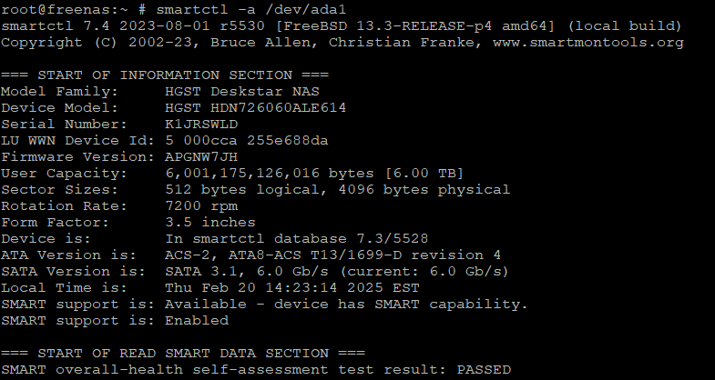
This provides manufacturer specific data. It also includes if SMART is supported or not.
This is the typical location to obtain the drive serial number, which you will use to replace a drive, hint hint.

Slide 13
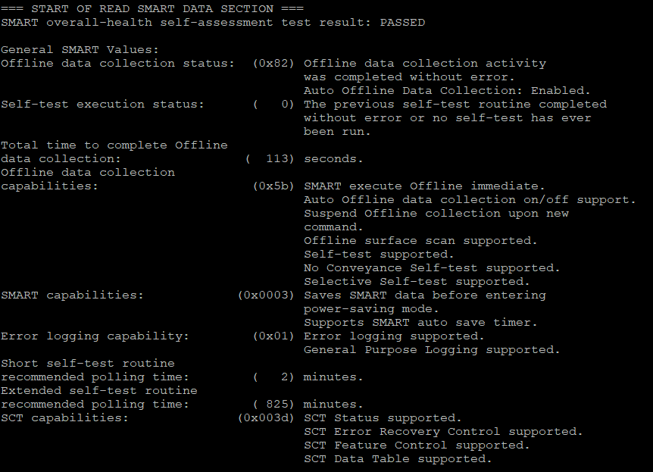
These two boxes show if the SMART drive power on self-tests PASSED or FAILED. A PASSED does not mean the drive is good. This is an assumption many people make which is very wrong.
The lower box identifies how long it takes for a ‘typical undisturbed’ SMART Short and Long test should take. Any drive activity (data access or scrub for example) slows this down as SMART testing has the lowest priority so it will take longer with drive activity.

Slide 14
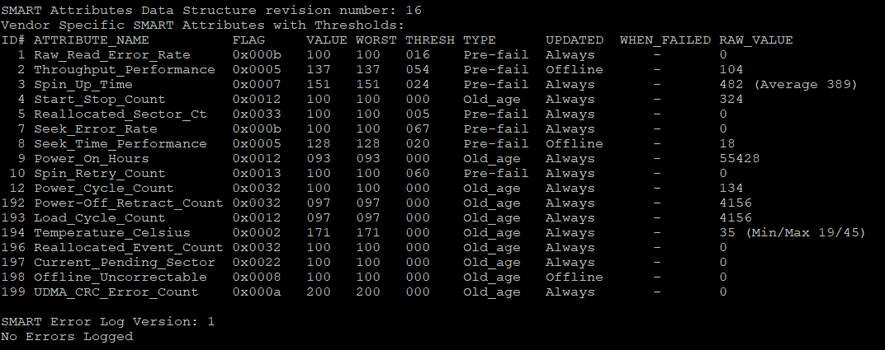
Current Normalized Value
These are typically not used during troubleshooting.
Worst Normalized Value
The worst value seen by the drive.
Raw Value
This is the “actual” value, not a “normalized” value.
These are the numbers to read when troubleshooting.
THRESH
If Current Value reaches this number, then it is failing.
ID and Attribute Name
Error Log Status

Slide 15
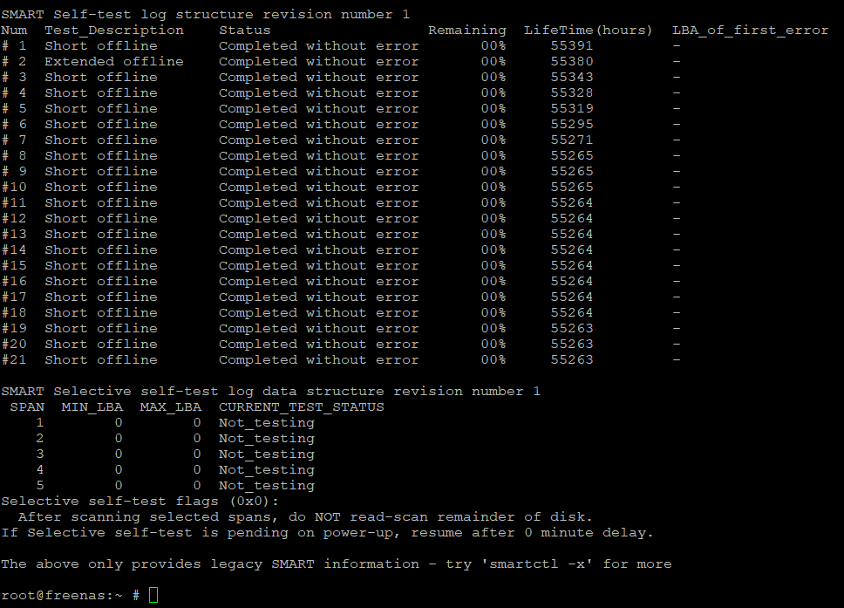
SMART Self-test Results
This is a list of the most recent SMART self-tests and the results.
It lists what type of SMART test was performed, if it completed without error, Failed, or Aborted.
If a test is in progress, you will see how much if the test remains.
When the test completes/fails/aborts, the Power On Hours value is recorded so you known when this test occurred.
(note: I have tested this drive a lot for script development hence the multiple entries for the same hour.)
And if there is a failure, typically you will see a number which identifies the LBA (Logical Block Address) where the failure occurred. There is likely problems right after that LBA as well, it is rarely one minor bad spot.

Slide 16
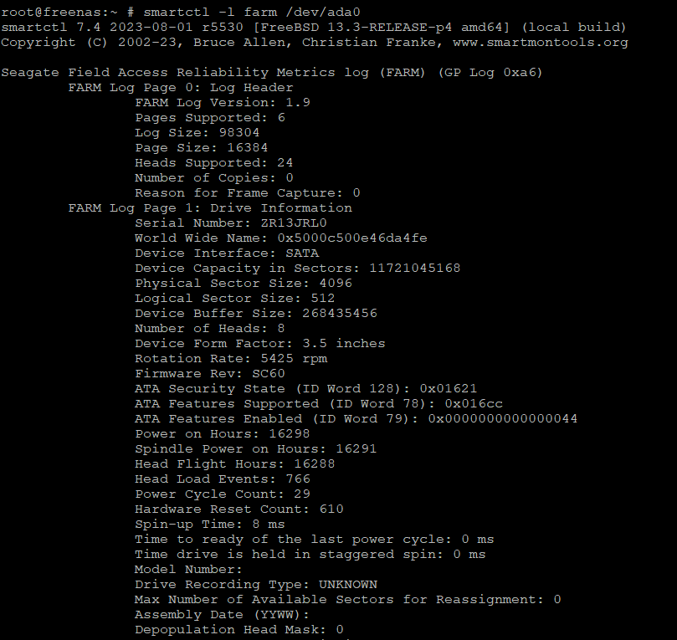
FARM Results
This is a list of the FARM results on a Seagate drive (currently only supported by Seagate).
Items to note are:
Serial Number:
Power on Hours:
Spindle Power on Hours:
Head Flight Hours:
Assembly Date: (if provided)
Compare to the SMART data:
Serial Number and Power on Hours
Spindle Power On Hours and Head Flight Hours should be reasonably close to Power On Hours, especially for a new drive, unless you Sleep the drive a lot. Reasonable for a new drive would be less than 100 hours (should be closer to almost zero).
Assembly Date, if provided should match. My drive does not have this data.

Slide 17
APPENDIX B
COMMANDS TO HELP YOU
Below is a list of common commands for both CORE (FreeBSD) and SCALE (Debian) which help diagnose the possible drive issue. Unless specifically identified as CORE or SCALE, the commands work for both. These commands are used in the troubleshooting procedures. Some commands can be dangerous and I will bold those in RED font. But can be simply means, don’t misuse the command, and be very precise and press the correct keys.
FORMAT: Each command will be surrounded by an apostrophe (`), the same way we post commands on the TrueNAS Forum. Blue Font represents the name of your pool, so replace pool with the name of your pool. Orange font indicates your Drive Ident. Green font is Extra Information.
SAFETY OF COMMANDS: These commands are all safe to use as outlined below. Some of the commands have do have destructive power, however you would have to significantly deviate from the examples provided.
ZPOOL COMMANDS
`zpool status -v` Provides the pool status for all pools.
`zpool scrub pool` Starts a SCRUB operation on the selected pool.
`zpool clear pool ` Clears all Read, Write, and Cksum errors for the designated pool.

Slide 18
IDENTIFY DRIVE BY GPTID or DRIVE IDENT
Note: Drives may have multiple partitions so when cross referencing by GPTID, you just need to look for a Drive ID, not the different partitions. Drive ada0p1 is the same physical drive as ada0p2.
Example “gptid/d0f8a4fe-bf79-11ed-a0df-000c296fd555 N/A ada0p2” This is Drive ID ada0 partition 2.
`lsblk -o +PARTUUID,NAME,LABEL,SERIAL` [SCALE]: Provides a listing of your disks, partitions, drive ident, and drive serial numbers so you can cross reference all these identifying areas so you replace the correct drive using the serial number.
`glabel status` [CORE]: Provides the GPTID and Drive Ident. “nvd0” = “nvme0” To obtain the Drive Serial Number, use the “OBTAIN DRIVE SMART DATA” section to cross reference the DRIVE IDENT to the DRIVE SERIAL NUMBER.
OBTAIN DRIVE SMART DATA INFERFACE
`smartctl --scan` [CORE/SCALE]: Lists the interface types for all available drive. If running the smartctl commands below, there is an error reading the drive, try adding the interface type.
Format: `smartctl -d interface_type command string`
Example: `smartctl -d scsi -a /dev/sda`
OBTAIN DRIVE SMART DATA
`smartctl -a /dev/sda` [SCALE]: Provides a BASIC listing of the drive SMART data. Most diagnosis can be made using this data. The Orange indicates the Drive Ident.
`smartctl -a /dev/da0` or `ada0` [CORE]: Same as above.
`smartctl -x /dev/sda` [SCALE]: Provides EXTENDED listing of the drive SMART data.
`smartctl -x /dev/da0` or `ada0` [CORE]: Same as above.

Slide 19
OBTAIN DRIVE FARM DATA
`smartclt -l farm /dev/sda` [SCALE]: Provides Field Access Reliability Metrics log ‘FARM’. This data can be useful in determining if a drive has had the SMART data reset.
`smartclt -l farm /dev/da0` or `ada0` [CORE]: Same as above.
START/STOP A SMART TEST (HDD/SSD/Most NVMe)
SHORT TEST
`smartctl -t short /dev/sda` [SCALE]: Run a “short” SMART test on the drive.
`smartctl -t short /dev/da0` or `ada0` [CORE]: Same as above.
LONG TEST
`smartctl -t long /dev/sda` [SCALE]: Run a “long” SMART test on the drive.
`smartctl -t long /dev/da0` or `ada0` [CORE]: Same as above.
STOP TEST
`smartctl -X /dev/sda` [SCALE]: This will abort the current SMART test if one is running.
`smartctl -X /dev/da0` or `ada0` [CORE]: Same as above.

Slide 20
START/STOP a SMART TEST (NVME UNIQUE, IF SMARTCTL DOES NOT WORK)
These commands if misused could be destructive, enter as written.
SHORT TEST
`nvme device-self-test /dev/nvme0 -s 1` [SCALE]: Run a “short” SMART test on the drive.
`nvmecontrol selftest -c 1 nvme0` [CORE]: Same as above.
LONG TEST
`nvme device-self-test /dev/nvme0 -s 2` [SCALE]: Run a “long” SMART test on the drive.
`nvmecontrol selftest -c 2 nvme0` [CORE]: Same as above.
STOP SMART TEST
`nvme device-self-test /dev/nvme0 -s 0xf` [SCALE]: This will abort the current SMART test if one is running.
`nvmecontrol selftest -c 0xf nvme0` [CORE]: Same as above.

