Slide 2
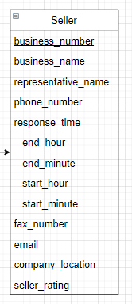
seller
CREATE TABLE seller (
business_number CHAR(10),
business_name VARCHAR(15),
representative_name VARCHAR(15),
phone_number VARCHAR(15),
response_start_hour TINYINT(2),
response_start_minute TINYINT(2),
response_end_hour TINYINT(2),
response_end_minute TINYINT(2),
fax_number VARCHAR(20),
email VARCHAR(30),
company_location VARCHAR(50),
seller_rating DECIMAL(2, 1)
);

Slide 3

Shopping mall
CREATE TABLE shopping_mall (
domain VARCHAR(20) PRIMARY KEY,
name VARCHAR(15) NOT NULL UNIQUE,
)

Slide 4
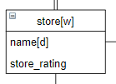
Store [weak entity set]
CREATE TABLE store (
shopping_mall_domain VARCHAR(20),
store_name VARCHAR(20),
store_rating DECIMAL(2, 1) NOT NULL,
seller_business_number CHAR(10) NOT NULL,
PRIMARY KEY (shopping_mall_domain, store_name),
FOREIGN KEY (shopping_mall_domain) REFERENCES shopping_mall (domain) ON DELETE RESTRICT,
FOREIGN KEY (seller_business_number) REFERENCES seller(business_number) ON DELETE RESTRICT
)

Slide 5
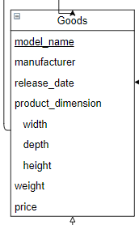
Goods
CREATE goods (
model_name VARCHAR(15) PRIMARY KEY,
category VARCHAR (15) NOT NULL,
manufacturer VARCHAR(15) NOT NULL,
release_date TIMESTAMP,
product_dimension_width UNSIGNED DOUBLE NOT NULL,
product_dimension_depth UNSIGNED DOUBLE NOT NULL,
product_dimension_height UNSIGNED DOUBLE NOT NULL,
product_weight UNSIGNED INT NOT NULL,
price UNSIGNED INT NOT NULL
);

Slide 6
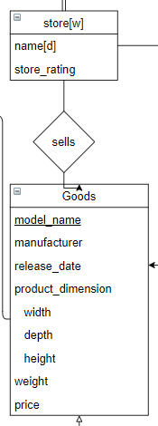
Sells
CREATE sells (
shopping_mall_domain VARCHAR(20),
store_name VARCHAR(20),
model_name VARCHAR(15),
PRIMARY KEY (shopping_mall_domain, store_name, model_name)
);

Slide 7
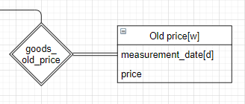
Old price [weak entity set]
CREATE old_price (
model_name VARCHAR(15),
measurement_date TIMESTAMP,
price UNSIGNED INT NOT NULL,
PRIMARY KEY (model_name, measurement_date)
);

Slide 8
Old price [weak entity set]
CREATE old_price (
model_name VARCHAR(15),
measurement_date TIMESTAMP,
price UNSIGNED INT NOT NULL,
PRIMARY KEY (model_name, measurement_date)
);

