Slide 1
Mutual Privacy Preserving k–Means Clustering in Social Participatory Sensing
IEEE TRANSACTIONS ON INDUSTRIAL INFORMATIONS

Slide 2
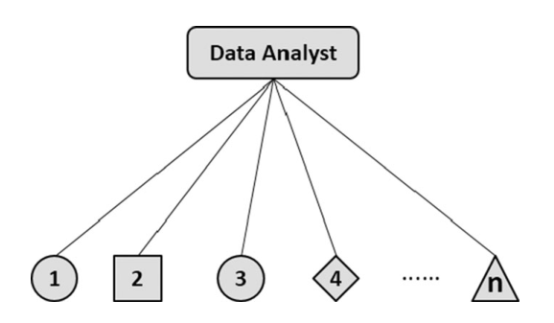

Clustering Model
Goal:
A cannot learn any private information owned by the participants;
Participants should learn nothing about A’s data(the centers) and should not be able to disrupt A’s computation.

Slide 3

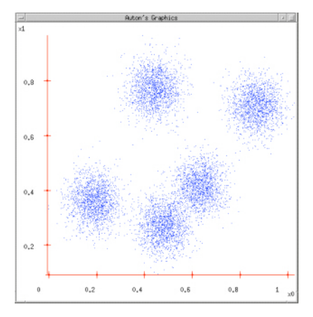
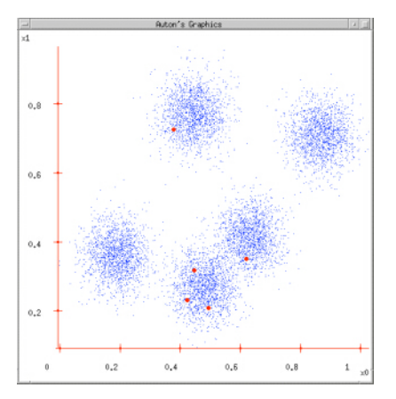
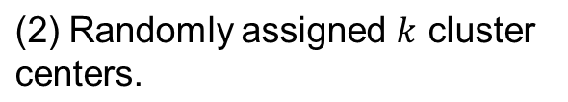
(1) Given a dataset.

Slide 4
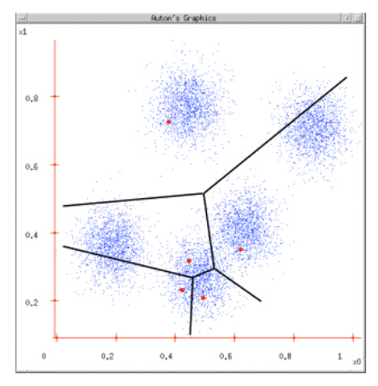
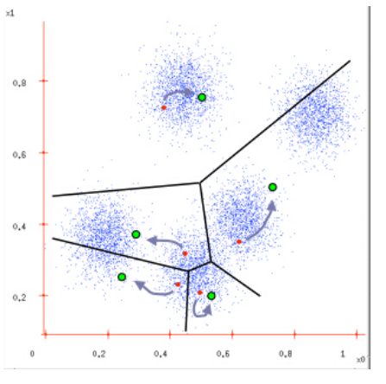
(1) Assigning each dot to its closest center.
(2) Update the cluster centers

Slide 5
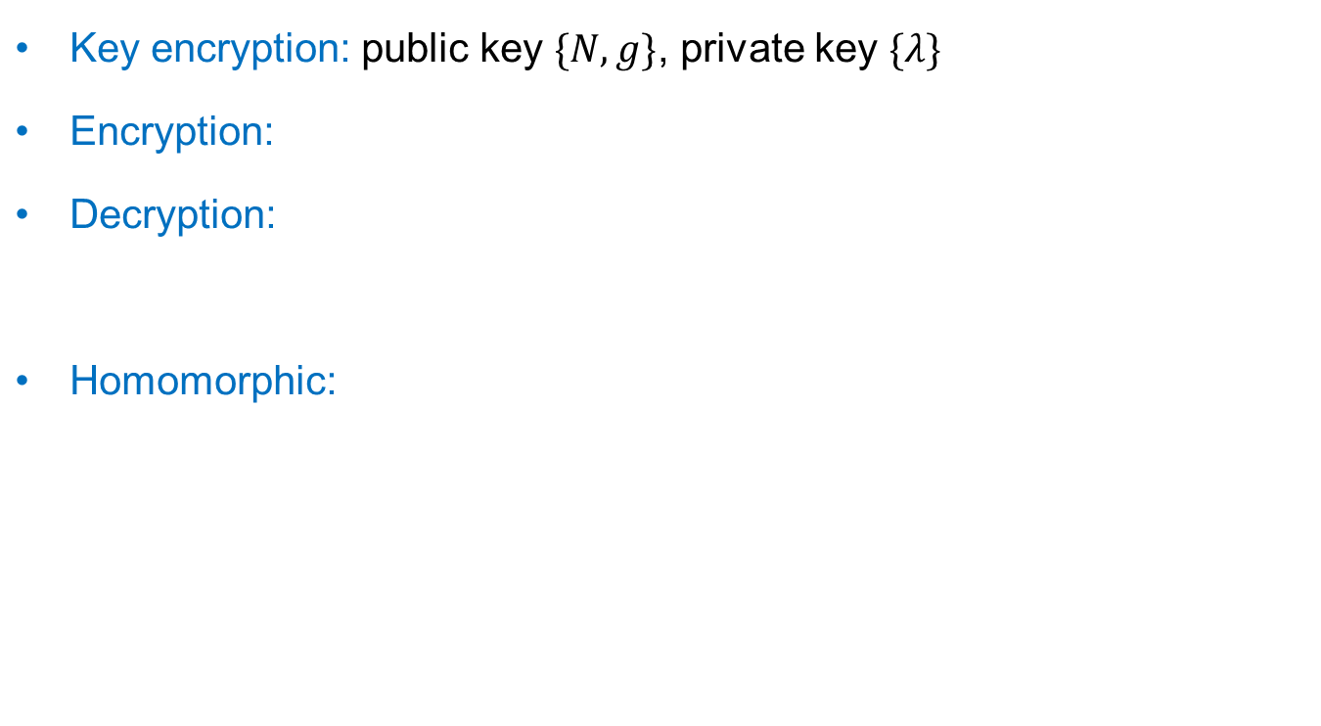




Pailier Encryption

Slide 6
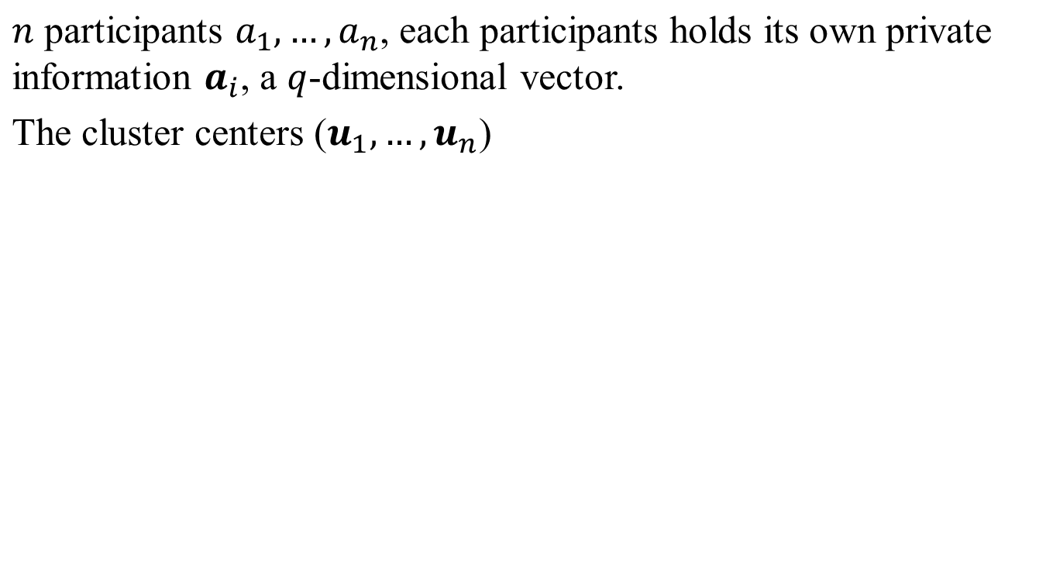
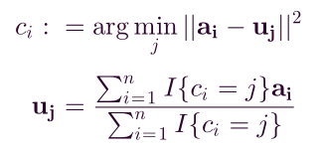
Assigning each participant to its closet center;
Computing the new center of each cluster.

Slide 7
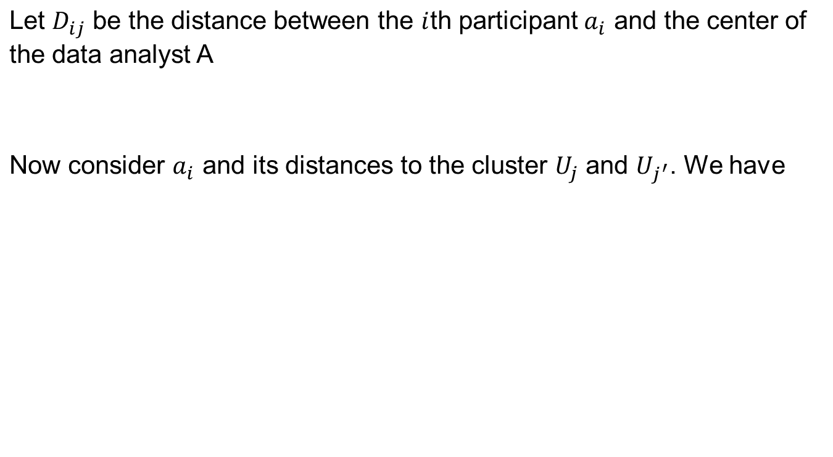

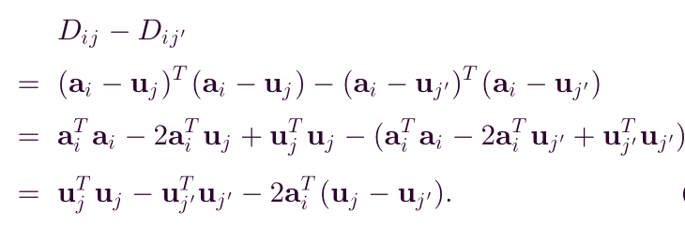
Assign participants to their nearest centers

Slide 8
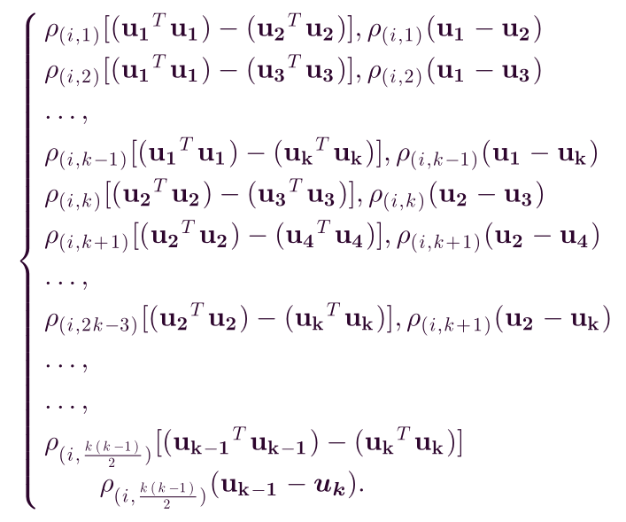


Slide 9


Update the cluster center

Slide 10

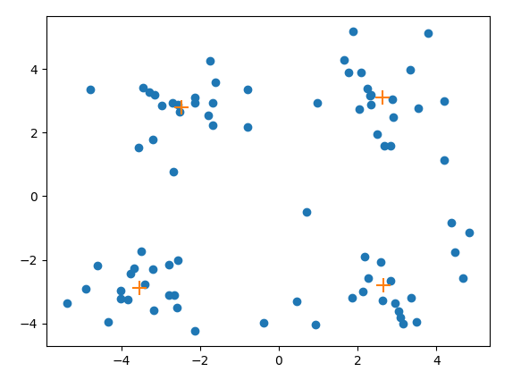
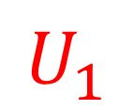


Slide 11


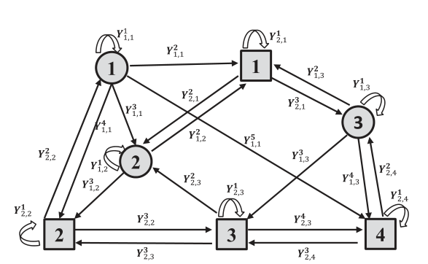

For label “+”, participants compute
For label “-”, participants compute
Next, each participant should share part of its ciphertext with others.

Slide 12
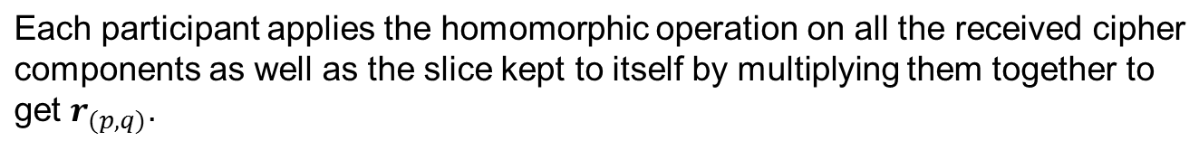
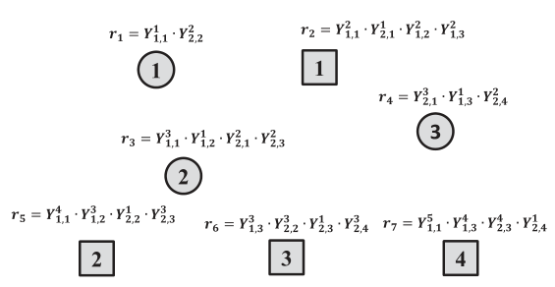

Slide 13
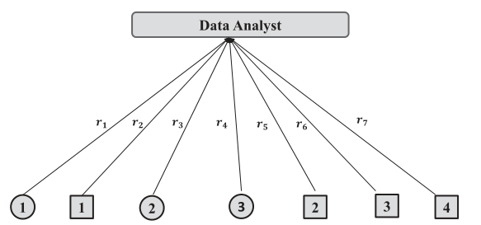
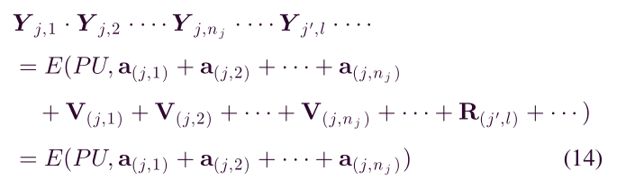
A multiples all the received data, and obtains the following result:

