Slide 1

Machine Learning Presentation-I Predicting investment housing property in the U.S. based on annual income of an individual
Team Members:
Harika Surada
Joe Valenzuela
Moumita Saha
Namitha Subbarama Rao
Susmitha Kunadharaju

Slide 2
Agenda
Business Use Case
Data Sources
Data Cleaning & Calculation
Machine Learning Model (Tentative)
Visualizations
References

Slide 3

Objective
To recommend the top five investment housing properties at different locations all over the United States of America based on the Annual income of an Individual

Slide 4

Business Use Case
Scenario:
As a young person who has managed to save up enough money for their first home purchase the question that is asked is, "Is this a good investment?" Most people buy a house where they work, but in the new 'work-from-home' job scene, anywhere is a possible option for investment. With this mindset, how can an individual identify an area where the home will not lose value, and also, maximize the chances of increased profit.

Slide 5

The high demand for the housing market has greatly impacted house pricing in the US. People are now willing to invest more in real estate as a form of investment. We used the summarized data of the monthly housing market for every State, Metro, and Zip code in the US from 2012 to 2021 from Redfin Real Estate. We are using this dataset to calculate the price difference between the listed price and the price for which the house has been sold to better understand the demand in different states and in different years.
Why this business idea and its importance

Slide 6

Data Sources
US Federal Census: American Community Survey
Free API Key (Reduces processing requirements by only calling necessary data)
Data by geographic region (currently using ZIP Code)
Wide range of demographic data available
Redfin Real Estate
Data Collected from Kaggle.com Dataset
Data represents different U.S. housing market data from 2012-2021 based on Zip Code, City, State.

Slide 7
Methods adopted for Data Cleaning and Calculation
Step 1
Removing Unnecessary Rows from the dataset
Step 2
Treating Null Variables
Step 3
Adding new parameter (DiffOflist&SalePrice)
Step 4
Grouping the data (by year and by state)
Step 5
Visualizing the data
Step 6
Using API request collect data of Median Income based on Zip Code from Census Website
Step 7
Merging the Census Median Income data with Redfin data

Slide 8
Redfin Data-set Fields

Slide 9
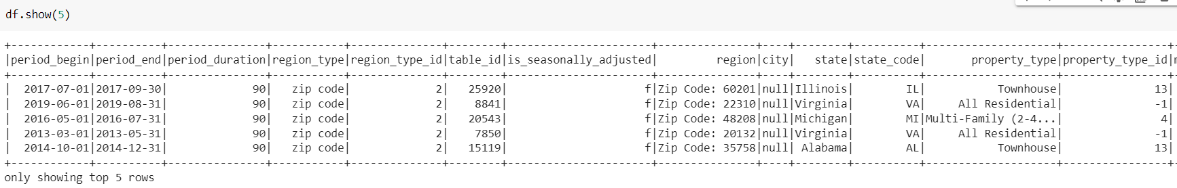
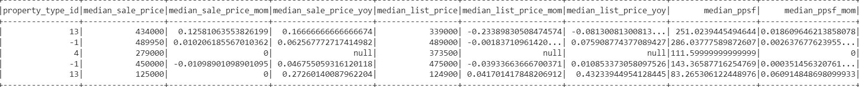
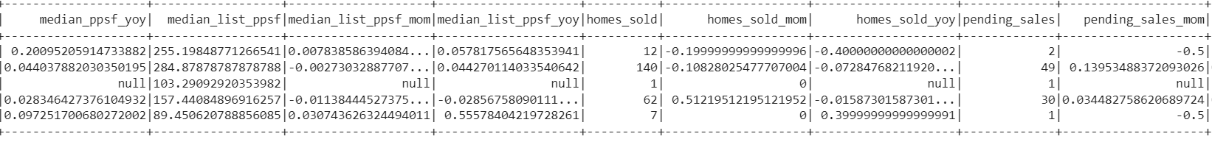

Slide 10
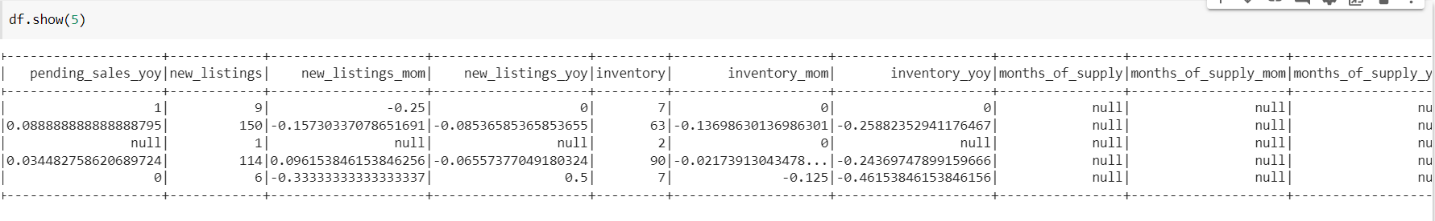
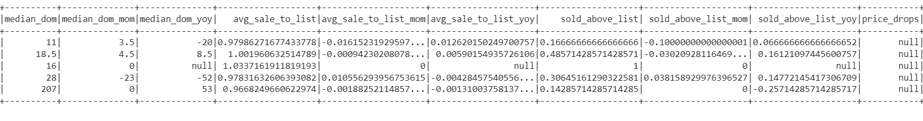
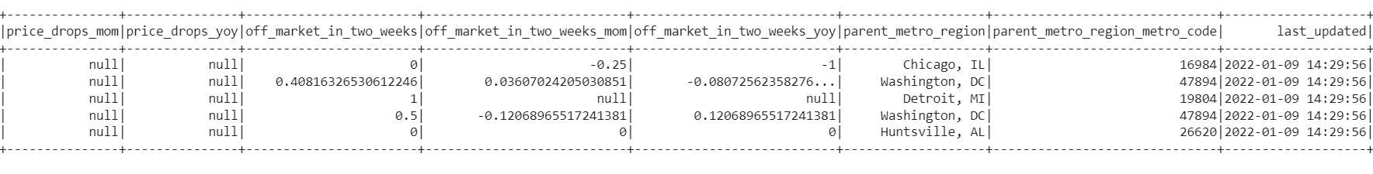

Slide 11
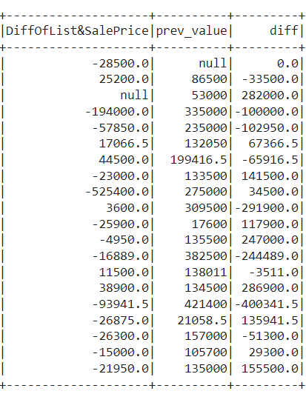
New Calculated Data fields

Slide 12
Visualizations

Slide 13
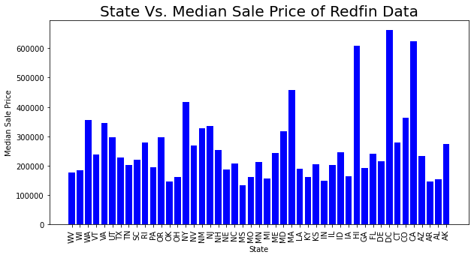
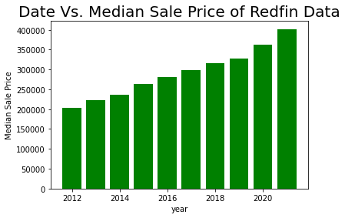
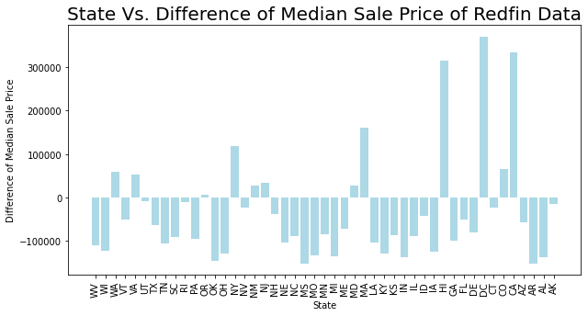

Slide 14
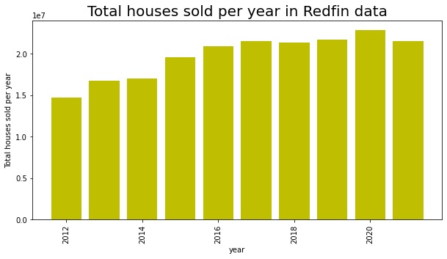
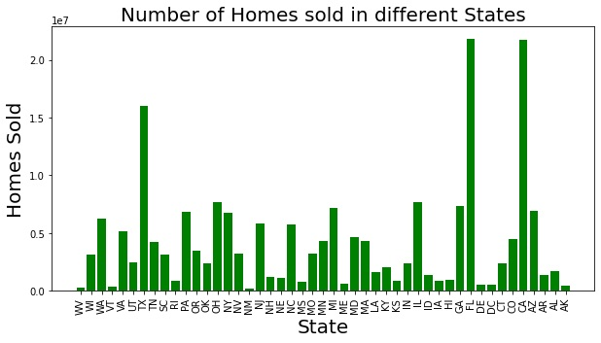

Slide 15
References
https://www.gobankingrates.com/investing/real-estate/experts-predict-housing-market-in-2022/
https://www.kaggle.com/thuynyle/redfin-housing-market-data?select=zip_code_market_tracker.tsv000
https://data.census.gov/cedsci/table?q=DP03&g=860XX00US20601

Slide 16



