Slide 1

EfficientNet: Rethinking Model Scaling for Convolutional Neural Networks
GROUP 22:
HE Yichen A0236326H
LOU Xinyun A0251245M
SONG Mingyue A0251125U
WANG Jiangyi A02346307J
YANG Sizhe A0236299N

Slide 2


BACKGROUND
MOTIVATION
CONTENTS
REPRODUCTION
EXTENTION
CONCLUSION

Slide 3
1
BACKGROUND

Slide 4

EVOLUTION OF CNNs
ResNet (2015)
Residual blocks skip connection
VGGNet (2014)
Depth is critical in CNN design
05
AlexNet (2012)
First winner of the ImageNet challenge based on a CNN
EfficientNet
03
01
GoogLeNet (2014)
Reduce parameter count, memory usage, and computation
04
ZFNet (2013)
Change in hyper parameter
02
Refer to: https://medium.com/appyhigh-technology-blog/convolutional-neural-networks-a-brief-history-of-their-evolution-ee3405568597
AlexNet was the first winner of the ImageNet challenge and was based on a CNN, and since 2012, every year’s challenge has been won by a CNN; significantly outperforming other deep and shallow ( traditional) machine learning methods.
ZFNet (named after its designer Zeiler and Fergus) became the winner of the ImageNet LSRVC. The architecture of ZFNet was the same as that of AlexNet, but there were a few changes in hyper parameters.
The VGGNet, stands for an (arcade) architecture, invented by Visual Geometry Group (at Oxford University). The Group worked on the philosophy that by increasing the depth, one can model more non-linearities in one’s function and hence the key contribution was consideration of depth as a critical component in design.
GoogLeNet again focused on deeper networks but with the objective of greater efficiency to reduce parameter count, memory usage, and computation. It went deeper up to 22 layers but without any fully connected (FC) layers.
Kaiming He et. al. from Microsoft Research came up with an idea of ‘residual blocks’ which are connected to each other through identity (skip) connections in their architecture ResNet (paper)..

Slide 5
EVOLUTION OF CNNs
Observation 1:
More sophisticated architecture
Larger scale
Better performance

Slide 6
2
MOTIVATION

Slide 7
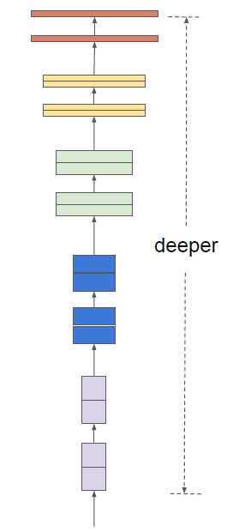
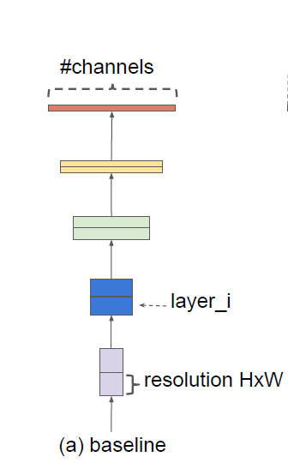
SCALING UP CNNs
Add more layers
Depth coefficient: d
(In this case, d=2)
Baseline
Depth scaling

Slide 8
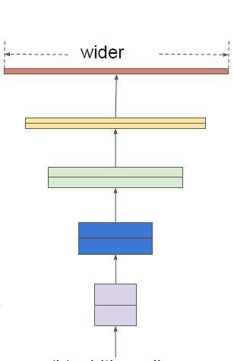
SCALING UP CNNs
Add more channels
Width coefficient: w
Baseline
Width scaling

Slide 9
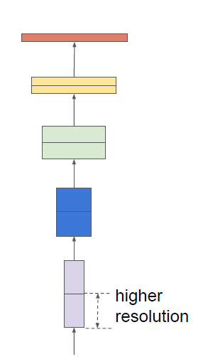
SCALING UP CNNs
Higher resolution
of input image
Resolution coefficient: r
Baseline
Resolution scaling

Slide 10
EMPIRICAL STUDY
Experiment setting:
Baseline: EfficientNet-B0 (Structure will be detailed discussed later)
Dataset: CIFAR-10 with only 3 classes (cat, deer and dog),
15k~ training samples, 3k~ testing samples
Epochs: 40

Slide 11
EMPIRICAL STUDY
Observation 2:
Scaling up any dimension of network width, depth, or resolution improves accuracy, but the degree of benefit diminishes as the models grow larger.

Slide 12
MOTIVATION
But different scaling dimensions are not independent.
They are interrelated.

Slide 13
MOTIVATION
So…….
Uniformly scaling up the coefficients!

Slide 14
Compound Scaling

Slide 15
Compound Scaling
Observation 3:
In order to pursue better accuracy and efficiency, it is critical to balance all dimensions of network width, depth, and resolution during ConvNet scaling.

Slide 16
MOTIVATION
Based on observation 2 & 3 ——
Observation 2:
Scaling up any dimension of network improves accuracy, but the degree of benefit diminishes as the models grow larger.
Observation 3:
We need to balance all dimensions of network during ConvNet scaling.

Slide 17
MOTIVATION
Based on observation 2 & 3 ——
Question:
How to balance the three dimensions of neural networks?

Slide 18
3
REPRODUCTION

Slide 19
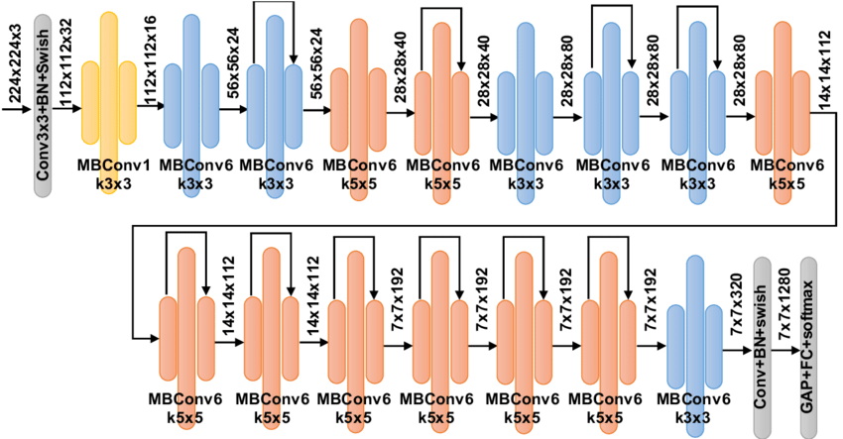
EFFICIEFFICIENTNET B0 ARCHITECTURE
Before talking about result, go through the general architecture of EfficientNet B0 (Baseline).
Network Architecture Searching

Slide 20
EFFICIENTNET REPRODUCTION
To conclude, there are two main parts for our reproduction:
1. To determine the optimal combination of depth, width, and resolution for specific computation resources.
2. Compare the performance of EfficientNet with other convolutional neural network (CNN) architectures.

Slide 21
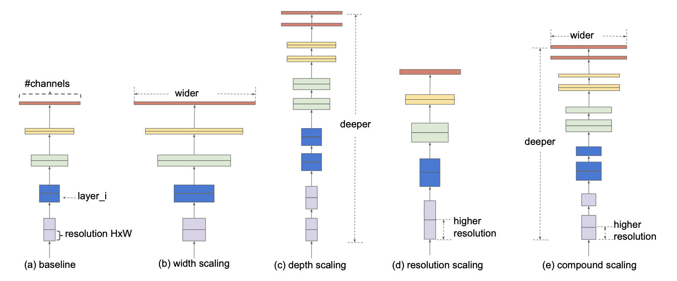
EFFICIENTNET REPRODUCTION
First part: Determine combination of depth, width, resolution
Efficient Net proposes ‘Compound Scaling’ Scheme to determine the optimal scaling factors.

Slide 22




EFFICIENTNET REPRODUCTION
First part: Determine combination of depth, width, resolution
$$N_{filter}=C_{out}$$
…
…
$$[K,K, C_{in}]$$
$$[H_{in},W_{in}, C_{in}]$$
$$[H_{out},W_{out}, C_{out }]$$
Computational Complexity $∼O{(C}_{in}×K^{2}×H_{out}×W_{out}×C_{out})$
# of pixels

Slide 23



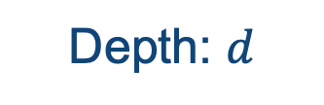
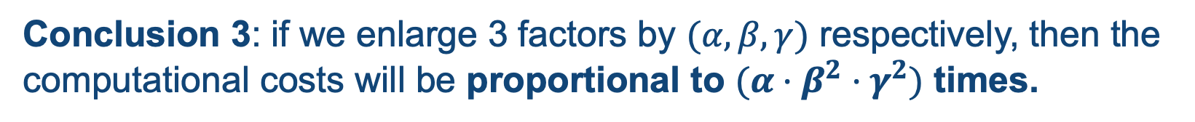

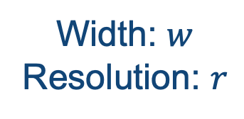
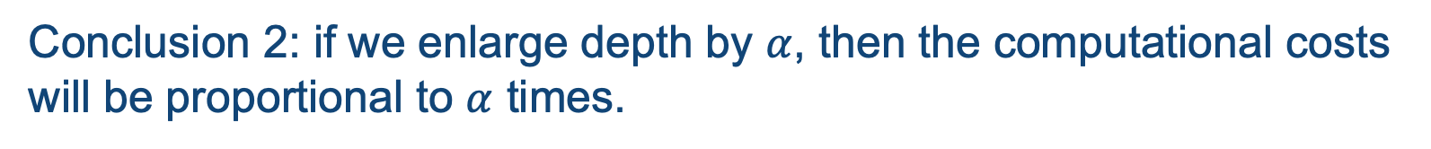

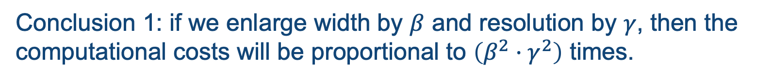

EFFICIENTNET REPRODUCTION
First part: Determine combination of depth, width, resolution
Result: Computational Complexity$∼O(C_{in}×K^{2}×H_{out}×W_{out}×C_{out})$
Scaling factor: $β$
Width: $w$
Resolution: $r$
$$(C_{in}, C_{out})$$
Scaling factor: $γ$
$$(H_{out}, W_{out})$$
Conclusion 1: if we enlarge width by $β$ and resolution by $γ$, then the computational costs will be proportional to $\left(β^{2}·γ^{2}\right)$ times.
Scaling factor: $α$
Depth: $d$
$$(\# of convolution modules)$$
Conclusion 2: if we enlarge depth by $α$, then the computational costs will be proportional to $α$ times.
Conclusion 3: if we enlarge 3 factors by $(α,β,γ)$ respectively, then the computational costs will be proportional to $(α·β^{2}·γ^{2})$ times.

Slide 24
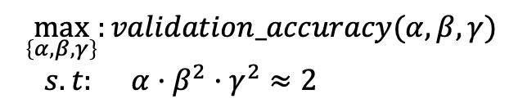
EFFICIENTNET REPRODUCTION
First part: Determine combination of depth, width, resolution
‘Compound Scaling’ Scheme:
Question: if our resources are N times larger, how to allocate for these 3 scaling factors?
Step 1: Assume twice more resources are available, as we illustrate in the previous slide, we are required to solve:
$$\max_{\left\{α, β, γ\right\}}:{validation_accuracy(α, β,γ)}$$
$$s.t: α·β^{2}·γ^{2}≈2$$
Grid Search!

Slide 25
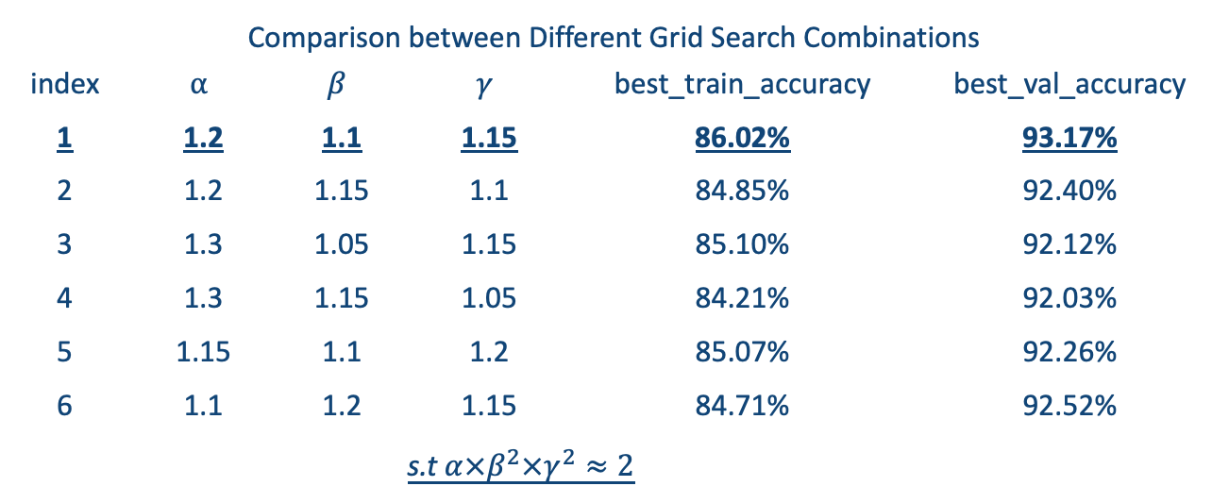
EFFICIENTNET REPRODUCTION
First part: Determine combination of depth, width, resolution
Grid Search Result:
Comparison between Different Grid Search Combinations
index | $$α$$ | $$β$$ | $$γ$$ | best_train_accuracy | best_val_accuracy
1 | 1.2 | 1.1 | 1.15 | 86.02% | 93.17%
2 | 1.2 | 1.15 | 1.1 | 84.85% | 92.40%
3 | 1.3 | 1.05 | 1.15 | 85.10% | 92.12%
4 | 1.3 | 1.15 | 1.05 | 84.21% | 92.03%
5 | 1.15 | 1.1 | 1.2 | 85.07% | 92.26%
6 | 1.1 | 1.2 | 1.15 | 84.71% | 92.52%
 | s.t $α×β^{2}×γ^{2}≈2$
Experiment setting:
Baseline: EfficientNet-B0
Dataset: CIFAR-10 with 10 classes
Epochs: 100

Slide 26



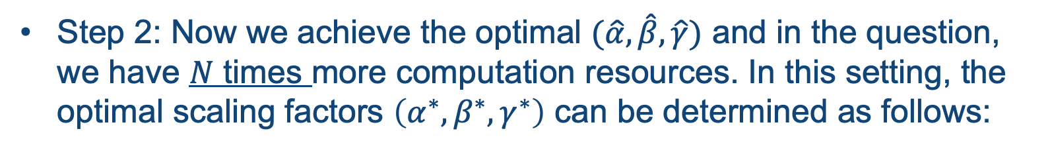


EFFICIENTNET REPRODUCTION
First part: Determine combination of depth, width, resolution
‘Compound Scaling’ Scheme:
Question: if our resources are N times larger, how to allocate for these 3 scaling factors?
Step 1: Assume twice more resources are available, as we illustrate in the previous slide, we are required to solve:
$$\max_{\left\{α, β, γ\right\}}:{validation_accuracy(α, β,γ)}$$
$$s.t: α·β^{2}·γ^{2}≈2$$
Step 2: Now we achieve the optimal $(\hat{α},\hat{β}, \hat{γ})$ and in the question, we have $N$ times more computation resources. In this setting, the optimal scaling factors $\left(α^{∗}, β^{∗},γ^{∗}\right)$ can be determined as follows:
$$α^{∗}, β^{∗}, γ^{∗}={\hat{α}}^{φ}, {\hat{β}}^{φ}, {\hat{γ}}^{φ}$$
$$d^{∗}=d_{0}·α^{∗}$$
$$w^{∗}=w_{0}·β^{∗}$$
$$φ=\log_{2}{N}$$
$$r^{∗}=r_{0}·γ^{∗}$$

Slide 27

EFFICIENTNET REPRODUCTION
First part: Determine combination of depth, width, resolution
Uniform Scaling Parameter $φ$
Big, Intractable Grid Search Problem
(N times more resources)
Small, Tractable Grid Search Problem
(2 times more resources)
Tractability
Trade-off
Loyalty

Slide 28
EFFICIENTNET REPRODUCTION
Second Part: Comparison between EfficientNet and other Network Architectures
Compare between EfficientNet and other CNN architectures including the CNN given in our lecture and famous ResNet152 on CIFAR10 Dataset.

Slide 29
4
EXTENSION

Slide 30
EXTENSION
Two possible directions of extension:
1
Apply EfficientNet on CIFAR100 dataset
2
Improve the EfficientNet Architecture

Slide 31
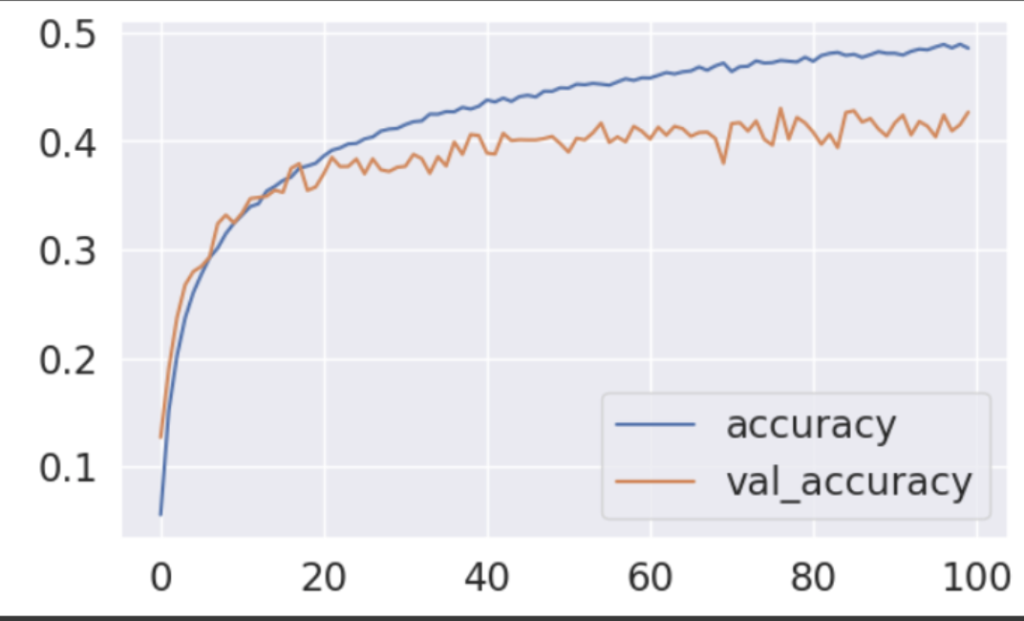
EFFICIENTNET EXTENSION
First part: Apply EfficientNet on CIFAR100 Dataset
Compare between EfficientNet and the CNN given in our lecture on CIFAR100 Dataset.
EfficientNet on Cifar100
CNN on Cifar100

Slide 32
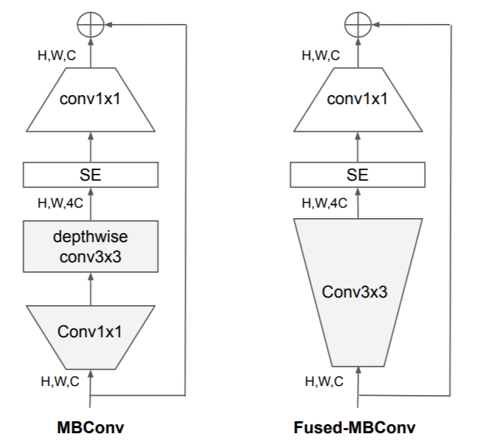
EFFICIENTNET EXTENSION
Second part: Improve EfficientNet Architecture
Limitations of the EfficientNet architecture,
Training with very large image sizes is slow
Depthwise convolutions are slow in early layers

Slide 33
EFFICIENTNET EXTENSION
Second part: Improve EfficientNet Architecture
Compare between EfficientNet and EfficientNet V2 with respect to model performance (accuracy) and model efficiency (steptime).

Slide 34
5
CONCLUSION

Slide 35
SUMMARY
Improve architecture
Compound scaling
Performance on other datasets
MBConv → Fused MBConv
ResNet
How to improve
Work on other datasets?
training performance?
Other improvements?

Slide 36
SUMMARY
Dataset: CIFAR-10 & CIFAR-100
Platform: Colab with GPU
Library: PyTorch
Links: https://github.com/SizheYang512/DSA5204-2023-Group22
Reference (paper and code):
ResNet, https://arxiv.org/abs/1512.03385
EfficientNet, https://arxiv.org/abs/1905.11946
EfficientNet V2, https://arxiv.org/abs/2104.00298
Code: https://github.com/qubvel/efficientnet
Code: https://github.com/WZMIAOMIAO/deep-learning-for-image- processing/tree/master/pytorch_classification/Test9_efficientNet

Slide 37
THANKS
HAVE A NICE DAY!

