Slide 1
Indirect reciprocity with inertial reputation updating
Part 2 · Model and methods
Wenqiang Zhu · Beihang University
B
S₁
S₂
G
Notes:
This part defines the model and the two levels of analysis: reputation formation in finite populations, and a mean-field theory that feeds into strategy evolution and invasion analysis.

Slide 2
Donation game with private assessment
ALLC
ALLD
DISC
Norm | p | q
Scoring (SC) | 1 | 0
Shunning (SH) | 0 | 0
Stern Judging (SJ) | 0 | 1
Simple Standing (SS) | 1 | 1
always intends to help
never helps
helps recipients it regards as good
Private assessment. A random observer judges the donor's action with its own image of the recipient.
p and q are the probabilities that cooperation and defection towards a recipient regarded as bad are assessed positively. Towards a good recipient, cooperation is good and defection is bad.
Errors. Intended cooperation fails with probability e₁, and assessments are reversed with probability e₂.
Positive recorded assessment, given intended action and the observer's image of the recipient
$$P_{C|G}^{+}=ε, P_{D|G}^{+}=e_{2}, P_{D|B}^{+}=e_{2}+\left(1−2e_{2}\right) q$$
$$P_{C|B}^{+}=e_{2}+\left(1−2e_{2}\right)\left[\left(1−e_{1}\right) p+e_{1} q\right], ε=\left(1−e_{1}\right)\left(1−e_{2}\right)+e_{1}e_{2}$$
Parameters throughout: b/c = 5 and e₁ = e₂ = 0.02.
Notes:
We consider a well-mixed population playing the donation game. A donor can help at cost c, giving the recipient b greater than c. ALLC always intends to help, ALLD never does, and DISC helps only recipients it regards as good. Reputations are private. A randomly drawn observer judges the donor's realized action using its own image of the recipient, so donor and observer can disagree. The four second-order norms differ only in how they judge actions towards recipients regarded as bad, summarized by p and q. Intended cooperation fails with probability e1, and the observer records the opposite assessment with probability e2. The equations give the probability that the recorded assessment is positive.

Slide 3
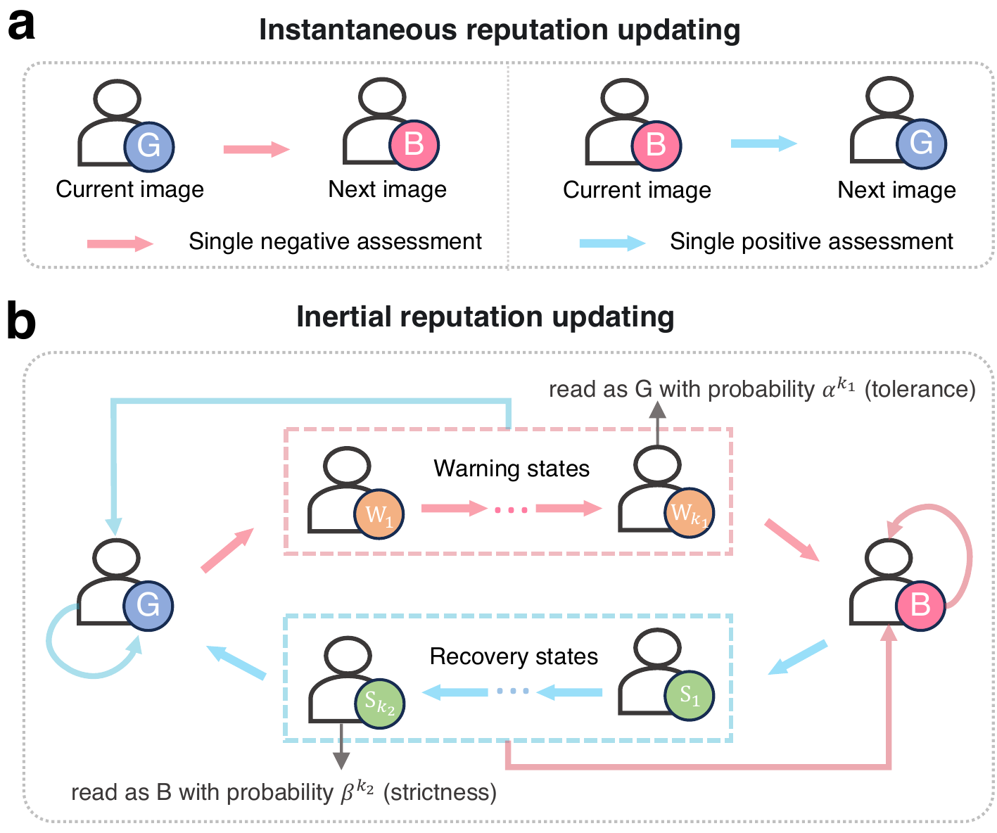
Inertial reputation updating
 | Losing standing | Regaining standing
Depth | k₁ warning states. Loss takes k₁+1 consecutive negative assessments. | k₂ recovery states. Recovery takes k₂+1 consecutive positive ones.
Strength | W_{m} is read as good with probability α^{m}. | S_{n} is read as bad with probability β^{n}.
A consulted record is read as good with probability
$$σ\left(G\right)=1, σ\left(W_{m}\right)=α^{m}, σ\left(B\right)=0, σ\left(S_{n}\right)=1−β^{n}$$
Compared settings with α = β = 1
No inertia (0,0), one-step (1,1), and the selected SC (2,0), SH (3,0), SJ (4,3) and SS (1,2)
Fig. 1 | a, instantaneous updating. b, inertial updating. An assessment in the opposite direction resets the record to the established state.
Notes:
Under instantaneous updating, each new assessment replaces the observer's image. Under inertial updating, consecutive negative assessments move a good record through k1 warning states before it turns bad, and consecutive positive assessments move a bad record through k2 recovery states before it turns good. An assessment that supports the established judgment returns the record to the established state. The pair (0,0) recovers instantaneous updating. Whenever a record is consulted, to act or to assess, its state is read as a good or bad image. Warning state W_m is read as good with probability alpha to the m, and recovery state S_n as bad with probability beta to the n. The depths set how much evidence changes a reputation, the strengths set how strongly incomplete evidence is expressed.

Slide 4
Two levels of analysis
1
2
3
4
Finite-population simulations
reputations only
Select architectures
from reputation statistics
Mean-field theory
stationary reputations
Evolution and invasion
replicator dynamics, rare mutants
Reputation formation (Fig. 2)
Evolutionary analysis (Figs. 3–5)
N = 150, equal numbers of ALLC, ALLD and DISC, strategies fixed
Each DISC keeps its own record of every individual, with no mean-field closure
30 replicate runs per architecture and a drift check before selection
Reputations equilibrate faster than strategy frequencies change
Replicator dynamics from 512 initial compositions, uniform over the simplex
Invasion of a resident DISC population by rare ALLC, ALLD and O-DISC mutants
Notes:
The analysis has two levels. First, individual-based simulations at fixed strategy composition test how private reputations form, without the mean-field closure. Every DISC individual keeps its own record of everyone. From these simulations we select one architecture per norm, using reputation statistics only. Second, a mean-field theory gives stationary private reputations at every strategy composition. Assuming that reputations equilibrate faster than strategies change, we use them in replicator dynamics and in invasion analyses with rare ALLC, ALLD and opportunistic mutants.

Slide 5


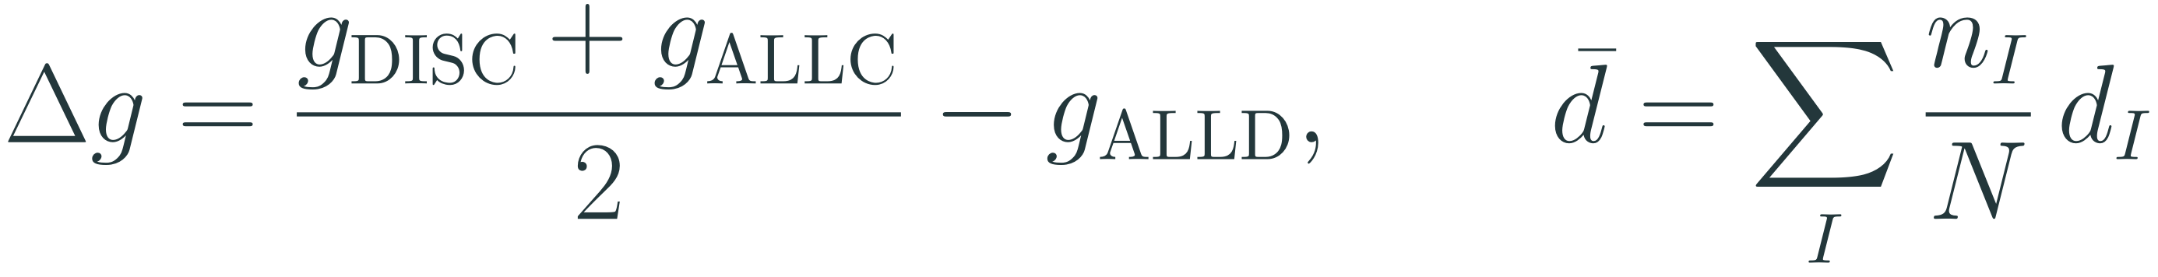
Recognition and agreement select the architectures
g_{I} is the probability that a DISC observer regards a type-I individual as good.
Selected architectures
SC
(2, 0)
d_{I} is the probability that two DISC observers disagree about the same type-I individual.
protects good standing
SH
(3, 0)
Δg=gDISC+gALLC2−gALLD, d=I​nIN dI
protects good standing
SJ
(4, 3)
Selection rule
Among allocations with Δg ≥ 0.8 and d̄ ≤ 0.1, take the one with the smallest total depth K = k₁+k₂. The rule uses reputation statistics only.
acts in both directions
SS
(1, 2)
slows recovery
warning state
recovery state
Notes:
We measure recognition by the reputational separation delta g: the average goodness of DISC and ALLC minus that of ALLD, as seen by DISC observers. We measure agreement by the mean disagreement d bar, the probability that two DISC observers hold different images of the same individual. Agreement alone is not enough, because observers can agree that everyone is bad. Among allocations with delta g at least 0.8 and d bar at most 0.1, we take the one with the smallest total depth. This gives (2,0) for Scoring, (3,0) for Shunning, (4,3) for Stern Judging and (1,2) for Simple Standing. The selection uses reputation statistics only, without reference to evolutionary outcomes.

Slide 6
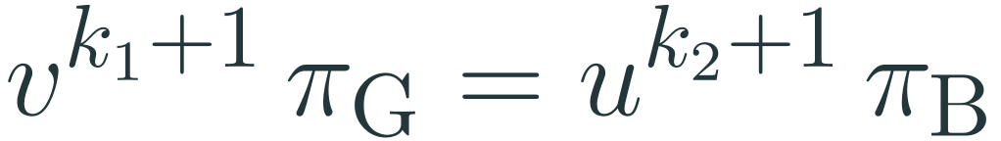
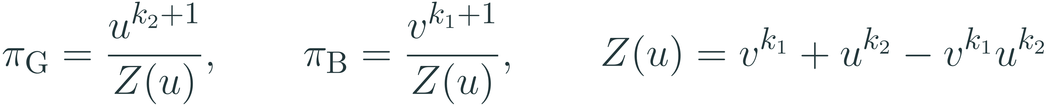
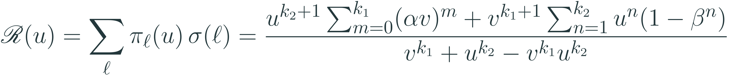
Deriving the stationary reputation map
Take one record whose assessments are independent and positive with probability u, and let v = 1−u. Its state follows the Markov chain T(u) = uT⁺+vT⁻.
Path states are entered only from their predecessor
1
$$π_{W_{m}}=v^{m} π_{G}, π_{S_{n}}=u^{n} π_{B}$$
Flux balance between good and bad standing
2
$$v^{k_{1}+1} π_{G}=u^{k_{2}+1} π_{B}$$
Normalization
$$π_{G}=\frac{u^{k_{2}+1}}{Z\left(u\right)}, π_{B}=\frac{v^{k_{1}+1}}{Z\left(u\right)}, Z\left(u\right)=v^{k_{1}}+u^{k_{2}}−v^{k_{1}}u^{k_{2}}$$
3
Reputation map, the stationary probability of being regarded as good
Ru=ℓ​πℓu σℓ=uk2+1m=0k1αvm+vk1+1n=1k2un1−βnvk1+uk2−vk1uk2
4
Notes:
Consider one record whose assessments are independent and positive with probability u. Its state is a Markov chain. Warning state W_m can only be entered from W_{m-1} after a negative assessment, and recovery state S_n only from S_{n-1} after a positive one. This gives the geometric weights in step 1. The only transitions from good to bad standing complete a run of k1 plus one negative assessments, and the only reverse transitions complete a run of k2 plus one positive ones. Balancing these two fluxes and normalizing gives the stationary distribution. Averaging the image probabilities over it gives the reputation map, the stationary probability that the target is regarded as good.

Slide 7
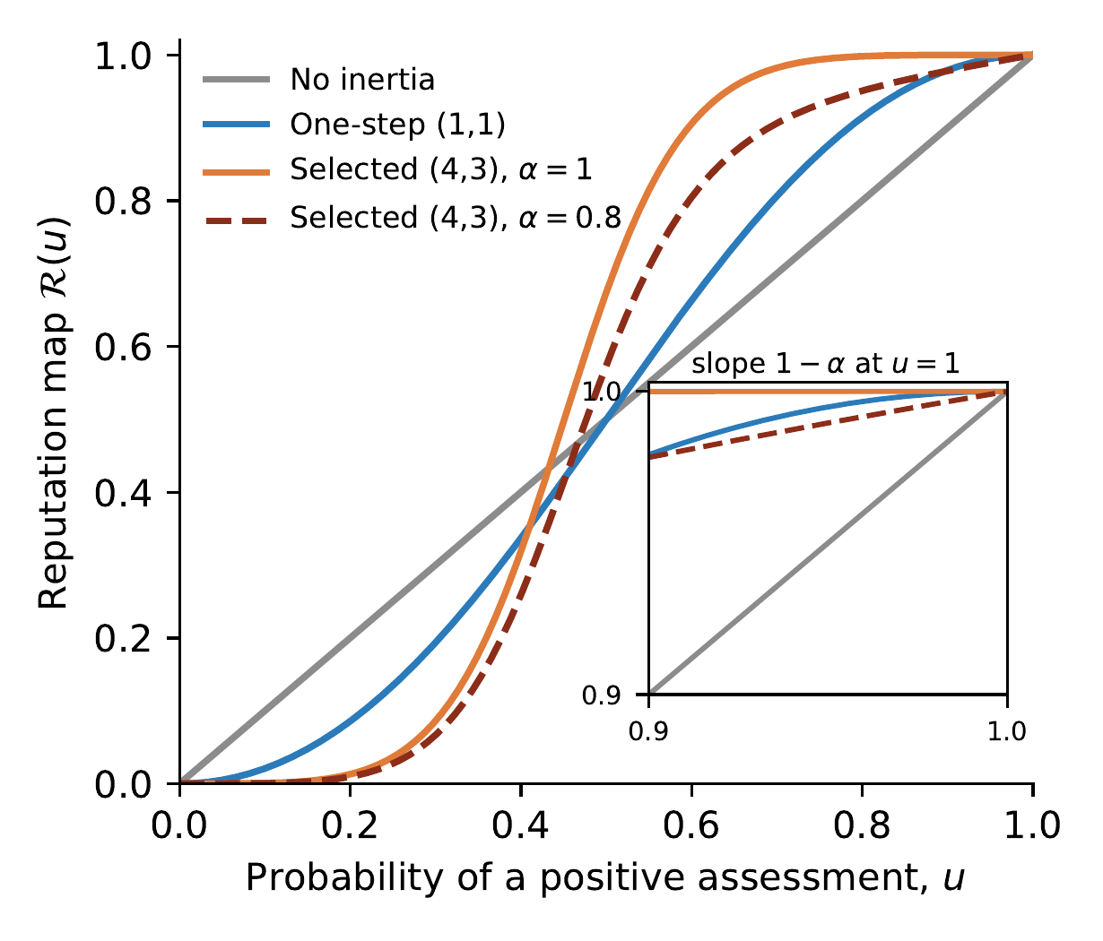
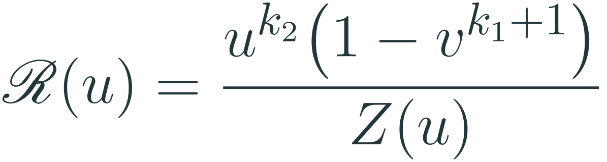
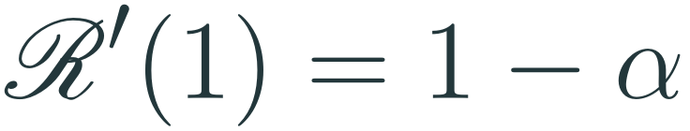
Properties of the reputation map
Without inertia, ℛ(u) = u.
With α = β = 1, ℛ is the fraction of time spent in good standing.
$$R\left(u\right)=\frac{u^{k_{2}}\left(1−v^{k_{1}+1}\right)}{Z\left(u\right)}$$
Slope near a good record, for k₁ ≥ 1
$$R′\left(1\right)=1−α$$
ℛ increases with α, decreases with β, and is concave when k₂ = 0.
With full tolerance strength, rare negative evidence barely changes a good reputation.
ℛ(u) for SJ architectures. Inset: near u = 1 the slope is 1−α.
Notes:
Without inertia the map is the identity. With full strengths it is the fraction of time spent in good standing. The map increases with the tolerance strength and decreases with the strictness strength, and it is concave when there is no recovery path. Near a mostly good record, with at least one warning state, its slope is one minus alpha. With full tolerance strength the map is therefore flat near u equals one, so rare negative evidence barely changes a good reputation. This property matters again for opportunistic defectors.

Slide 8
From single records to population reputations
Donor and observer images of a recipient are independent, given its strategy.
Assessments entering a record are independent, positive with probability u_{I}.
A1
A2
Assessment of type-I donors
$$u_{ALLC}=Φ_{C}\left(\overset{‾}{r}\right), u_{ALLD}=Φ_{D}\left(\overset{‾}{r}\right)$$
$$u_{DISC}=h_{GG}P_{C|G}^{+}+h_{GB}\left(P_{C|B}^{+}+P_{D|G}^{+}\right)+h_{BB}P_{D|B}^{+}$$
Self-consistency, from initially good records
$$r_{I}^{*}=R\left(u_{I}\left(r^{*};f\right)\right), \frac{dr_{I}}{dτ}=R\left(u_{I}\right)−r_{I}, r_{I}\left(0\right)=1$$
Homogeneous DISC population
$$u_{R}\left(r\right)=r Φ_{C}\left(r\right)+\left(1−r\right) Φ_{D}\left(r\right), F\left(r\right)=R\left[u_{R}\left(r\right)\right]−r$$
Φ_{C}(r) and Φ_{D}(r) are the probabilities that intended cooperation and defection are assessed positively, and the h terms are joint probabilities of the donor's and the observer's images. The resident reputation r_{R}* is the highest strictly stable root of F.
Notes:
To go from single records to a population we use two mean-field assumptions, as in previous analyses of private assessment. First, the donor's and the observer's images of a recipient are independent given its strategy. Second, the assessments entering a record of a type-I individual are independent with a common probability u_I, so each record has the stationary response R. Stationary reputations then satisfy r_I equals R of u_I. This can have several solutions, and we select the one reached from initially good records. In a homogeneous DISC population the condition reduces to a scalar equation F of r equals zero. Stable roots have F prime negative, and the resident reputation is the highest strictly stable root.

Slide 9
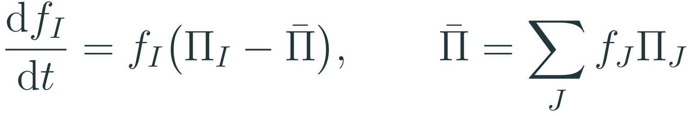
Strategy evolution and cooperation
Payoffs per unit time, with stationary reputations at every composition
DISC
$$Π_{I}=\left(1−e_{1}\right)\left[b \left(f_{ALLC}+f_{DISC} r_{I}^{*}\right)−c χ_{I}\right], χ_{ALLC}=1, χ_{ALLD}=0, χ_{DISC}={\overset{‾}{r}}^{*}$$
Replicator dynamics
dfIdt=fIΠI−Π, Π=J​fJΠJ
Realized cooperation
$$ρ=\left(1−e_{1}\right)\left(f_{ALLC}+f_{DISC} {\overset{‾}{r}}^{*}\right), \overset{‾}{ρ}≈ω_{C} {\overset{‾}{ρ}}_{C}$$
ρ̄
ω_{C}
ρ̄_{C}
ALLC
ALLD
mean long-run cooperation
cooperative basin
cooperation within the basin
Initial compositions are sampled uniformly by area, 512 per analysis (90 shown).
Notes:
Reputations equilibrate quickly relative to strategy change, so payoffs at every composition use the stationary reputations reached from initially good records. ALLC always pays the cost, ALLD never does, and DISC pays it at rate r bar. Strategy frequencies follow the replicator dynamics. Realized cooperation is at most one minus e1, that is 0.98. We integrate from 512 initial compositions sampled uniformly by area. Every trajectory ends either in the zero-cooperation set or at an attractor with positive cooperation, so we report mean cooperation rho bar, the cooperative basin omega C and cooperation within the basin, with rho bar approximately omega C times rho bar C.

Slide 10
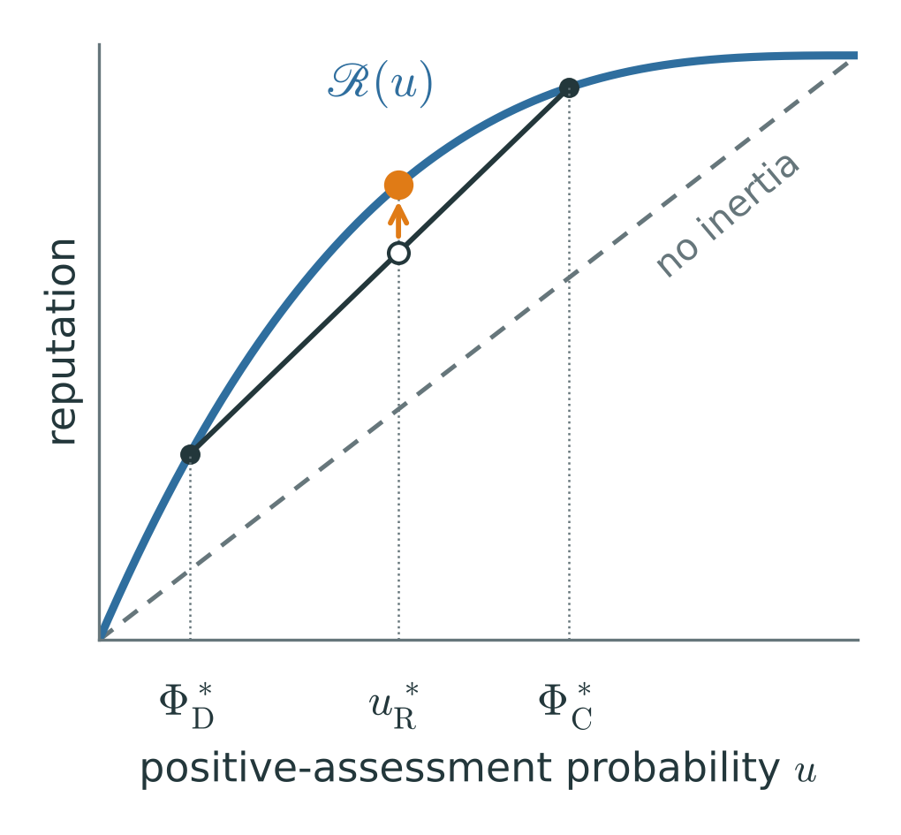
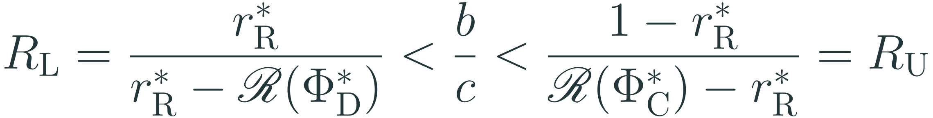
Local stability against rare unconditional mutants
A rare mutant X intends to help with probability χ_{X}, whatever its image of the recipient. ALLD has χ = 0 and ALLC has χ = 1.
$$Λ_{X}=\frac{Π_{X}−Π_{R}}{c\left(1−e_{1}\right)}=\left(r_{R}^{*}−χ_{X}\right)−\frac{b}{c}\left(r_{R}^{*}−r_{X}^{*}\right), r_{X}^{*}=R\left(u_{X}\right)$$
Pure DISC resists both ALLD and ALLC if and only if
$$R_{L}=\frac{r_{R}^{*}}{r_{R}^{*}−R\left(Φ_{D}^{*}\right)}<\frac{b}{c}<\frac{1−r_{R}^{*}}{R\left(Φ_{C}^{*}\right)−r_{R}^{*}}=R_{U}$$
The window is open if and only if ℛ lies above its chord,
$$r_{R}^{*} R\left(Φ_{C}^{*}\right)+\left(1−r_{R}^{*}\right) R\left(Φ_{D}^{*}\right)<R\left(u_{R}^{*}\right)$$
Schematic of the chord condition.
Without inertia ℛ is linear, so no b/c protects pure DISC. Inertia bends ℛ and opens the window.
Notes:
Consider a homogeneous DISC population at its resident reputation and a rare mutant X that helps with probability chi, independently of its image of the recipient. Its normalized payoff advantage is the cost it saves minus the benefit it loses through reputation. ALLD has chi zero and ALLC has chi one. The resident resists both if and only if b over c lies between R_L and R_U. The lower bound requires ALLD to lose enough help to offset the cost it saves. The upper bound prevents ALLC from gaining more through a better reputation than it pays for helping recipients regarded as bad. The window is non-empty exactly when the reputation map at the resident's assessment probability lies above the chord joining its values at Phi_D and Phi_C. Without inertia the map is linear, the chord coincides with it, and no benefit-to-cost ratio protects DISC.

Slide 11
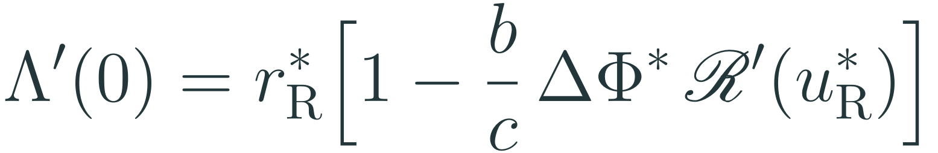
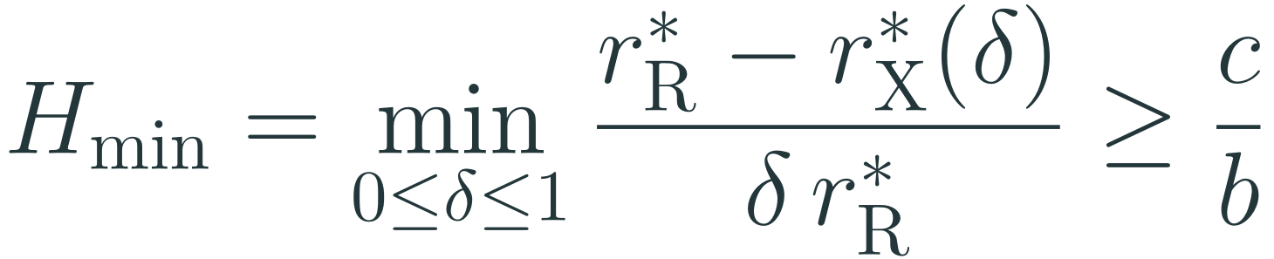
Opportunistic discriminators (O-DISC)
O-DISC behaves like DISC but withholds help from a recipient it regards as good with probability δ.
δ = 0, DISC
occasional defection, 0 < δ < 1, not tested by resistance to ALLD
δ = 1, ALLD
Invasion payoff
$$Λ\left(δ\right)=δ r_{R}^{*}−\frac{b}{c}\left[r_{R}^{*}−r_{X}^{*}\left(δ\right)\right], u_{X}\left(δ\right)=u_{R}^{*}−δ r_{R}^{*} ΔΦ^{*}$$
Slope at δ = 0
$$Λ′\left(0\right)=r_{R}^{*}\left[1−\frac{b}{c} ΔΦ^{*} R′\left(u_{R}^{*}\right)\right]$$
Every O-DISC is excluded if and only if
$$H_{min}=\min_{0≤δ≤1}\frac{r_{R}^{*}−r_{X}^{*}\left(δ\right)}{δ r_{R}^{*}}≥\frac{c}{b}$$
Error-free limit (e₁ = e₂ = 0, β = 1, k₁ ≥ 1). Every O-DISC is excluded if and only if α ≤ 1−c/b, for all four norms and every k₂.
Notes:
Tolerance protects discriminators from erroneous negative assessments, but it might also shelter individuals who defect occasionally. The opportunistic discriminator withholds help from a recipient it regards as good with probability delta. Delta zero is DISC and delta one is ALLD, so resistance to ALLD only tests the endpoint. The invasion payoff is the cost saved minus the benefit lost through a worse reputation. At delta zero its slope depends on the slope of the reputation map at the resident state. If the map is flat there, as with full tolerance strength, weak opportunism costs almost no reputation and can invade. The whole family is excluded if and only if the smallest reputation loss per unit of withheld cooperation is at least c over b. In the error-free limit this reduces to alpha at most one minus c over b, which is 0.8 at b over c equal to 5. Secure tolerance strengths form an interval: its lower end is a fold of the high-reputation state, and its upper end is set by this slope condition.

Slide 12


From methods to results
Reputation quality
Evolution of cooperation
Resistance to opportunism
Finite-population simulations
Mean-field reputations and replicator dynamics
Invasion analysis of the O-DISC family
Δg and d̄
ρ̄, ω_{C} and the window R_{L} < b/c < R_{U}
Λ′(0), H_{min} and secure α
Fig. 2 · ED Fig. 1
Figs. 3–4 · ED Figs. 2–8
Fig. 5 · ED Fig. 9
The architectures are selected in the first step and tested, unchanged, in the other two.
Notes:
The three parts of the method map onto the results. Simulations of reputation formation give Fig. 2 and the selection of the architectures. Mean-field reputations with replicator dynamics and the local stability window give Figs. 3 and 4 and most Extended Data figures. The invasion analysis of opportunistic discriminators gives Fig. 5. The architectures are chosen in the first step and are not tuned for the later ones.

