Slide 1
Indirect reciprocity with inertial reputation updating
Part 3 · Main results
Wenqiang Zhu · Beihang University
G
W₁
B
S₁
G
Notes:
This part presents the four main results in figure order. Each figure answers one part of the two questions from the motivation.

Slide 2
Four results
1
Where inertia sits decides whether private reputations are accurate and shared
2
Directional inertia makes cooperation both stable and easy to reach
Fig. 2
Fig. 3
3
Allocation matters more than the amount of memory
4
Forgiveness can shelter opportunists, and partial consequences restore deterrence
Fig. 4
Fig. 5
Results 1–3 concern the direction of inertia. Result 4 concerns how incomplete evidence is treated.
Notes:
Four results, one per main figure. The first two concern the direction of inertia: it decides whether private reputations are accurate and shared, and whether cooperation is stable and easy to reach. The third separates direction from amount. The fourth concerns the second question, how incomplete evidence should be treated: tolerance invites occasional defectors, and giving warning states partial consequences restores deterrence.

Slide 3
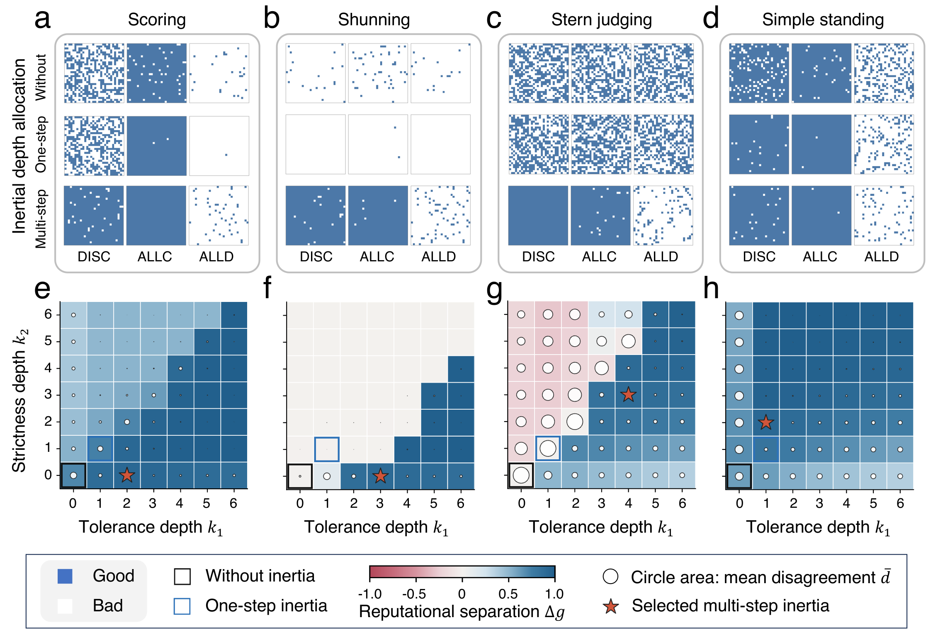
Where inertia sits decides reputation quality
Fig. 2
a–d, Private reputation matrices without inertia, with one-step inertia and with the selected architectures. Rows are DISC observers, columns are DISC, ALLC and ALLD targets, and blue means good. e–h, Separation Δg (colour) and disagreement d̄ (circle area) across depths. Stars mark the selected architectures.
Key message
Without inertia, or with one step in both directions, observers disagree or agree on the wrong verdict. Inertia in the norm-specific direction makes them agree and still separate cooperators from defectors.
Parameters: e₁ = e₂ = 0.02, equal strategy numbers, N = 90 for the matrices and N = 150 for the depth maps, α = β = 1.
Notes:
Each norm fails in its own way without inertia. Under Scoring observers are divided about discriminators, Shunning drives almost everyone to bad, Stern Judging sustains widespread disagreement and Simple Standing trusts defectors. One-step inertia does not fix this. Under Shunning, observers now agree, but only because they regard nearly everyone as bad. The depth maps show that allocations with the same total depth give very different separation and disagreement. The stars mark the smallest qualifying architectures: (2,0) for Scoring, (3,0) for Shunning, (4,3) for Stern Judging and (1,2) for Simple Standing. With them, observers regard DISC and ALLC as good and ALLD as bad, and they largely agree.

Slide 4
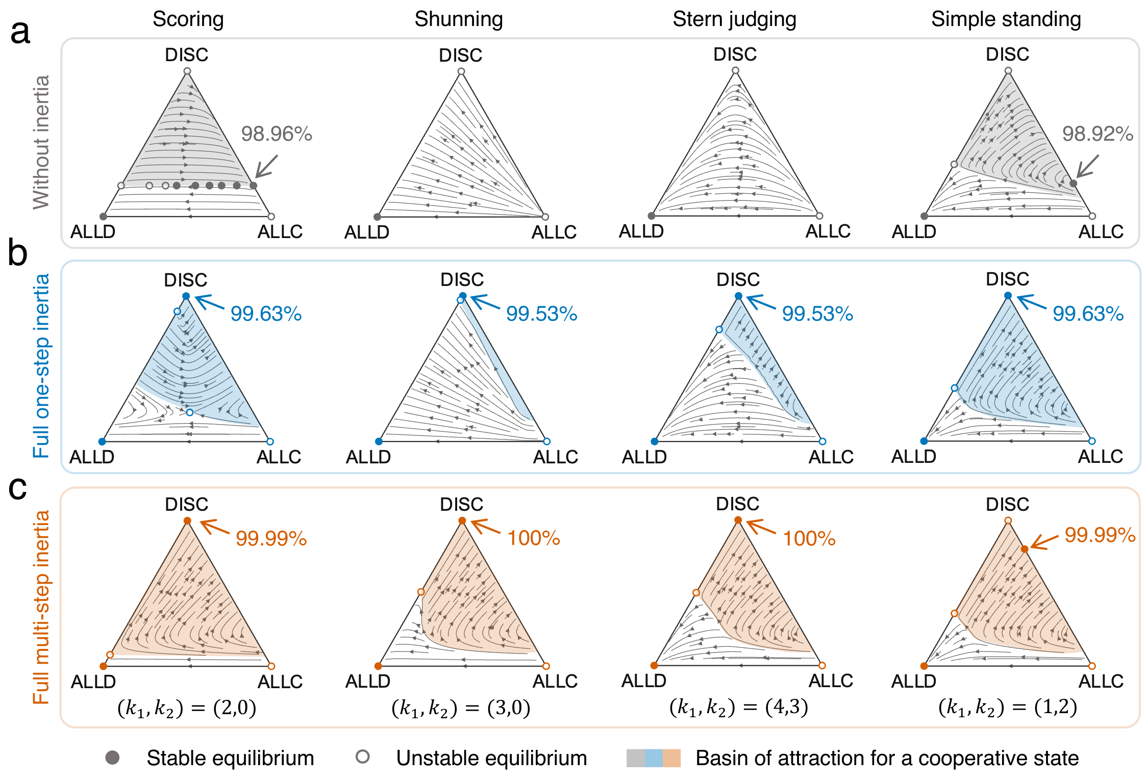
Cooperation becomes stable and easy to reach
Fig. 3
Replicator dynamics of ALLC, ALLD and DISC without inertia (a), with one-step inertia (b) and with the selected architectures (c). Filled and open circles are stable and unstable equilibria. Shading marks the basin of a cooperative state, and percentages give intended cooperation there.
Key message
One-step inertia already stabilizes discriminators, but under Shunning and Stern Judging few starting points lead there. The selected architectures make cooperation the outcome for most initial conditions under all four norms.
Parameters: b/c = 5, e₁ = e₂ = 0.02, α = β = 1. Reputations are relaxed from initially good records at every composition.
Notes:
Without inertia, Shunning and Stern Judging do not support cooperation, and under Scoring and Simple Standing a pure DISC population is not a stable cooperative state. Note that the Scoring panel in row a is still the draft version; Scoring has a line of equilibria there, which will be drawn as a single line. One-step inertia makes highly cooperative DISC populations locally stable under all four norms, but under Shunning and Stern Judging their basins are narrow. With the selected architectures, pure DISC is a stable equilibrium with near-complete intended cooperation under Scoring, Shunning and Stern Judging, and it is reached from most initial compositions. Under Simple Standing, the cooperative attractor is a stable mixture of DISC and ALLC.

Slide 5
Selected architectures enlarge the cooperative basin
Shunning
8% → 71%
Stern Judging
23% → 71%
Cooperation within the basin is 96–98% in every case, so mean cooperation follows the size of the basin.
Basin: share of 512 initial compositions that reach an attractor with positive cooperation. Verified data, b/c = 5, e₁ = e₂ = 0.02, α = β = 1.
Notes:
This chart summarizes the basins of attraction in Fig. 3. Under Shunning the cooperative basin grows from 8 to 71 percent of initial compositions, and under Stern Judging from 23 to 71 percent. Under Scoring it grows from about 60 to 88 percent. Under Simple Standing the gain is small, because one-step inertia already does well there. Cooperation inside the basin is 96 to 98 percent in every case, so the gain in mean cooperation comes almost entirely from larger basins rather than from more cooperation within them. The ALLD–DISC edge in Extended Data Fig. 4 shows why the basins expand.

Slide 6
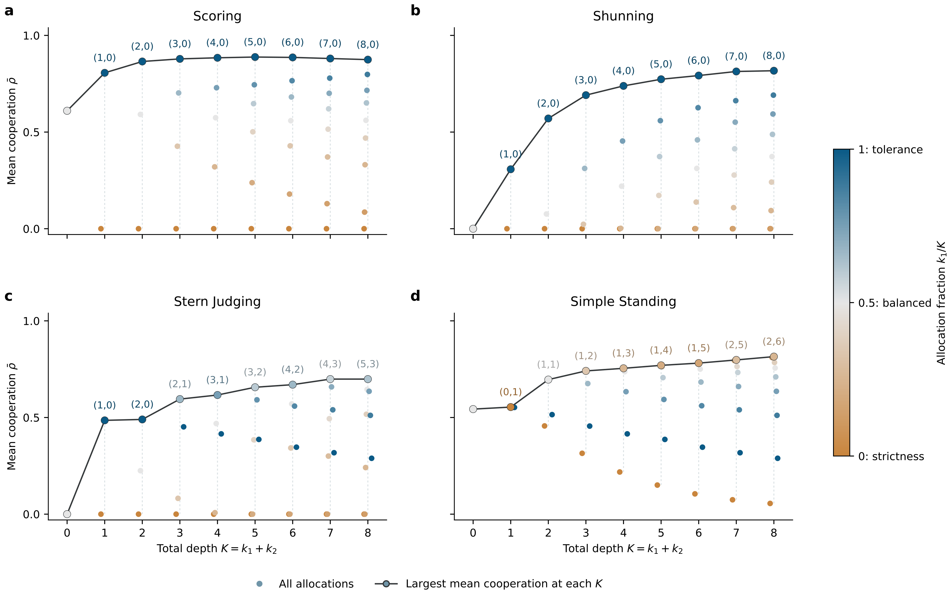
Allocation matters more than the amount of memory
Fig. 4
Mean cooperation ρ̄ for every allocation (k₁,k₂) at total depth K = k₁+k₂, coloured by the tolerance fraction k₁/K. Outlined points joined by the line are the best allocation at each depth. K = 0 is instantaneous updating.
Key message
At the same depth, cooperation ranges from absent to high depending on which path receives the states, and extra depth gives diminishing returns. The selected architectures are the best allocations at their depth.
Verified data. Parameters: b/c = 5, e₁ = e₂ = 0.02, α = β = 1, 512 initial compositions per point.
Notes:
Here we compare all allocations with the same total depth. Under Scoring with eight intermediate states, mean cooperation ranges from zero when all are recovery states to high when all are warning states. The best allocations protect good standing under Scoring and Shunning, combine both paths under Stern Judging at larger depths, and pair a short warning path with a longer recovery path under Simple Standing. Gains flatten after a few states. The four architectures chosen from reputation statistics alone are the most cooperative allocations at their depths.

Slide 7
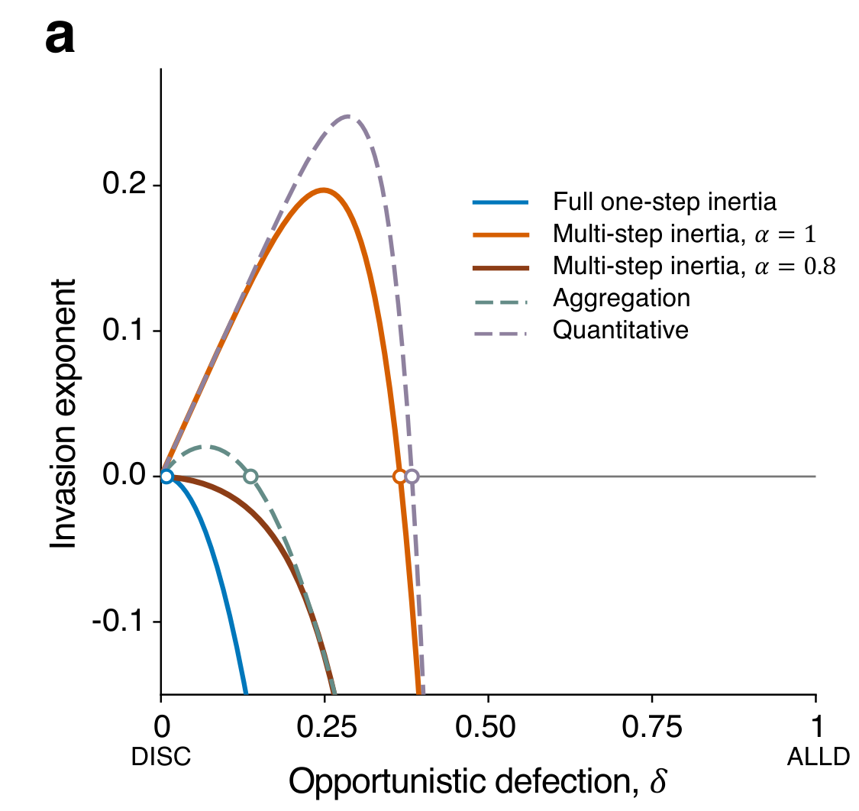
Forgiveness can shelter opportunists
Fig. 5a
Invasion payoff Λ (vertical axis) of an O-DISC mutant against a DISC resident under SJ, as a function of the omission probability δ. Curves compare one-step inertia, the selected architecture (4,3) with α = 1 and α = 0.8, an aggregation rule and a quantitative score. Positive values mean invasion.
Key message
Every mechanism shown excludes ALLD. Under full tolerance strength, O-DISC mutants with 0 < δ < 0.365 can still invade, and aggregation and quantitative scores show similar windows.
Aggregation after Michel-Mata et al. 2024, quantitative score after Schmid et al. 2023. Parameters: b/c = 5, e₁ = e₂ = 0.02, β = 1.
Notes:
An opportunistic discriminator withholds help from good recipients with probability delta. All five mechanisms compared here exclude ALLD, the endpoint delta equal to one. Under the selected Stern Judging architecture with full tolerance strength, however, every mutant with delta between 0 and 0.365 can invade, and one-step inertia admits a narrow window of the same kind. Aggregation of two sampled assessments and a bounded quantitative score show similar windows. These two mechanisms were neither optimized nor matched in memory, so they illustrate a shared vulnerability, not a ranking. The cause is the flat reputation map near a good resident: weak opportunism costs almost no reputation.

Slide 8
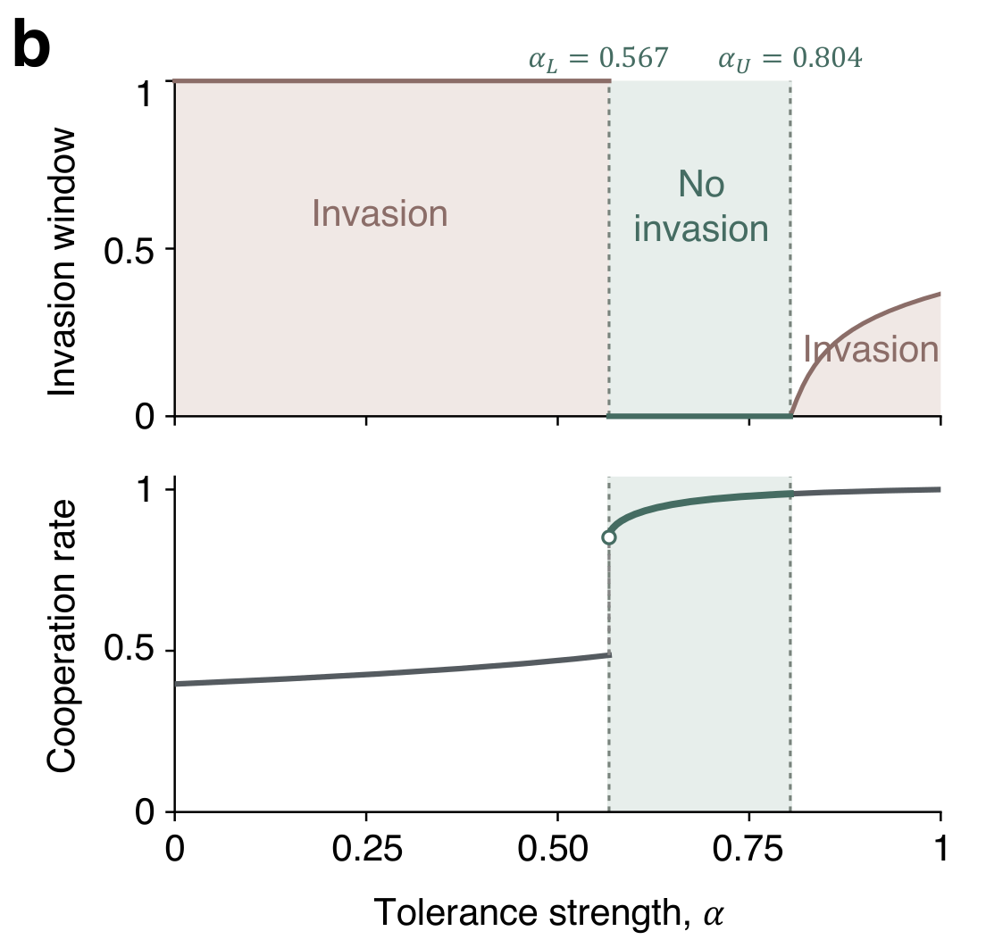
Partial consequences restore deterrence
Fig. 5b
Selected SJ architecture as the tolerance strength α varies. Top, the largest endpoint δ_{c} of the invasion window. Bottom, resident intended cooperation r_{R}*. The green band is the secure range α_{L} < α ≤ α_{U}.
Key message
Lowering α from 1 to 0.8 excludes every O-DISC mutant while residents stay highly cooperative. Below α_{L} ≈ 0.57 the high-reputation state is lost, so protection holds in a bounded range.
α_{L} = 0.567 and α_{U} = 0.804. Parameters: b/c = 5, e₁ = e₂ = 0.02, β = 1.
Notes:
Lowering the tolerance strength gives warning states an immediate chance of being read as bad, which restores a reputational cost to weak opportunism. For the selected Stern Judging architecture, reducing alpha from 1 to 0.8 excludes every O-DISC mutant, and residents remain highly cooperative. Lowering alpha too far destroys the high-reputation resident state. The secure range runs from about 0.57 to 0.80. The lower end is a fold of the high-reputation state and does not depend on b over c. The upper end rises with b over c. Extended Data Fig. 9 shows that protective tolerance strengths exist under all four norms, and that the range closes under Shunning at b over c equal to 2.

Slide 9
Results at a glance
Norm | Selected (k₁,k₂) | Role of inertia | Cooperative basin, one-step → selected | Mean cooperation ρ̄ | Resists O-DISC at α = 0.8
Scoring | (2, 0) | protects good standing | 61% → 88% | 0.87 | yes
Shunning | (3, 0) | protects good standing | 8% → 71% | 0.69 | yes
Stern Judging | (4, 3) | acts in both directions | 23% → 71% | 0.70 | yes
Simple Standing | (1, 2) | slows recovery | 71% → 76% | 0.74 | yes
Reputational criteria alone pick architectures that also make cooperation stable and accessible. Lowering the tolerance strength then closes the opportunistic loophole.
Verified data, b/c = 5, e₁ = e₂ = 0.02, α = β = 1 unless stated. Under SS the cooperative attractor is a DISC–ALLC mixture, because ALLC can invade pure DISC.
Notes:
This table collects the four results per norm. The selected architectures protect good standing under Scoring and Shunning, act in both directions under Stern Judging and slow recovery under Simple Standing. They enlarge the cooperative basin, most strongly under Shunning and Stern Judging. At a tolerance strength of 0.8 all four resist the whole family of opportunistic discriminators while cooperation stays high. Under Simple Standing, ALLC can still invade pure DISC, so the cooperative attractor is a mixture of DISC and ALLC.

