Slide 1
Indirect reciprocity with inertial reputation updating
How reputations accumulate and express behavioral evidence
Wenqiang Zhu
School of Artificial Intelligence, Beihang University
Discussion with Christian Hilbe · November 2026

Slide 2
Overview
1
Motivation and research gap
Two candidate storylines (Introduction V1 and V2)
2
Model and methods
Inertial records, stationary reputation map, population theory, invasion analysis
3
Results
Main-text Figs. 2–5
4
Conclusion
Answers to the research gap and points for discussion
5
Supplementary results
Extended Data and analytical results (backup)

Slide 3
Motivation and research gap
1

Slide 4
Two candidate storylines
Storyline A · Introduction V1
Start from the failure of classical norms under private assessment
Identify overwrite updating as a root cause of the fragility
End with two explicit open questions about evidence
Storyline B · Introduction V2
Start from reputation as a currency of social life
Ask how a reputation system should integrate evidence over time
Motivate directional inertia by human evaluation and institutions
Both storylines lead to the same framework and the same results. The following slides present each line in turn, then compare them.

Slide 5
Classical norms need reputations that are shared
Storyline A · Intro V1
Helping others raises one's standing and the chance of being helped by third parties (indirect reciprocity).
The leading-eight norms stabilize cooperation when reputations are public, even with occasional errors.
Under private, noisy assessment, observers hold different views of the same person, and most leading-eight norms fail.
Accurate reputations
(cooperators vs defectors)
+
Shared reputations
(observers agree)
Stable cooperation
Central problem: under private assessment, reputations must remain both accurate and shared.
Nowak & Sigmund 1998, 2005; Ohtsuki & Iwasa 2004, 2006; Hilbe et al. 2018; Fujimoto & Ohtsuki 2022, 2023

Slide 6
Part of the fragility lies in how reputations are updated
Storyline A · Intro V1
In the standard binary framework, every new assessment replaces the previous image.
A single error can reverse a reputation built over many interactions, and the next observation can reverse it again.
Under private assessment these flips spread. Discriminators are condemned when observers disagree about the recipient.
assessment
+
+
+
+
−
+
+
image
G
G
G
G
B
G
G
time
Cooperation depends not only on which norm is used, but also on how much evidence is required before a judgment is revised.
Ohtsuki & Iwasa 2004; Hilbe et al. 2018; Radzvilavicius et al. 2019; Okada 2020

Slide 7
Existing remedies treat losing and regaining standing alike
Storyline A · Intro V1
Restore agreement
Public institutions
Gossip
Empathetic evaluation
Opinion synchronization
Integrate more information
Generous or stochastic assessment
Graded reputations, reasoning about errors
Quantitative scores
Aggregation of observations
Using more than the latest observation helps but needs tolerance, and tolerance can also forgive deliberate defection. Loss and recovery of standing are governed by one score, threshold or window.
Open questions
Should losing and regaining standing require different amounts of evidence?
How should accumulating but inconclusive evidence affect how a person is treated?
Radzvilavicius et al. 2019, 2021; Kawakatsu et al. 2024; Murase & Hilbe 2023, 2024; Tham et al. 2026; Schmid et al. 2021, 2023; Clark et al. 2020; Michel-Mata et al. 2024

Slide 8
Societies separate an accumulating record from a verdict
Storyline A · Intro V1
Institutions
Graduated sanctions escalate with repeated violations
Online markets summarize long feedback histories
Criminal records stop signaling risk only after years
Impression formation
Impressions are updated as behavior unfolds
The weight of new evidence depends on its diagnostic value
Asymmetries run both ways: trust is lost faster, beliefs about bad people are volatile
Standing can persist while contrary evidence accumulates, and losing and regaining it need not require the same evidence.
Ostrom 1990; Cox et al. 2010; Tadelis 2016; Blumstein & Nakamura 2009; Mende-Siedlecki et al. 2013; Slovic 1993; Siegel et al. 2018

Slide 9
Private information makes reputations fragile
Storyline B · Intro V2
Reputation lets past behavior shape future opportunities, and social norms turn behavior into moral standing.
Classical norms sustain cooperation when observers agree on each other's standing.
In reality, information is noisy and privately interpreted, so observers disagree whether an action was justified.
In binary models each assessment overwrites the image, so a single mistake can undo a long record.
Recent remedies
Restore agreement: institutions, gossip, empathy, opinion synchronization
Use more information: generosity, graded reputations, reasoning about errors, quantitative scores, aggregation
These approaches show that information beyond the latest observation can stabilize cooperation.
Milinski 2016; Nowak & Sigmund 2005; Hilbe et al. 2018; Murase & Hilbe 2024; Schmid et al. 2023; Michel-Mata et al. 2024

Slide 10
Gap: how should reputations integrate evidence over time?
Storyline B · Intro V2
Accumulating information is not the same as using more of it.
A good reputation may persist while contrary evidence accumulates, and recovery may follow a different process.
Existing approaches treat losing and regaining standing as one process, with one score, threshold or window.
Human evaluation is directional
Impressions are revised over sequences of behavior
Good and bad individuals are updated asymmetrically
Graduated sanctions escalate with repeated violations
Restoring standing after a criminal record takes years
Standing should have inertia, and the inertia of losing standing may differ from that of regaining it.
Schmid et al. 2023; Michel-Mata et al. 2024; Yamamoto et al. 2025; Siegel et al. 2018; Ostrom 1990; Blumstein & Nakamura 2009

Slide 11
The two storylines at a glance
 | Storyline A (Introduction V1) | Storyline B (Introduction V2)
Opening | Leading-eight norms fail under private assessment | Reputation as a currency of social life
Central problem | Reputations must be accurate and shared | How should evidence be integrated over time?
Diagnosis | Overwrite updating triggers disagreement cascades | Loss and recovery are treated as one process
Gap | Two explicit questions: evidence asymmetry and the role of inconclusive evidence | Directional inertia, motivated by human evaluation and institutions
Tone | Problem-driven, close to the private-assessment literature | Conceptual, aimed at a broad readership

Slide 12
This work: separate accumulation from interpretation of evidence
Evidence accumulation
Depths k₁, k₂ determine how much consistent evidence changes an established reputation.
Main findings
The allocation of inertia between losing and regaining standing determines whether private reputations are accurate and shared.
Compact, norm-specific architectures make cooperation stable and accessible. Allocation matters more than amount.
Tolerance shelters occasional defectors. Giving warning states partial consequences restores deterrence.
Evidence interpretation
Strengths α, β determine how strongly incomplete evidence already affects treatment.

Slide 13
Model and methods
2

Slide 14
Donation game with private assessment
A donor pays c and the recipient gains b > c. Strategies: ALLC, ALLD and DISC (helps recipients it regards as good).
A random observer judges the action with its own image of the recipient (private assessment).
Errors: failed cooperation (e₁) and reversed assessment (e₂).
Norm | p | q
Scoring (SC) | 1 | 0
Shunning (SH) | 0 | 0
Stern Judging (SJ) | 0 | 1
Simple Standing (SS) | 1 | 1
p, q: probability that C or D towards a recipient regarded as bad is assessed as good. C towards a good recipient is good, D is bad.
Positive recorded assessment, given intended action and the observer's image of the recipient:
$$P_{C|G}^{+}=ε, P_{D|G}^{+}=e_{2}, P_{D|B}^{+}=e_{2}+\left(1−2e_{2}\right) q$$
$$P_{C|B}^{+}=e_{2}+\left(1−2e_{2}\right)\left[\left(1−e_{1}\right) p+e_{1} q\right], ε=\left(1−e_{1}\right)\left(1−e_{2}\right)+e_{1}e_{2}$$
Reference parameters: b/c = 5, e₁ = e₂ = 0.02

Slide 15
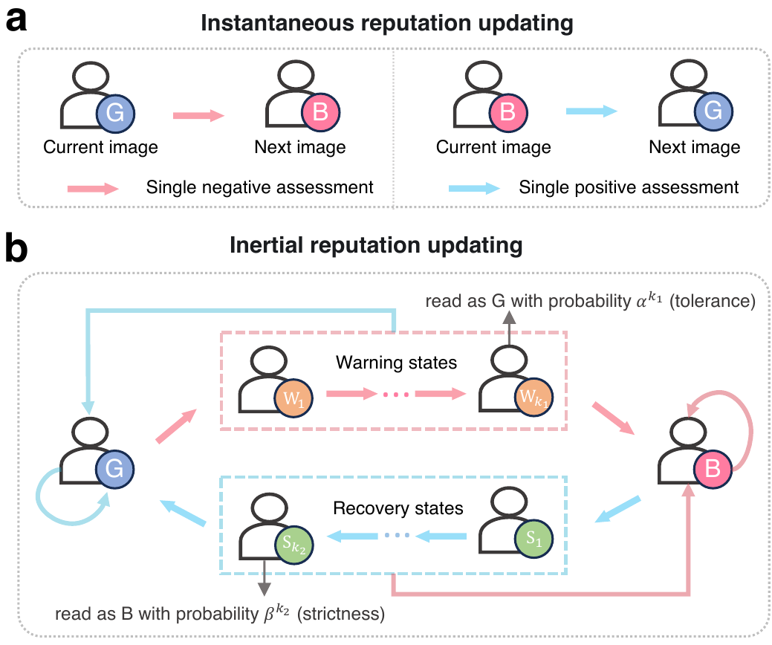
Inertial reputation updating
Tolerance depth k₁: warning states W_{m}. Strictness depth k₂: recovery states S_{n}.
Loss needs k₁+1 consecutive negative assessments, recovery k₂+1 positive ones.
A consulted record is interpreted as good with probability
$$σ\left(G\right)=1, σ\left(W_{m}\right)=α^{m}$$
$$σ\left(B\right)=0, σ\left(S_{n}\right)=1−β^{n}$$
Compared settings (α = β = 1)
No inertia (0,0) and one-step (1,1)
Selected: SC (2,0), SH (3,0), SJ (4,3), SS (1,2)
Fig. 1 | a, instantaneous updating. b, inertial updating with warning and recovery paths. An assessment in the opposite direction returns the record to the established state.

Slide 16
Two levels of analysis
Finite-population
simulations
Select architectures
(reputation only)
Mean-field theory
(stationary reputations)
Evolution and
invasion
Reputation formation (Fig. 2)
N = 150, equal numbers of ALLC, ALLD and DISC
Every DISC keeps a record of everyone; no closure
30 replicates and a drift check for the selection
Evolutionary analysis (Figs. 3–5)
Reputations equilibrate faster than strategies
Replicator dynamics from 512 area-uniform initial compositions
Local invasion by rare ALLC, ALLD and O-DISC mutants

Slide 17
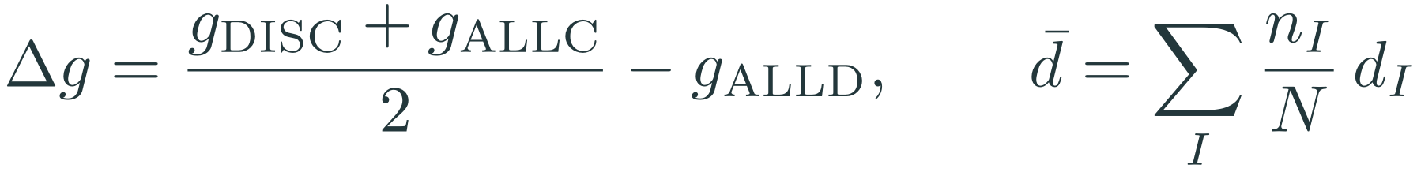
Measuring recognition and agreement
g_{I}: probability that a DISC observer regards a type-I individual as good.
d_{I}: probability that two DISC observers disagree about the same type-I individual.
Δg=gDISC+gALLC2−gALLD, d=I​nIN dI
Selection rule: among allocations with Δg ≥ 0.8 and d̄ ≤ 0.1, take the smallest total depth K = k₁+k₂.
Selected: SC (2,0), SH (3,0), SJ (4,3), SS (1,2), chosen without reference to evolutionary outcomes.
Agreement alone is not enough: observers can agree that everyone is bad.

Slide 18

The stationary reputation map
A record with independent assessments, positive with probability u (v = 1−u), is a Markov chain T(u) = uT⁺+vT⁻.
1 Path states are entered only from their predecessor:
$$π_{W_{m}}=v^{m} π_{G}, π_{S_{n}}=u^{n} π_{B}$$
2 Flux balance between good and bad standing:
$$v^{k_{1}+1} π_{G}=u^{k_{2}+1} π_{B}$$
3 Normalization:
$$π_{G}=\frac{u^{k_{2}+1}}{Z\left(u\right)}, π_{B}=\frac{v^{k_{1}+1}}{Z\left(u\right)}, Z\left(u\right)=v^{k_{1}}+u^{k_{2}}−v^{k_{1}}u^{k_{2}}$$
4 Reputation map (stationary probability of being regarded as good):
Ru=ℓ​πℓu σℓ=uk2+1m=0k1αvm+vk1+1n=1k2un1−βnvk1+uk2−vk1uk2

Slide 19
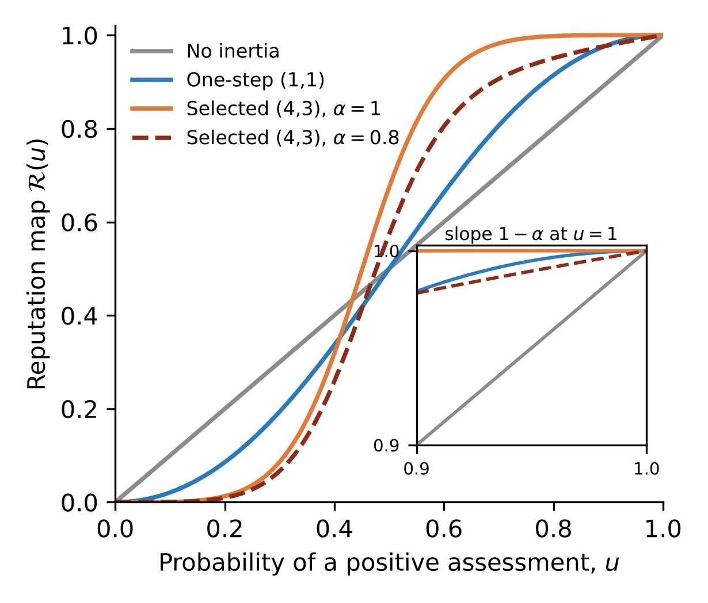
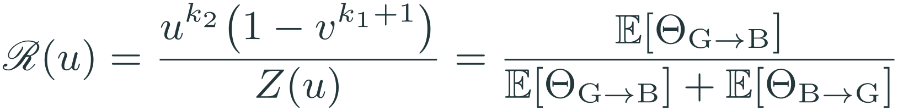
Properties of the reputation map
No inertia: ℛ(u) = u.
Full strengths (α = β = 1): fraction of time in good standing,
$$R\left(u\right)=\frac{u^{k_{2}}\left(1−v^{k_{1}+1}\right)}{Z\left(u\right)}=\frac{E\left[Θ_{G→B}\right]}{E\left[Θ_{G→B}\right]+E\left[Θ_{B→G}\right]}$$
Mostly good record (k₁ ≥ 1):
$$1−R\left(1−v\right)=\left(1−α\right) v+O\left(v^{2}\right), R′\left(1\right)=1−α$$
ℛ increases with α and decreases with β, and it is concave when k₂ = 0.
ℛ(u) for SJ architectures. Inset: near u = 1 the slope is 1−α.
With full tolerance strength, rare negative evidence barely changes a good reputation.

Slide 20
From single records to population reputations
Mean-field closure. (A1) Donor and observer images of a recipient are independent given its strategy. (A2) Assessments entering a record are independent with probability u_{I}.
$$u_{ALLC}=Φ_{C}\left(\overset{‾}{r}\right), u_{ALLD}=Φ_{D}\left(\overset{‾}{r}\right), u_{DISC}=h_{GG}P_{C|G}^{+}+h_{GB}\left(P_{C|B}^{+}+P_{D|G}^{+}\right)+h_{BB}P_{D|B}^{+}$$
Self-consistency, with the branch reached from initially good records:
$$r_{I}^{*}=R\left(u_{I}\left(r^{*};f\right)\right), \frac{dr_{I}}{dτ}=R\left(u_{I}\right)−r_{I}, r_{I}\left(0\right)=1$$
Homogeneous DISC population:
$$u_{R}\left(r\right)=r Φ_{C}\left(r\right)+\left(1−r\right) Φ_{D}\left(r\right), F\left(r\right)=R\left[u_{R}\left(r\right)\right]−r$$
Stable roots have F′ < 0, and folds satisfy F = F′ = 0. The resident reputation r_{R}* is the highest strictly stable root.

Slide 21
Strategy evolution and measures of cooperation
Payoffs per unit time, with stationary reputations recomputed at every composition:
$$Π_{I}=\left(1−e_{1}\right)\left[b \left(f_{ALLC}+f_{DISC} r_{I}^{*}\right)−c χ_{I}\right], χ_{ALLC}=1, χ_{ALLD}=0, χ_{DISC}={\overset{‾}{r}}^{*}$$
Replicator dynamics and cooperation:
$${\dot{f}}_{I}=f_{I}\left(Π_{I}−\overset{‾}{Π}\right), \overset{‾}{ρ}≈ω_{C} {\overset{‾}{ρ}}_{C}$$
Intended cooperation ρ_{int} = f_{ALLC}+f_{DISC} r̄*; realized ρ = (1−e₁)ρ_{int} ≤ 0.98.
ρ̄: mean long-run cooperation over 512 area-uniform initial compositions; ω_{C}: cooperative basin; ρ̄_{C}: cooperation within it.

Slide 22
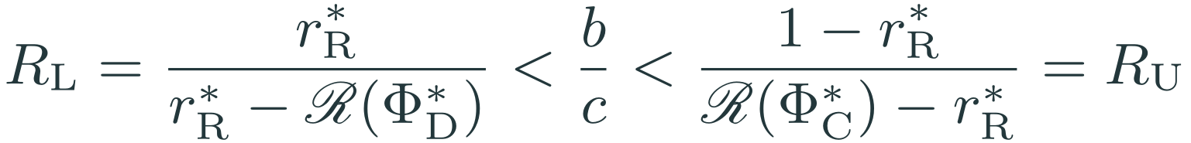
Local stability against rare unconditional mutants
A rare mutant X that intends to help with probability χ_{X} (ALLD: χ = 0, ALLC: χ = 1):
$$Λ_{X}=\frac{Π_{X}−Π_{R}}{c\left(1−e_{1}\right)}=\left(r_{R}^{*}−χ_{X}\right)−\frac{b}{c}\left(r_{R}^{*}−r_{X}^{*}\right), r_{X}^{*}=R\left(u_{X}\right)$$
Pure DISC resists both ALLD and ALLC if and only if
$$R_{L}=\frac{r_{R}^{*}}{r_{R}^{*}−R\left(Φ_{D}^{*}\right)}<\frac{b}{c}<\frac{1−r_{R}^{*}}{R\left(Φ_{C}^{*}\right)−r_{R}^{*}}=R_{U}$$
The window is open if and only if ℛ lies above its chord:
$$R_{L}<R_{U}⇔r_{R}^{*} R\left(Φ_{C}^{*}\right)+\left(1−r_{R}^{*}\right) R\left(Φ_{D}^{*}\right)<R\left(u_{R}^{*}\right)$$
Without inertia ℛ is linear, so no b/c protects pure DISC. Inertia bends ℛ and opens the window.

Slide 23
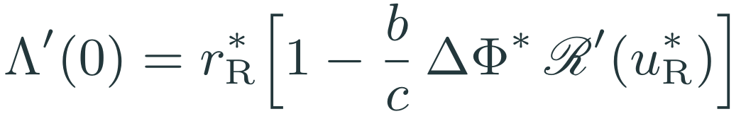
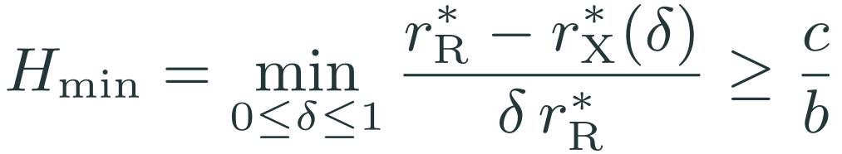
Opportunistic discriminators (O-DISC)
O-DISC withholds help from a recipient it regards as good with probability δ (δ = 0: DISC, δ = 1: ALLD).
$$Λ\left(δ\right)=δ r_{R}^{*}−\frac{b}{c}\left[r_{R}^{*}−r_{X}^{*}\left(δ\right)\right], u_{X}\left(δ\right)=u_{R}^{*}−δ r_{R}^{*} ΔΦ^{*}$$
Weak opportunism invades when the reputation response is flat:
$$Λ′\left(0\right)=r_{R}^{*}\left[1−\frac{b}{c} ΔΦ^{*} R′\left(u_{R}^{*}\right)\right]$$
Every O-DISC mutant is excluded if and only if
$$H_{min}=\min_{0≤δ≤1}\frac{r_{R}^{*}−r_{X}^{*}\left(δ\right)}{δ r_{R}^{*}}≥\frac{c}{b}$$
Exact result in the error-free limit
e₁ = e₂ = 0, β = 1, k₁ ≥ 1: every O-DISC mutant is excluded if and only if α ≤ 1−c/b (i.e. α ≤ 0.8 at b/c = 5), for all four norms and all k₂.

Slide 24
Results
3

Slide 25
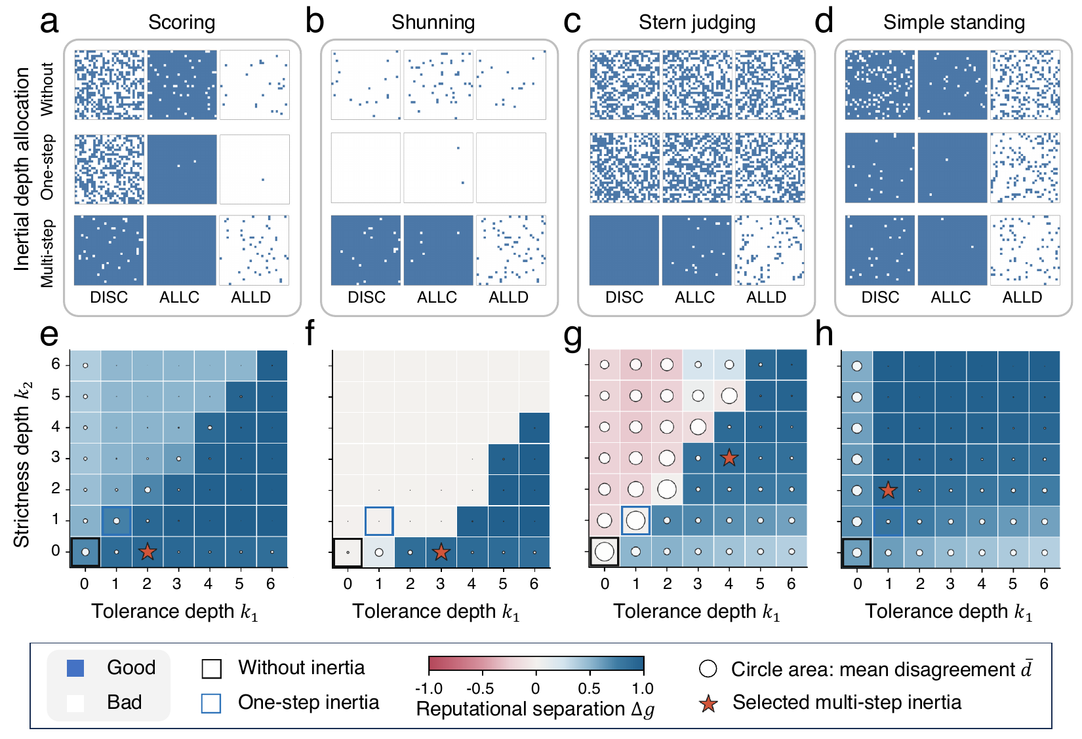
Directional inertia restores recognition and agreement
Fig. 2 | a–d, private image matrices (rows: DISC observers; columns: DISC, ALLC, ALLD targets; blue: good) without inertia, with one-step inertia and with the selected architectures. e–h, separation Δg (color) and disagreement d̄ (circle area) across k₁, k₂. Stars: smallest K with Δg ≥ 0.8 and d̄ ≤ 0.1.
One-step inertia fails: SH agrees that everyone is bad, and SJ keeps disagreeing. Norm-specific allocations achieve both recognition and agreement.

Slide 26
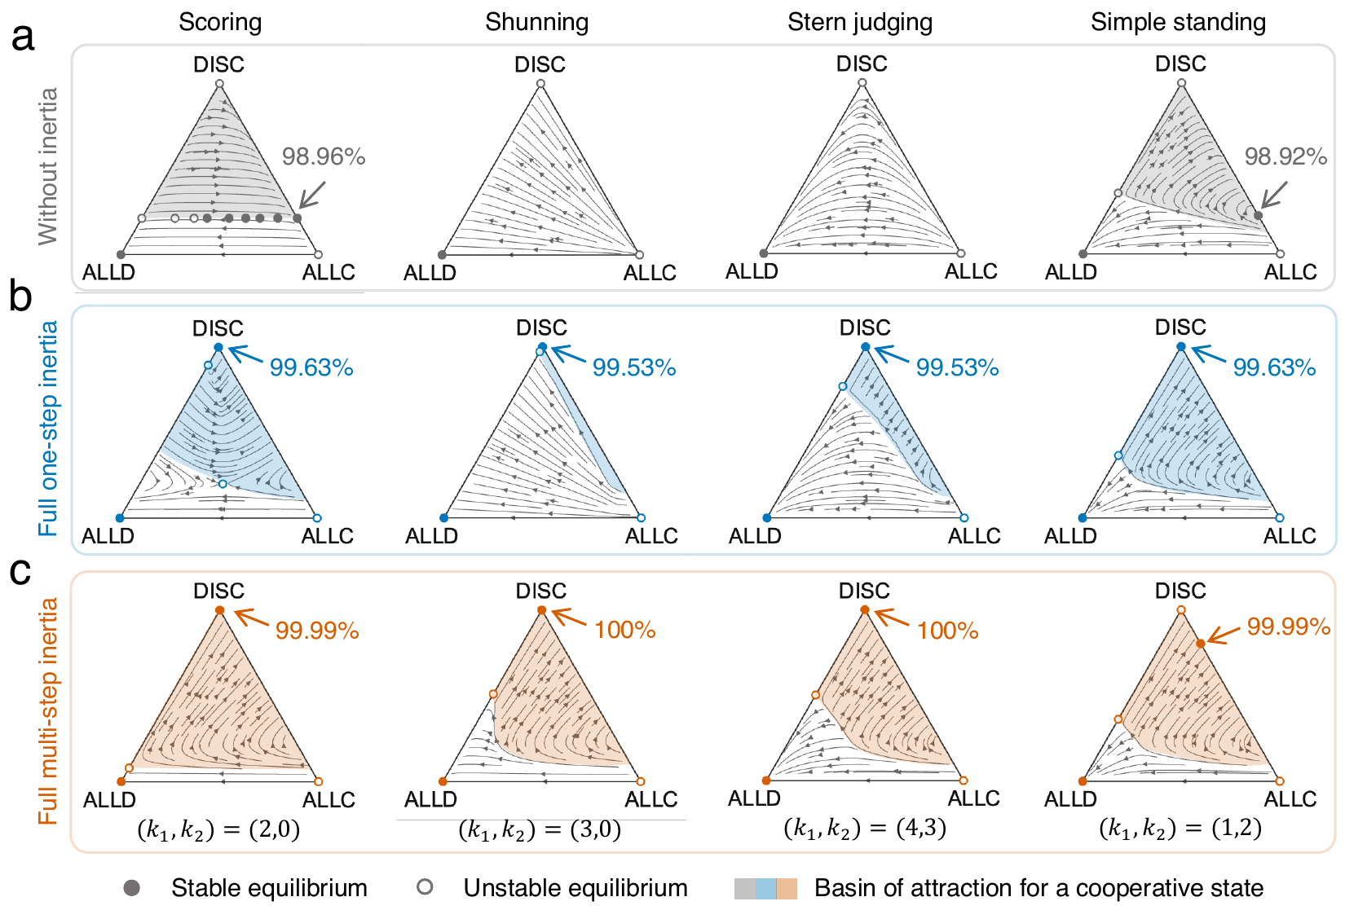
Selected architectures make cooperation stable and accessible
Fig. 3 | Replicator dynamics of ALLC, ALLD and DISC without inertia (a), with one-step inertia (b) and with the selected architectures (c). Filled and open circles: stable and unstable equilibria. Shading: basin of a cooperative state. Percentages: intended cooperation. b/c = 5, e₁ = e₂ = 0.02.
Cooperative basins grow from 8% (SH) and 23% (SJ) under one-step inertia to 70–88% under the selected architectures. Under SS, the attractor is a stable DISC–ALLC mixture.
SC panel in a to be redrawn as a single line of equilibria.

Slide 27
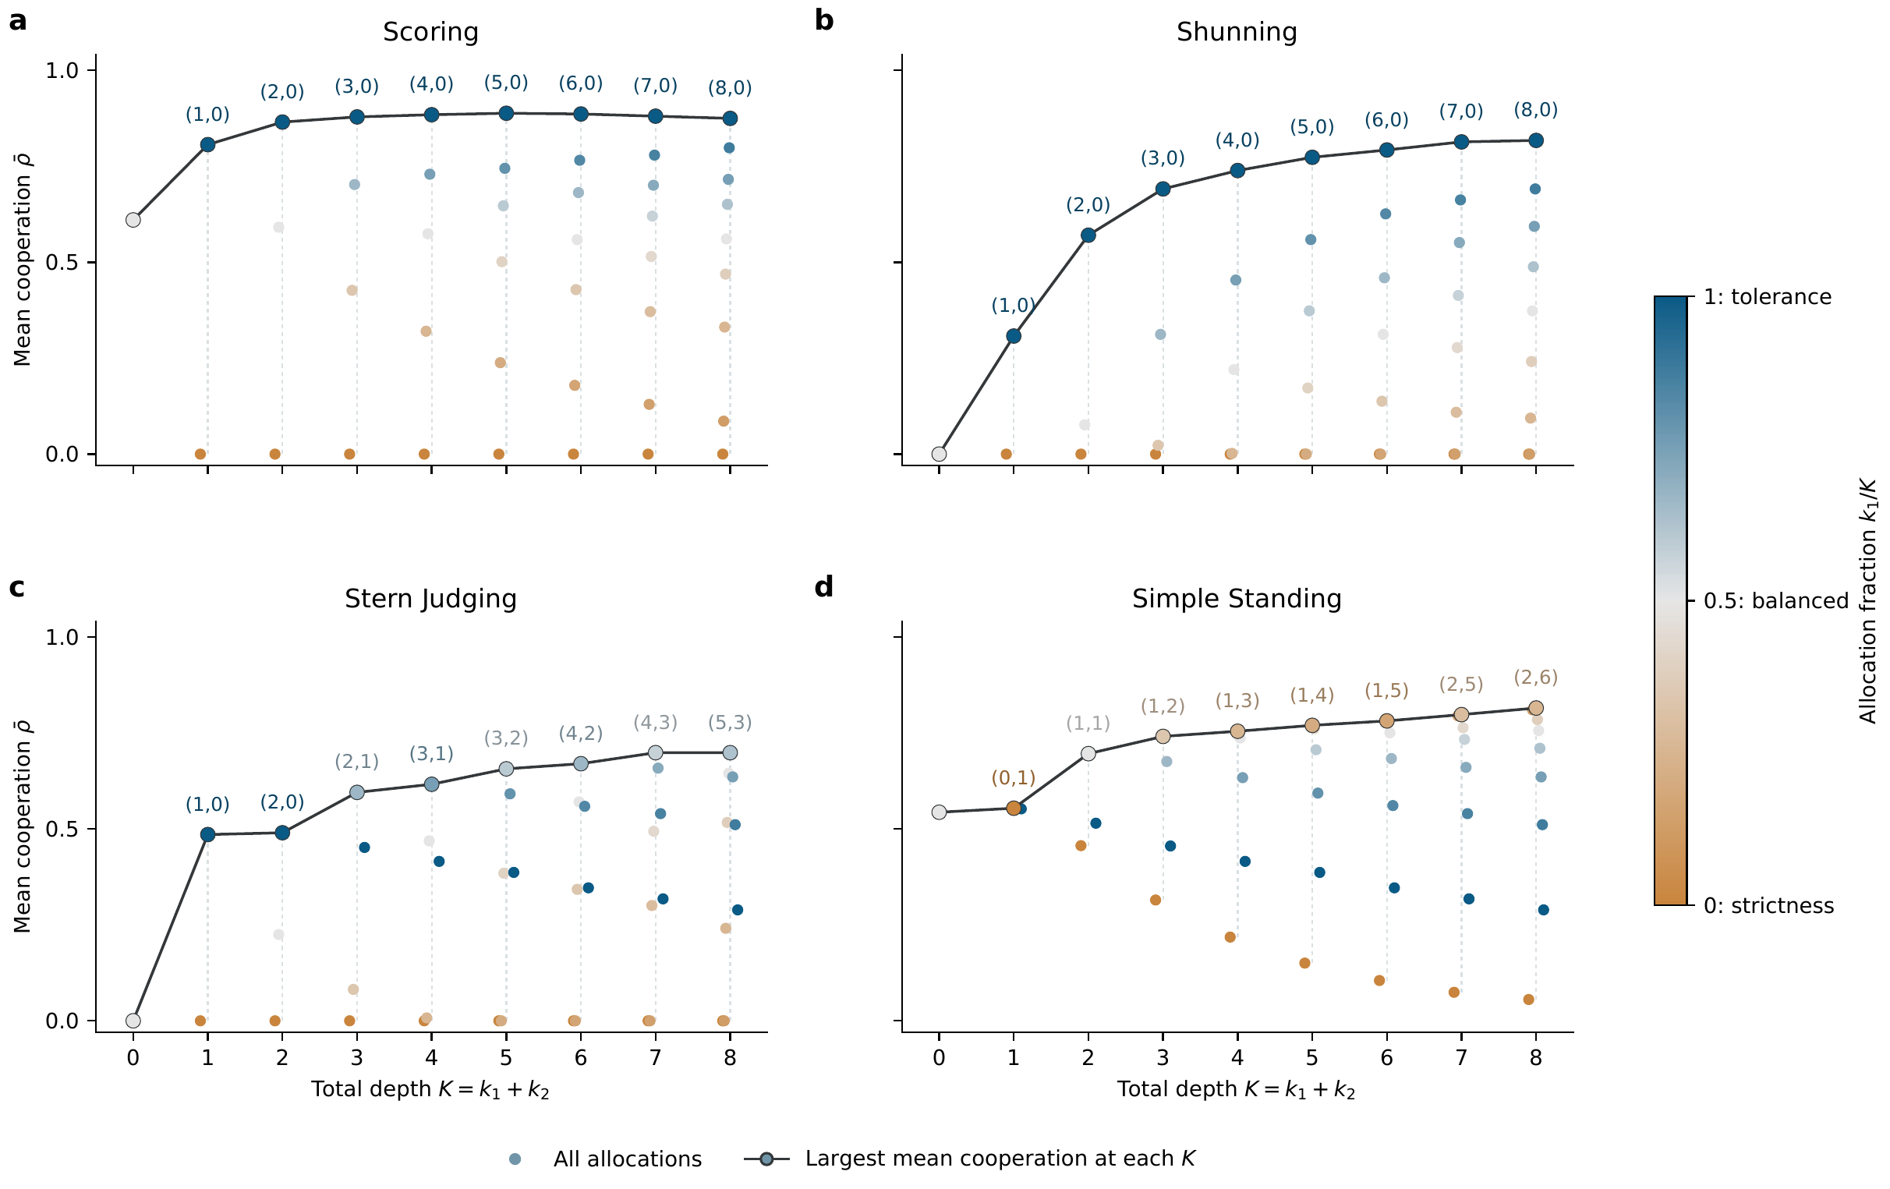
Allocation, not amount, determines cooperation
Fig. 4 | Mean realized cooperation ρ̄ (512 initial compositions) for every allocation (k₁,k₂) at total depth K. Color: tolerance fraction k₁/K. Black line: best allocation at each K. α = β = 1, b/c = 5.
At fixed depth, cooperation ranges from none to high depending on direction. The reputation-selected architectures are the best allocations at their depths, and extra depth saturates.
Rendered from the verified data; manuscript artwork to be updated.

Slide 28
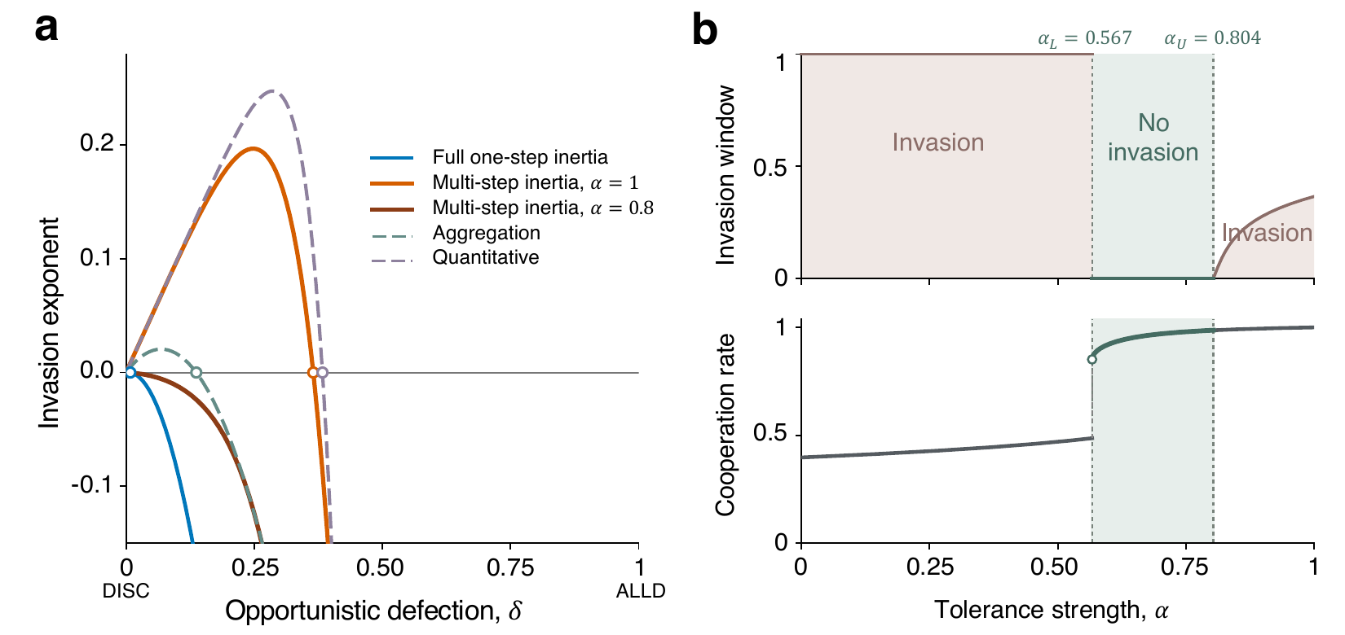
Tolerance invites opportunism; lower tolerance strength restores deterrence
Fig. 5 | a, invasion payoff Λ(δ) of O-DISC under SJ: one-step inertia, (4,3) with α = 1 and 0.8, aggregation and a quantitative score. b, (4,3) against α: invasion endpoint δ_{c} (top) and resident cooperation (bottom). Green: secure range α_{L} < α ≤ α_{U}. β = 1, b/c = 5.
All mechanisms exclude ALLD, yet partial opportunists invade (0 < δ < 0.365 for (4,3) at α = 1). For 0.57 < α ≤ 0.80, every O-DISC mutant is excluded and cooperation stays high.

Slide 29
Conclusion
4

Slide 30
Back to the research gap
How should reputations integrate evidence over time? | Separately for losing and regaining standing. The allocation of inertia, not its amount, decides whether private reputations are accurate and shared.
Does this matter for the evolution of cooperation? | Yes. Compact architectures selected on reputational criteria alone make cooperation stable and accessible under all four norms.
Is tolerance safe? | No. Tolerance shelters occasional defectors even when ALLD is excluded. Partial consequences of warning states (α < 1) restore deterrence while cooperation stays high.

Slide 31
Reputation-based cooperation depends not only on which behaviors are judged good, but also on how reputations accumulate and express behavioral evidence.
Conceptual: accumulation versus interpretation of evidence
Analytical: closed-form reputation map, chord and family criteria
Evolutionary: norm-specific architectures and the tolerance–accountability trade-off

Slide 32
Points for discussion
Narrative and venue
Storyline A or B?
Target journal and framing
Evolving architectures
Let k₁, k₂, α, β evolve
Co-evolution with norms
Strategic opportunism
Defections timed to the record
Temporally correlated omissions
Beyond mean field
Simultaneous reputation and strategy change
Structured populations
Combining mechanisms
Inertia plus opinion synchronization
Dual (recipient) assessment
Empirical tests
Partial distrust after a single lapse
Norm-dependent asymmetric updating

Slide 33
Supplementary results
5

Slide 34
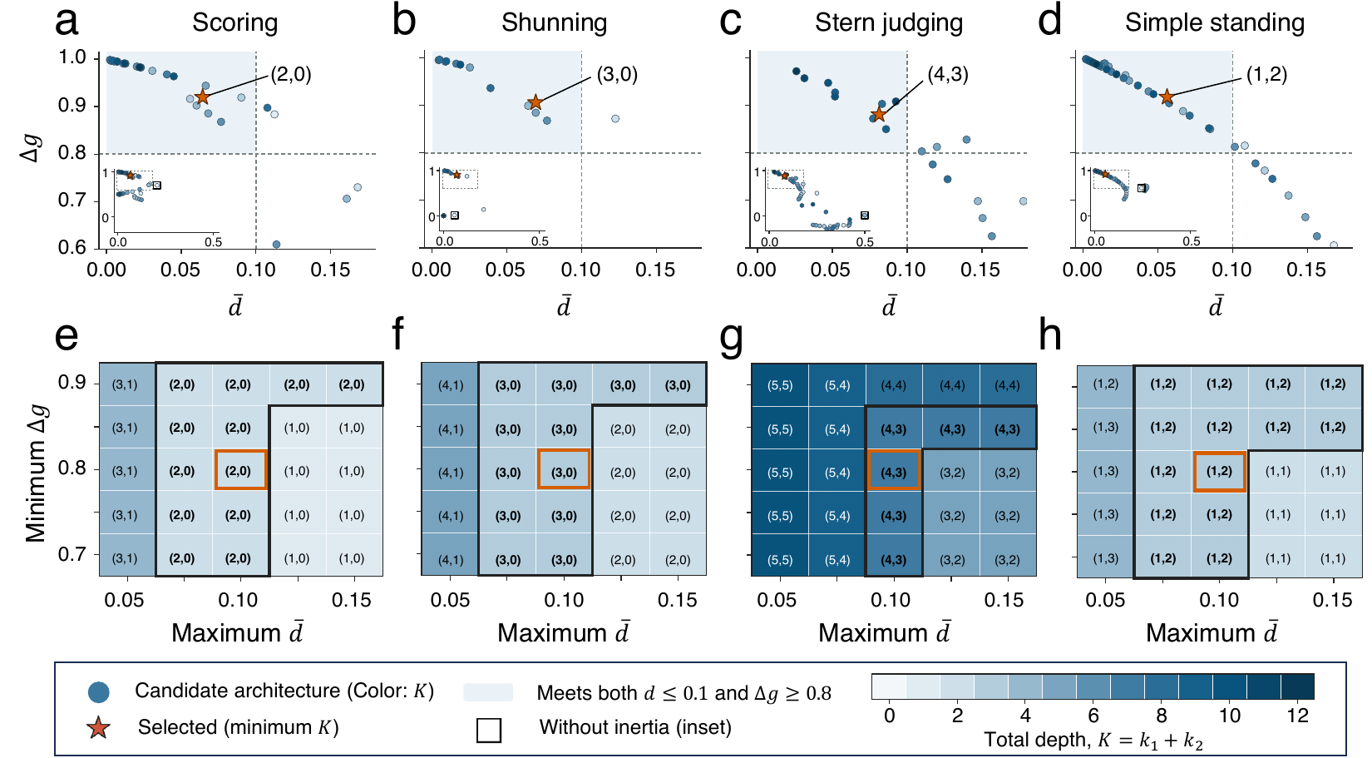
Selection is robust across criteria
Extended Data Fig. 1 | a–d, Δg against d̄ for all depth pairs (30 replicates; color: total depth K); stars: selected pairs. e–h, minimum-depth pair selected as the separation and disagreement thresholds vary; orange: default criteria.
Exact depth pairs depend on the thresholds, but compact, norm-specific architectures qualify over a wide range of criteria.

Slide 35
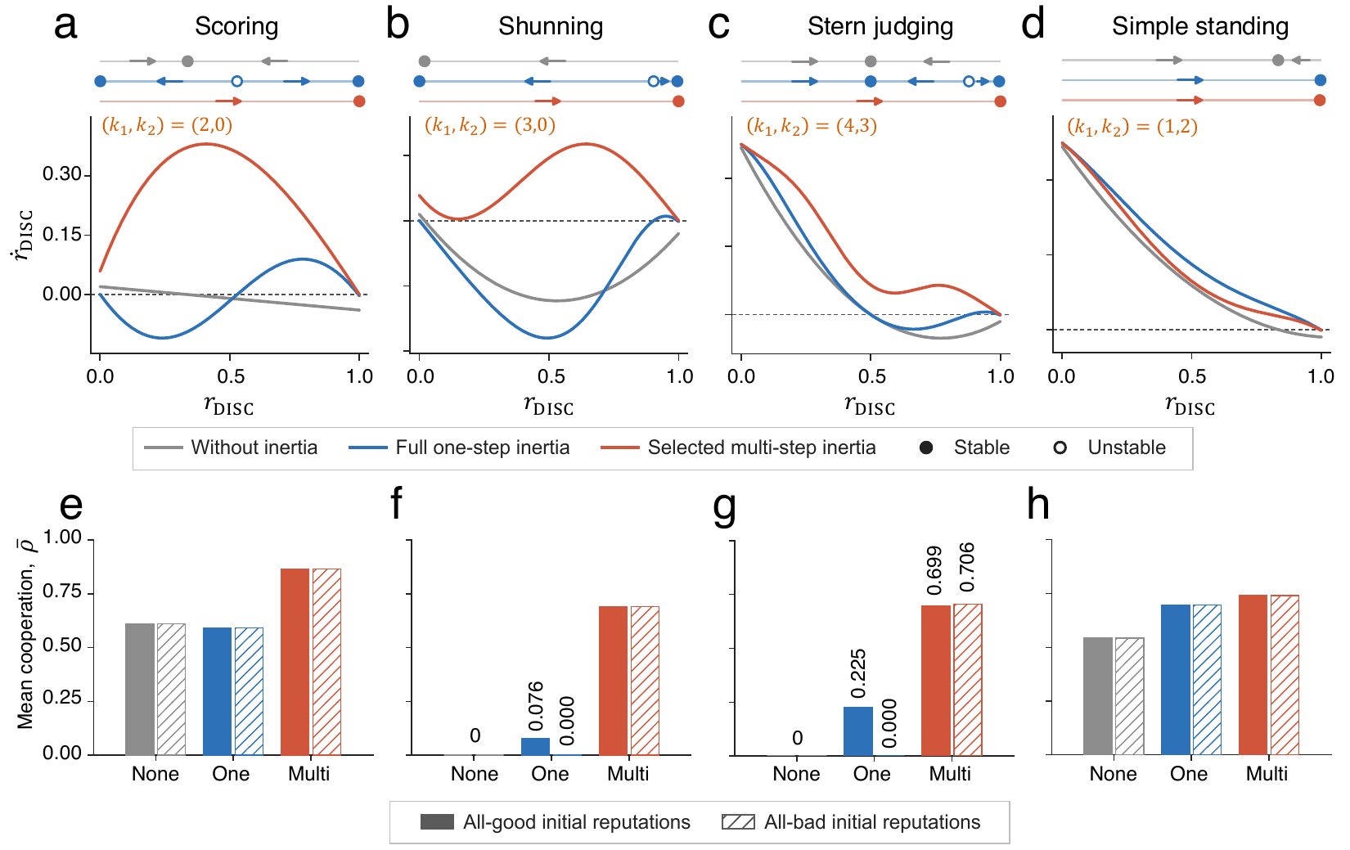
One-step inertia is bistable; the selected architectures are not
Extended Data Fig. 2 | a–d, reputation dynamics in homogeneous DISC populations (gray: none; blue: one-step; red: selected). e–h, mean cooperation ρ̄ after all-good (solid) and all-bad (hatched) initial reputations.
One-step inertia leaves SC, SH and SJ bistable, so cooperation under SH and SJ collapses from all-bad records. The selected architectures have a single high-reputation state.

Slide 36
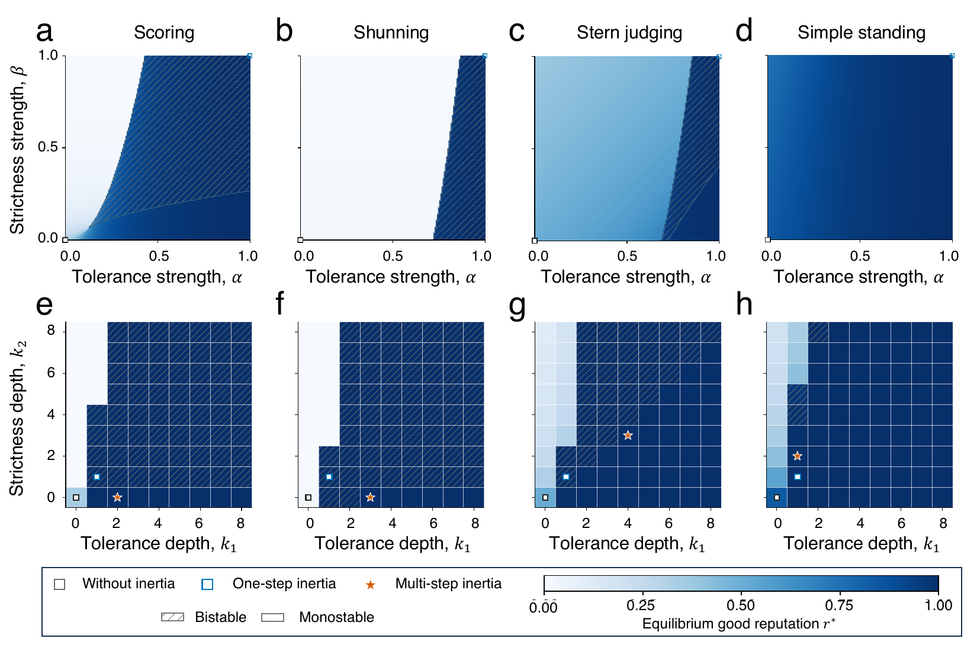
Strengths and depths jointly shape reputation equilibria
Extended Data Fig. 3 | Highest stable reputation of a homogeneous DISC population across (α,β) at one-step depths (a–d) and across (k₁,k₂) with α = β = 1 (e–h). Hatching: bistability; stars: selected architectures.
Reputation levels and bistability depend on the norm and on the direction and strength of inertia.

Slide 37
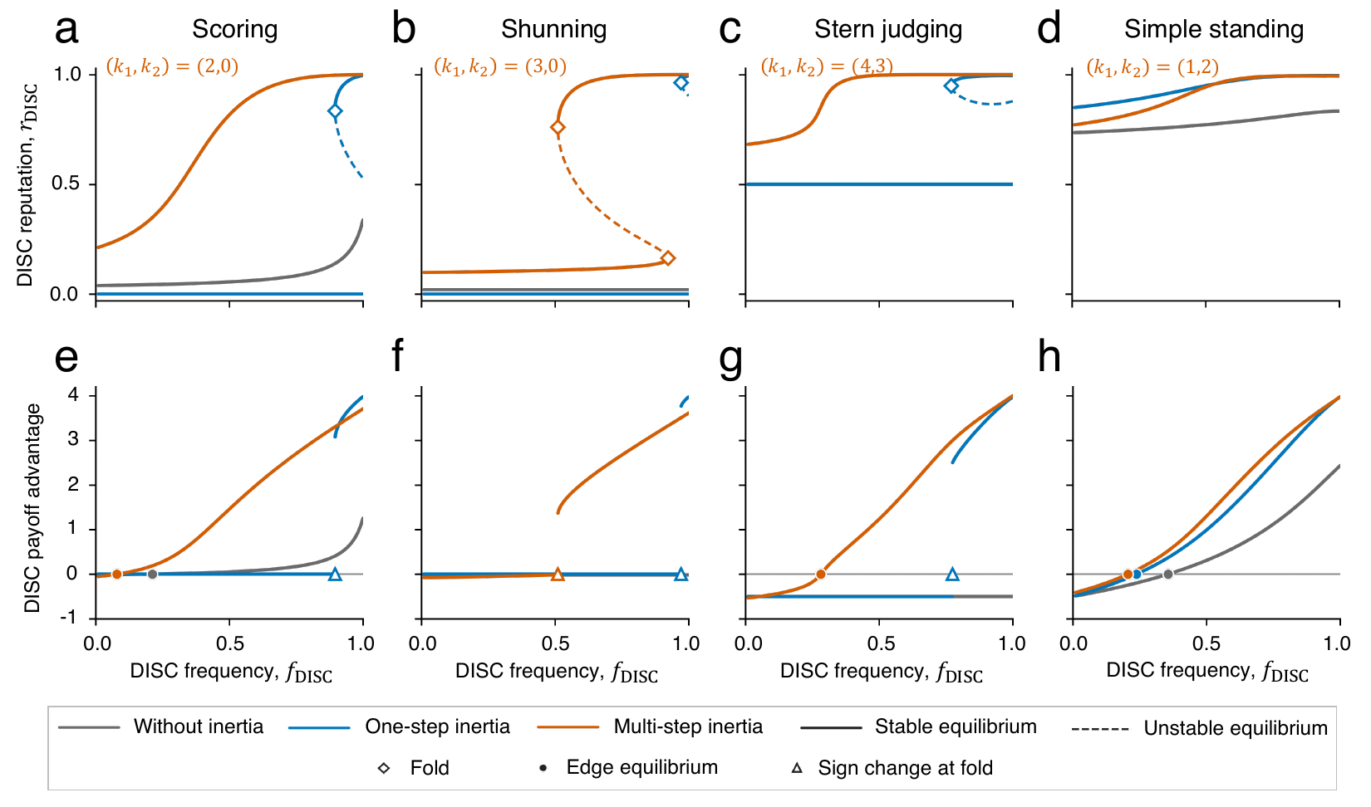
Why basins expand: the ALLD–DISC edge
Extended Data Fig. 4 | a–d, DISC reputation along the ALLD–DISC edge (solid: stable; dashed: unstable; diamonds: folds). e–h, payoff advantage of DISC over ALLD on the all-good branch.
Under one-step inertia DISC loses its good reputation abruptly when rare. The selected architectures shift (SH) or remove (SC, SJ) this fold.

Slide 38
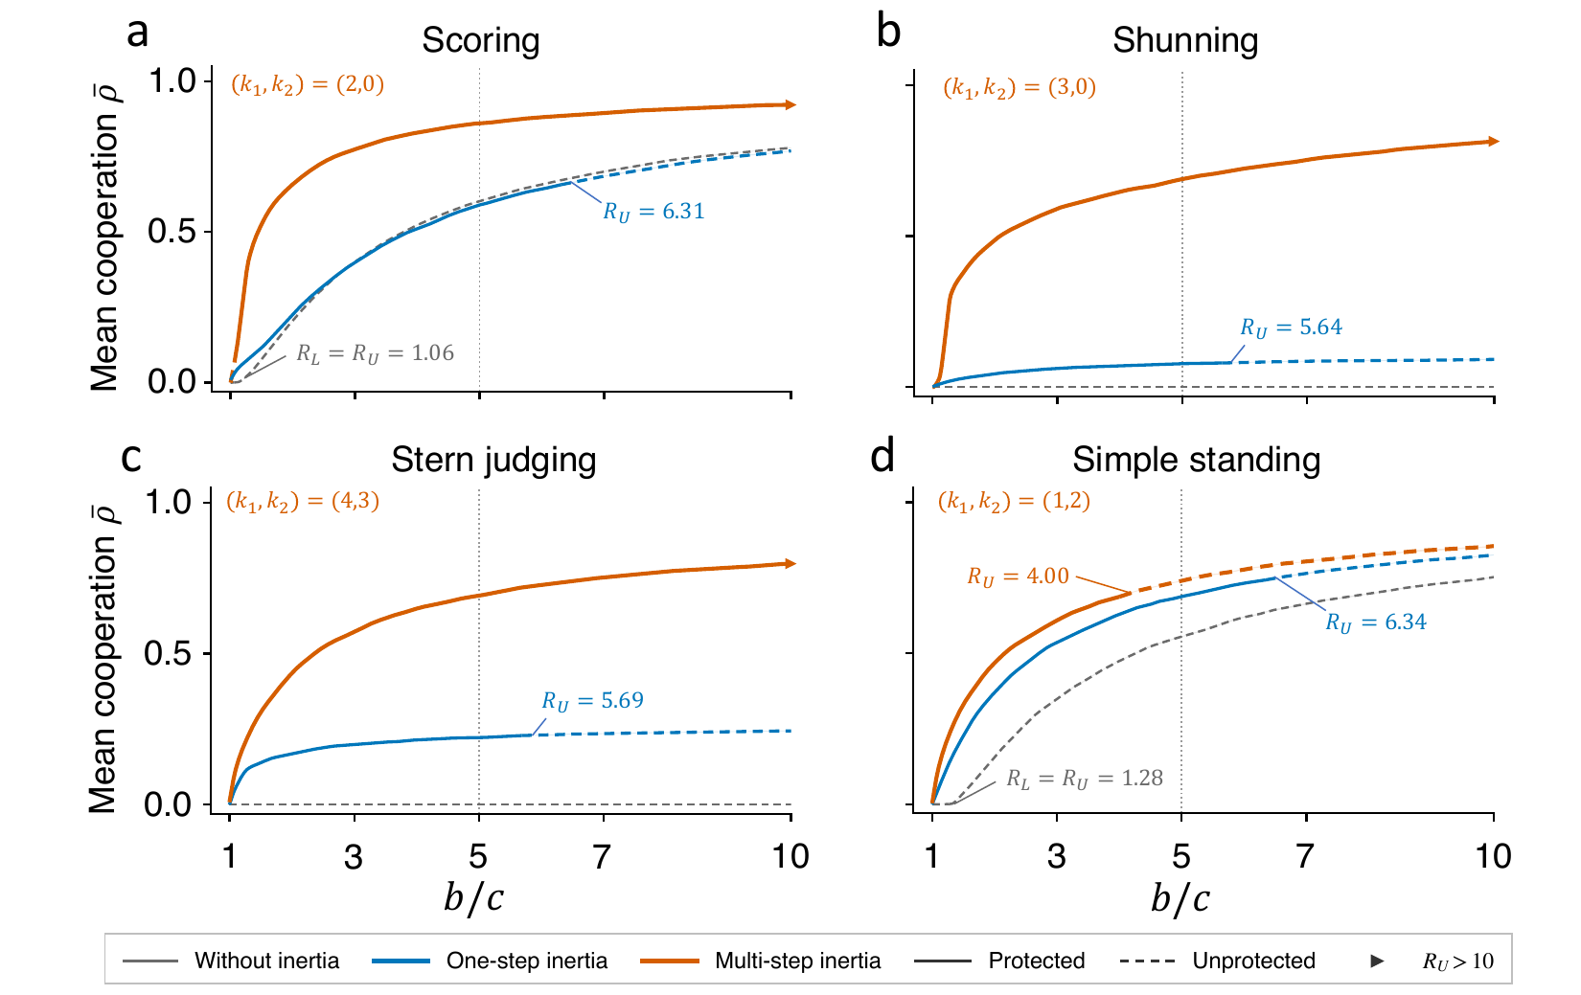
Benefit-to-cost ratio and local protection
Extended Data Fig. 5 | Mean cooperation ρ̄ against b/c. Solid: pure DISC resists ALLC and ALLD (R_{L} < b/c < R_{U}); dashed: not protected. Means over eight samples of 512 initial compositions.
The selected architectures give the most cooperation across b/c. Under SS, cooperation stays high even above R_{U} ≈ 4.

Slide 39
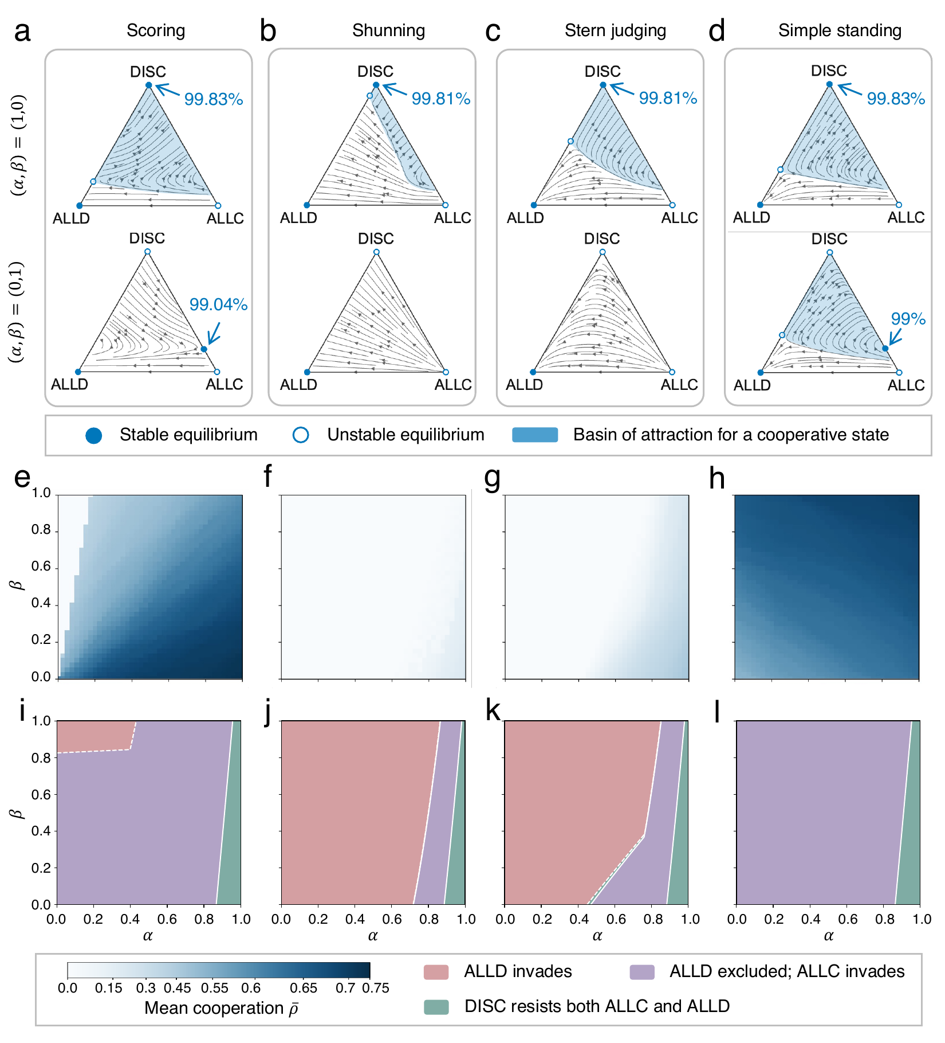
Tolerance and strictness strengths act differently
Extended Data Fig. 6 | One-step depths. a–d, dynamics with tolerance only, (α,β) = (1,0) (top), and strictness only, (0,1) (bottom). e–h, mean cooperation over the (α,β) plane. i–l, local invasion classes.
Tolerance only stabilizes highly cooperative DISC populations under all four norms. Strictness only does not, and its effect depends on the norm.

Slide 40
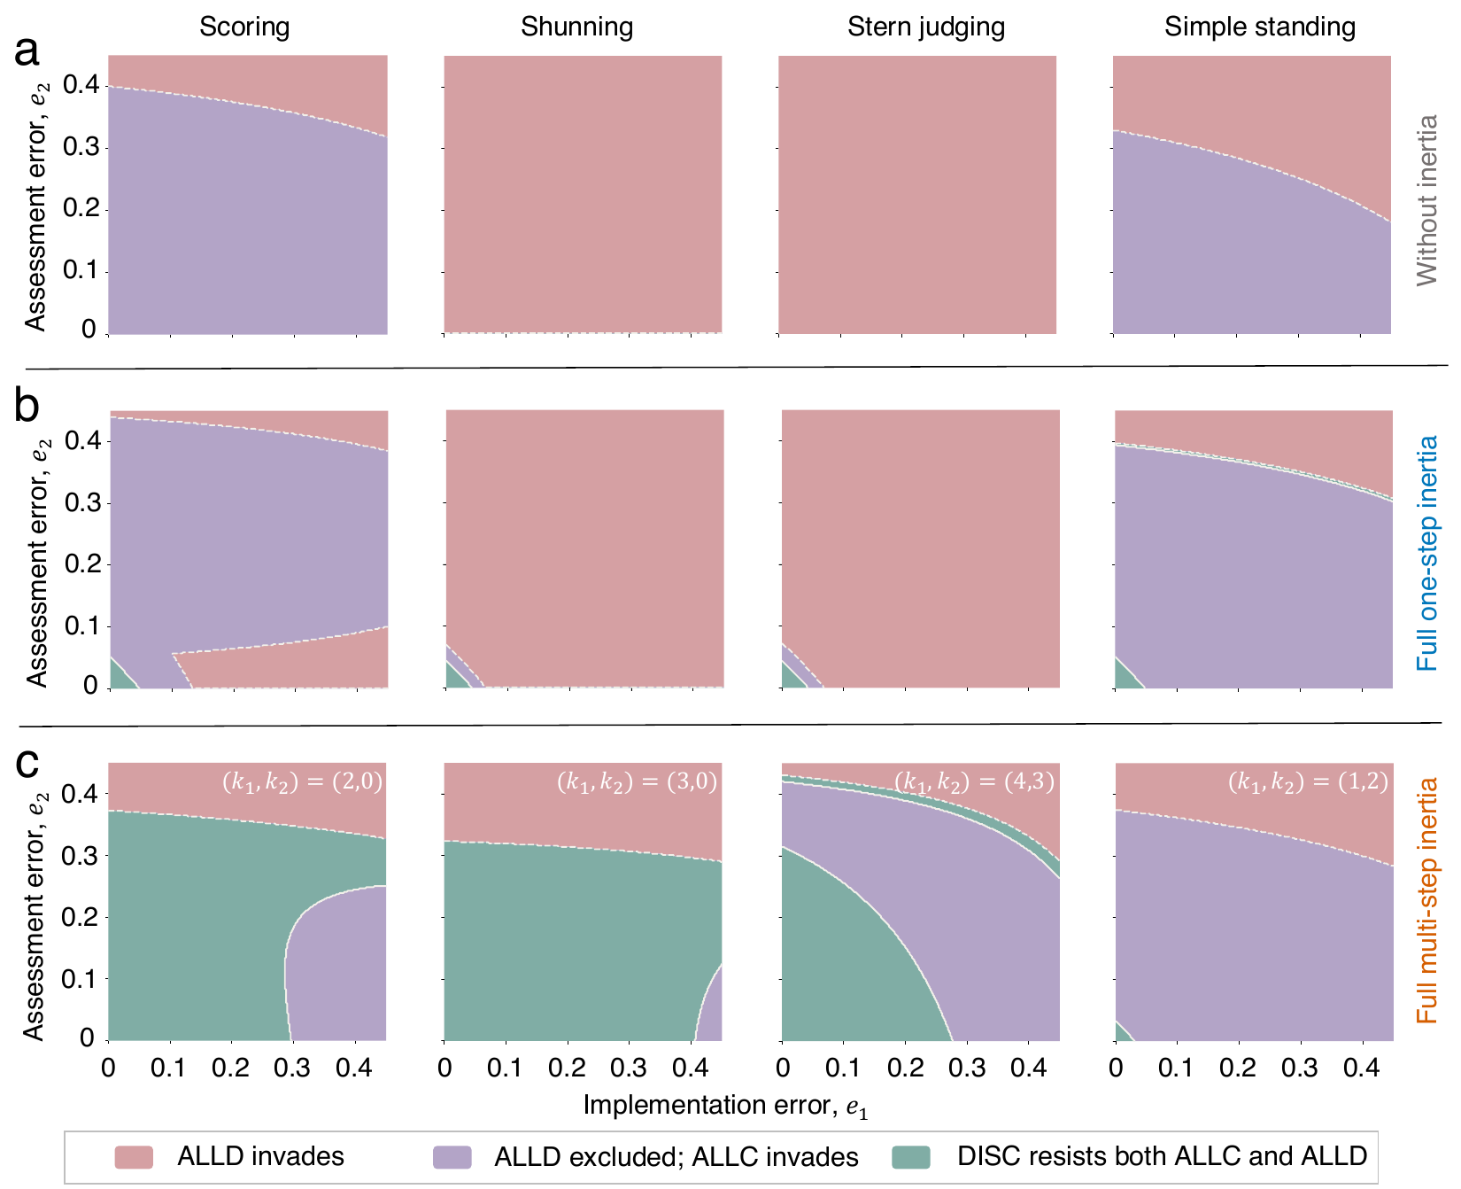
Local protection across error rates
Extended Data Fig. 7 | Local invasion classes over implementation error e₁ and assessment error e₂ without inertia (a), with one-step inertia (b) and with the selected architectures (c). Pink: ALLD invades; purple: ALLC invades; green: DISC resists both.
The selected architectures exclude ALLD over most error rates under SH and SJ, and protect DISC against both mutants over most of the plane under SC and SH.

Slide 41
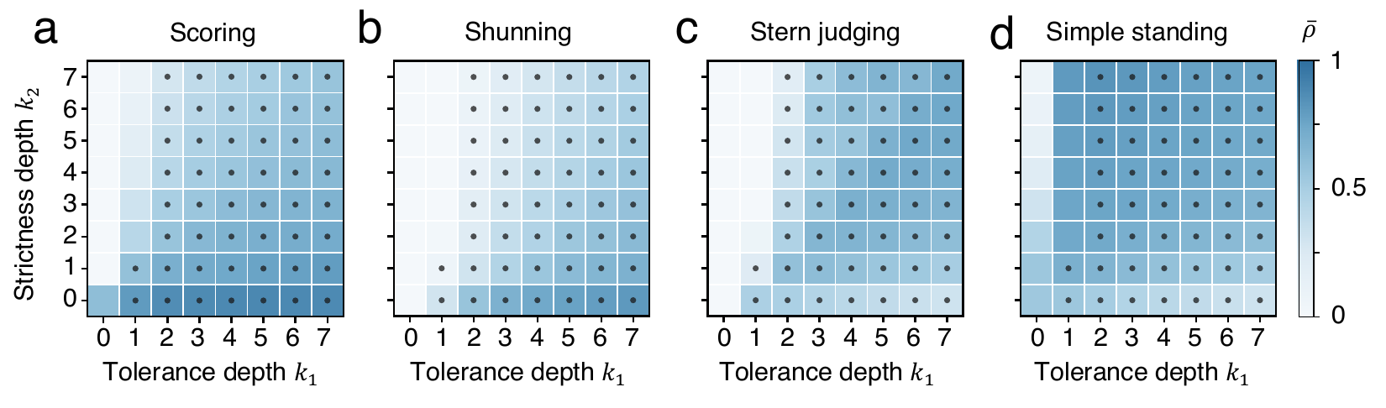
Cooperation and protection across the depth plane
Extended Data Fig. 8 | Mean cooperation ρ̄ over (k₁,k₂); dots: pure DISC resists rare ALLC and ALLD. α = β = 1, b/c = 5.
High cooperation follows norm-specific directions, and local protection of pure DISC does not coincide with high population-level cooperation.

Slide 42
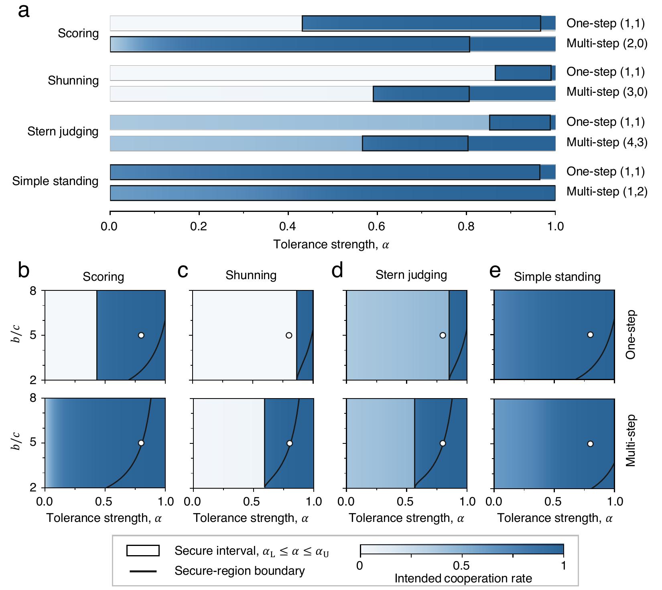
Secure tolerance strengths across norms and benefit-to-cost ratios
Extended Data Fig. 9 | a, secure intervals of α at b/c = 5 for one-step and selected architectures (black frames; shading: resident cooperation). b–e, security across α and b/c; circles: (α,b/c) = (0.8,5).
At α = 0.8 all selected architectures resist O-DISC with high cooperation. Protective ranges shrink as b/c decreases and close under SH at b/c = 2.

Slide 43
Analytical highlights
Result | Statement
No window without inertia | If ℛ(u) = u, then R_{L} = R_{U} = 1/ΔΦ*, so no b/c protects pure DISC against both ALLD and ALLC.
Chord condition | The protection window is open if and only if ℛ lies above its chord between Φ*_{D} and Φ*_{C} at u_{R}*.
Worst opportunist | If ℛ is concave (e.g. k₂ = 0), H is non-decreasing in δ, so Λ′(0) ≤ 0 excludes the whole O-DISC family.
Error-free threshold | With β = 1 and k₁ ≥ 1, an all-good resident excludes every O-DISC mutant if and only if α ≤ 1−c/b.
Closing of secure intervals | Near a fold the interval closes at b/c = u_{R}′/ΔΦ, which equals 2 under SH for all errors and depths.
SC without inertia | A line of equilibria at f_{DISC} = c/[b(ε−e₂)], attracting on the ALLC side and repelling on the ALLD side.

Slide 44
Reference values
Local protection thresholds (α = β = 1)
Basin ω_{C} and mean cooperation ρ̄
Norm | Setting | r_{R}* | R_{U}
SC | one-step | 0.9963 | 6.31
 | selected (2,0) | 0.9999 | 230
SH | one-step | 0.9953 | 5.64
 | selected (3,0) | 1.0000 | 4410
SJ | one-step | 0.9953 | 5.69
 | selected (4,3) | 1.0000 | 20910
SS | one-step | 0.9963 | 6.34
 | selected (1,2) | 0.9937 | 4.00
Norm | None | One-step | Selected
SC | 0.63 / 0.61 | 0.61 / 0.59 | 0.88 / 0.87
SH | 0 / 0 | 0.08 / 0.08 | 0.71 / 0.69
SJ | 0 / 0 | 0.23 / 0.22 | 0.71 / 0.70
SS | 0.56 / 0.54 | 0.71 / 0.70 | 0.76 / 0.74
512 initial compositions, b/c = 5.
R_{L} lies between 1.00 and 1.08 in all inertial cases.

Slide 45
References (1/2)
Milinski, M. Reputation, a universal currency for human social interactions. Phil. Trans. R. Soc. B 371, 20150100 (2016).
Nowak, M. A. & Sigmund, K. Evolution of indirect reciprocity by image scoring. Nature 393, 573–577 (1998).
Nowak, M. A. & Sigmund, K. Evolution of indirect reciprocity. Nature 437, 1291–1298 (2005).
Ohtsuki, H. & Iwasa, Y. How should we define goodness? Reputation dynamics in indirect reciprocity. J. Theor. Biol. 231, 107–120 (2004).
Ohtsuki, H. & Iwasa, Y. The leading eight: social norms that can maintain cooperation by indirect reciprocity. J. Theor. Biol. 239, 435–444 (2006).
Hilbe, C., Schmid, L., Tkadlec, J., Chatterjee, K. & Nowak, M. A. Indirect reciprocity with private, noisy, and incomplete information. Proc. Natl Acad. Sci. USA 115, 12241–12246 (2018).
Fujimoto, Y. & Ohtsuki, H. Reputation structure in indirect reciprocity under noisy and private assessment. Sci. Rep. 12, 10500 (2022).
Fujimoto, Y. & Ohtsuki, H. Evolutionary stability of cooperation in indirect reciprocity under noisy and private assessment. Proc. Natl Acad. Sci. USA 120, e2300544120 (2023).
Radzvilavicius, A. L., Stewart, A. J. & Plotkin, J. B. Evolution of empathetic moral evaluation. eLife 8, e44269 (2019).
Okada, I. A review of theoretical studies on indirect reciprocity. Games 11, 27 (2020).
Radzvilavicius, A. L., Kessinger, T. A. & Plotkin, J. B. Adherence to public institutions that foster cooperation. Nat. Commun. 12, 3567 (2021).
Kawakatsu, M., Kessinger, T. A. & Plotkin, J. B. A mechanistic model of gossip, reputations, and cooperation. Proc. Natl Acad. Sci. USA 121, e2400689121 (2024).
Murase, Y. & Hilbe, C. Indirect reciprocity with stochastic and dual reputation updates. PLoS Comput. Biol. 19, e1011271 (2023).
Murase, Y. & Hilbe, C. Indirect reciprocity under opinion synchronization. Proc. Natl Acad. Sci. USA 121, e2418364121 (2024).

Slide 46
References (2/2)
Tham, Y. J., Hilbe, C. & Murase, Y. Indirect reciprocity with dual private assessment. Proc. Natl Acad. Sci. USA 123, e2624656123 (2026).
Schmid, L., Shati, P., Hilbe, C. & Chatterjee, K. The evolution of indirect reciprocity under action and assessment generosity. Sci. Rep. 11, 17443 (2021).
Schmid, L., Ekbatani, F., Hilbe, C. & Chatterjee, K. Quantitative assessment can stabilize indirect reciprocity under imperfect information. Nat. Commun. 14, 2086 (2023).
Clark, D., Fudenberg, D. & Wolitzky, A. Indirect reciprocity with simple records. Proc. Natl Acad. Sci. USA 117, 11344–11349 (2020).
Michel-Mata, S. et al. The evolution of private reputations in information-abundant landscapes. Nature 634, 883–889 (2024).
Yamamoto, H., Okada, I. & Suzuki, T. Gradual reputation dynamics evolve and sustain cooperation in indirect reciprocity. PLoS ONE 20, e0329742 (2025).
Ostrom, E. Governing the Commons: The Evolution of Institutions for Collective Action (Cambridge Univ. Press, 1990).
Cox, M., Arnold, G. & Villamayor-Tomás, S. A review of design principles for community-based natural resource management. Ecol. Soc. 15, 38 (2010).
Tadelis, S. Reputation and feedback systems in online platform markets. Annu. Rev. Econ. 8, 321–340 (2016).
Blumstein, A. & Nakamura, K. Redemption in the presence of widespread criminal background checks. Criminology 47, 327–360 (2009).
Mende-Siedlecki, P., Cai, Y. & Todorov, A. The neural dynamics of updating person impressions. Soc. Cogn. Affect. Neurosci. 8, 623–631 (2013).
Mende-Siedlecki, P., Baron, S. G. & Todorov, A. Diagnostic value underlies asymmetric updating of impressions in the morality and ability domains. J. Neurosci. 33, 19406–19415 (2013).
Slovic, P. Perceived risk, trust, and democracy. Risk Anal. 13, 675–682 (1993).
Siegel, J. Z., Mathys, C., Rutledge, R. B. & Crockett, M. J. Beliefs about bad people are volatile. Nat. Hum. Behav. 2, 750–756 (2018).

