Slide 1
Containerization

Slide 2
Who are we
About me:
I became member of Flug when I studied at Imada
President of Flug since… Well tool long
Work at Blue Ocean Robotics as TechOps
About Flug:
Flug is a local association of volunteer who want to study and support FOSS
We like to experiment with new stuff and share our experiences
We also like to tell about the tools we use everyday
Our events are free. But you have to pay for the Pizzas before and Beers after

Slide 3
What I’ll talk about today
Well, Docker have become boring
Let’s spice it up with opinions.
I will go through stuff that I think is important. And skip what I don’t care about ( Like docker-compose ;-) )

Slide 4

What is Containerization for
All the advantage of running one app per box and without the overhead
  When the code is confined to a container
  Cheaper than a billion boxes
  Cheaper than Virtual machines. Even when hardware accelerated. Does not require special hardware support and is not transcoding executables.
Run software independent of OS, package versions, interpreter versions
Collaborate.
  Especially collaborating with devs on other teams.
Feel like root
CI/CD

Slide 5
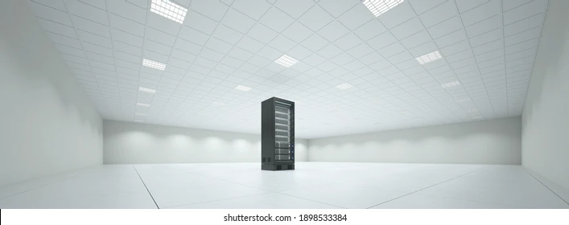
The early history
Other OSes makes cool features like:
  IBM mainframes make Logical partition ( LPAR )
  Solaris Zones
  Jails in FreeBSD

Slide 6
Linux enters the Containerization age
OpenVZ
  Originally called Virtuozzo
  Frist client 2002 and OpenSource 2005
Xen
  Research project on Cambridge in 2003. Sold to Citrix in 2007
Linux Containers ( LXC )
  Was better integrated into the Linux kernel. Using cgroups and so on.
  First release in 2008
How they were used:
With existing tools for building ( eg. Kickstart and Packer )

Slide 7
And then came Docker
Docker created as a userspace tool to LXC
Creators of Docker changed their name to Docker Inc.
Docker open sources 2014
docker compose 2014
libcontainer created and to better work with LXC devs
OpenContainer Initiative created in 2015
rewriten docker compose in Go 2017

Slide 8
How does it work:
On most modern OSes apps runs as one or more processes and processes runs in Virtual Machines.
New Linux feature cgroups. Highly inspired by a feature of FreeBSD called Jails. You can group processes into a cgroup. Processes in the same cgroup can see each other. And only each other. And they have the same file system root and network rules. etc.
LCS was first to use cgroups. LXC gained some traction. It worked great and was a good system.
Docker recycled kernel API from LXC
Added registry ( DockerHub ).
And support for private registries.

Slide 9
What Docker doesn’t do
Docker is really god for many things. But remember this:
User separation ( If you are in the Docker group, you are also root )
Set some practises:
  If app fails it is supposed to terminate
  Log info from any app should be written to stdout
  Log error should be written to stderr
You should tag images ( Eg “FROM ubuntu:22.04” )
You should update dependencies regularly
App should run without root privileges
Don’t push images that contains your secrets!
Garbage collect images

Slide 10
More recent stuff
Further compartmentalization to avoid code conflicts between Docker and LXC:
client/server split of Docker to help not step in the toes of LXC
containerd comes into the picture with OpenContainer Initiative started in 2015
  This was first implemented by Docker Inc and then given to Cloud Native Computing Foundation that is part of the Linux Foundation
Lots of Docker rewritten i Go.

Slide 11
Go deep level with containerd
TOOLBOX_DOCKER_IMAGE=docker.io/library/fedora
TOOLBOX_DOCKER_TAG=latest
TOOLBOX_DIRECTORY="/var/lib/toolbox"
TOOLBOX_TEMP_DIR=$(mktemp -d)
containername=”containername”
machinepath=/usr/local/toolbox; sudo mkdir -p ${machinepath}
sudo ctr image pull "${TOOLBOX_DOCKER_IMAGE}:${TOOLBOX_DOCKER_TAG}"
sudo ctr containers create "${TOOLBOX_DOCKER_IMAGE}:${TOOLBOX_DOCKER_TAG}" ${containername} /bin/true
sudo ctr snapshot mounts "${TOOLBOX_TEMP_DIR}" ${containername} | xargs sudo
sudo rsync -a "${TOOLBOX_TEMP_DIR}/" "${machinepath}"
sudo umount "${TOOLBOX_TEMP_DIR}"
sudo ctr container rm ${containername}
sudo rm -rf "${TOOLBOX_TEMP_DIR}"
Look what you can do with containerd:

Slide 12
What does ctr snapshot mounts do?
mount -t overlay overlay /tmp/tmp.njwmrOGcEZ -o index=off,workdir=/var/lib/containerd/io.containerd.snapshotter.v1.overlayfs/snapshots/2/work,upperdir=/var/lib/containerd/io.containerd.snapshotter.v1.overlayfs/snapshots/2/fs,lowerdir=/var/lib/containerd/io.containerd.snapshotter.v1.overlayfs/snapshots/1/fs

Slide 13
Little about PodMan
Podman Developed by RedHat from ~2019 and Docker developed by Docker Inc
Both under Apache license
Podman is pretty much compatible with Docker. ( both cli and Images )
Some differences:
  They default to different registries.
    podman pull fedora gets you registry.fedoraproject.org/fedora and docker gets docker.io/library/fedora
    podman pull centos gets you quay.io/centos/centos and docker gets docker.io/library/centos
Docker have Docker Desktop that is available under a custom commercial license.
Podman have Podman Desktop that is available under Apache license

Slide 14
Buildx plugin
Adds cool features like:
  Concurrent build to speed up build times
  Can build and run arm packages on x86_64 and vice versa

