Slide 1
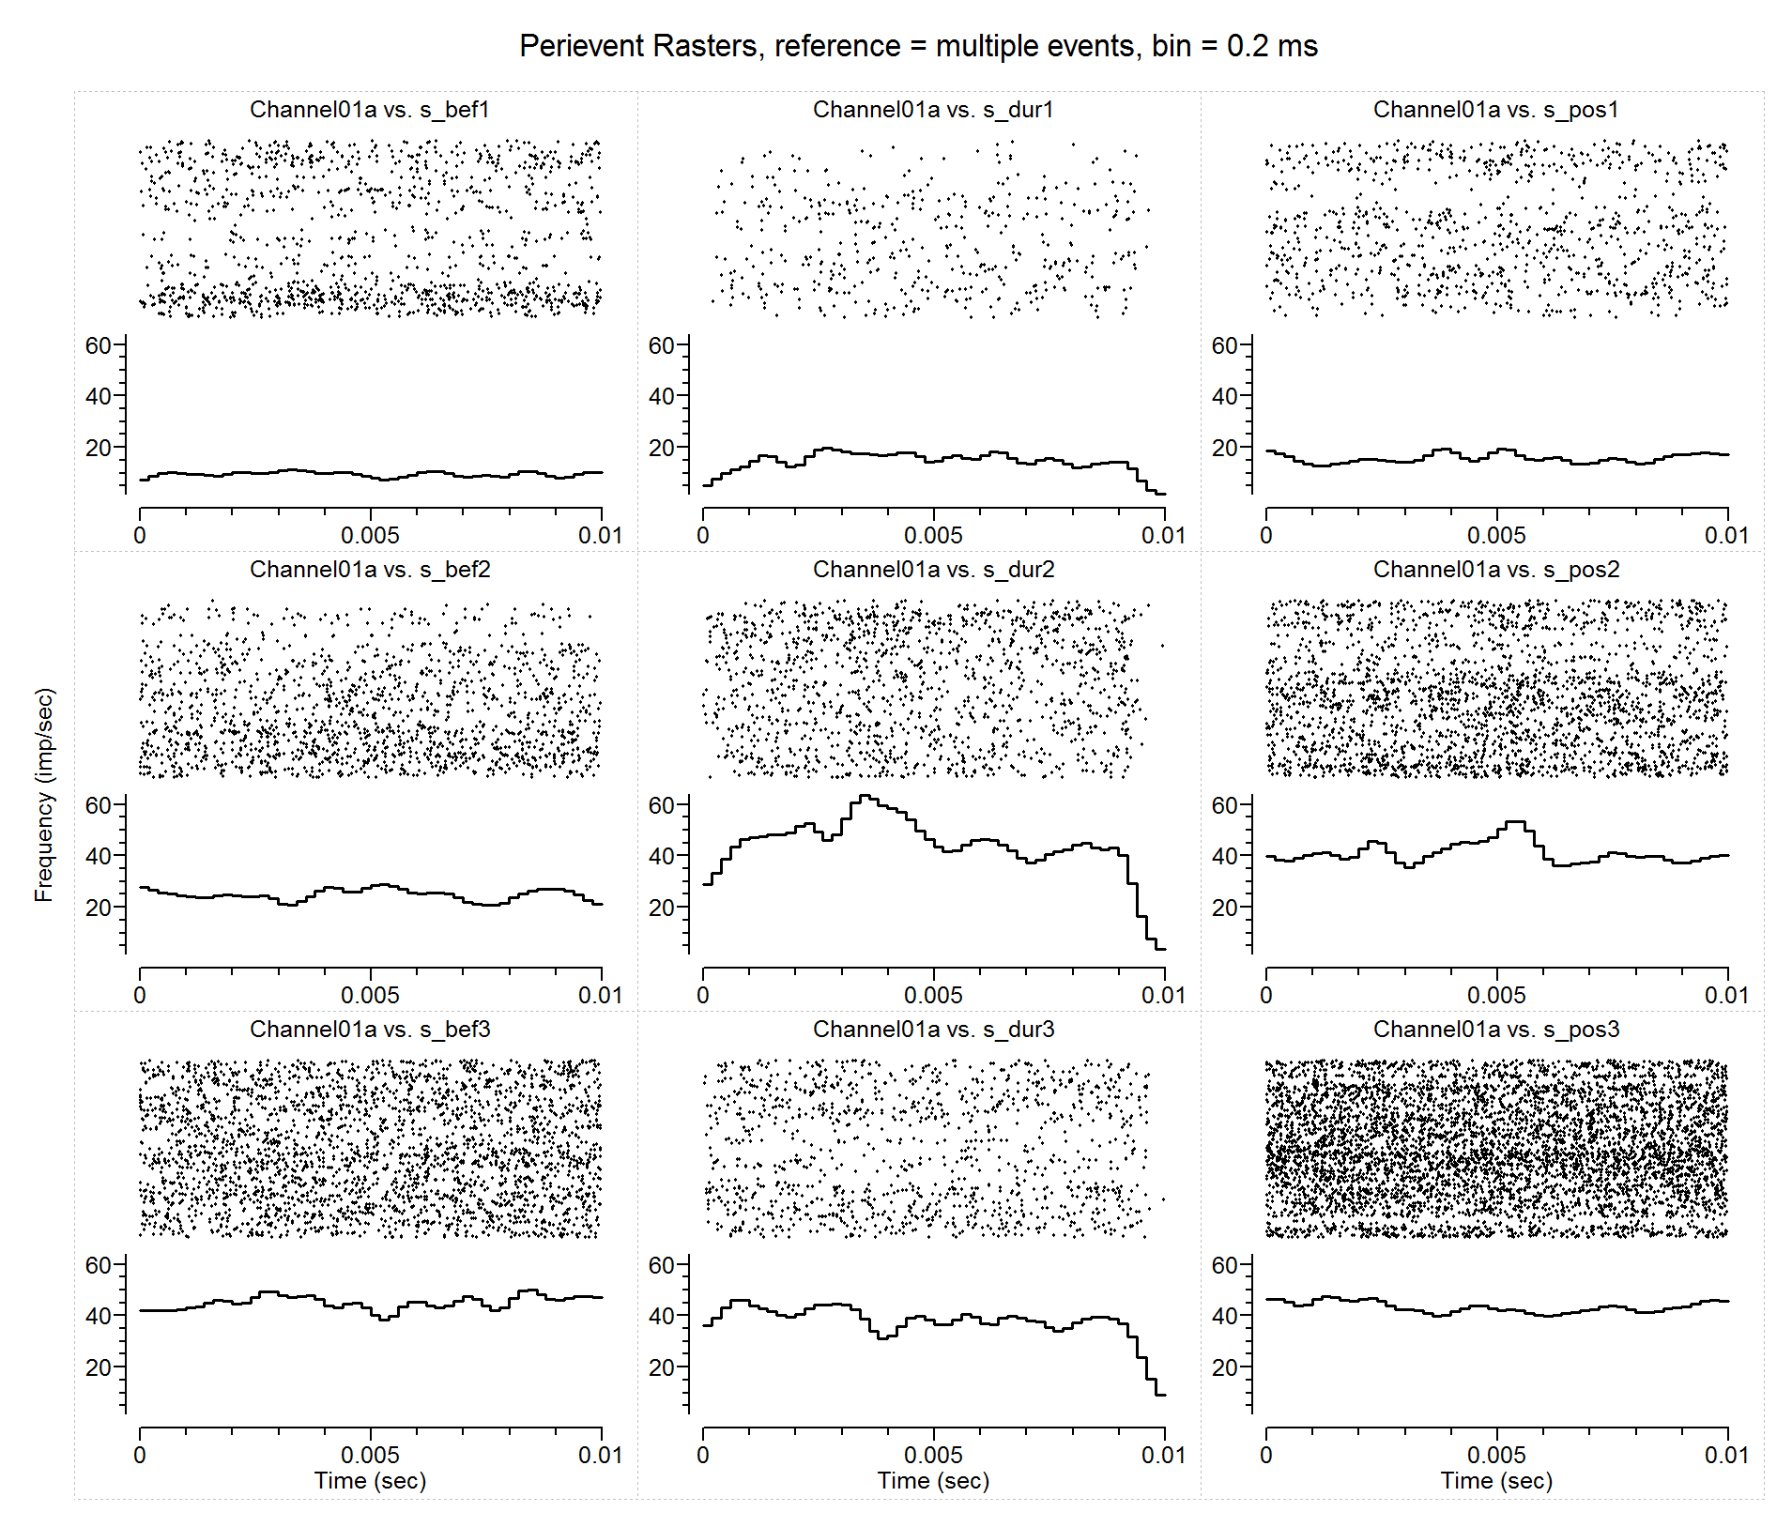
15_07_31k_0003_C1 (17510 count)

Slide 2
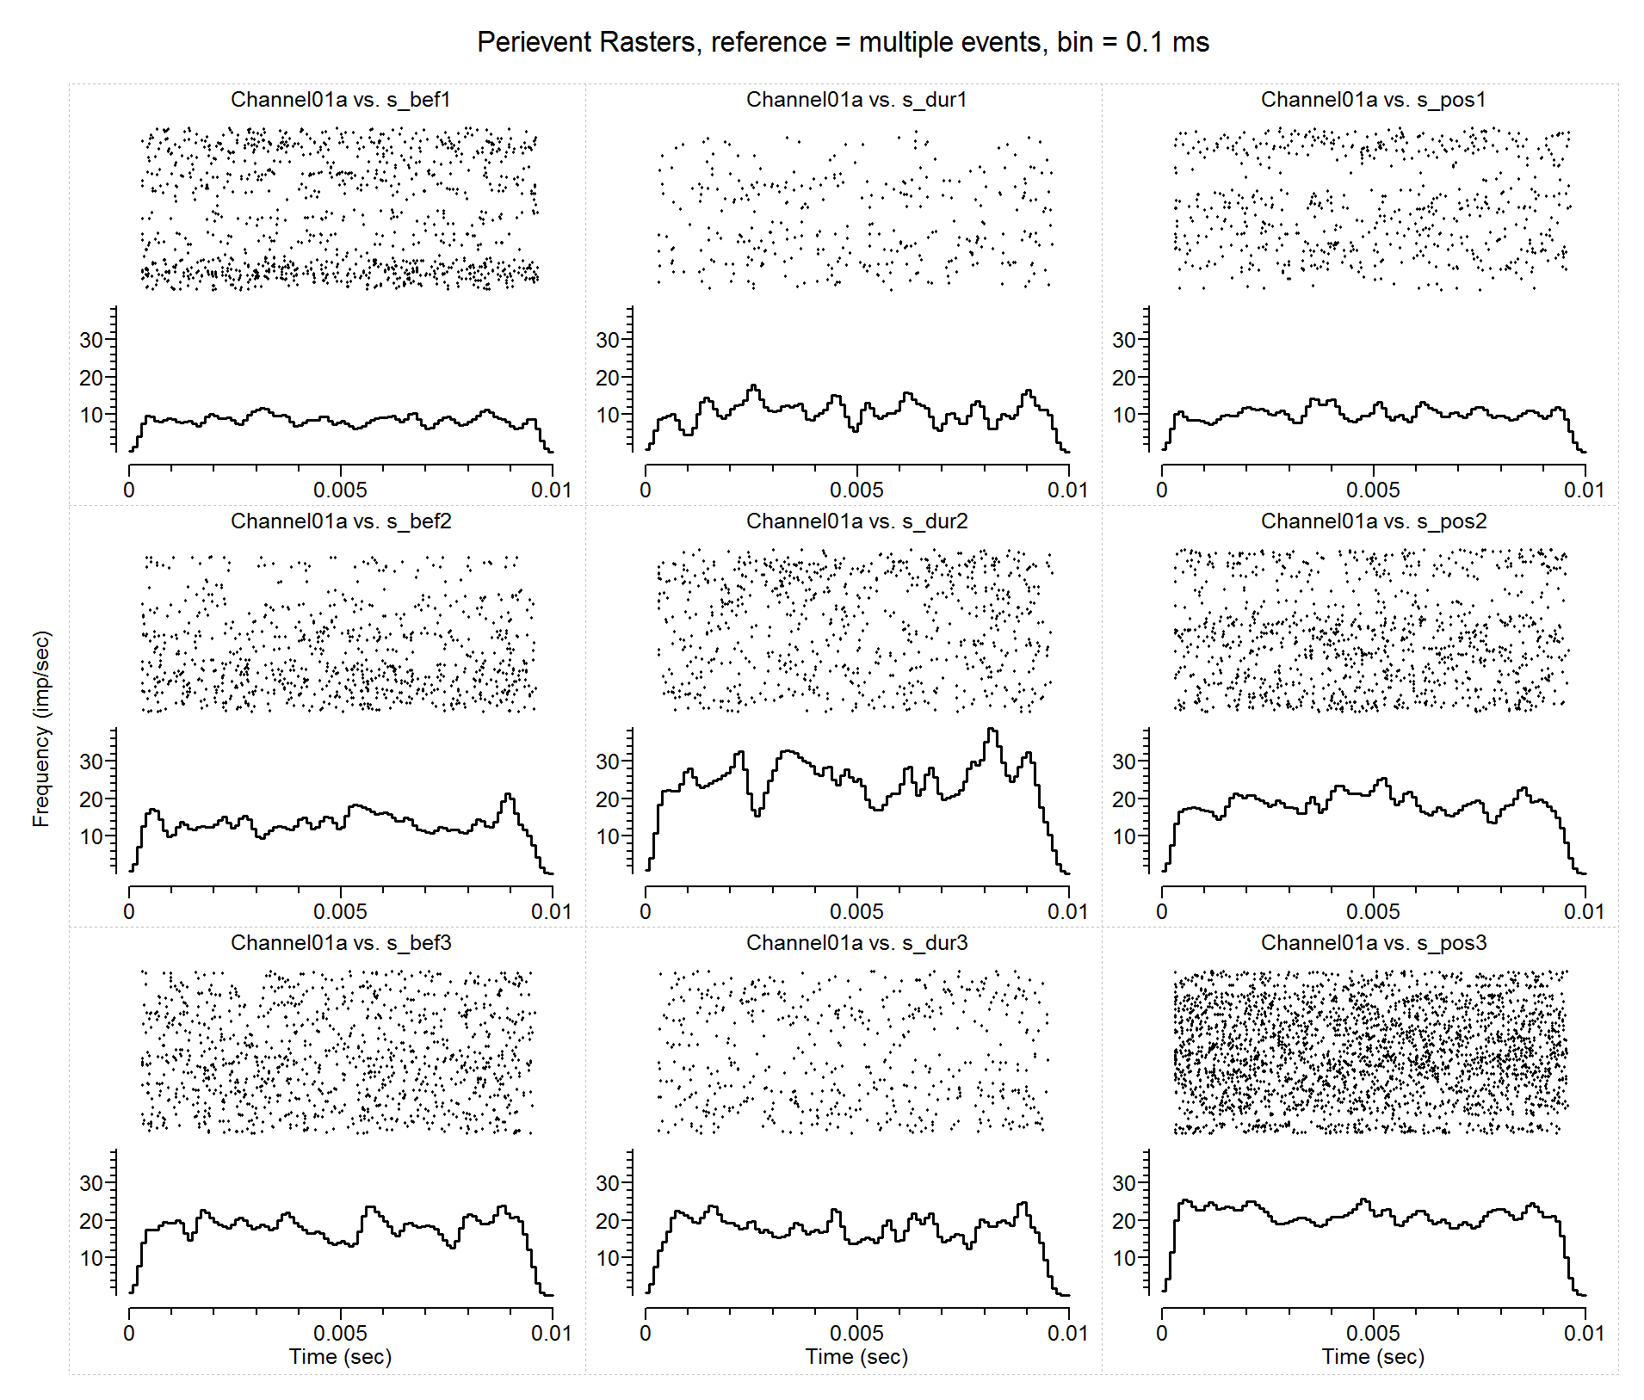
15_07_31k_0003_C1.nex (count = 8613)

