Slide 1
自我介紹
(Nizima Live)

Slide 2
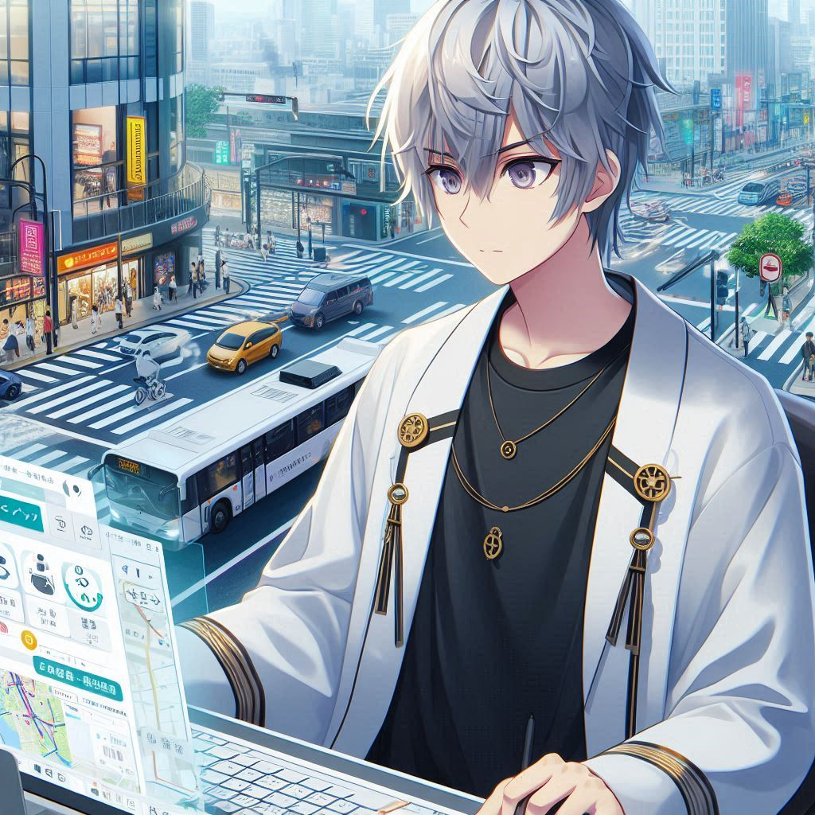
1.目標
Notes:
Prompt：圖片整體是要2d的日系風格，像是動畫那樣，不是這樣有點韓系的、讓他的衣服有些金色裝飾，背景描述如下，圖片中的人物是位住在大城市的工程師，目標是開發一款應用程式，幫助市民改善日常通勤，提供實時交通狀況、最佳路徑建議，並整合共享交通工具，如共享單車、共享汽車等，減少交通擁堵，讓人們出行更加便捷與環保

Slide 3
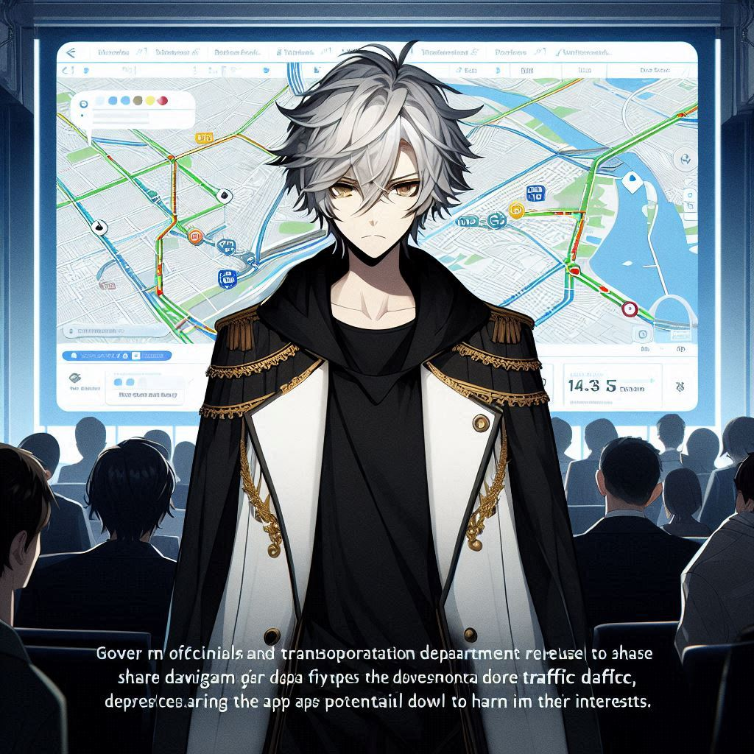
2.阻礙
Notes:
Prompt：A 2D anime-style male character with silver-gray messy hair, wearing a black long-sleeve T-shirt and a long white coat with gold accents. The character is standing in front of a digital city map display, looking frustrated as government officials and transportation department representatives refuse to share traffic data, fearing the app's potential to harm their interests. In the background, skeptical citizens are using old-fashioned navigation apps or public transport, appearing disinterested and resistant to the new technology. The overall image is in a clean, detailed Japanese anime style, not resembling Korean art

Slide 4
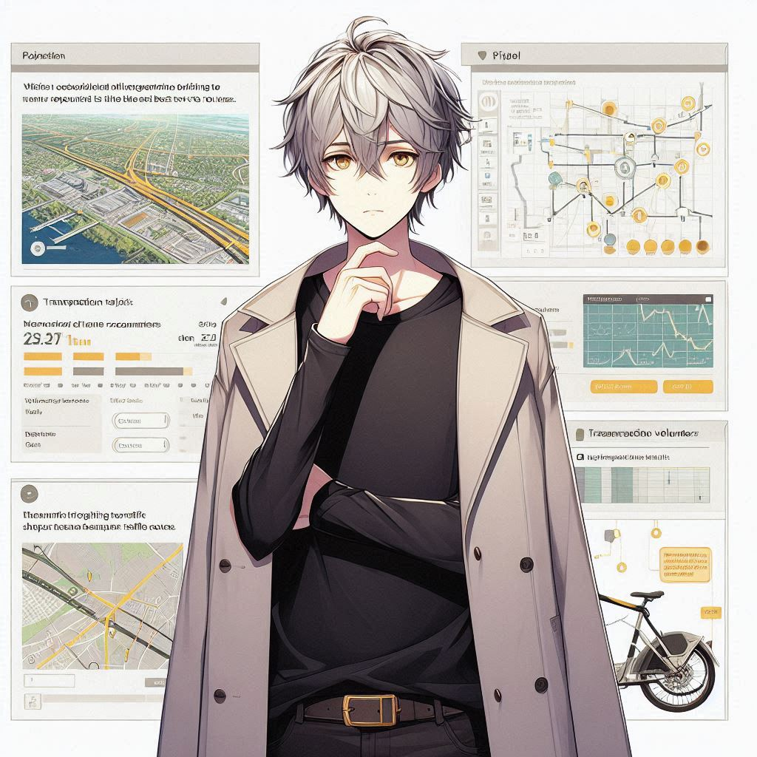
3.努力
Notes:
Prompt：A 2D anime-style male character, Eren, with silver-gray messy hair, wearing a black long-sleeve T-shirt and a long white coat with gold accents. Eren is working on a pilot project in a small community, collaborating with transportation volunteers to gather real-time traffic data. He is focused on developing an algorithm that recommends the best travel routes, with a background featuring data charts, maps, and bicycle-sharing stations. The style is clean, detailed, and follows a Japanese anime aesthetic

Slide 5
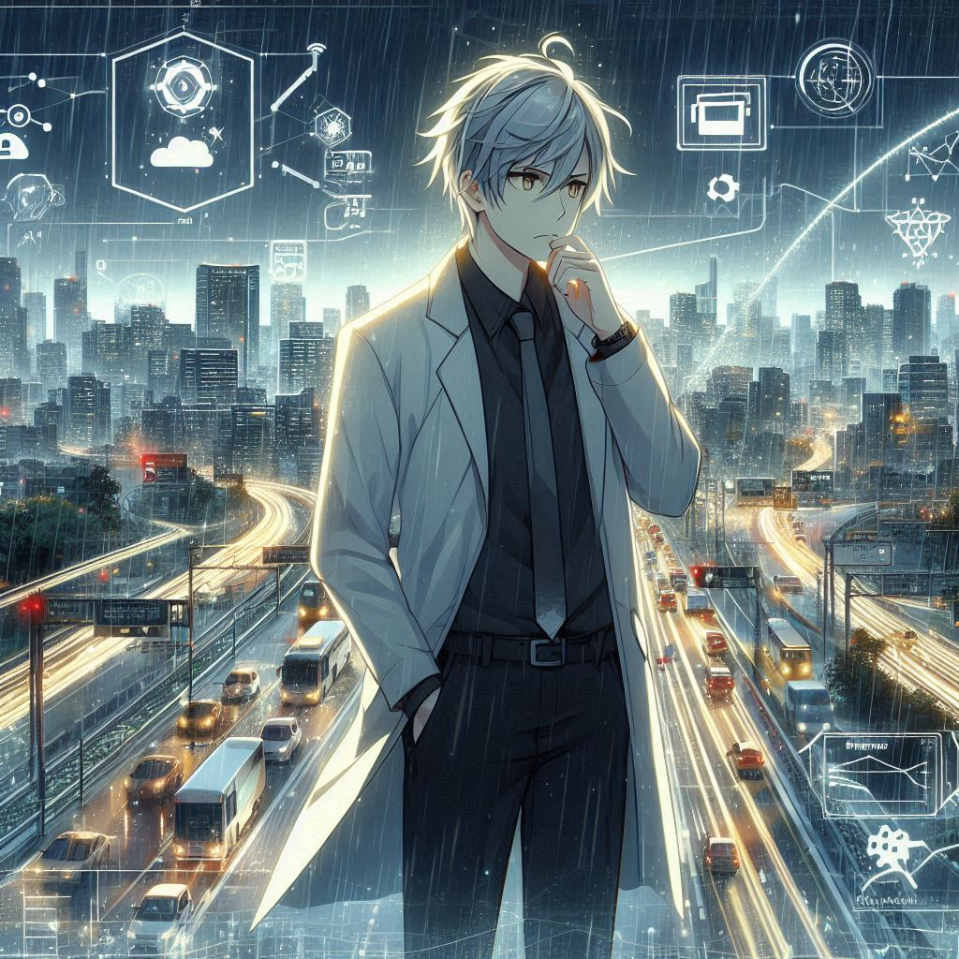
4.結果
Notes:
Prompt：Silver-gray hair, black long-sleeve T-shirt, white coat with gold accents,Sudden storm, traffic system collapse, app failure, users stranded, intense rain, dark skies, urgent crisis, ineffective route suggestions, overwhelming frustration, system breakdown, unexpected conditions, emergency response failure, chaos, unprepared for extreme weather

Slide 6
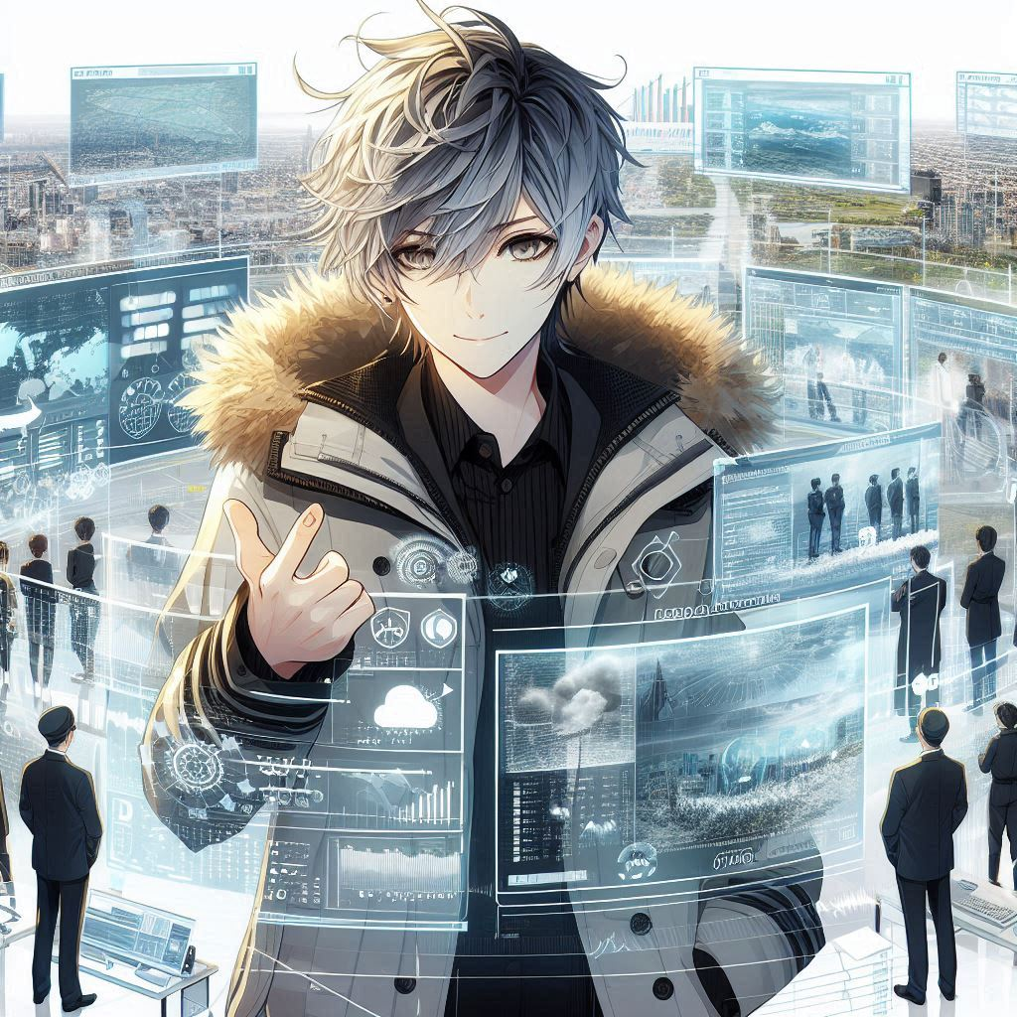
5.意外
Notes:
Prompt：2D anime-style male character with messy silver-gray hair, black long-sleeve shirt, white coat with gold accents. The character actively collaborates with weather officials, surrounded by screens displaying weather data and traffic conditions. The scene focuses on the turning point: he improves his app’s server capacity and integrates AI technology to handle sudden traffic disruptions caused by extreme weather. The background emphasizes the adaptation process, with evolving data and real-time responses to emergency situations

Slide 7
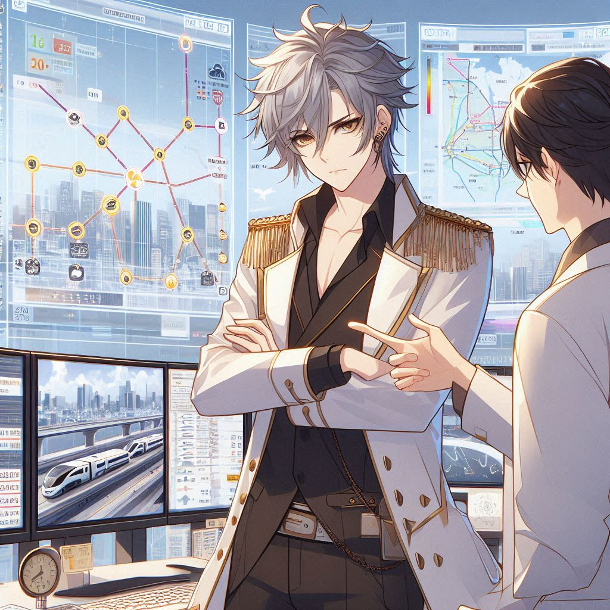
6. 轉彎
Notes:
Prompt：2D anime-style male character with messy silver-gray hair, black long-sleeve shirt, white coat with gold accents. The character collaborates with weather officials, surrounded by some weather data screens, but the background also includes elements of a cityscape, showing transportation routes and urban infrastructure. The focus is on his improvements to the app’s server capacity and AI technology to handle sudden traffic disruptions caused by extreme weather. The scene should balance the screens with city elements, avoiding too many monitors.

Slide 8
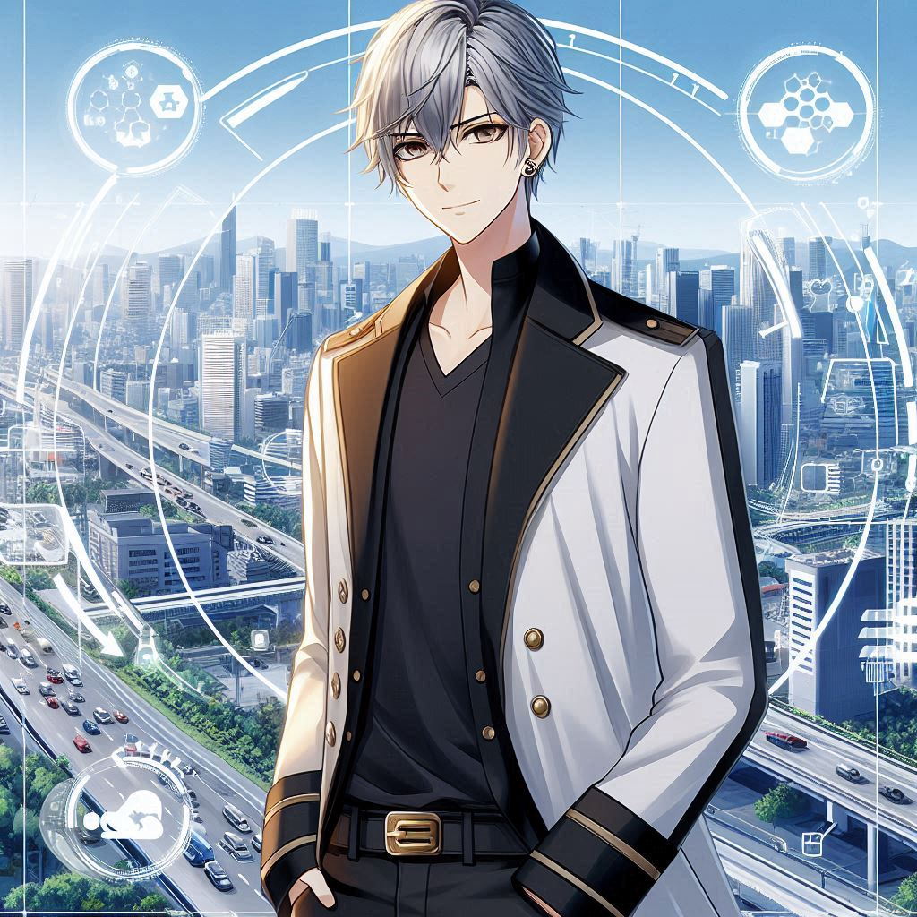
7. 結局
Notes:
Prompt：City skyline, urban transportation, residents commuting, traffic improvement, reduced congestion, smart city infrastructure. Background shows city streets, data integration screens, weather forecasting systems, and AI technology. Silver-gray hair character in white coat with gold accents stands confidently, proud of his successful app transforming urban mobility and public service.

