Slide 1
冒險故事
(Vtuber Studio)

Slide 2
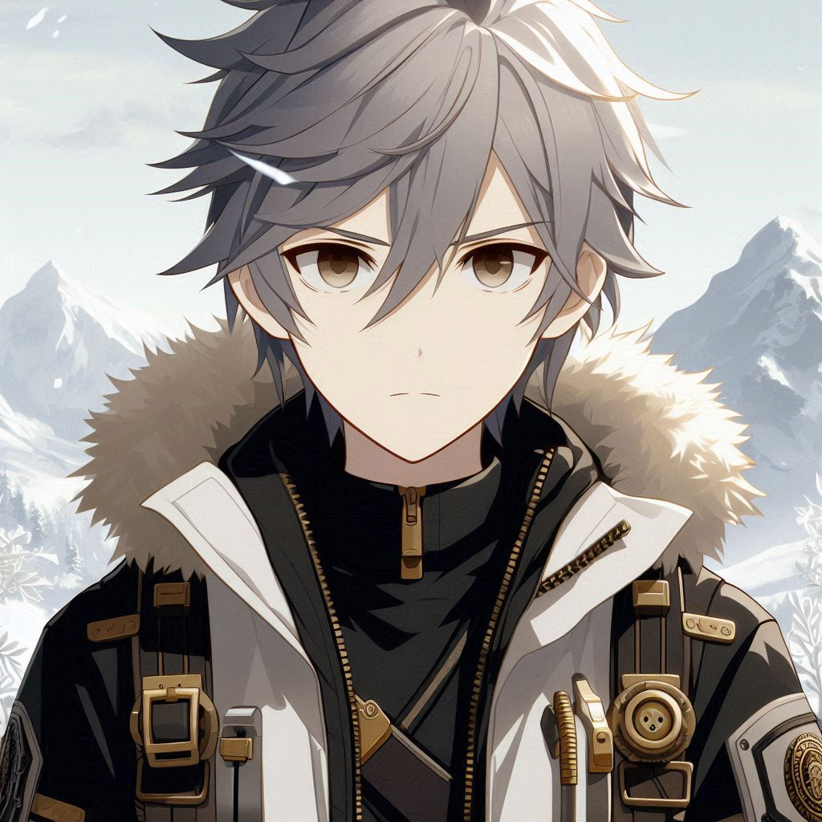
Notes:
Prompt：2D anime-style male character with messy silver-gray hair, black long-sleeve shirt, white coat with gold accents. Mountain rescue volunteers

Slide 3
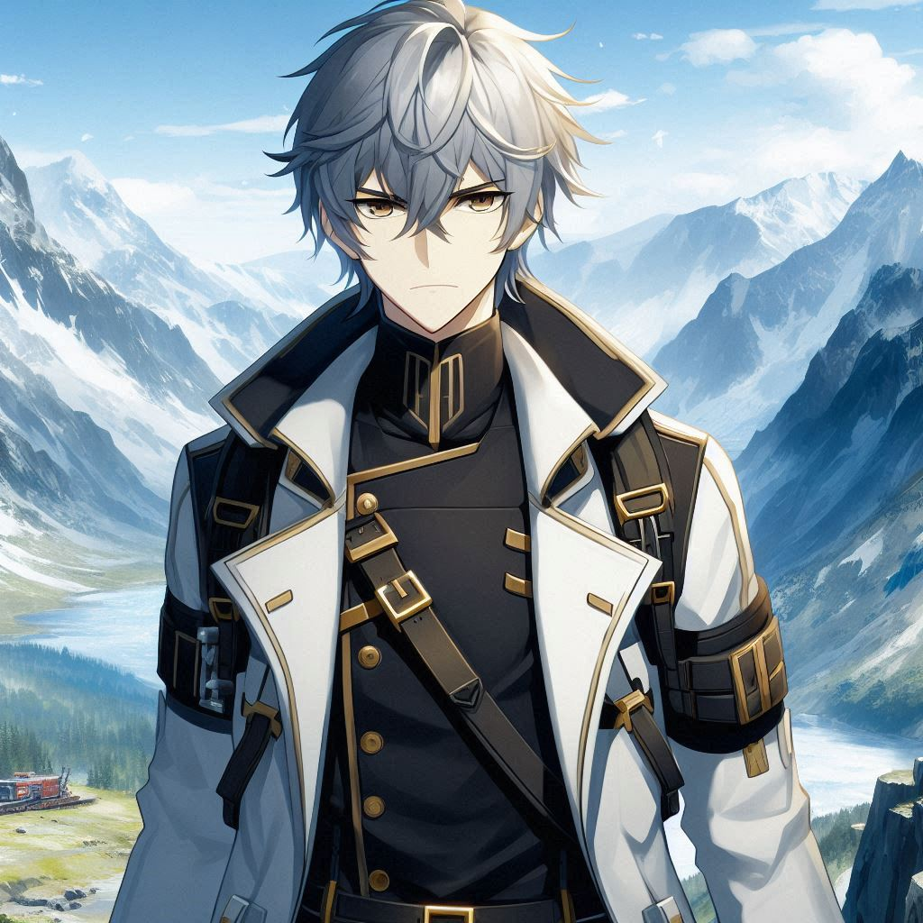
Notes:
Prompt：2D anime-style male character with messy silver-gray hair, black long-sleeve shirt, white coat with gold accents. The goal is to participate in a rescue operation in a remote mountainous area

Slide 4
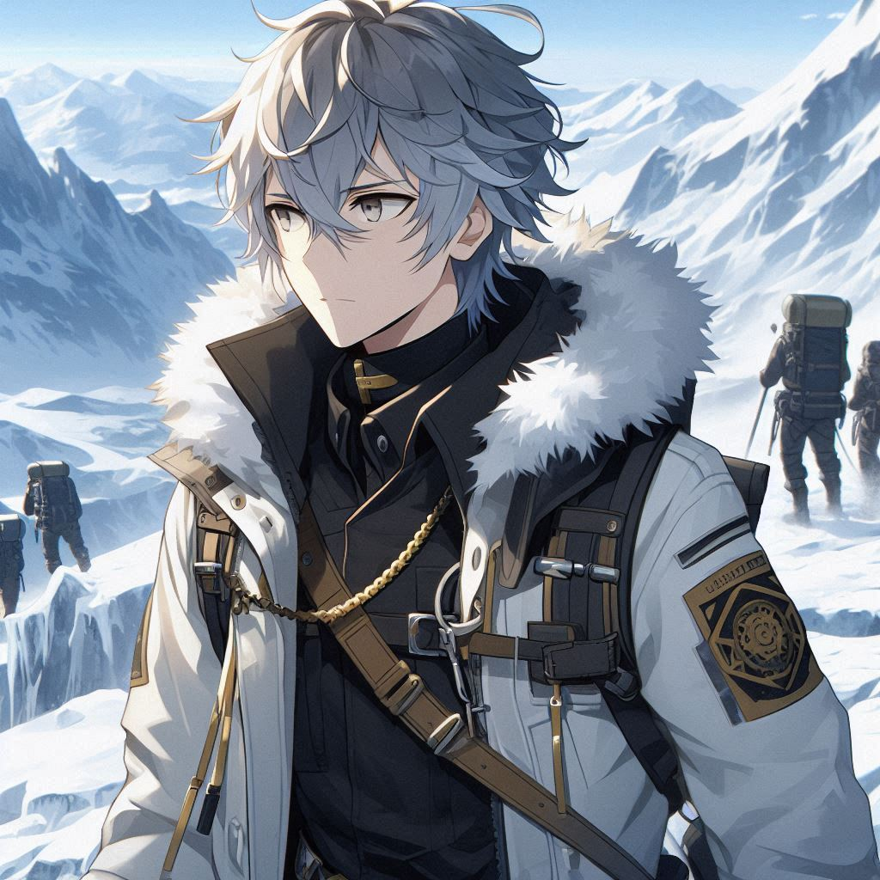
Notes:
Prompt：2D anime-style male character with messy silver-gray hair, black long-sleeve shirt, white coat with gold accents. Find a group of mountaineering teams who lost contact due to unexpected weather changes

Slide 5
Notes:
Prompt：2D anime-style male character with messy silver-gray hair, black long-sleeve shirt, white coat with gold accents. Find a group of mountaineering teams who lost contact due to unexpected weather changes

Slide 6
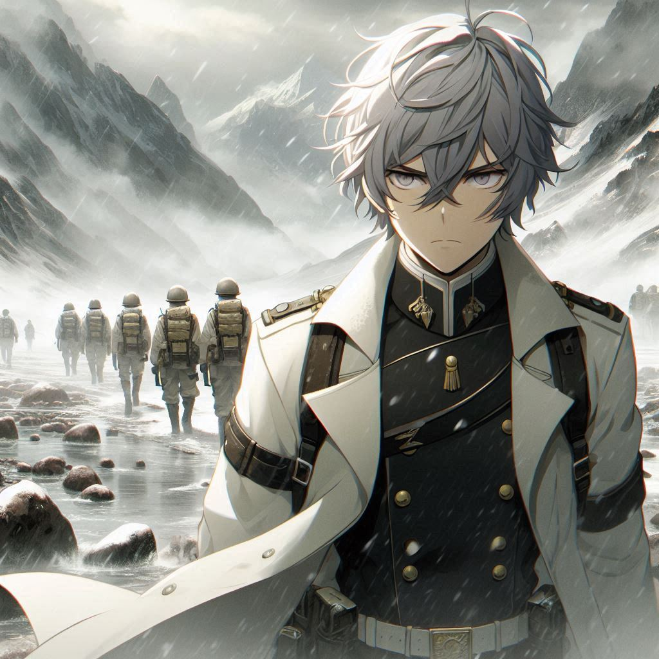
Notes:
Prompt：2D anime-style male character with messy silver-gray hair, black long-sleeve shirt, white coat with gold accents.While leading the rescue team into the mountains, adverse weather conditions began to impede their operations. The sudden heavy fog greatly reduced visibility, and the ground became muddy, making the path difficult to identify.

Slide 7
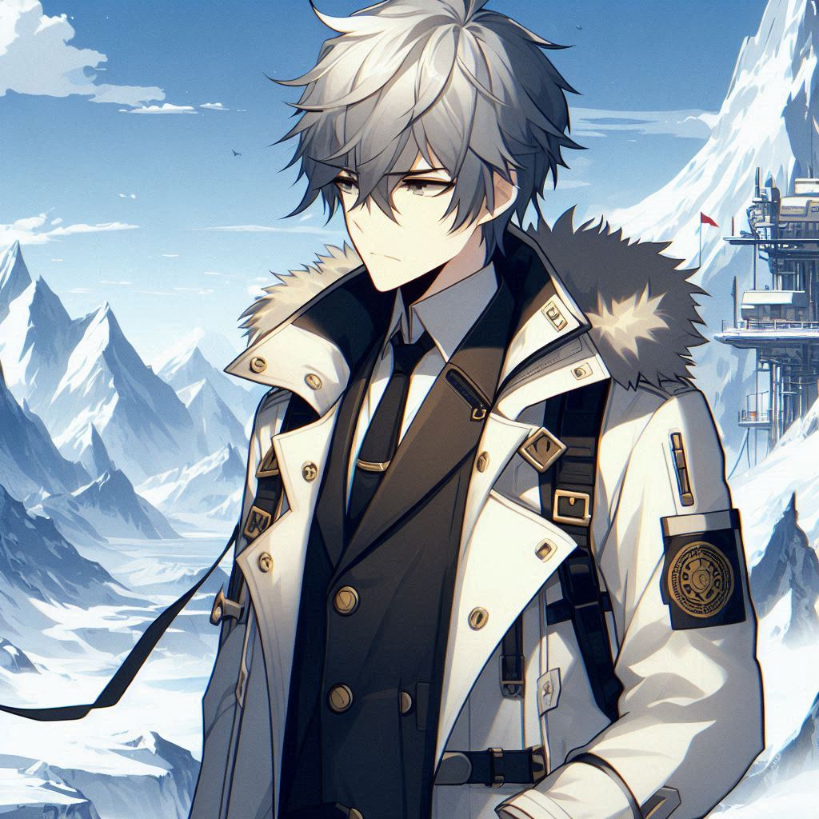
Notes:
Prompt：2D anime-style male character with messy silver-gray hair, black long-sleeve shirt, white coat with gold accents.Communication equipment was disabled, preventing rescue teams from maintaining contact with the ground.In mountainous areas, communication equipment fails, preventing rescue teams from maintaining contact with the ground.

Slide 8
Notes:
Prompt：2D anime-style male character with messy silver-gray hair, black long-sleeve shirt, white coat with gold accents.Communication equipment was disabled, preventing rescue teams from maintaining contact with the ground.In mountainous areas, communication equipment fails, preventing rescue teams from maintaining contact with the ground.

Slide 9
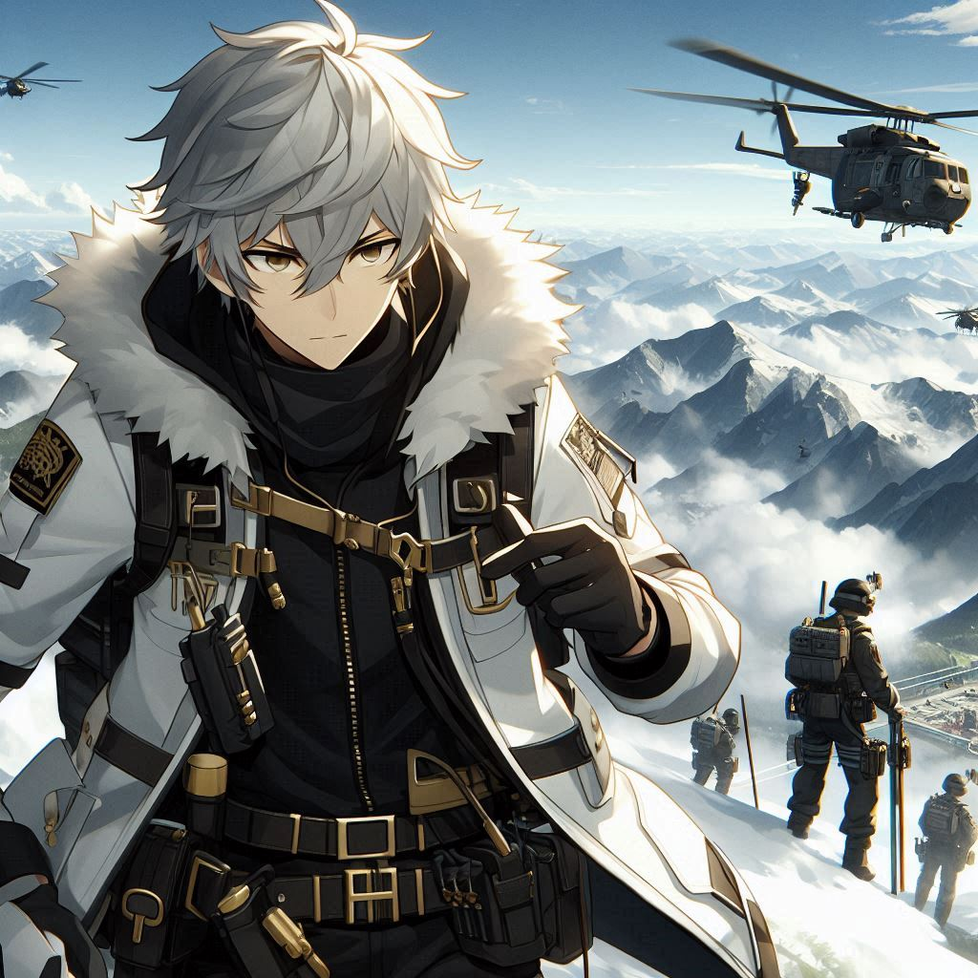
Notes:
Prompt：2D anime-style male character with messy silver-gray hair, black long-sleeve shirt, white coat with gold accents.Facing difficulties, lead the rescue team to move forward

Slide 10
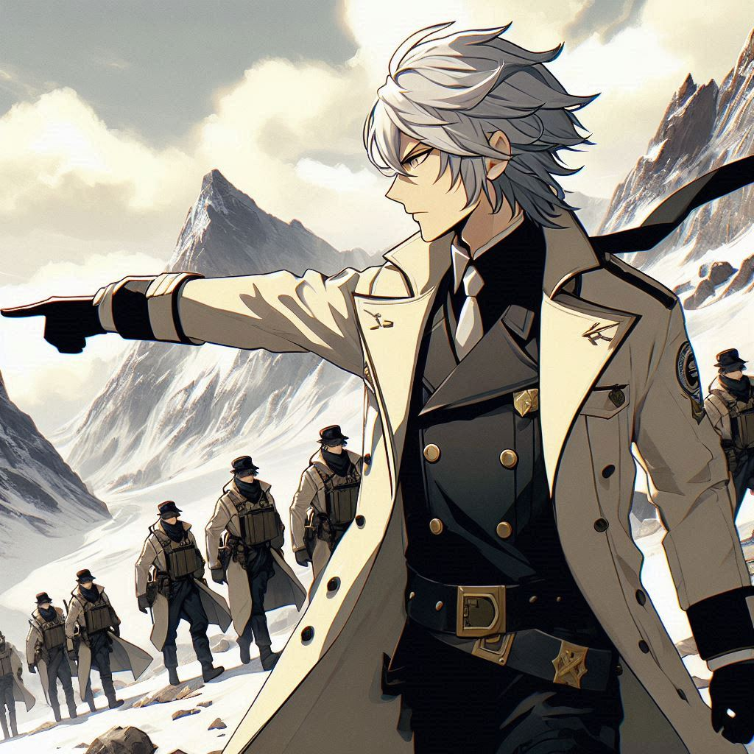
Notes:
Prompt：2D anime-style male character with messy silver-gray hair, black long-sleeve shirt, white coat with gold accents.Lead the team to search along the ridge

Slide 11
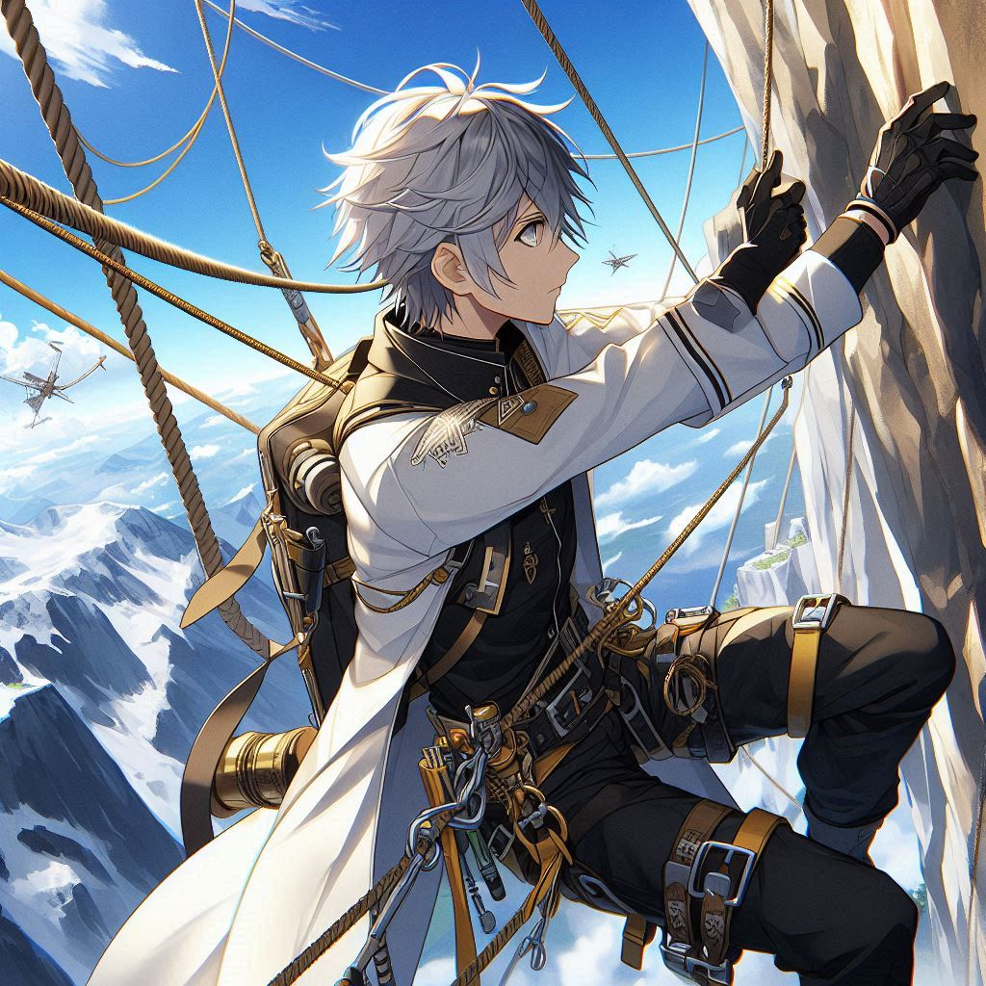
Notes:
Prompt：Used ropes and safety equipment to overcome dangerous cliffs2D anime-style male character with messy silver-gray hair, black long-sleeve shirt, white coat with gold accents.

Slide 12
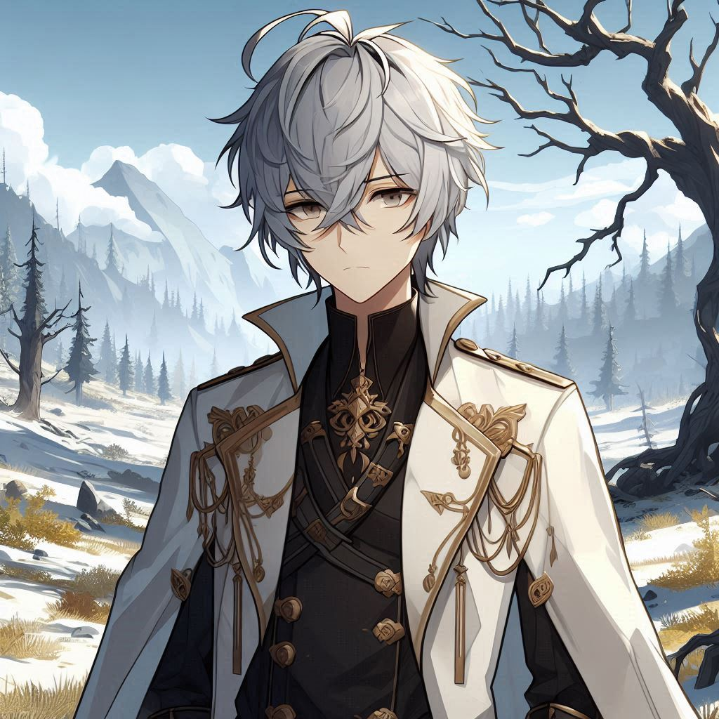
Notes:
Prompt：The vegetation on the mountain is unusually sparse.2D anime-style male character with messy silver-gray hair, black long-sleeve shirt, white coat with gold accents.The vegetation on the mountain is unusually sparse

Slide 13
Notes:
Prompt：The vegetation on the mountain is unusually sparse.2D anime-style male character with messy silver-gray hair, black long-sleeve shirt, white coat with gold accents.The vegetation on the mountain is unusually sparse

Slide 14
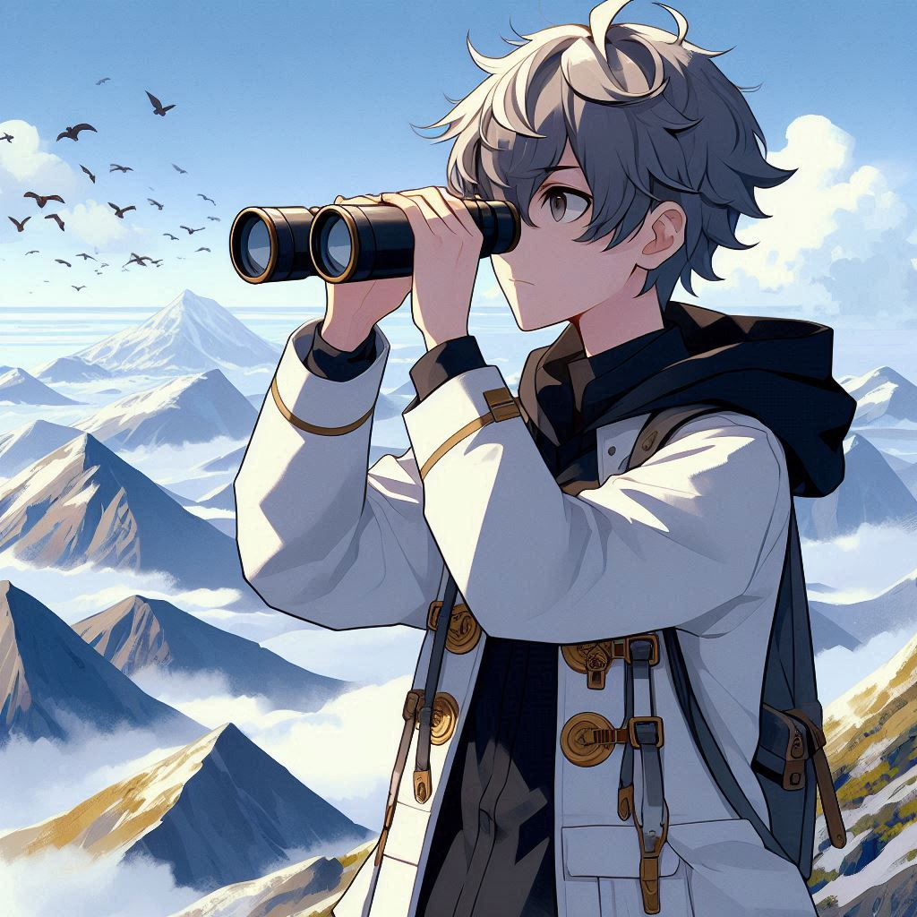
Notes:
Prompt：After searching with binoculars, we were still unable to find any trace of the climbers.2D anime-style male character with messy silver-gray hair, black long-sleeve shirt, white coat with gold accents.The vegetation on the mountain is unusually sparse

Slide 15
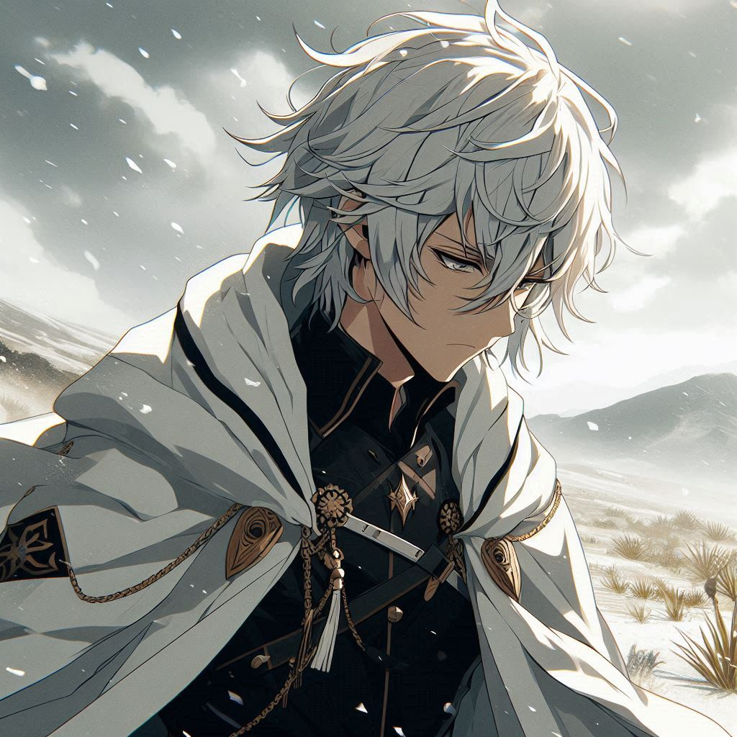
Notes:
Prompt：Bad weather, other people in the team, fatigue and lack of energy.2D anime-style male character with messy silver-gray hair, black long-sleeve shirt, white coat with gold accents.The vegetation on the mountain is unusually sparse

Slide 16
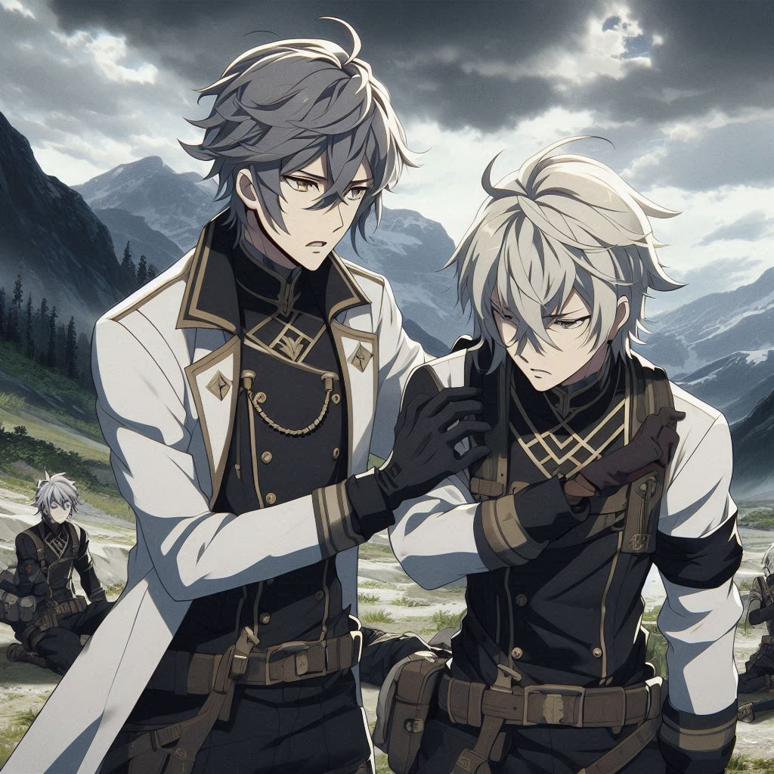
Notes:
Prompt：2D anime-style male character with messy silver-gray hair, black long-sleeve shirt, and a white coat with gold accents. The character is the team leader, standing with a serious expression as he helps an injured team member. They are in a mountainous area with unusually sparse vegetation. The team is forced to suspend their operation and find temporary shelter. Dark clouds gather overhead, and the environment looks harsh and unforgiving, reflecting the difficult situation.

Slide 17
Notes:
Prompt：2D anime-style male character with messy silver-gray hair, black long-sleeve shirt, and a white coat with gold accents. The character is the team leader, standing with a serious expression as he helps an injured team member. They are in a mountainous area with unusually sparse vegetation. The team is forced to suspend their operation and find temporary shelter. Dark clouds gather overhead, and the environment looks harsh and unforgiving, reflecting the difficult situation.

Slide 18
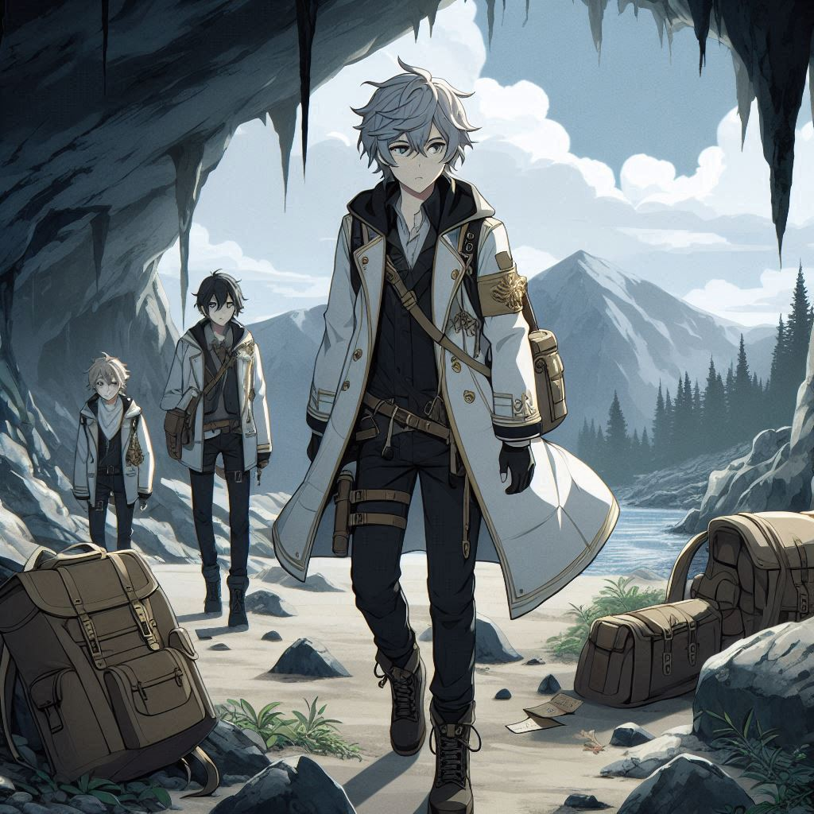
Notes:
Prompt：2D anime-style male character with messy silver-gray hair, black long-sleeve shirt, and a white coat with gold accents. The character, leading a team, discovers discarded backpacks and a note with a distress message inside a hidden mountain cave. Sparse vegetation surrounds the cave, with dark clouds and rugged terrain indicating a tough journey. The team must now decide how to proceed after this surprising discovery, as the situation becomes more intense.

Slide 19
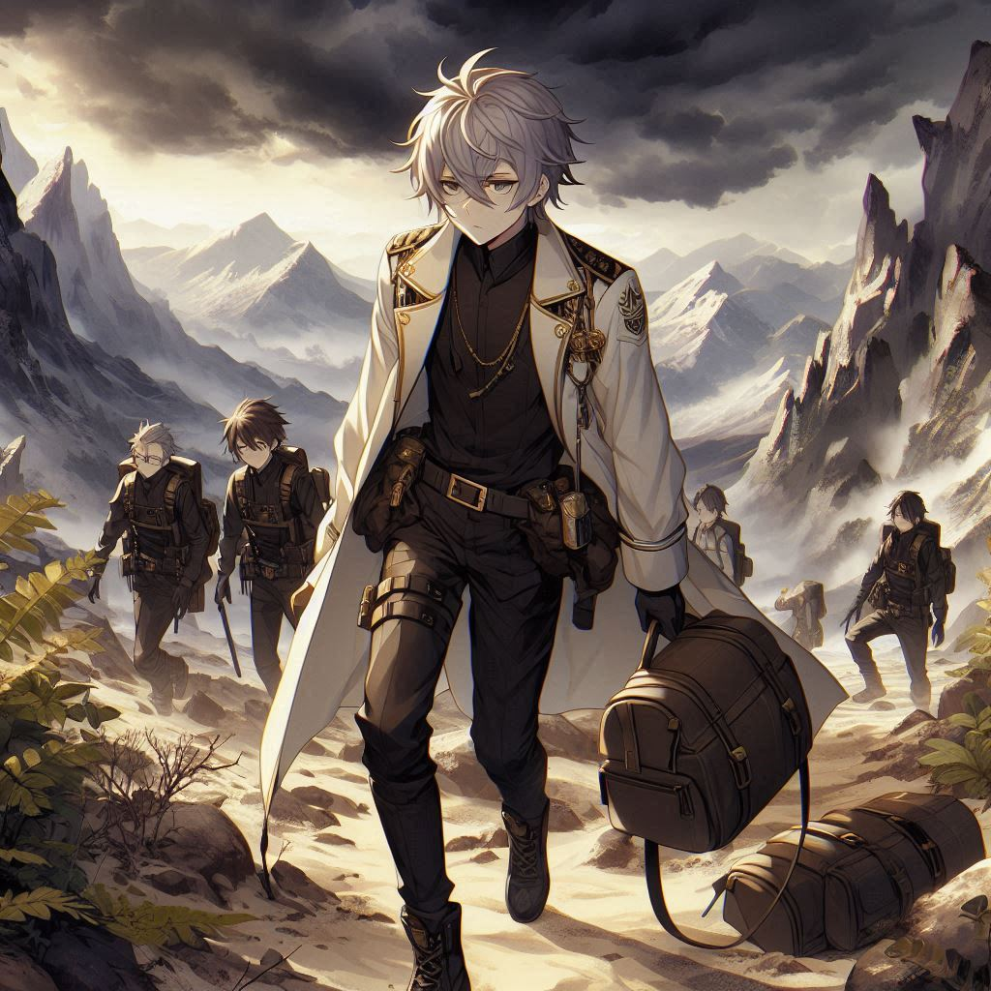
Notes:
Prompt：2D anime-style male character with messy silver-gray hair, black long-sleeve shirt, white coat with gold accents. The character, leading a team, finds discarded backpacks and a distress note in a hidden cave, surrounded by sparse mountain vegetation. Dark clouds loom over rugged terrain. The team deduces that the lost climbers must be nearby and decides to track the clues further, driven by the urgency of the situation and the hope of a rescue.

Slide 20
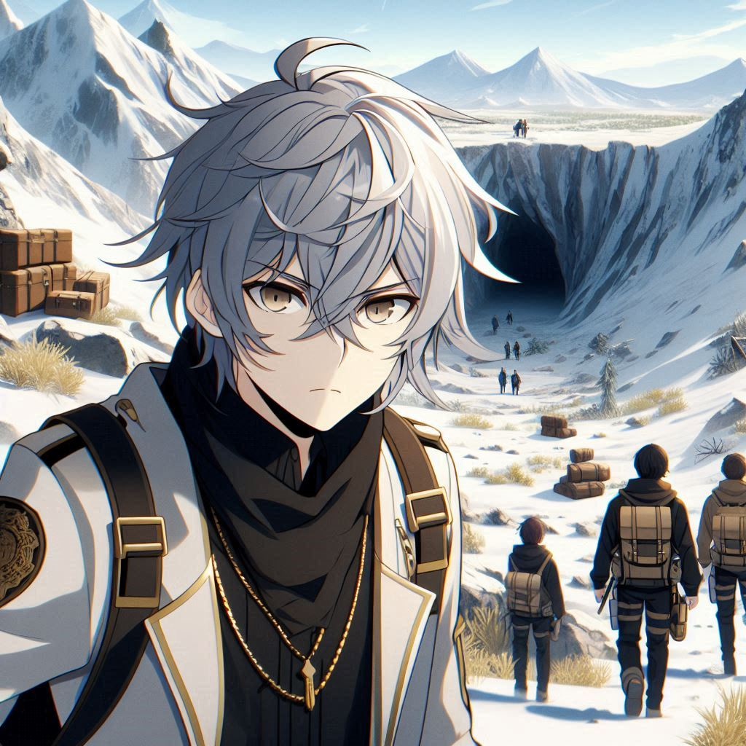
Notes:
Prompt：2D anime-style male character with messy silver-gray hair, black long-sleeve shirt, white coat with gold accents. The protagonist, as the team leader, leaves part of the team behind in a temporary shelter to care for an injured teammate. The remaining team members, led by the protagonist, press forward in their search for the missing climbers. The setting is sparse mountain terrain with a hidden cave containing abandoned backpacks and a distress note, creating tension and urgency.

Slide 21
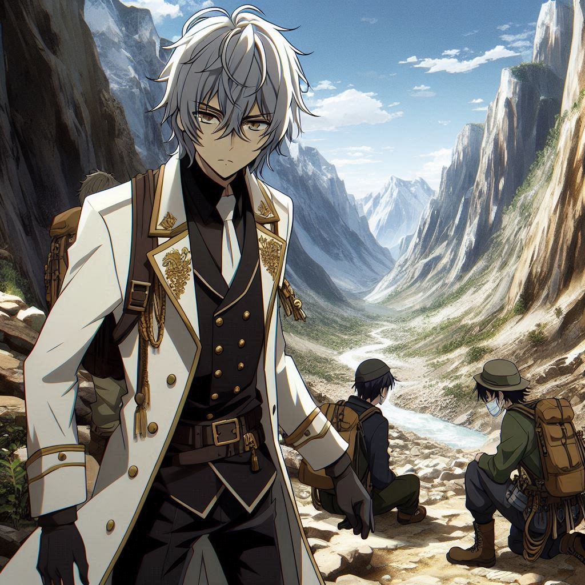
Notes:
Prompt：2D anime-style male character, messy silver-gray hair, black long-sleeve shirt, white coat with gold accents, narrow mountain valley, trapped climbers, weak but alive, discovery moment, hidden survivors, remote location, rescue operation, rugged terrain, sparse vegetation, survival situation, climbers in distress, search team effort, tracking clues, dramatic rescue scene, isolated environment, urgency, mountain rescue, sense of relief, found survivors, challenging conditions.

Slide 22
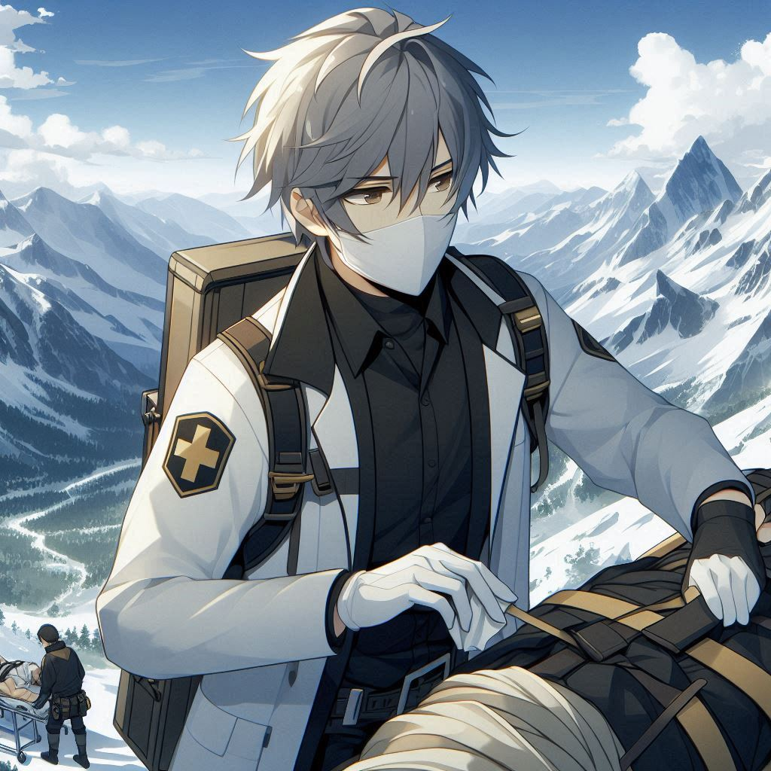
Notes:
Prompt：2D anime-style male character, messy silver-gray hair, black long-sleeve shirt, white coat with gold accents, providing first aid, injured climbers, mountain rescue, emergency response, remote location, survival situation, planning escape route, harsh terrain, helping climbers, relief and urgency, rescue planning, stretcher preparation, search team coordination, rugged mountain environment, safe evacuation, teamwork, rescuing stranded climbers, survival instinct, critical decision-making, mountain descent strategy, overcoming challenges.

Slide 23
Notes:
Prompt：2D anime-style male character, messy silver-gray hair, black long-sleeve shirt, white coat with gold accents, providing first aid, injured climbers, mountain rescue, emergency response, remote location, survival situation, planning escape route, harsh terrain, helping climbers, relief and urgency, rescue planning, stretcher preparation, search team coordination, rugged mountain environment, safe evacuation, teamwork, rescuing stranded climbers, survival instinct, critical decision-making, mountain descent strategy, overcoming challenges.

Slide 24
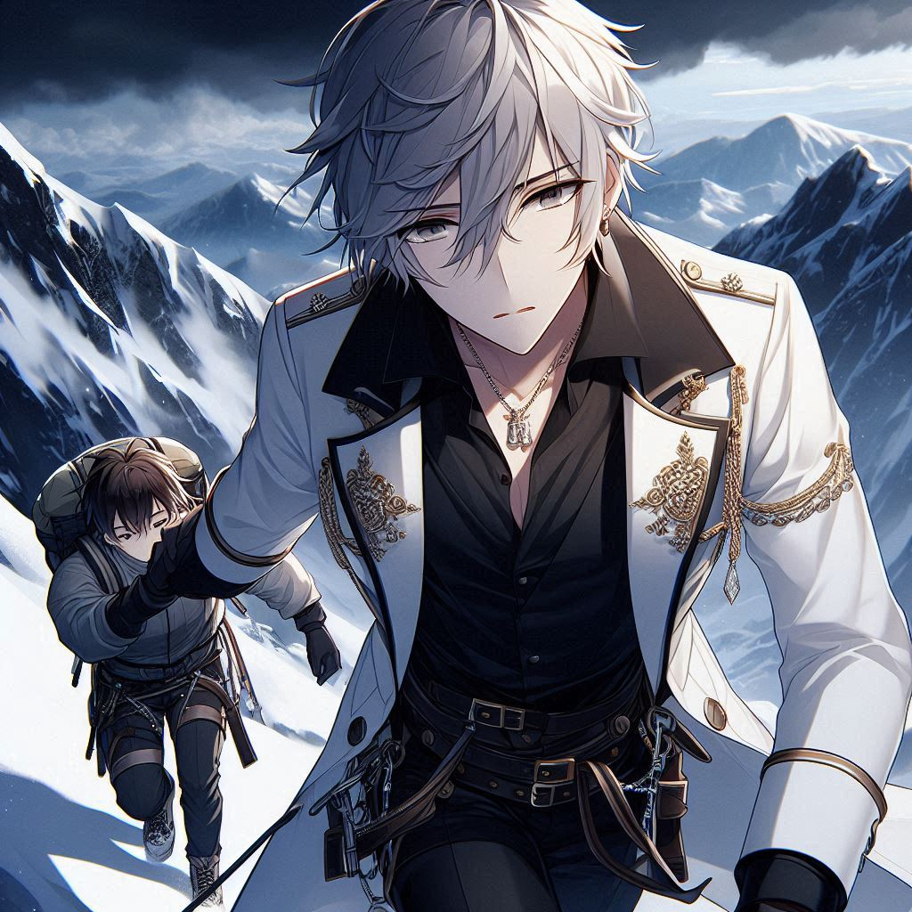
Notes:
Prompt：A 2D anime-style male character with messy silver-gray hair, wearing a black long-sleeve shirt and a white coat adorned with elegant gold accents. He is focused and determined, carefully guiding a climber down a snowy mountain, navigating steep slopes and rocky terrain. The scene captures the dramatic mountain landscape, with dark clouds gathering above and a sense of urgency as they descend safely

Slide 25

Notes:
Prompt：A 2D anime-style male character named Allen, with messy silver-gray hair and a determined expression, standing triumphantly on a snowy mountain after completing a challenging rescue mission. He is wearing a black long-sleeve shirt and a white coat with gold accents. The background features a dramatic mountain landscape, with the sun breaking through the clouds, symbolizing hope and teamwork. Allen’s posture exudes confidence, highlighting his strengthened sense of purpose as a rescue volunteer and the importance of teamwork and perseverance.

