Slide 1
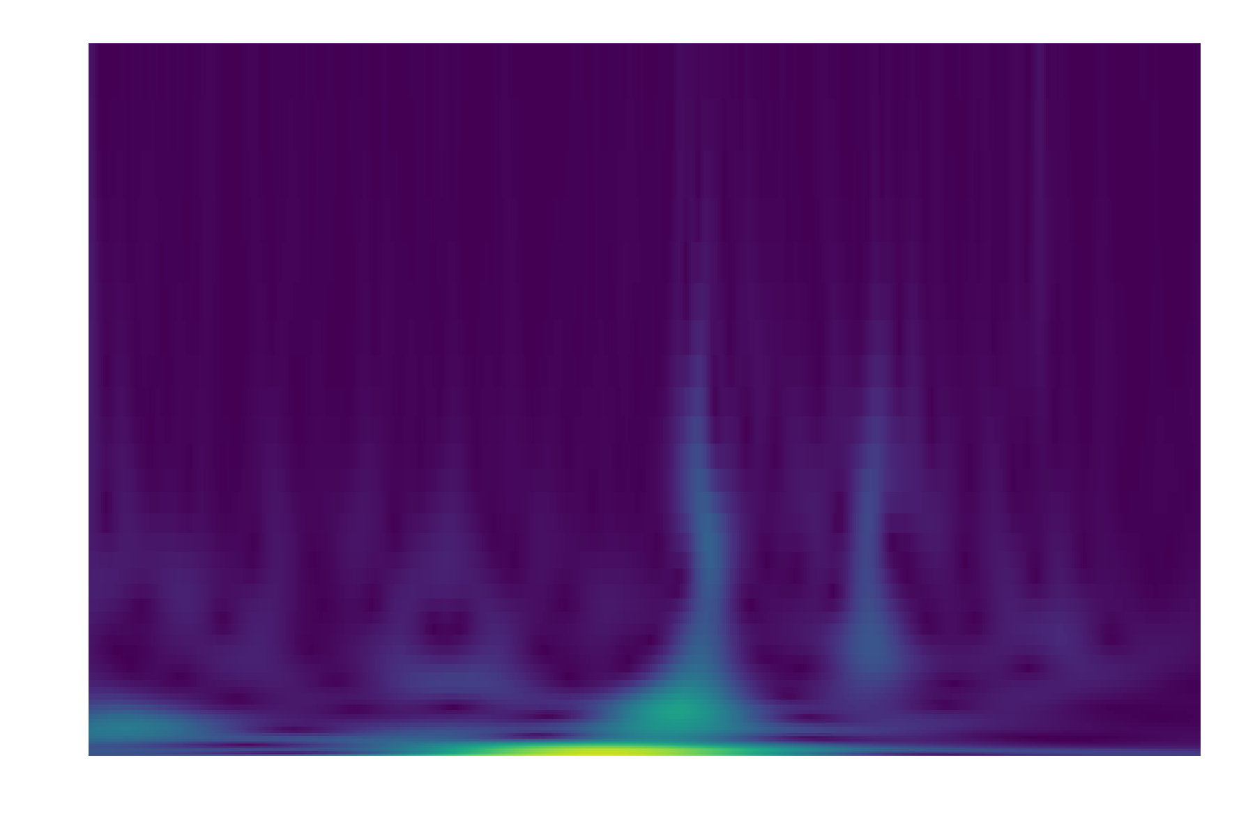
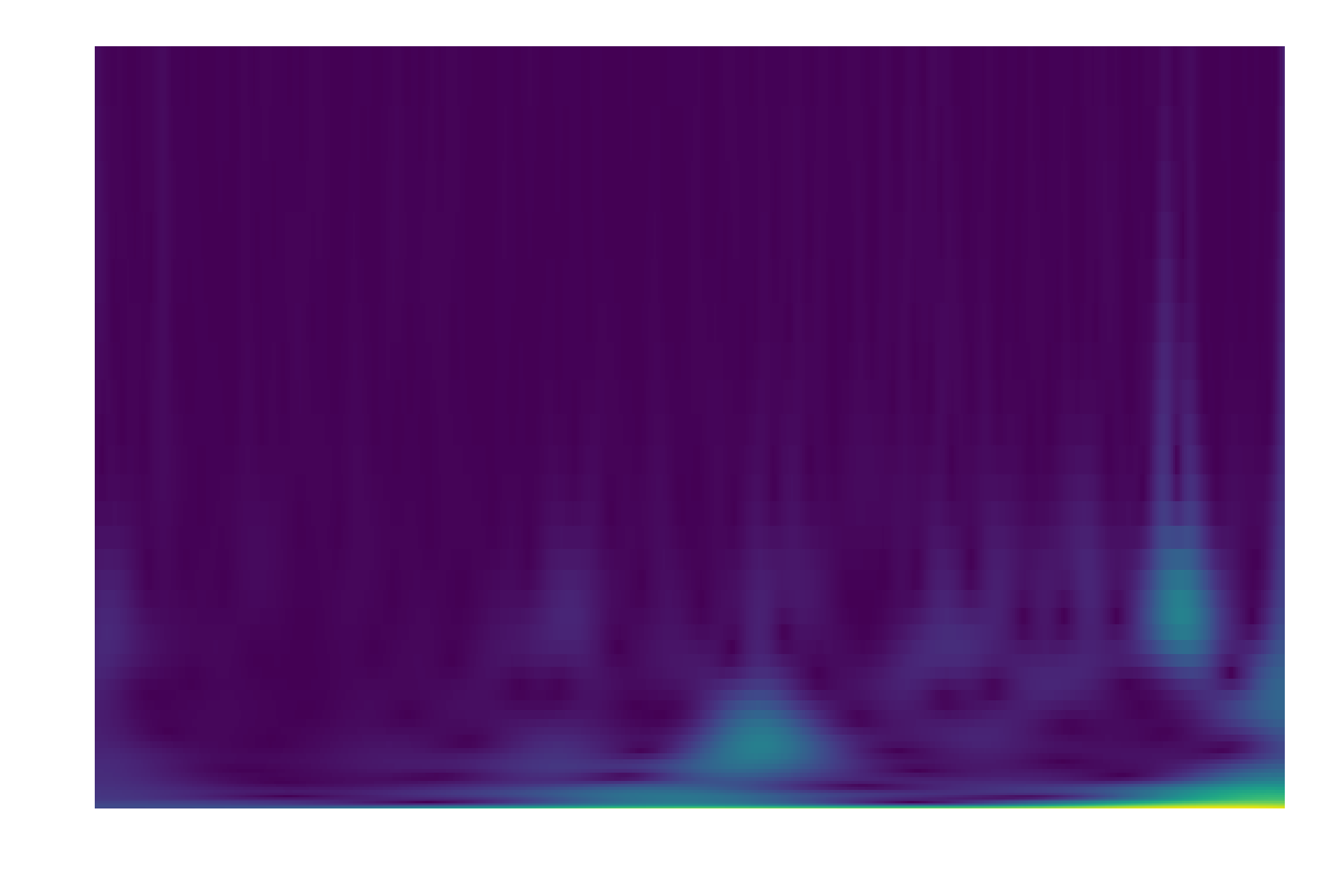
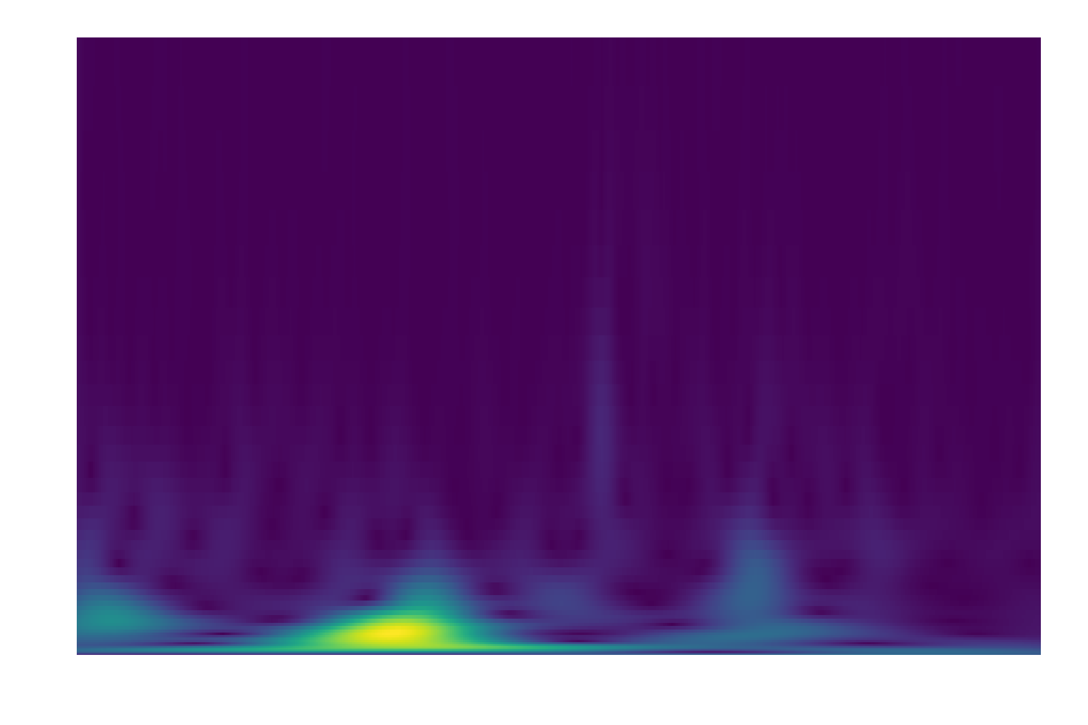
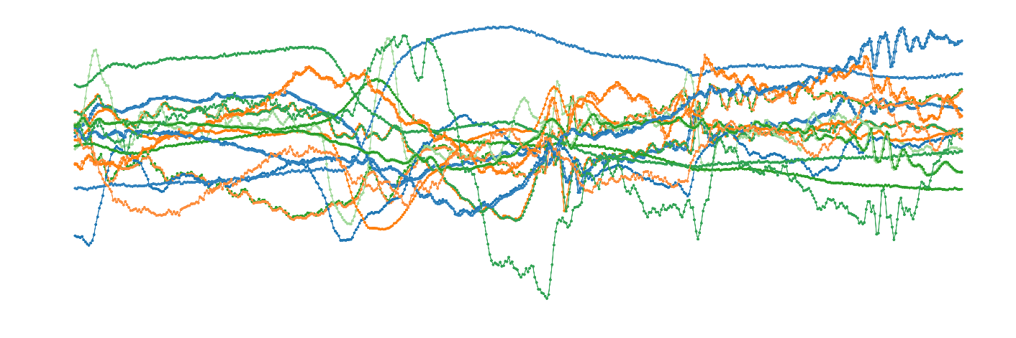
…
Time
Domain
Frequency
Domain
Continuous Wavelet Transform

Slide 2
Transformer Encoder $×N$
Transformer Encoder $×M$
(Optional)
Positional
Embedding
0
1
2
3
4
5
6
7
8
0
1
2
3
4
5
6
7
8
(Optional)
Positional
Embedding
Dimensionality Reduction by 1D Convolutions and Poolings
Dimensionality Reduction by 2D Depthwise Separable Convolutions
…
Time
Domain
Frequency
Domain

Slide 3
Class
MLP Header
+
MLP Header
Sequence Pooling
Sequence Pooling
Cross Attention : Transformer Encoder $×L$
Transformer Encoder $×N$
Transformer Encoder $×M$
(Optional)
Positional
Embedding
0
1
2
3
4
5
6
7
8
0
1
2
3
4
5
6
7
8
(Optional)
Positional
Embedding
Dimensionality Reduction by 1D Convolutions and Poolings
Dimensionality Reduction by 2D Depthwise Separable Convolutions
…
Time
Domain
Frequency
Domain

