Slide 1
H&M fashion recommendation
Baoxi Liu
Haokai Zhao
Jiaqi Wang
Ziang Zhang

Slide 2
Background

Slide 3
Background
Background
Dataset
Methods
Evaluation
What problem:
Most of fashion online store does not have a general recommendation, but categories.
Nowadays, the fashion industry generally exhibits a long-tail effect.
Different objectives lead to different evaluation criteria.
Deploy within a larger system:
Feedback collection
Integration and User Interface
Competitor analysis/limitation:
long-tail effect ->
popularity-based recommendations ->
homogenization
Notes:
还要一些user study之类的，从pitch吵

Slide 4
Our system
Background
Dataset
Methods
Evaluation
Any feedback:
User feedback: How they like the recommendation (Too subjective?) Actual trading volume
Updating models based on user purchase history.
Self-identify:
Our recommendation system will solve the user purchase prediction problem and rank the most likeable products for sale.

Slide 5
Datasets

Slide 6
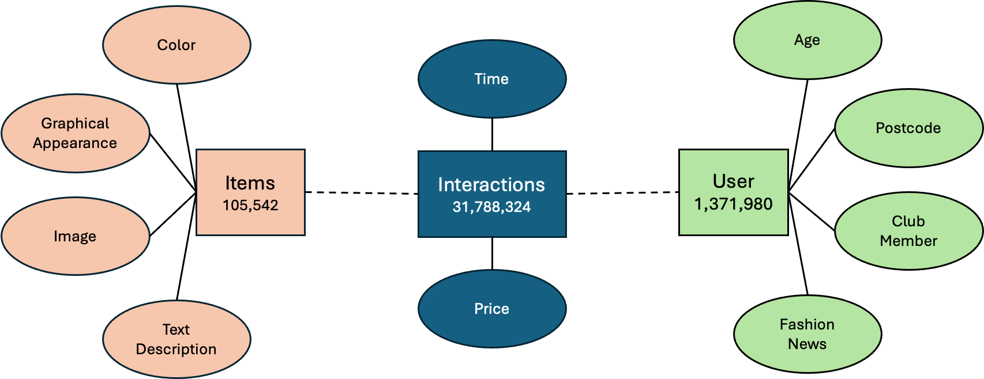
Dataset
Background
Dataset
Methods
Evaluation

Slide 7
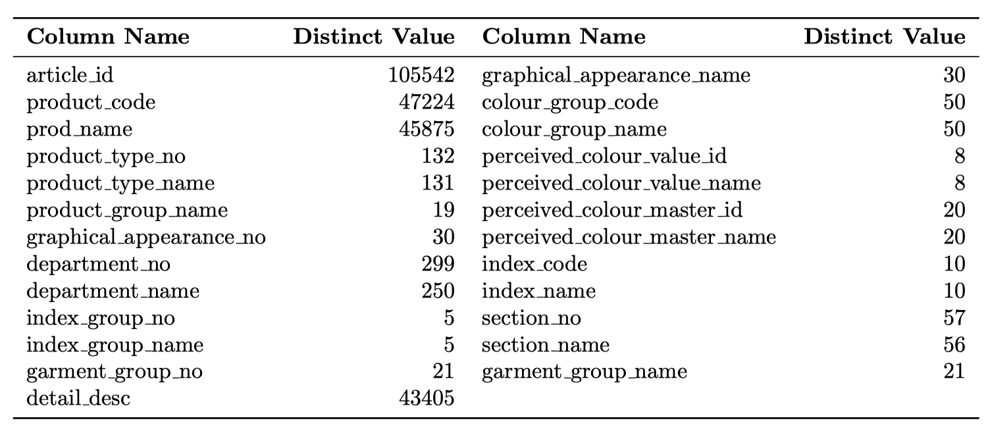
EDA: Item Attributes
Background
Dataset
Methods
Evaluation
Weakness
Too many items for recommendations
Strength
Item has rich attributes
Distinctive item attributes can be used for filtering. E.g. get products with product code in purchase history

Slide 8
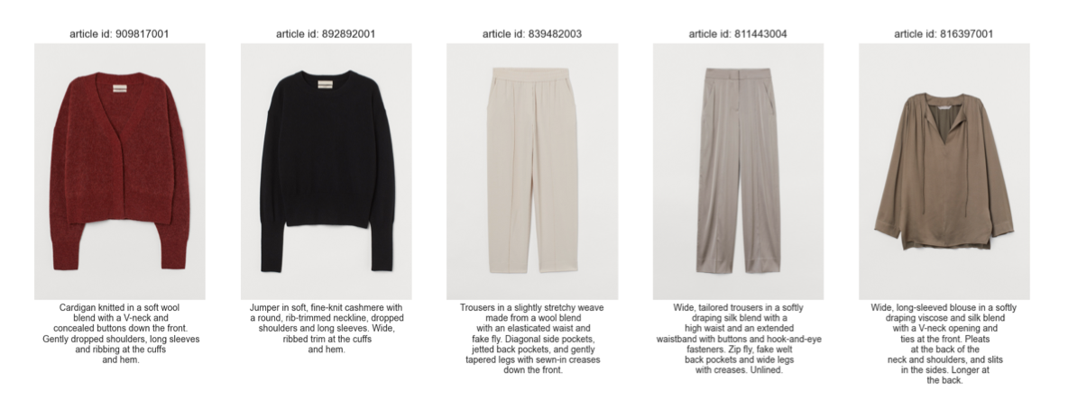
EDA: Item images / texts
Background
Dataset
Methods
Evaluation
Weakness
Images introduce heavy computational cost
Strength
Image and text description provides rich information for content-based methods

Slide 9
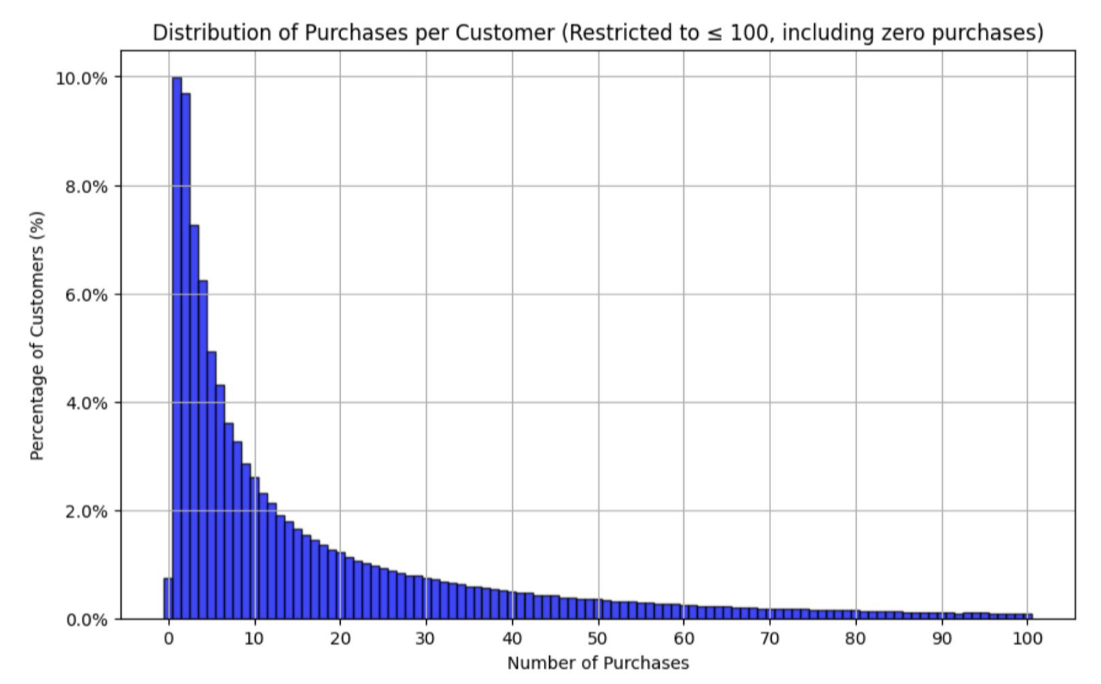
EDA: User Purchase Distribution
Background
Dataset
Methods
Evaluation
30% of customers purchased 4 or fewer articles 50% of customers purchased 9 or fewer articles. 70% of customers purchased 21 or fewer articles 90% of customers purchased 60 or fewer articles
Weakness
Hard to make recommendation for user with less purchase
Popularity of items can be dominant by a small group of users
Strength
Diversity in user purchase counts provide us chance to build robust model

Slide 10
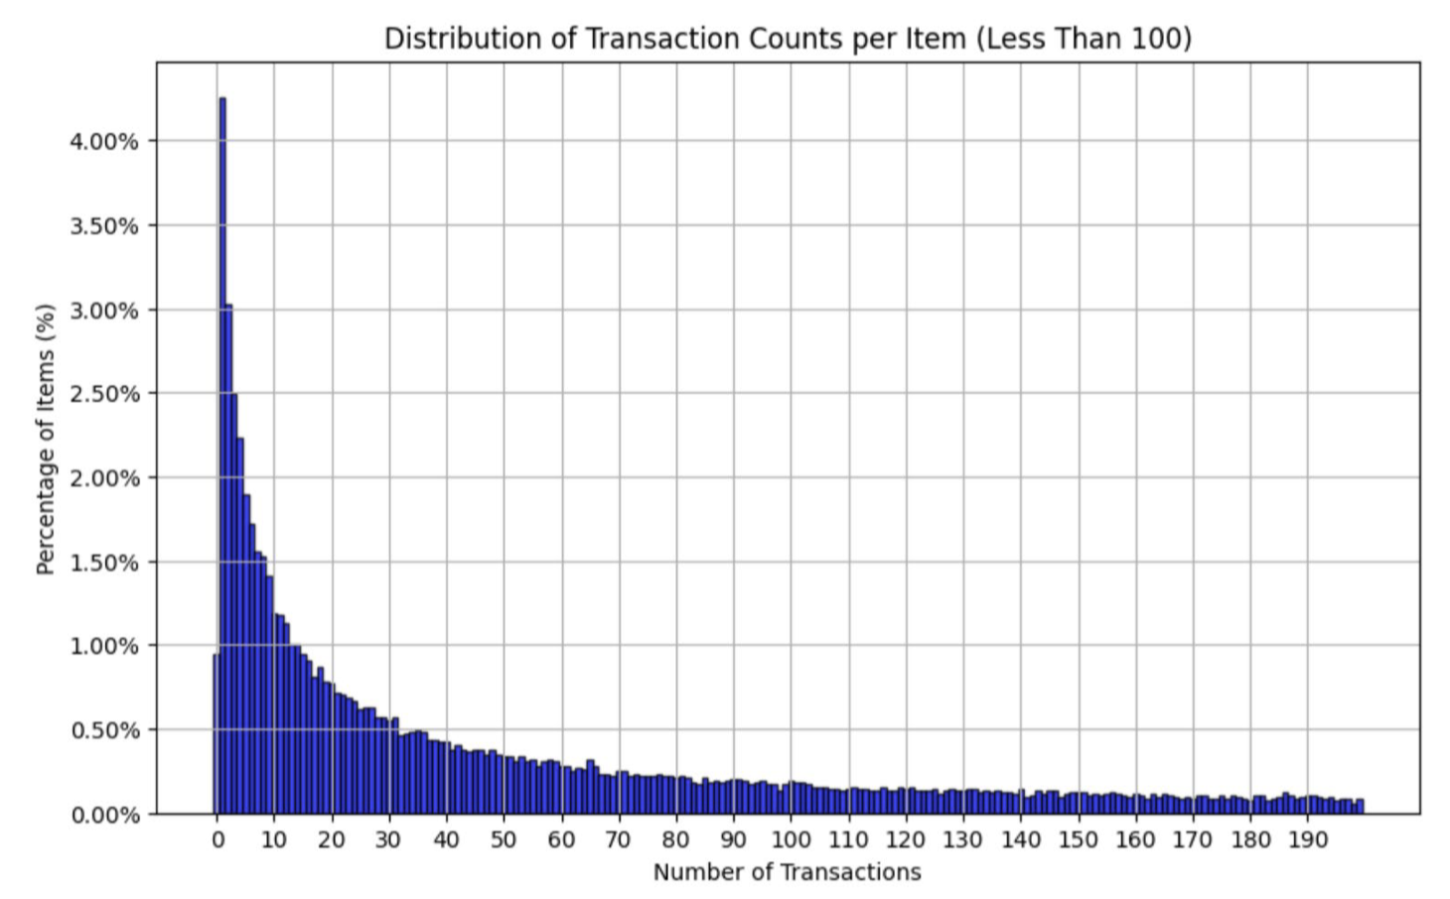
EDA: Item Purchased Distribution
Background
Dataset
Methods
Evaluation
10% of items were purchased 3 times or fewer. 30% of items were purchased 18 times or fewer. 50% of items (median) were purchased 63 times or fewer. 70% of items were purchased 208 times or fewer. 90% of items were purchased 786 times or fewer.
Weakness
Items with limited purchase are hard to be recommended

Slide 11
Methods

Slide 12
Overview
Problems
Dataset
Methods - Overveiw
Evaluation
Content Based Methods (Recall)
Tackles item long-tail problem
Use pretrained model for image / text feature extraction
Collaborative Filtering (Recall)
Item2Vec
Matrix Factorization
Statistical Filtering (Recall)
Most popular in user’s region
Most popular in user’s age
Items with product-code in user’s purchase history
…
Aggregation (Ranking)
Score from each recall pipeline as input feature
Tree-based classification model to predict the probability of transaction given a pair of user-item

Slide 13
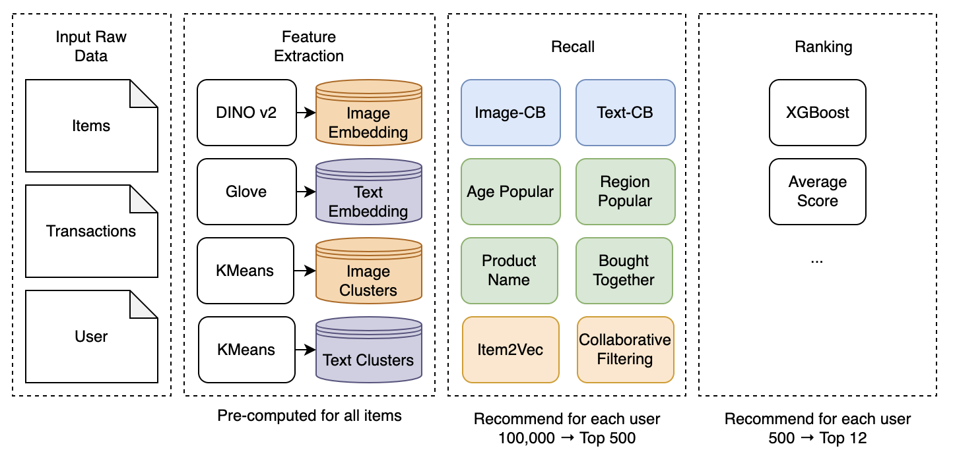
Recommendation System
Problems
Dataset
Methods - Overveiw
Evaluation

Slide 14
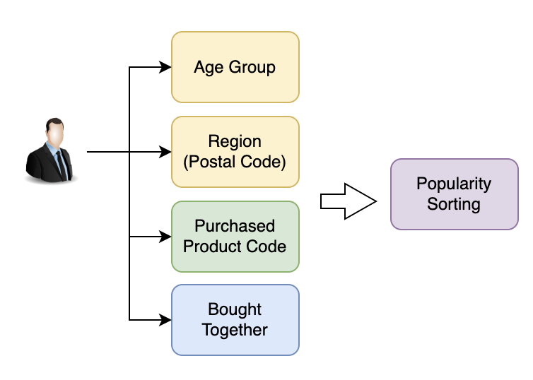
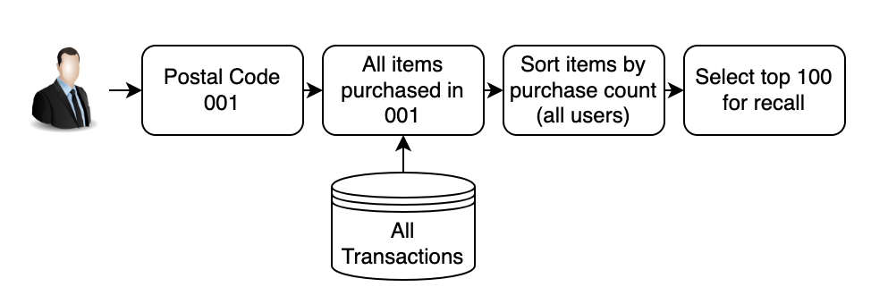
Statistical Filtering
Problems
Dataset
Methods - Recall
Evaluation
Various Static Attributes are applied to filter items
Age
Postal code
Purchased product code
Items commonly bought together
While candidate size could still be large, user popularity to do further filtering, to recall top 100 from each attributes

Slide 15
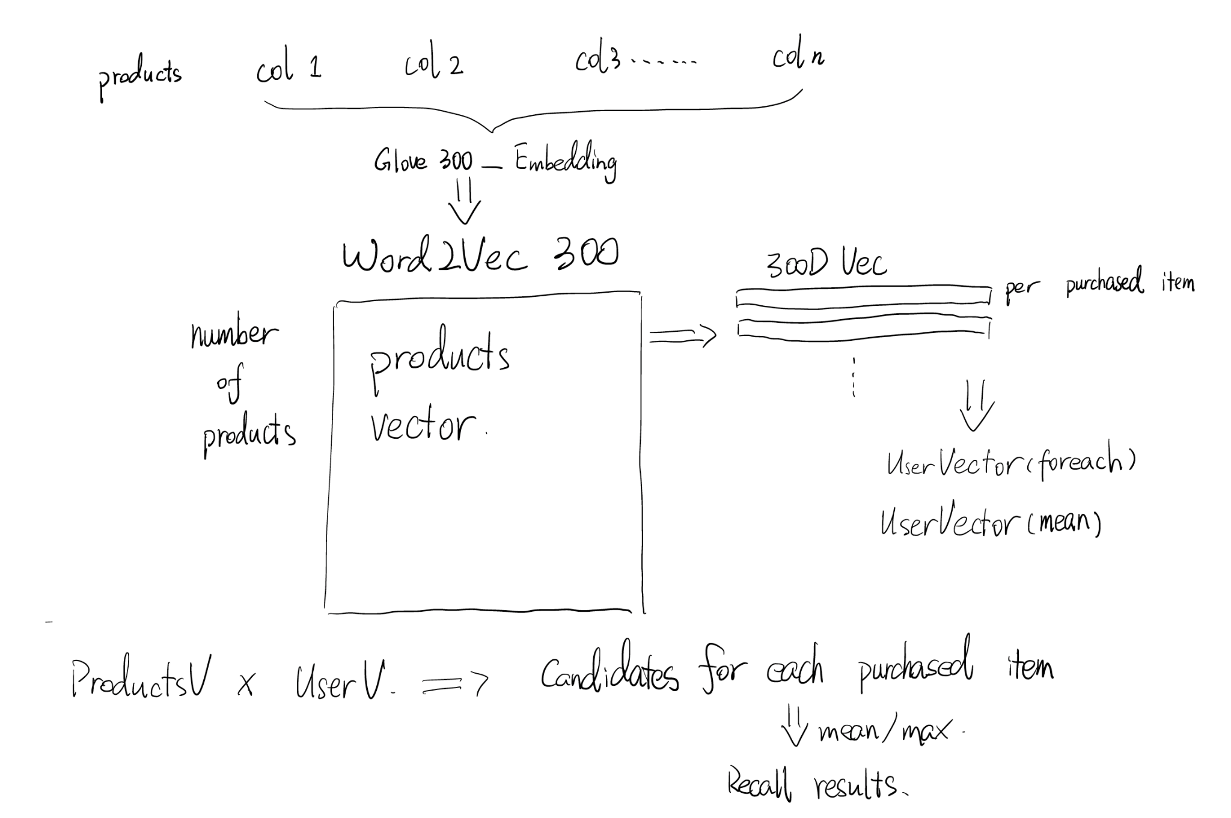
Embedding
Text
content based
Problems
Dataset
Methods - Recall
Evaluation
Notes:
foreach better but slow -> neglecting individual items, and only care about user’s general purchase habits

Slide 16
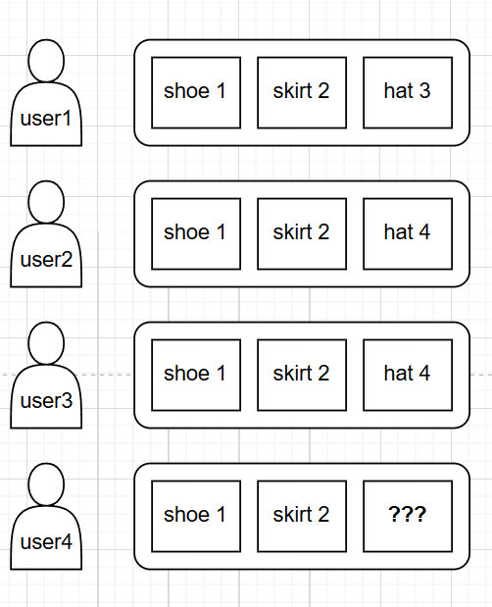
Item2Vec: Transaction based
Problems
Problems
Dataset
Dataset
Methods
Methods - Recall
Evaluation
Evaluation
This section introduces the concept of using Item2Vec, a model similar to Word2Vec, to predict the most likely next item a user might purchase based on historical transaction data.

Slide 17
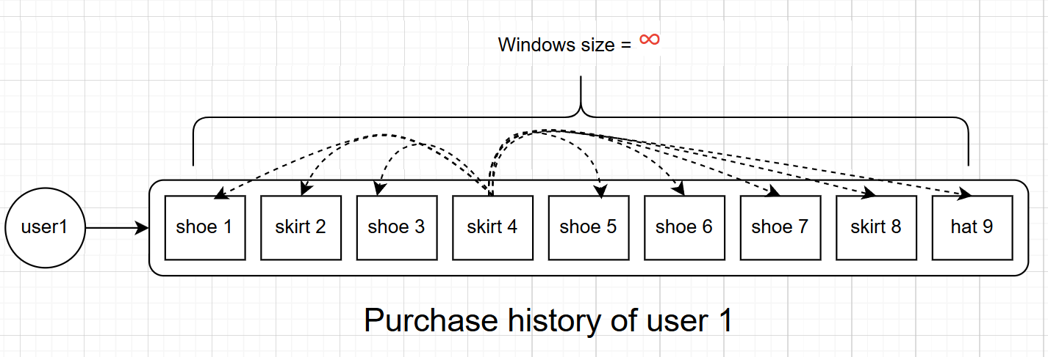
Item2Vec: Transaction based
Problems
Problems
Dataset
Dataset
Methods
Methods - Recall
Evaluation
Evaluation
It is modeled on the neural network architectures used in NLP (specifically, Word2Vec) to capture the context of items within transactions, treating items similarly to words in a sentence.

Slide 18
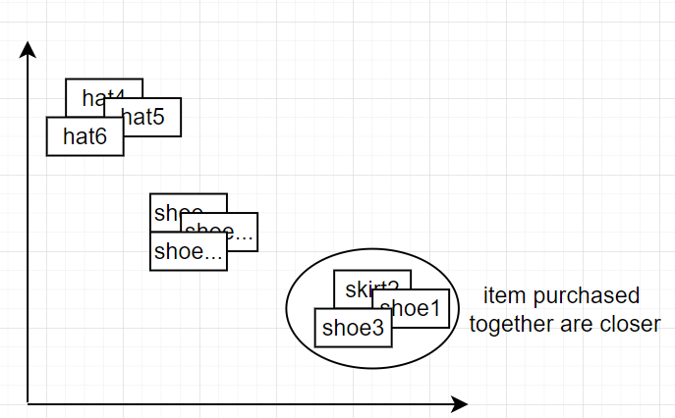
Item2Vec: Item profiles for Item2Vec
Each item is represented as a vector in a multidimensional space. By training the model on user transactions, items that are frequently bought together move closer in this vector space, thereby encoding their similarities and relationships.

Slide 19
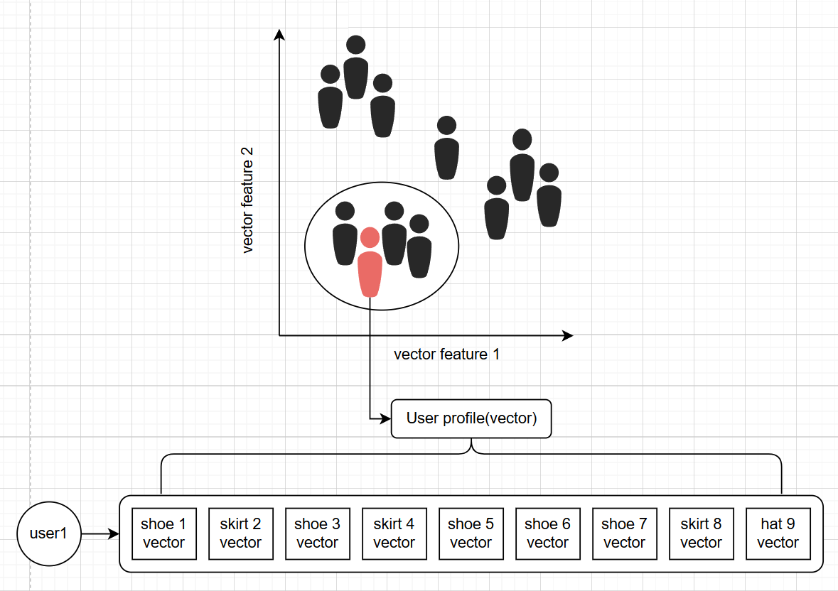
Item2Vec: User profiles for Item2Vec
Problems
Problems
Dataset
Dataset
Methods
Methods - Recall
Evaluation
Evaluation
User vectors are created by averaging the vectors of items they have bought. These vectors help in identifying user profiles or segments with similar tastes or purchasing behaviors.

Slide 20
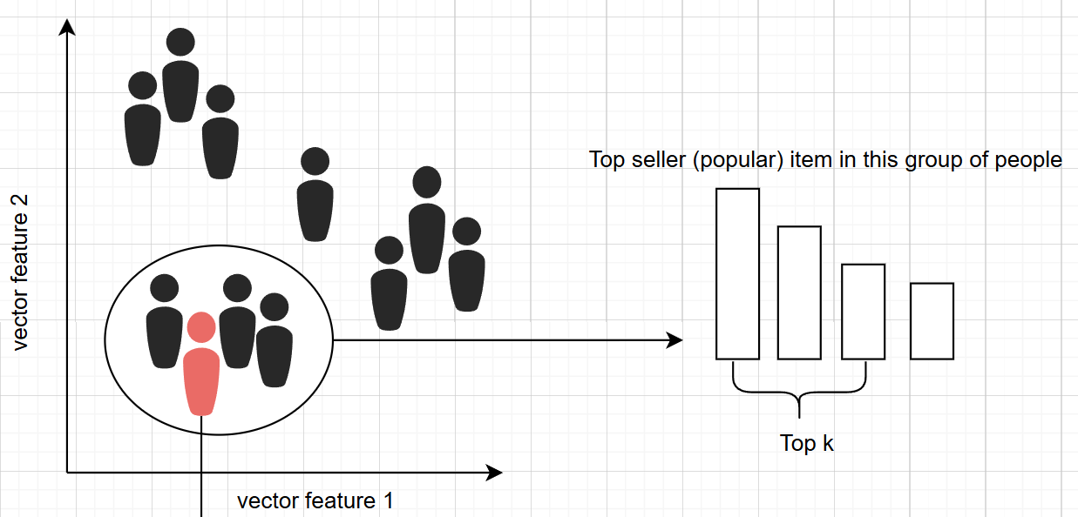
Item2Vec: Recommend base on user profile’s cluster
Problems
Problems
Dataset
Dataset
Methods
Methods - Recall
Evaluation
Evaluation
For recommending items, the system identifies the user’s vector and finds the nearest user cluster. It then recommends items that are popular in this cluster, potentially filtering for items the user hasn't bought yet.

Slide 21
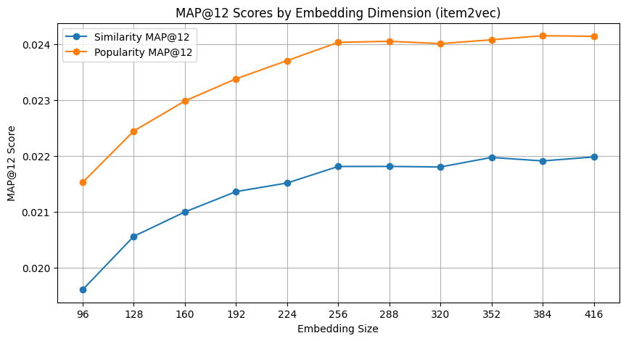
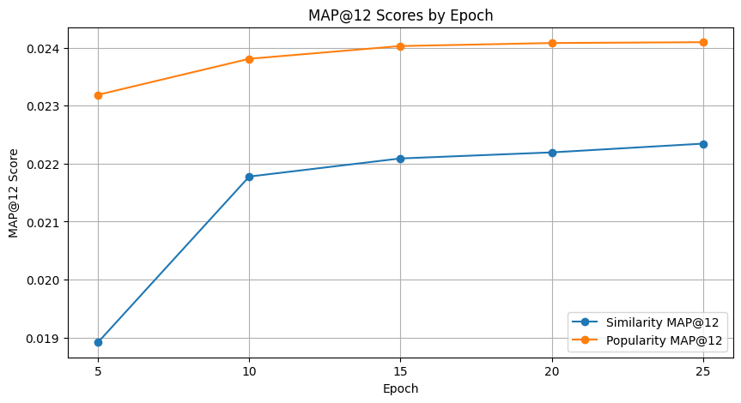
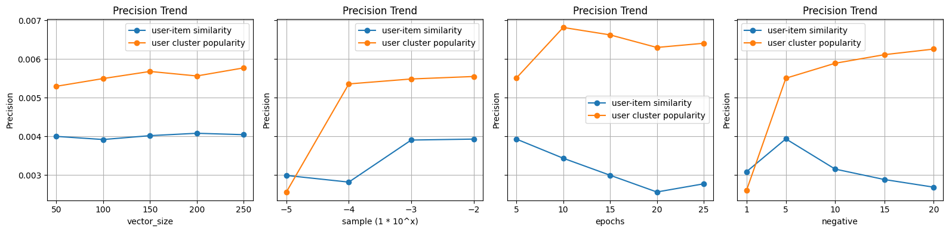
Item2Vec: Hyperparamter Tuning
Problems
Dataset
Methods - Recall
Evaluation

Slide 22
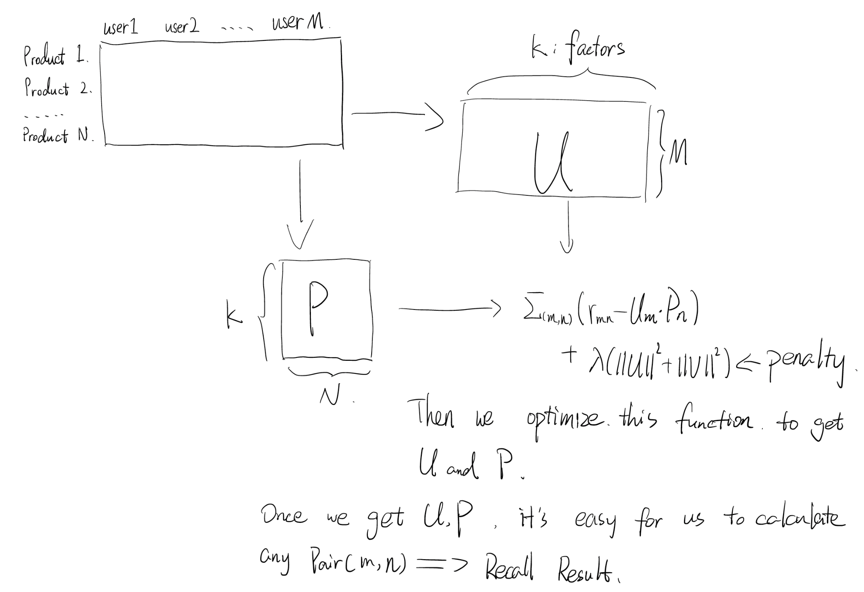
Matrix Factorization based on transaction(user collaborative)
Problems
Dataset
Methods - Recall
Evaluation

Slide 23
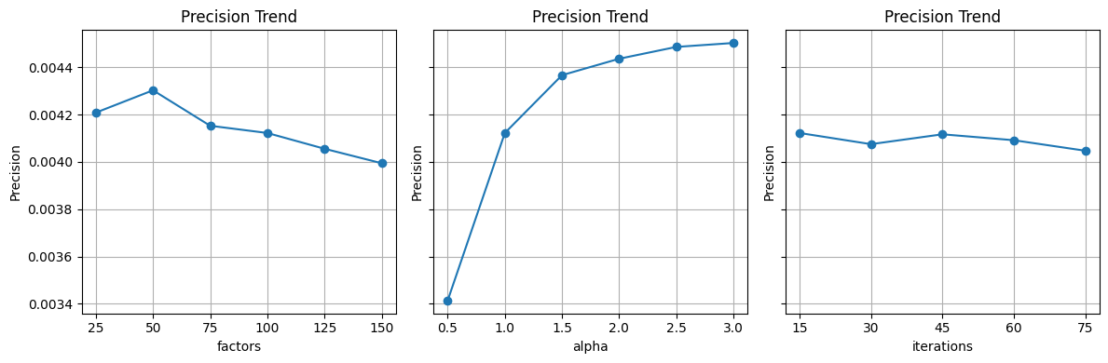
Matrix Factorization: Hyperparamter Tuning

Slide 24
Ranking Model
Problems
Dataset
Methods - Ranking
Evaluation
Classification Model
Classification Model with XGBoost
Score from each candidates generation (recall) pipeline as input feature
Predict whether the user purchased an item
During inference, use model output logits to sort recalled items and select top 12 as final recommendations
Average Score:
Averaging score from each candidates generation (recall) pipeline

Slide 25
Experiments & Evaluation

Slide 26
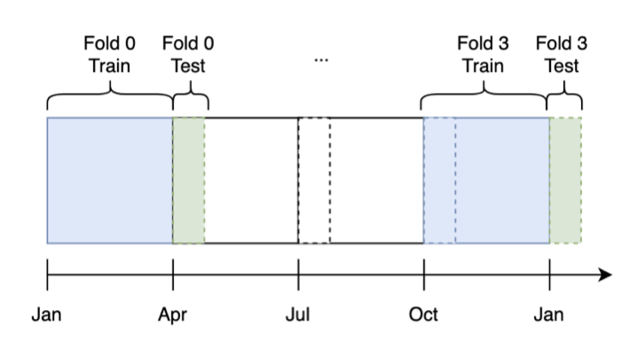
Data Split Strategies
Problems
Dataset
Methods
Evaluation
Split data to three months (train) and the following week (test).
Why not 80/20? randomly split will ruin the time series
Considering to different seasons affection, the split rule is divide one year into four subsets, three months + one week.
Separate evaluation for user with purchase history and without purchase history, for evaluation with different scenarios

Slide 27
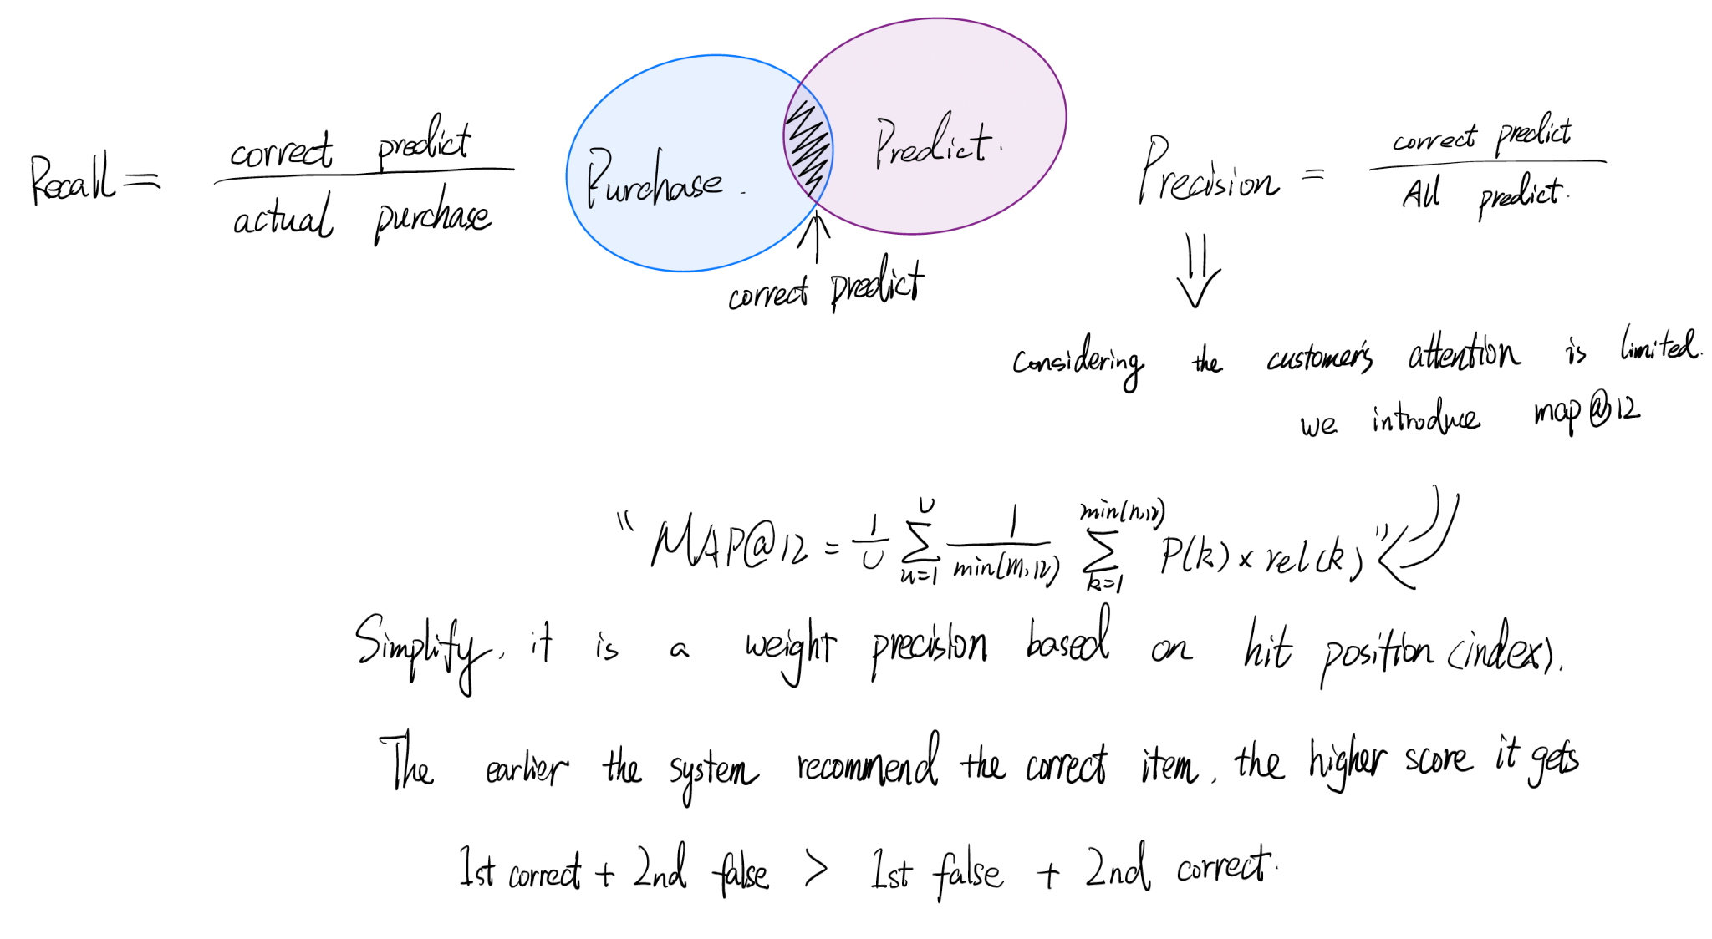
Experiments - identify evaluation matrix
Problems
Dataset
Methods
Evaluation

Slide 28
Metrics tradeoff
Problems
Dataset
Methods
Evaluation
Recall: Coverage vs. ranking ease, once we pick more items, the coverage will increase, but bad for the further ranking, since there are more candidates.
Presicion: Bad for mobile device, small screen -> less information -> TOP12 order matter, but a traditional precision will not consider that. That’s why we introduce MAP@12.
MAP@12_unweighted： It introduces a new variable, recommendation position. This ensures our system will not consume much user’s attention, since the first one is the best one.
MAP@12_counts_weighted: Introduce count variable, the predicted items that are most purchased will be placed first. But, some cloth are consumables, such as socks.
MAP@12_prices_weighted: Introduce price variable, the highest price predicted item will be placed first. Not friendly to customers, even the company.
Notes:
unweight -> counts: but, what if one specific item customer likes a lot, and but it multiple times counts -> price:
For those disposable cloth, they are often much cheaper than a common cloth, like jacket or coat.

Slide 29
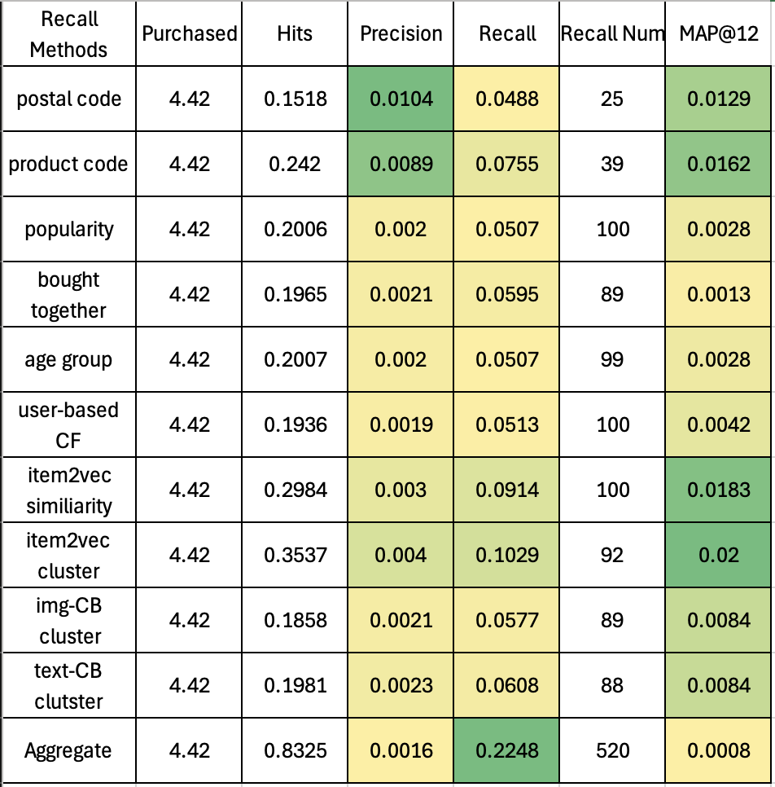
Evaluation Results: Recall Stage
Problems
Dataset
Methods
Evaluation
Evaluation based on all users in selected period, one-fold.
Recalling Maximum 100 items from each pipeline, for each user
item2vec, postal code and product code are the most competitive methods

Slide 30
Evaluation Results: Classification Model Ranking
Problems
Dataset
Methods
Evaluation
Evaluation based on all users in selected period, one-fold.
XGBoost classification performance (on train set)
Accuracy: 0.982
ROC AUC: 0.998
MAP@12: 0.0256

Slide 31
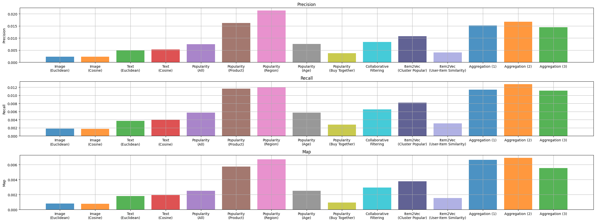
Evaluation Results: Recall + Average Score Ranking
Problems
Dataset
Methods
Evaluation
Evaluation based on selected users, 4-fold average

Slide 32
Computations Optimization
Problems
Dataset
Methods
Evaluation
2-Stage recommendation are used: recall to reduce the candidates size and rank to use time consuming algorithm
Image feature and text feature for each items are pre-computed and dumped, to avoid duplicate computations
Use GPU to accelerate model training and similarity computation
For similarity computations, adapt faiss to accelerate

Slide 33
Cold start & Dynamically update
Problems
Dataset
Methods
Evaluation
Two types of data need to be added in our system: New uploaded product -> for those items, their content base weight will be increased & this update volumn is big, but less frequent, because the fashion industry often launches new products every season, so no need to apply a real time update here. New customer -> mockup some fake purchase history based on the category we put it in & the system should record every transaction the new customer completed real time, high frequent but less volumn.
How to update model/algorithms:
Regarding to our evaluation metrics, we have a lot of monitoring indices that represent different situations, the model and algorithm should be updated based on what the company needs. And we have to know that, the customers are not “smart”, they dont buy what they need, acutally, they buy what we recommande, so we can change the model to lead a trend. Some of algorithms are aligned with time series
Notes:
https://dl.acm.org/doi/abs/10.1145/3340531.3412687 推荐系统对用户购买的反向印象

Slide 34
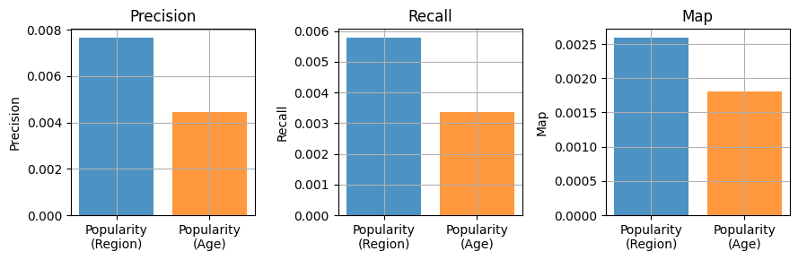
Cold start: evaluations
Problems
Dataset
Methods
Evaluation
Comparison between 2 recommendation methods for new users:
Recommend most popular items within user’s postal-code (region)
Recommend most popular items with user’s age group

Slide 35
Reflection
Problems
Dataset
Methods
Evaluation
What we did well
Developed lots of methods and an aggregated system
Reasonable comparison between each methods, and overall demonstrate a good performance
Good team work, modularized developments allows different parts can be developed in parallel with different people
What we did bad
Spent too much effort on exploring complex deep learning models in the early stage (wide & deep, transformers for sequential recommendation etc.), which did not found helpful
Time management issues. Should do quick validation for various methods in early stage instead of focus on system engineering. Some methods do not work as expected
Evaluation is still in progress, there are much more hyper-parameters tuning and ablation studies to do.
Evaluation is focusing on precision / recall / MAP, which may not be that important in real world
Real people survey is still in progress due to the time limit

Slide 36
Q & A

