Slide 1
OneTick Training
Sample Query Solutions

Slide 2
Contents
Example 1: Demo Strategy Framework

Slide 3
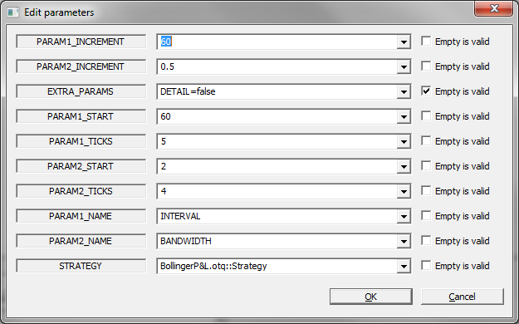
Example 1: Demo Strategy Framework
The use case demonstrates how to dynamically generate a list of strategy parameters and execute the specified strategy for each set of parameters.
Query files: DemoStrategyFramework.otq, BollingerP&L.otq
Details: Query DemoStrategyFramework.otq::RunStrategy runs the strategy for 2 varying numeric parameters and any number of fixed parameters:
This example runs query STRATEGY for all values of INTERVAL=60,120,180,240 against all values of BANDWIDTH 0.5,1.0,1.5,2.0
See next slide for details…

Slide 4
Example 1: Demo Strategy Framework
Query Parameters:
STRATEGY is the strategy query to run
PARAMETER<N>_INCREMENT - the start value for parameter N
PARAMETER<N>_START - the initial value for parameter N
PARAMETER<N>_TICKS - the number of values to generate for parameter N
PARAMETER<N>_NAME - the name of the parameter as used in the strategy
EXTRA_PARAMS - to add values of query parameters applicable in all cases. Example: DETAIL=false; DETAIL=<true|false> allows you to drill down into the strategy.
Sample settings: Run with DETAIL=false for a range of INTERVAL and BANDWIDTH, which only shows the P&L at close and then reset the parameters to just run the strategy with an INTERVAL and BANDWIDTH of interest and DETAIL=true to show the full evolution of the P&L.

Slide 5
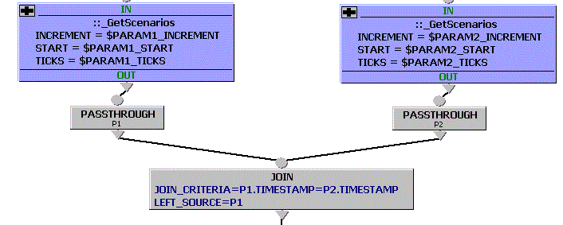
Example 1: Demo Strategy Framework
Query DemoStrategyFramework.otq::_GetScenarios is used to generate parameter values.
Query DemoStrategyFramework.otq::_GetScenariosLimit can be used instead to generate all value up to a limit rather than a number of scenarios.
Query DemoStrategyFramework.otq::RunStrategy
Note the JOIN on timestamp to get a Cartesian join of the 2 scenario sources.

Slide 6
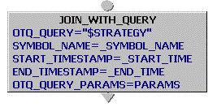
Example 1: Demo Strategy Framework
Query DemoStrategyFramework.otq::RunStrategy
Make a note of JOIN_WITH_QUERY event processor:
Description: Joins every input tick with the resulting ticks of a query, executed upon the arrival of that tick. The query name as well as query parameters are subject to being reevaluated dynamically each time an input tick arrives.
An output tick is formed by joining the respective input tick with the successive resulting tick of the respective query. To avoid name collisions, field names of resulting ticks are optionally prefixed with the value of the PREFIX_FOR_OUTPUT_TICKS parameter (see below). An output tick carries the timestamp of the respective input tick. Timestamps of joined ticks are propagated in the special field TIMESTAMP, prefixed accordingly.
See Event Processor Help for more details.

Slide 7
Example 1: Demo Strategy Framework
Sample strategy query BollingerBandsP&L.otq
The actual sample strategy being run in this demo. It uses a basic Bollinger generation logic with a couple of additions passing its output into a P&L calculation.
The trades are passed through a cleaning otq that removes any trades outside the current bid/ask having first removed any backward or zero quotes. Note that this uses TRD_QUOTE_JOIN with a delay of zero. We could pass delay as a parameter.
P&L example:
We start with 0 cash and 0 stocks.
If we see a signal we BUY or SELL 1 at the current mid price (we could make this the prevailing bid/ask, with a possible delay in the join, as appropriate or the last traded price).
At close we calculate the value of our holdings at the closing price. Cash+holdings value=P&L.
Could be added: stop loss limits, maximum holding period (fixed or variable) and other parameters passed from the RunStrategy query

