Slide 1
OneTick Training
Use case:
Trade performance

Slide 2
Requirement
For each of OUR trades/fills (contained in a csv file) report...
  Market Bid/ask at 0,1,5,15,60 seconds before and after fill time.
  Market Bid/ask at time of 10,25...500 trades before/after fill time.
  Market VWAP,trades and traded shares for above intervals before and after fill time.
  Last trade price and time
  Next and last bid/ask and time

Slide 3
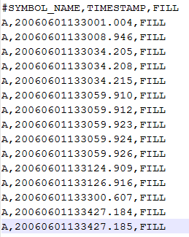
Inputs
Our CSV file of our trades (which should be in a directory on CSV_FILE_PATH) looks like this…

Slide 4
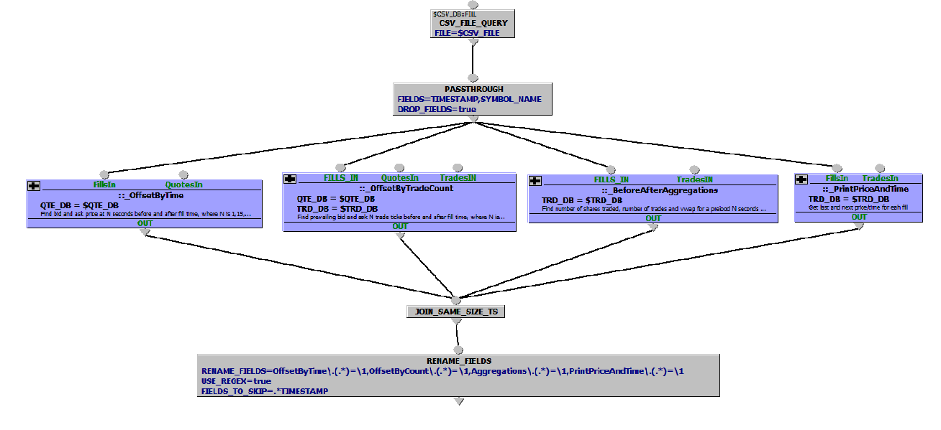
Basic structure:

Slide 5
Basic structure:
Use Nested Queries as much as possible

Slide 6
Basic structure:
Note new JOIN_SAME_TIME_TS EP

Slide 7
Basic structure:
Note use of REGEX to remove prefixes in RENAME_FIELDS

Slide 8
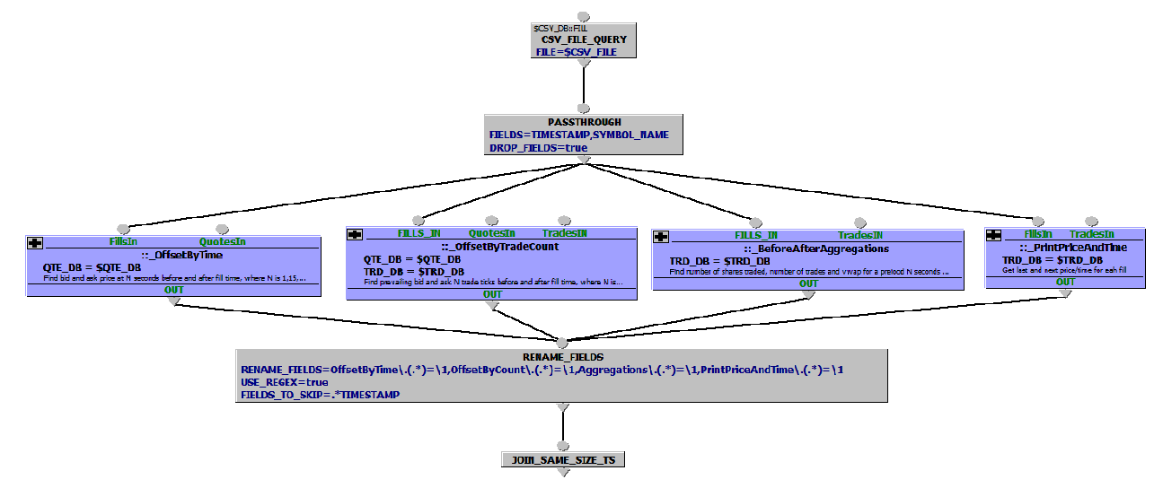
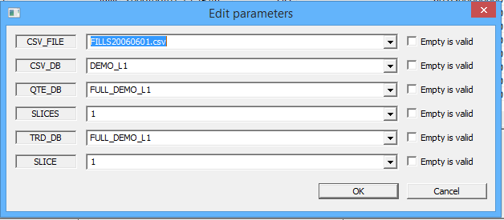
Basic structure: PARAMETERS

Slide 9
Basic structure: PARAMETERS
Parameterise EVERYWHERE

Slide 10
Basic structure: PARAMETERS
Parameterise EVERYWHERE
Parameterise EVERYWHERE
Csv is in CSV_FILE_PATH
CSV_DB tells query whether to look on client or server
QTE and TRD may be in different DBs
SLICE/SLICES for testing subset of data

Slide 11
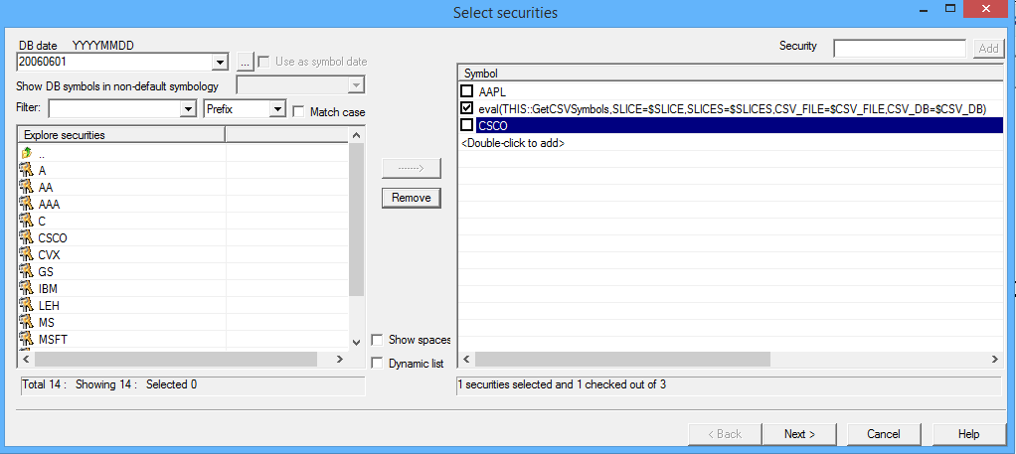
Symbols:

Slide 12
Symbols:
Stage 1 is also highly parameterised

Slide 13
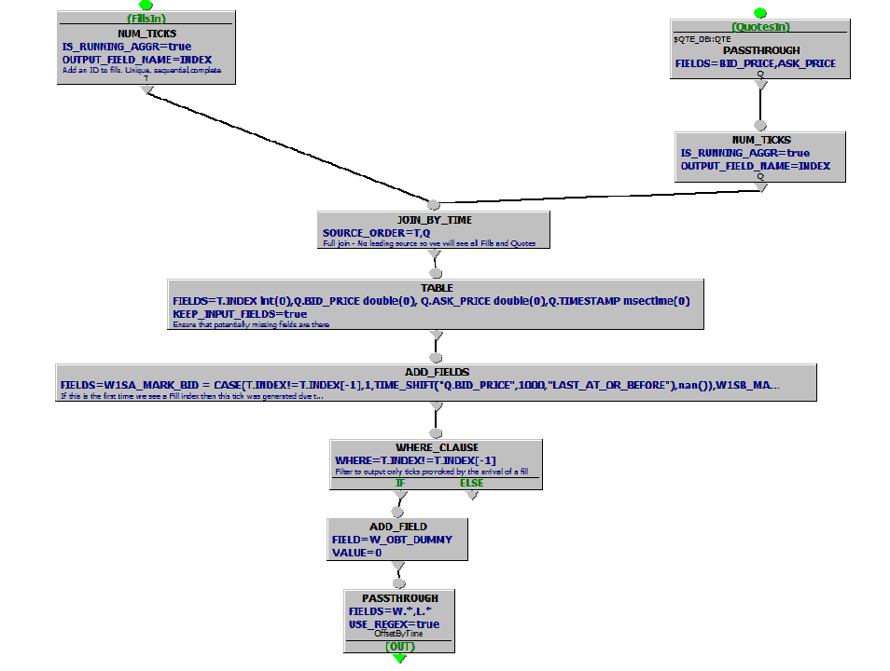
Get bid/ask at market time offsets
Join By Time has no leading source. So we output if EITHER source ticks

Slide 14
Get bid/ask at market time offsets
We may not have a Quote so ensure that Quote fields are present using TABLE as we refer to them later

Slide 15
Get bid/ask at market time offsets
ADD_FIELDS using positive and negative TIME_SHIFT() function. Note use of CASE() function to avoid unnecessary calculation. We only want to calculate if the output was caused by a FILL event.

Slide 16
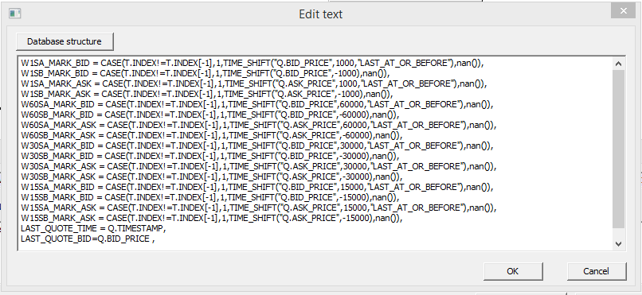
Get bid/ask at market time offsets
ADD_FIELDS using positive and negative TIME_SHIFT() function. Note use of CASE() function to avoid unnecessary calculation. We only want to calculate if the output was caused by a FILL event.

Slide 17
Get bid/ask at market time offsets
We are only interested in outputs caused by the arrival of a FILL event.

Slide 18
Get bid/ask at market time offsets
We may end up with no W* fields to PASSTHROUGH in the next EP. So ensure that there is at least one. (We could have done this with TABLE ! )

Slide 19
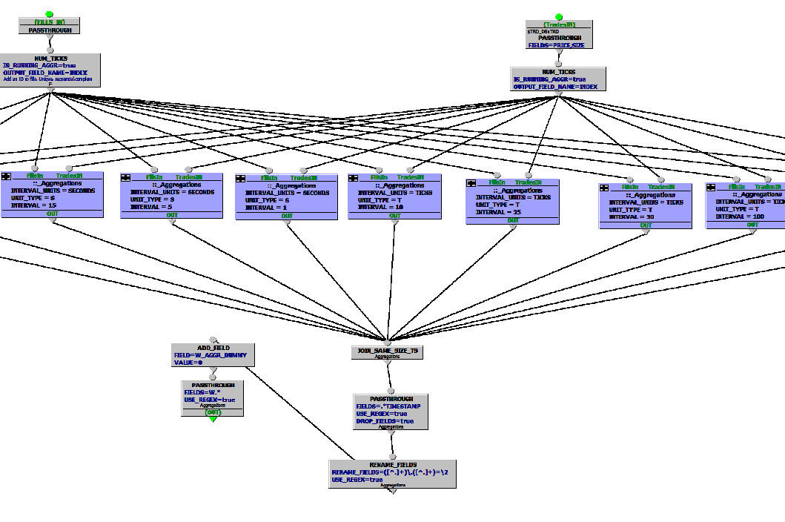
Get aggregations at tick/seconds before/after
Multiple re-use of parameterised nested query _Aggregations.
Parameterised to say what units (ticks or seconds) we are using and what the aggregation interval is.
So what does the _Aggregations nested query look like….

Slide 20
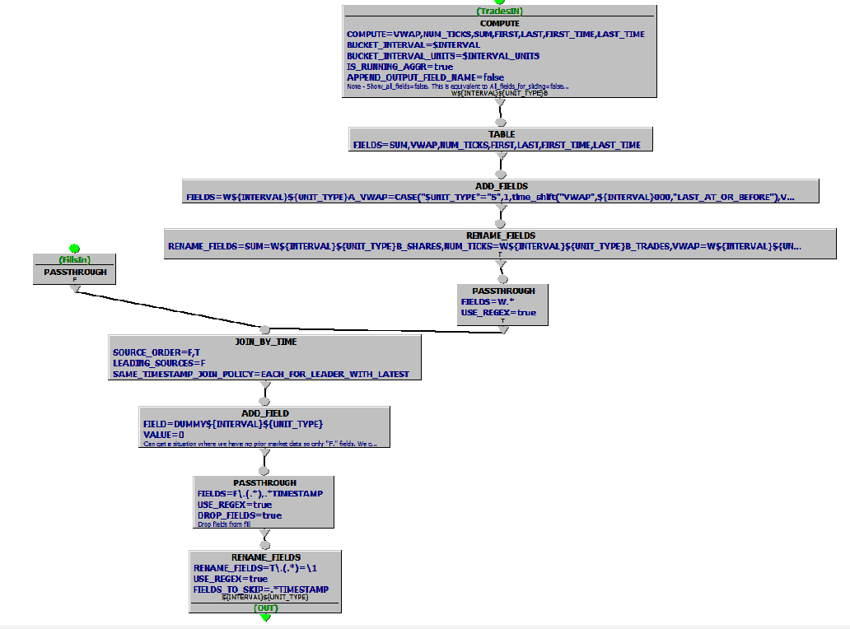
Get aggregations at tick/seconds before/after: _Aggregations
Compute aggregations for interval and units parameters. Running aggregation. ALL_FIELDS_FOR_SLIDING is FALSE. So we get an output tick when a tick leaves our window. This allows us to get accurate aggregations at times which are not TRD times (i.e FILL times)

Slide 21
Get aggregations at tick/seconds before/after: _Aggregations
Add new fields (“after” aggregations)
Rename existing fields (“before” aggregations)

Slide 22
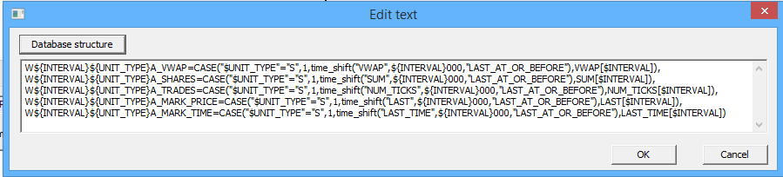
Get aggregations at tick/seconds before/after: _Aggregations
Add new fields (“after” aggregations)
Rename existing fields (“before” aggregations)
Add fields uses time_shift() for time offsets and [index] for tick offsets.
Note that parameters can be used to create field names on the fly.

Slide 23
OneTick Training
Use case:
Trade performance
Now we’ll look at the actual query…..

