Slide 1
OneTick Training
The Basics

Slide 2
Outcomes and further help
By the end of tomorrow you should be able to write and test complex queries using the otq query language.
Get help from:
support@onetick.com
Jira knowledge base KB project.
e.g KB-272 with training materials.
OneTick University:
https://vimeopro.com/onemarketdata/onetick-university

Slide 3
Databases
Each customer defines their own databases and their contents.
Usually, a database contains information from one feed (source).
Each database may contain multiple “Tick Types”.

Slide 4
Tick Types
Each “Tick Type” contains a set of field definitions (field name and type) for each record.
This is similar to a “Table” in a relational database.
However, the columns for a tick may change on a daily basis depending on the feed and the loading program.
See ../docs/datamodeling.html for details

Slide 5
Field types (data types)
Easier to just look at the docs…
See ../docs/datamodeling.html for details

Slide 6
Data Model Changes
In a regular SQL DB, when the data model changes you need to run an ALTER TABLE which will redefine the data structure for all old records in the table.
OneTick does not alter history. Instead, the data model for each DB segment (usually day) is recorded in the DB. This allows the data model to change over time. However, this places some additional requirements on queries that we will cover later.
See ../docs/datamodeling.html for details

Slide 7
“Standard” Tick Types
For loaders that ship with OneTick the following are “standard” tick types used.
TRD – Trade
QTE – Level 1 quote
OB – Order Book
PRL – Price level (generalization of an order book input)

Slide 8
Trade (TRD) Tick Type
Trades are expected to have the following fields at a minimum:
PRICE
SIZE
If the feed provides cancellations and corrections, the following fields should also be present:
DELETED_TIME
TICK_STATUS

Slide 9
Quote (QTE) Tick Type
Quotes are expected to have the following fields at a minimum:
BID_PRICE
BID_SIZE
ASK_PRICE
ASK_SIZE
May have additional fields, e.g to identify the source of the quote (iEXCHANGE, MMID, etc.)

Slide 10
Order Book Basics
PRL and OB tick types contain fields that store changes in Level 2 orderbook data or full orderbook data in a manner where the state at any time can be effieciently retrieved. This is discussed in depth in module 5 – Order Book Aggregations.

Slide 11
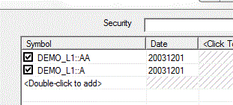
Symbol date
Symbols may change over time.
OneTick allows reference data (“REF_DATA”) to be loaded for use by the system
Corporate actions (price and size adjustments)
Symbol changes over time
Mappings between symbologies (i.e. VIA.B and “VIA B”
Etc.
The symbol date allows OneTick to select the proper time series when symbols are reused over time. The semantics are “the symbol is provided as-of the symbol date”.
You MUST specify symbol date only when using reference data in the query.

Slide 12

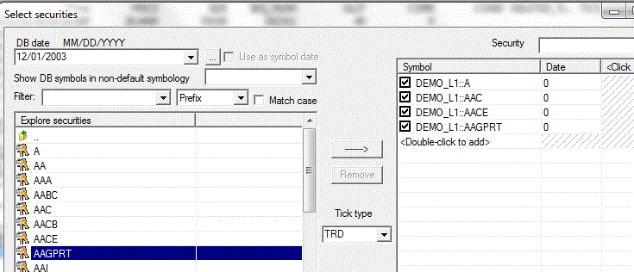
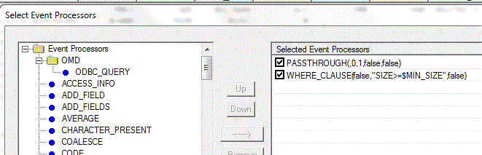
Chain Queries
Usually process one tick type
The tick type is specified on the security selection screen
A sequence of EPs that are executed one after the other

Slide 13
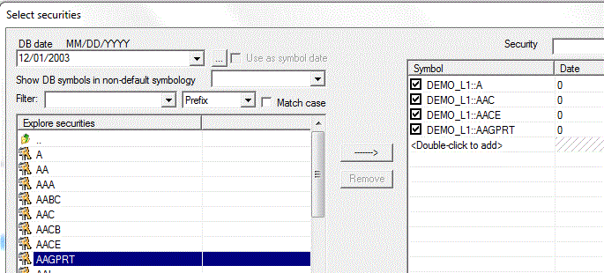
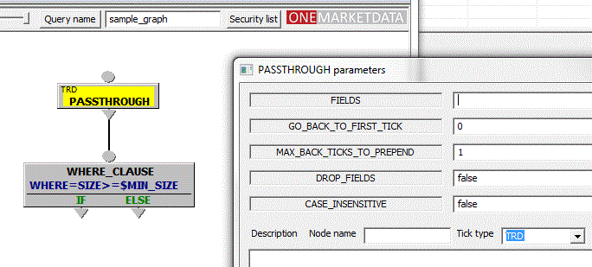
Graph Queries
May have multiple ticks types from different databases.
The tick type (and database) are usually specified in the EP for each branch of the graph.
Streams of ticks can be joined and split.
EPs only apply to the ticks that come down that branch of the graph.
Reminder: EP = Event Processor

Slide 14
Query Example: Bollinger Bands
OneTick query language makes it easy to analyse data and implement strategies.
Bollinger Bands
Buy if price is low relative to moving average
Sell if price is high relative to moving average

Slide 15
Multi-Stage Queries
Stage 1 – Run EPs to generate a list of symbols or events
Stage 2 – Run each symbol or each event through its own copy of the graph
Stage 3 – Combine the Stage 2 results from multiple symbols or events and run EPs across all of the results.
Sample applications: Portfolio price and P&L, Portfolio of Portfolios or Index level calculations, Event driven statistics.

Slide 16
Query Language Basis
Regular SQL is defined by set operations. This makes it difficult to define time ordering.
The OneTick query language is stream oriented. Since the data is always stored in time sequence, the analytics are always done in time sequence.
OneTick provides many analytics called “Event Processors” (or EPs for short). The remaining sections will explore the most commonly used EPs.

Slide 17
OneTick Training
Filter EPs

Slide 18
Filter EPs
These EPs drop “uninteresting” ticks from the stream
CHARACTER_PRESENT : See if one of the valid values is in the field. A common use is to provide a list of “interesting” trade or quote conditions .
VALUE_COMPARE : Compare a single field to a single value
VALUE_PRESENT : Compare a single field to a multiple values. A common use is to compare the EXCHANGE field agains a list of exchange codes.
WHERE_CLAUSE : General SQL type of comparison. May use built-in functions. More time consuming to run than a VALUE_COMPARE but you can use built-in functions in addition to complex conditions
You may use fields on a previous tick by using an index i.e. PRICE < PRICE[-1]
TIME_FILTER : Only allow ticks that are between the START_TIME and END_TIME

Slide 19
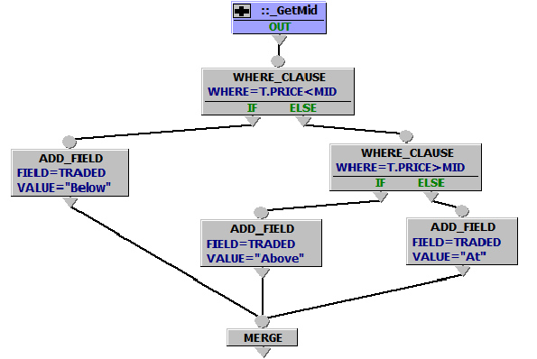
Filter EPs
There are frequently more ways than one to do things in OneTick. Take a common use case of flagging trades as being done Above, At or Below the prevailing mid. We could do this with cascading WHERE_CLAUSE Eps….(Ignore the dark blue “nested query” and the MERGE – We’ll becoming to those).

Slide 20
Filter EPs
But using WHERE_CLAUSEs is not the only, and probably not the most efficient, way of doing this. We could also consider:
ADD_FIELD and conditional UPDATE_FIELDs
The SWITCH EP
An expression using the CASE() function
An expression using other functions
Expressions using filter EPs as functions (Yes – You can do this ! )

Slide 21
Column Filtering
The PASSTHROUGH EP can limit the columns that are passed to following EPs.
The TABLE EP can be used to both limit the columns and create columns where they do not exist. It will initialize them to NaN, 0 or an empty string depending on the field type. Or you can provide a literal initial value.

Slide 22
The PASSTHROUGH EP
Often the first EP in chain or graph. In this case, it is used as a source of ticks. This is very useful for nested queries or joins.
Can be used to provide an initial tick from before the query start time (using the GO_BACK_TO_FIRST_TICK parameter)
Often used as the first or last EP to reduce the number of columns (using the FIELDS and DROP_FIELDS parameters)

Slide 23
The PASSTHROUGH EP (cont.)
The default PASSTHROUGH can be thought of as the equivalent of “SELECT *” in SQL
When specifying fields it is the equivalent of “SELECT <field list>”
The GO_BACK_TO_FIRST_TICK is useful when a query must have a starting value. Often, there is no tick at exactly query start time. The GO_BACK allows you to get the last value.

Slide 24
The PASSTHROUGH EP (cont.)
The period where the PASSTHROUGH looks at ticks from before the query for the GO_BACK is called “the initialization phase” and happens before the main query is run.
However, if you place EPs (such as filters) before the PASSTHROUGH then these EPs will be executed for the initialization ticks as well.

Slide 25
Getting Data from Other Periods
Sometime, you need data from much earlier for the query. For example, your algorithm needs yesterday’s close price for its computations.
You can use PASSTHROUGH with GO_BACK_TO_FIRST_TICK parameter was the only way to get this kind of information.
The MODIFY_QUERY_TIMES EP can also be used to change the start and end time for one portion of the graph. This will be discussed more later in the class.

Slide 26
The TABLE EP
Earlier, when discussing changes to tick types, we said that OneTick doesn’t change history. However, if you try to access a field that doesn’t exist you get a fatal error.
The TABLE can be thought of as a “dynamic ALTER TABLE” in that it forces the data coming out of the TABLE to have the same data model. This way, you can access a field that wasn’t in the DB and get a reasonable default.

Slide 27
Sample Exercises are below
For more exercises see PDF Exercise Manual

Slide 28
GUI Exercise 1 – Query & Graph Trades
Get the TRAIN_C_QTE_TRD::MSFT trades for a day
Start time and end time (20180205)
Select the DB and security
Use PASSTHROUGH to get all of the trades
Connect the PASSTHROUGH to a WHERE_CLAUSE to select only trades with EXCHANGE=“Q” or “D”
Graph the PRICE
Use the “Switch Dataseries” button to get a list of the fields to graph
Use Ctrl-A Space to turn off all of series’
Select PRICE to graph only the price

Slide 29

GUI Exercise 2 – Saving & Using Queries
Use “File” -> “Save Query File As …” to save the otq file.
Use “File” -> “Exit” (or click on the X icon in the upper right) to exit the OneTick Display application.
Use “File” -> “Open Query File …” (or Ctrl-O) to open a saved query file.
When there are multiple queries in an otq file, highlight the query or queries to run and
Press F3 or RETURN to edit
Press F5 or to run
Right click and select* “Edit Query Name and Description” or “Edit Query Parameters”
TIP * When 1+ graph query windows are open, some context sensitive functions are disabled to avoid ambiguous actions. Close extra windows when not in use.

