Slide 1
OneTick Training
Aggregation EPs

Slide 2
Aggregation EPs
Aggregations have two parts
The calculation (or sampling) to be performed
The interval (called “bucket”) over which the calculation will be performed
The EP name describes the calculation to be performed
Combinations of parameters are used to define the buckets.

Slide 3
Commonly Used Aggregation EPs
AVERAGE
FIRST
FIRST/LAST_TICK
FIRST/LAST_TIME
HIGH/LOW
FIRST/LAST
NUM_TICKS
RETURN
STDDEV
SUM
TW_AVERAGE
VARIANCE
VWAP
See Event Processor Guide or GUI On-Line Help for more

Slide 4
Aggregation Buckets
One bucket, start to end
BUCKET_INTERVAL = 0
IS_RUNNING_AGGR=false
Fixed size buckets, start to end
BUCKET_INTERVAL=<size>
BUCKET_INTERVAL_UNITS= TICKS| SECONDS*| DAYS | MONTHS
IS_RUNNING_AGGR=false
TIP * MILLISECONDS and HOURS can be expressed as Number of SECONDS

Slide 5
Aggregation Buckets (cont.)
One bucket from the start to this tick
BUCKET_INTERVAL = 0
IS_RUNNING_AGGR=true
Trailing fixed size buckets
BUCKET_INTERVAL=<size>
BUCKET_INTERVAL_UNITS= TICKS | SECONDS | DAYS
IS_RUNNING_AGGR=true
NOTE: If ALL_FIELDS_FOR_SLIDING=false then there will be one output tick when a new tick is added to the bucket as well as when a tick is removed from the bucket.

Slide 6
Aggregation Buckets (cont.)
Flexible buckets:
Usage: When forming a bucket depends on a dynamic condition in the incoming tick stream
BUCKET_INTERVAL = 0
BUCKET_INTERVAL_UNITS= FLEXIBLE
BUCKET_END_CRITERIA (expression) - specifies criteria for when to compute the value for the current bucket/start the next aggregation bucket. Allows use of functions and preceding ticks (e.g., SIZE[-1]). See Help for more…
BOUNDARY_TICK_BUCKET set to NEW or PREVIOUS [bucket] determines where to place the boundary condition output tick

Slide 7
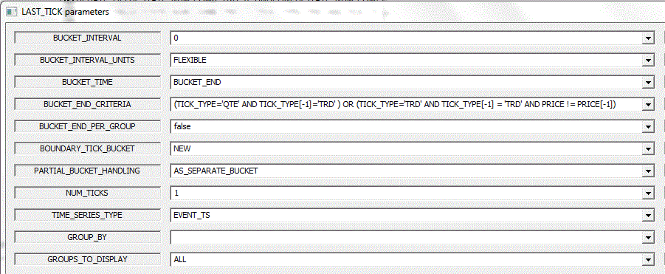
Aggregation Buckets (cont.)
Flexible buckets - example:
TIP – Each aggregation has Generic Aggregation Parameters (e.g., BUCKET_INTERVAL) and specific EP parameters (e.g., NUM_TICKS for LAST_TICK EP). See EP Help for details.

Slide 8
Aggregation Buckets (cont.)
Commonly used additional parameters
ALL_FIELDS_FOR_SLIDING=true This is used for running aggregations and causes the EP to add the output field of this aggregation to the tick that triggered it. Output events will only be generated by arrival events.
GROUP_BY allows aggregation by categories in addition to time/tick intervals
INPUT_FIELD_NAME Most EPs default to work on (BID_/ASK_)SIZE and/or (BID_/ASK_)PRICE.
OUTPUT_FIELD_NAME Default is VALUE – which can cause an error when multiple aggregations are used since they all try to create the VALUE field.
OUTPUT_INTERVAL and UNITS defines the frequency in which the current aggregated value is outputted, in seconds or ticks.
TIP - See Parameters Common to Generic Aggregations and individual EP Help for more parameters and details.

Slide 9
COMPUTE EP
The COMPUTE EP can be used to run multiple aggregations over the same tick stream
The parameters for the bucket interval are specified once on the COMPUTE EP and apply to all of the aggregations
The compute EP prepends the name of the aggregation to the OUTPUT_FIELD_NAME (i.e. AVERAGE.VALUE, SUM.VALUE) unless APPEND_OUTPUT_FIELD_NAME=false

Slide 10
COMPUTE EP (cont.)
The COMPUTE parameter contains the names of the aggregations and their parameters
For example, to compute both the average price and size over some interval AVERAGE(INPUT_FIELD_NAME=PRICE, OUTPUT_FIELD_NAME=PRICE), AVERAGE(INPUT_FIELD_NAME=SIZE, OUTPUT_FIELD_NAME=SIZE)
Frequently used to calculate OCHL bars.

Slide 11
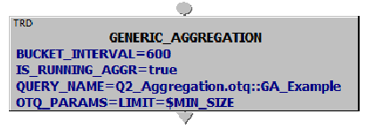
Generic Aggregation EP
If you REALLY have an aggregation that is not available using the existing EPs you can use the GENERIC_AGGREGATION EP to build and call your own. Like this….

Slide 12
TIMESTAMPS on Aggregation Ticks
Since aggregations work on intervals, the TIMESTAMPs on the ticks coming out of the aggregation are by default the TIMESTAMPs of the end of the interval.
BUCKET_TIME=BUCKET_START sets the output tick TIMESTAMPs to the start of the interval (where applicable)
For aggregations like FIRST_TICK and LAST_TICK the original TIMESTAMP is copied to the TICK_TIME field.

Slide 13
Sample Exercises are below
For more exercises see PDF Exercise Manual

Slide 14
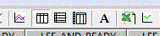
GUI Exercise 1 – Calculate and Save Results to Spreadsheet
Calculate daily average PRICE during trading hours for TRAIN_C_QTE_TRD::MSFT for a week.
Start time end end time (20180205 9:3020180209 16:00 New York)
Use the EP AVERAGE with a 1 day interval □ Click “Table View 3”
Use “View” -> “External Spreadsheet – All Data” to convert the data to an Excel spreadsheet. Or use the Excel button.
Repeat with interval=0 and “Apply Times Daily” checked. What difference do you see ? Why ?
Select a different security or securities to run the query on

Slide 15
GUI Exercise 2 - Aggregations
Using TRD data for TRAIN_C_QTE_TRD::MSFT on 201810205
Compute the 1 minute moving average and the 10 minute moving average for each tick and place the calculated values on each tick
Hint: Use AVERAGE 2 times, with IS_RUNNING=true, the first one for 1-min average, the 2nd one for 10-min average
Compute the average and standard deviation for each 15 minute interval in the trading day
Hint: Use COMPUTE EP
Compute the 15 minute average and standard deviation for each trade. Use them to compute a Z- score for the trade (average-price)/standard deviation
Calculate the open, close, high, low, volume, VWAP and number of ticks for the whole trading day.

