Slide 1
OneTick Training
Fields
State Variables
Nested Queries

Slide 2
Fields
Queries can add fields to a record for the duration of the query using the ADD_FIELDS EP using expressions containing:
Built-in functions
“Special” fields (_SYMBOL_NAME,_START_DATE…)
The value of a field on this tick, or a previous or future tick by using a negative/positive index. E.g. PRICE-PRICE[-1] or PRICE[+1]
Field values can be changed (including the TIMESTAMP field*) using the UPDATE_FIELDS EP. The WHERE parameter allows you to control when the changes will occur.
TIP * If you do change the TIMESTAMP field it must still have a value between _START_TIME and _END_TIME. UPDATE_TIMESTAMP EP provides more time-specific options – see Help for more details.

Slide 3
State Variables
A state variable is a variable of a particular type used to keep and share a value of that type (state) between several event processors within the graph and between ticks.
The group of event processors which can access/modify a particular state variable is determined by its scope.
Scope, type and initial values of state variables are specified by the DECLARE_STATE_VARIABLES event processor.
State variables can be accessed/modified both by a subset of built-in OneTick EPs like UPDATE_FIELDS and any user-defined event processor (a.k.a. UDEPs).

Slide 4
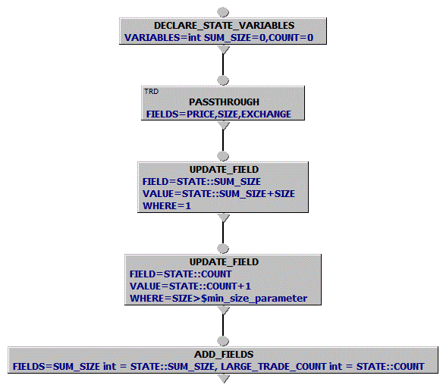

State Variables (cont.)
Declare STATE vars
Retrieve Trades
Update values of STATE vars on each tick. Use WHERE as needed.
Output values of STATE vars as FIELDS
TIP - $[parameter_name] creates query parameters that can be re-used across the whole query.

Slide 5
State Variables Types
int, long, double, and string
TICK_SETS
Allows storing a set of ticks with unique values of given fields (also referred to as key fields).
Covered in a later presentation….
TICK_LISTS
Allows storing a set of ticks which can be traversed using PER_TICK_SCRIPT methods.
Covered in a later presentation….

Slide 6
OneTick Training
Nested Queries (Subroutines)

Slide 7
Nested Queries
Each *.otq file may contain multiple queries
Each query is named and may be referred to by <otq file name>::<query name>
Queries may be “called” from other queries
Query parameters can be set on the “call”. The usual practice is to expose the parameter to the inner query as a parameter to the outer query

Slide 8
Nested Queries – Step 1 - Pins
“Pins” on the inner query can be named in the GUI so that the pins are visible in the caller and tick streams can be connected to the pins
The practice is to name the nodes with output pins the same as the pin name so that they can be used as the input to a JOIN

Slide 9
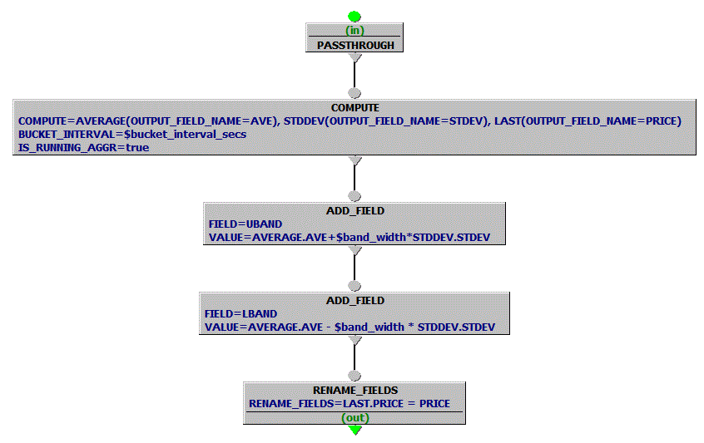
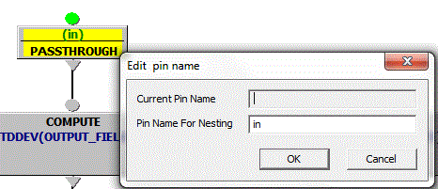
Nested Queries – Step 1 - Pins
Example: Bollinger_Bands query prepared for “nesting”
Right-Click on the Input Pin[s]
Create a”Pin Name For Nesting”, OK
Repeat for the Output Pin[s]
Multiple in/out pins with different names are allowed (e.g., for WHERE_CLAUSE 2 outputs)

Slide 10
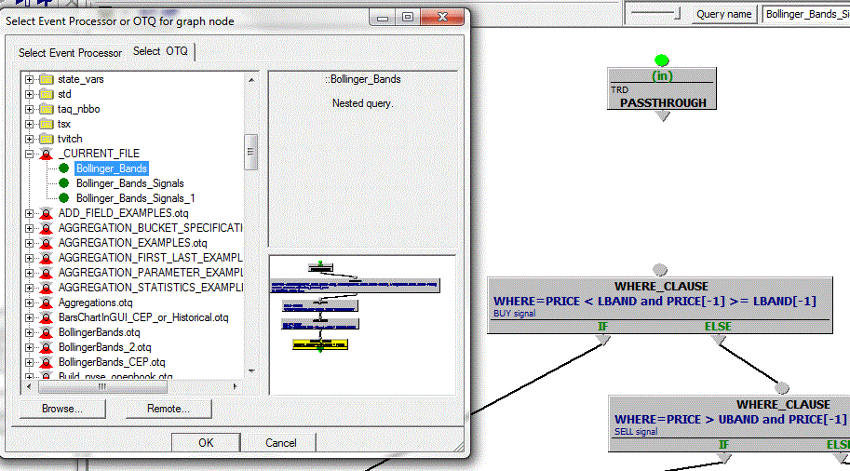
Nested Queries – Step 2
Instead of inserting a new EP, click on the tab “Select OTQ”, select file (e.g., _CURRENT_FILE), and select a query with pins for nesting

Slide 11
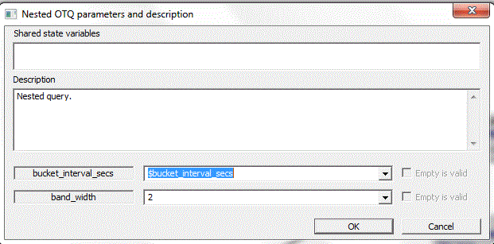
Nested Queries – Step 3
Modify nested query parameters and click OK
A new node shows up representing nested query.
Connect the existing EPs to the new node and you’re ready to go…

Slide 12
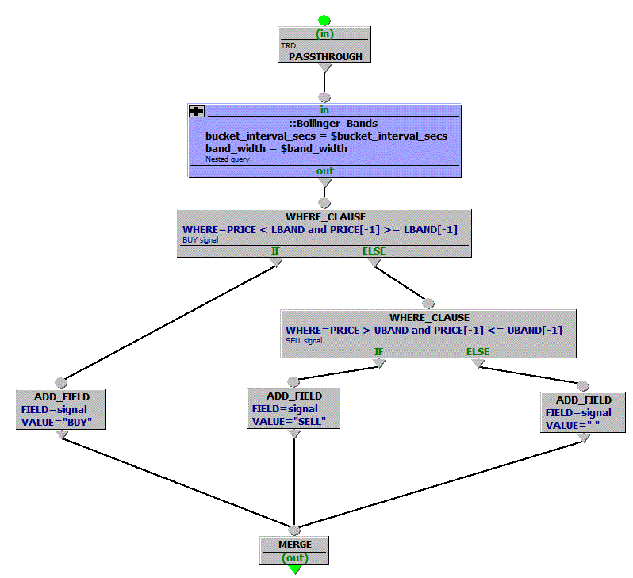
Nested Queries - Ready
Bollinger_Bands_Signals “parent” query. ::Bollinger_Bands is a nested query that can be shared across “parent” queries with different parameters. Its code can be maintained in the same or different OTQ file.
NOTE: This “parent” query can be further nested.

Slide 13
GUI Exercise - Advanced
Bollinger Bands Signal generation
Create a Bollinger_Bands query
Retrieve trade prices for a given symbol
Compute average and standard deviation on each
Add fields carrying upper and lower bands using the formula: [average] +/- [query parameter set to number of bands]*[standard deviation]
Create query PINS for nesting
Create the parent signal generation query
Retrieve trade ticks and pass to the nested Bollinger_Bands query
Add “signal” field to each tick set to: - BUY for the PRICE that went below lower band - SELL for the PRICE went above the upper band - “” otherwise
Make sure all signals are part of the same timeseries output
Turn symbol into a query parameter
(See slides for Hints…)

Slide 14
GUI Exercise - Advanced
Re-using nested queries
Build a query that takes the following $Parameters:
$FIELD: The name of a numeric field
$MINIMUM: The minimum value of $FIELD to include in our calculations.
In the query calculate the cumulative sum and count of ticks where $FIELD>$MINIMUM
Hint: Use a state variable to accumulate conditionally
Change the query into a nested query and use your nested query in a query that calculates:
The sum of BID_SIZE and count of ticks where BID_SIZE>10
The sum of ASK_SIZE and count of ticks where ASK_SIZE>20
Run your query for TRAIN_C_QTE_TRD::INFN QTE ticks for:
20180205 09:30-11:00
(See slides for Hints…)

