Slide 1
OneTick Training
Order Book EPs

Slide 2
Order book data
OneTick has special data types to store order book data, data representing the current state of available bid and ask prices and sizes at any given time.
This can be consolidated across a market, exchange or geography, or you may be able to drill down further to, e.g, venue or market maker or even individual orders. This depends on what level of detail the source data contains and how it is stored. Each implementation differs.
The commonest implementation consolidates on size for each distinct price and bid/ask (so called level 2 data).

Slide 3
Price level (PRL) Tick Type
Represents an order (or group of orders) in the book and is expected to have the following fields:
PRICE
SIZE
BUY_SELL_FLAG: 0=Buy, 1=Sell
RECORD_TYPE
Single character field to define the operation of this tick
TICK_STATUS
Integer fields to define the type of this tick
DELETED_TIME
May contain additional key fields to define the price level (i.e. ORDER_ID, MMID, etc.)

Slide 4
Price level (PRL) Tick Type
Represents an order (or group of orders) in the book and is expected to have the following fields:
PRICE
SIZE
BUY_SELL_FLAG: 0=Buy, 1=Sell
RECORD_TYPE
Single character field to define the operation of this tick
e.G R=Regular, Z=Zero, B/E=Transaction Begin/End
TICK_STATUS
Integer fields to define the type of this tick
DELETED_TIME
May contain additional key fields to define the price level (i.e. ORDER_ID, MMID, etc.)
All documented in file:///C:/omd/one_market_data/one_tick/docs/datamodeling.html#prl

Slide 5
Order Book (OB) Tick Type
Deprecated (obsolete) method of representing order books in which the size always represents a delta rather than an absolute value. In other ways similar to a PRL with some limitations.
These are rare (extinct ?) in the wild and it is recommended that new developments DO NOT USE THIS FORMAT.

Slide 6
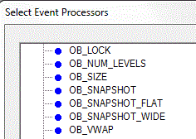
OB_... Event Processors
OneTick provides a list of Order Book specific Event Processors to aggregate Order Book data loaded into OneTick Price Level (PRL like) or Order Book (OB like) Tick Types
Analyze order books in a few easy steps
Utilize generic aggregation parameters: interval, running aggregation flag, etc

Slide 7
OB_SNAPSHOT
Convert a series of OB or PRL ticks into an order book with one row of output for each combination of keys (e.g., PRICE and BUY_SELL_FLAG)
The output contains the following fields:
PRICE
SIZE
BUY_SELL_FLAG
LEVEL
Additional parameters can be used to provide further granularity (e.g., ORDER_ID) if available

Slide 8
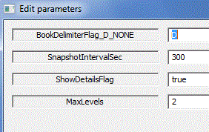
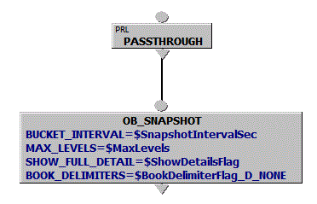
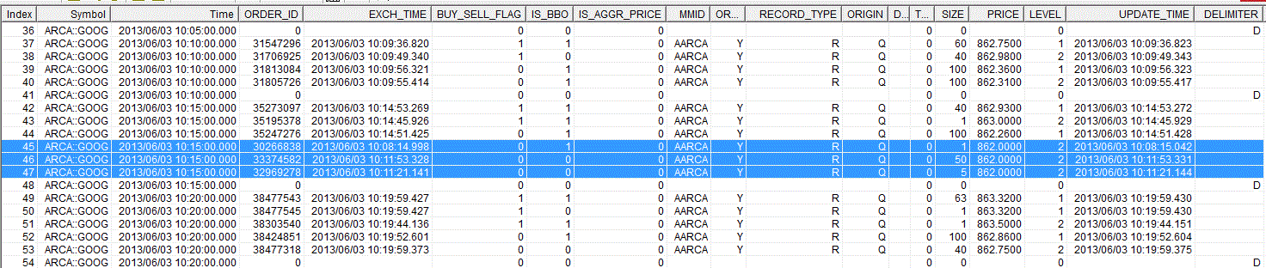
OB_SNAPSHOT (cont.)
Parameter SHOW_FULL_DETAIL=true allows to see which orders made up each level – provided ORDER_ID is part of the PRL key
Notes:
Explain output

Slide 9
OB_SNAPSHOT_WIDE
Convert a series of orders (OB ticks) or price levels (PRL ticks) into an order book with one row of output for each level of the book
The output contains the following fields:
BID_PRICE
BID_SIZE
ASK_PRICE
ASK_SIZE
LEVEL
If there are no orders for a particular side at a level then the SIZE is set to 0 and the PRICE is set to NaN for that side and level.

Slide 10
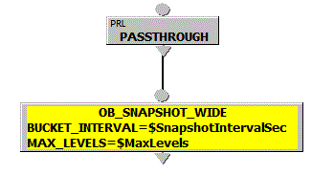
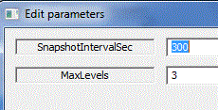
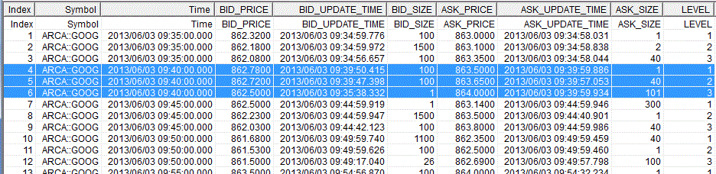
OB_SNAPSHOT_WIDE
OB_SNAPSHOT_WIDE outputs 1 line with ASK/BID values per interval per LEVEL

Slide 11
OB_SNAPSHOT_FLAT
Convert a series of OB or PRL ticks into an order book with one row per snapshot
The output contains the following fields:
BID_PRICE1 through BID_PRICEn
BID_SIZE1 through BID_SIZEn
ASK_PRICE1 through ASK_PRICEn
ASK_SIZE1 through ASK_SIZEn
LEVEL
If there are no orders for a particular side at a level then the SIZE is set to 0 and the PRICE is set to NaN for that side and level.

Slide 12
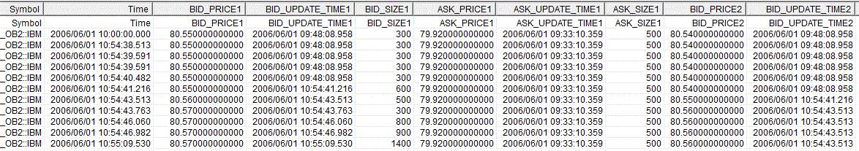
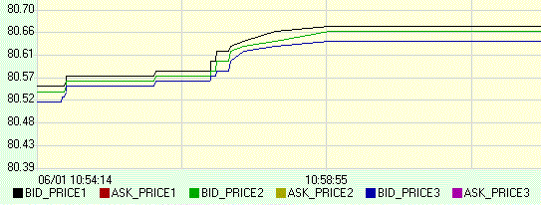
OB_SNAPSHOT_FLAT Sample
Sample Output in GUI Report or Plot views:

Slide 13

OB_NUM_LEVELS
Returns the number of levels in the order book at the end of each bucket.
The output contains the following fields: ASK/BID_VALUE – number of ASK/BID side levels
Parameters:
BUCKET_INTERVAL – to intervalize output
IS_RUNNING_AGGREGATION – for tick by tick output
SIDE – to limit side to ASK or BID only

Slide 14
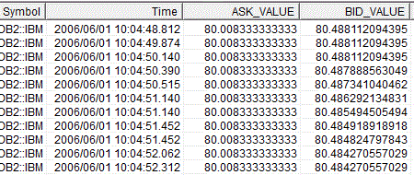
OB_VWAP
Returns the size-weighted average price computed over a specified number of order book levels at the end of each interval.
The output contains the following fields:
VALUE, if the SIDE parameter is specified
or ASK/BID_VALUE and BID_VALUE for 2 sides

Slide 15
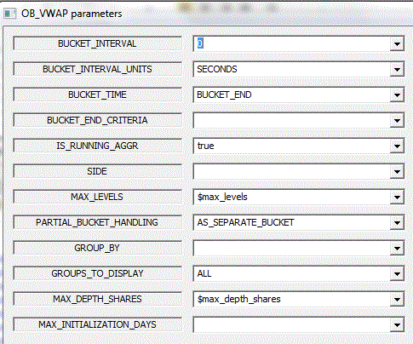
OB_VWAP Example:
Intervalize
Tick-by-tick Output
Empty OR Max Number of Book Levels
If specified, determines the Number or Levels to process
Only the top N levels that contain the
first MAX_DEPTH_SHARES of the book will be computed. If N >MAX_LEVELS, only MAX_LEVELS levels of the book will be computed. When computing OB_VWAP, the shares in access of MAX_DEPTH_SHARES, from the last included level, are ignored.

Slide 16
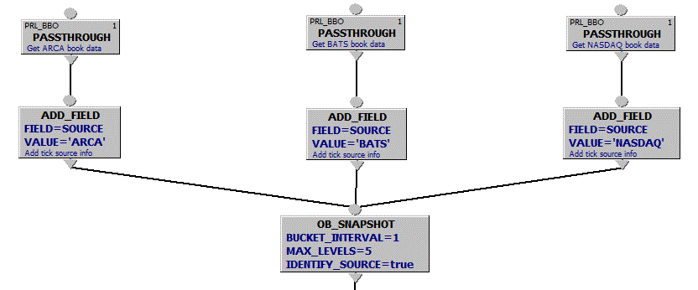
Order Book Consolidation
In this case each PASSTHROUGH node is “bound” to 1 symbol name corresponding to particular exchange
OB_SNAPSHOT... Event Processors can have more than 1 input:

Slide 17
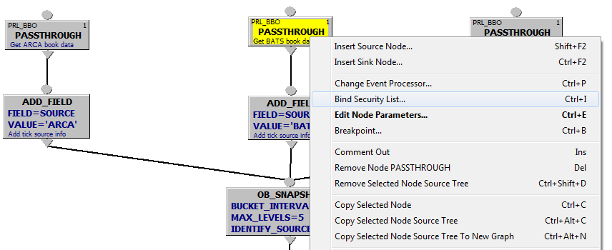
Order Book Consolidation (2)
In this case each PASSTHROUGH node is “bound” to 1 symbol name corresponding to particular exchange
OB_SNAPSHOT... Event Processors can have more than 1 input:

Slide 18
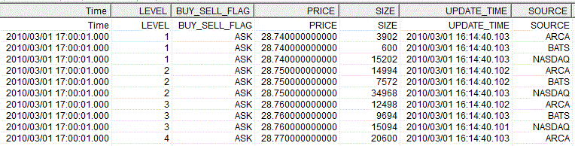
Order Book Consolidation (3)
OB_SNAPSHOT output allows to view additional price level details for each side

Slide 19
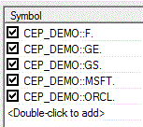
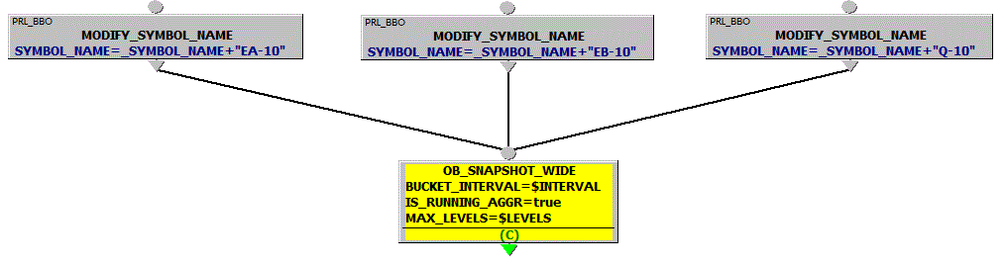
Order Book Consolidation (4)
Unbound graph symbol list:
Symbol names can be modified
dynamically per branch using event processor MODIFIED_SYMBOL_NAME

Slide 20
VIRTUAL_OB
Convert Level 1 quotes (a.k.a. QTE ticks or BBO) into a stream of “synthetic” orders
Pass “synthetic” orders through OB_SNAPSHOT_... event processors (with MAX_LEVELS=1) to create the BBO from all of the sources
See example…

Slide 21
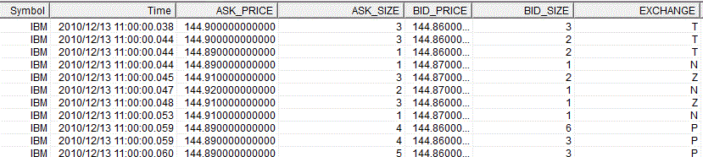
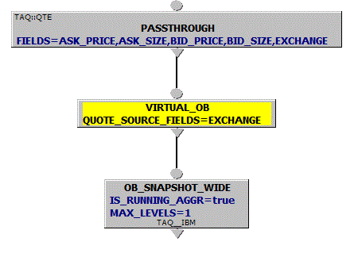
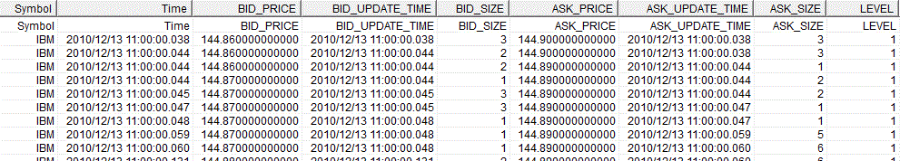
VIRTUAL_OB Sample
QTE Input
NBBO Output

Slide 22
OB_LOCK
Causes price level ticks from a given source to be excluded (i.e., “locked”) from the aggregate order book when the LOCK_FIELD value is positive.
Requires two input streams:
PRL ticks or output ticks of OB_SNAPSHOT
A stream of lock indications
Sample use cases:
To prevent messages from some exchanges flowing when they are illiquid, to correctly compute aggregate book
Disconnect some book inputs for some time

Slide 23
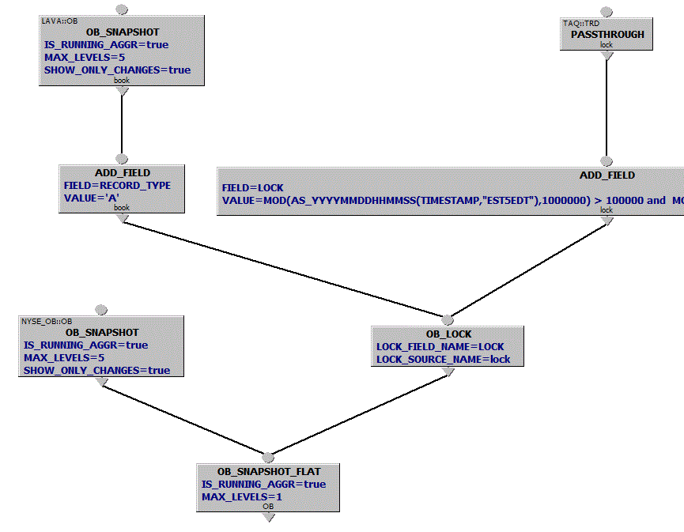
OB_LOCK Example:
5-Level “running” tick-by-tick snapshots from LAVA order book
Lock Condition based on TAQ Trades
Lock LAVA book based on LOCK field value
Consolidate Order Books from LAVA and NYSE and get BBO

Slide 24
GUI Exercises – Order Book Snapshots
Order Book Snapshot with Details
Use any database with PRL-like ticks
Select symbol for which you have valid PRL-like ticks
Calculate OB_SNAPSHOT as of time T up to number of max levels (specified as a parameter); if ORDER_ID is available as an order book key, use parameter SHOW_FULL_DETAIL to view ORDER_ID details
Copy query (select query in the list, hit F2 to create a copy)
Modify new version replacing OB_SNAPSHOT with OB_SNAPSHOT_WIDE, see the difference. Try setting BUCKET_INTERVAL and IS_RUNNING_AGGR parameters
Copy query again, modify query replacing OB_SNPASHOT* with OB_VWAP, OB_SIZE or OB_NUM_LEVELS.

Slide 25
GUI Exercises – Trades vs Order Books
Trades vs Order Book Snapshots
Identify database and symbol that carries Trades and PRL-like ticks on the same date
Design a query that shows 3-level order book snapshot in “FLAT” form for each trade
Hints:
Branch 1: trade ticks. If symbol name for trades is different you can bind specific symbol name to the trade branch PASSTHROUGH node
Branch 2: PRL-like ticks. Event Processors: PASSTHROUGH and OB_SNAPSHOT_FLAT. If symbol name for trades is different you can bind specific symbol name to the order book branch PASSTHROUGH node
Advanced: Reproduce Trade Event Triggered OB_VWAP calculations – see training OTQ samples.

