Slide 1
OneTick Training
Selecting Ticks to Analyze

Slide 2
Information Needed to Get Ticks
Database
Symbol
Tick type
Start/end time range
With this information, the engine knows which ticks to pass to this leg of the graph

Slide 3
Extra Information to Get Ticks
Symbology
Specific host
Sometimes you will need to specify one of these to exactly define a timeseries.

Slide 4
Specifying the Database
Default: the symbols in the symbol list are expected to be specified as <DB>::<Symbol>. So the Database information will come from the symbol
When you want to access multiple DBs in different branches of one query you should override the DB by specifying <DB>::<Tick type> in the tick type field of the legs that will be going to a different DB than the one specified in the symbol list.
If you use the <DB>::<Tick type> override on all of the legs of the query then you can specify the symbol in the symbol list without the DB

Slide 5
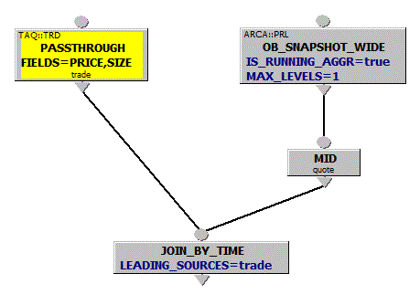

Specifying the Database
In this example
the left branch gets TAQ::TRD ticks and joins them to
the right branch with ASK/BID/MID level 1 quotes generated from ARCA:PRL (depth of book)
Security List can be specified without DB name:

Slide 6
Specifying the Symbol
Default: The symbols in the symbol list are expected to be specified as <DB>::<Symbol>. So the Symbol information will come from the symbol in the symbol list.
To access multiple symbols for data in one query instance (e.g., for symbol pair correlation) you will need to override the symbol:
Either binding an override symbol to the leg that will use a different symbol
Or use the MODIFY_SYMBOL_NAME EP in the leg that will use a different symbol than the one specified in the symbol list.
Overriding the symbol using MODIFY_SYMBOL_NAME is generally more scalable than binding a security name to a node but might not be applicable

Slide 7
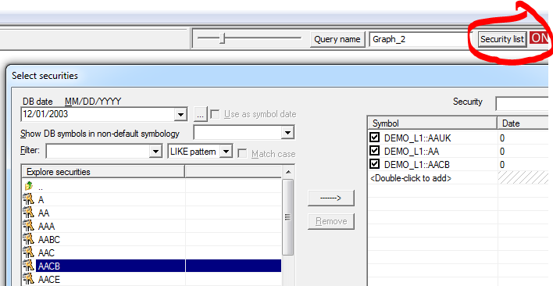
Specifying the Symbol
In the symbol list as <DB>::<Symbol>
The query will be executed for each symbol.

Slide 8
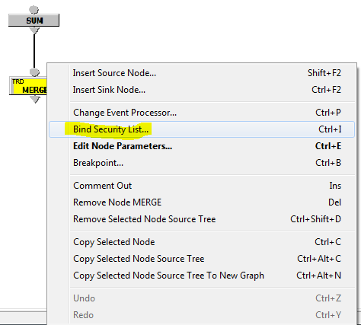
Combining results of a Query for multiple Symbols
Can bind multiple symbols to Merge or Presort
Results from the EPs before the Merge will be combined across symbols
We’ll be looking at this in detail later.

Slide 9
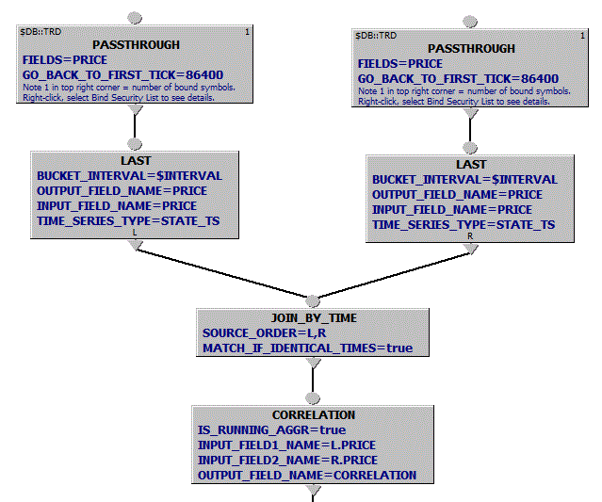
Queries with Multiple Symbols
Bound Symbols
In this example
Each PASSTHROUGH is “bound” to one symbol (1 is shown in top right corner) Right-click on PASSTHROUGH, select Bind Security List, enter symbol

Slide 10
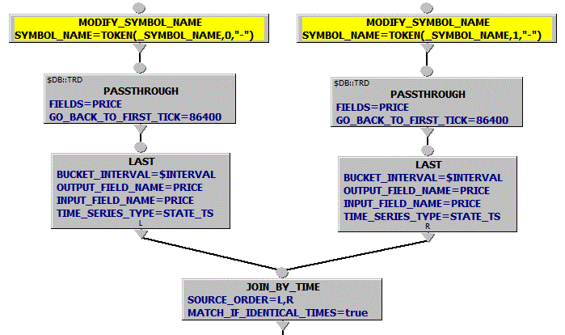
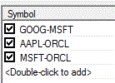
Modifying Symbol Name
In this example each branch overrides symbol using MODIFY_SYMBOL_NAME based on the currently processed symbol _SYMBOL_NAME from the “unbound” Security List:
Choosing symbols automatically
- see Find_DB_SYMBOLS in the Multi Stage Queries lecture.

Slide 11
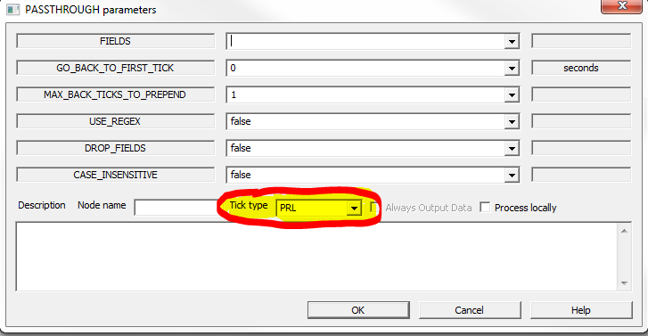
Specifying the Tick Type
This is always done in the “Tick type” field for each input leg

Slide 12
Specifying the Time Range
Default: start and end time are specified on the main GUI screen (and can be overridden in the API and command line utilities). These can be expressions (and often are in CEP queries where we want to have time based on “now”.
On a per symbol basis, you can use special Symbol Parameters _PARAM_START_TIME and _PARAM_END_TIME to override the start/end time for that symbol alone. (More on this later).
On a per query leg, you can use MODIFY_QUERY_TIMES to override the start/end time for that leg of the graph.

Slide 13
Specifying Symbology
Data vendors, and some users, define their own set of symbols for securities.
VOD.L is Vodafone in RIC symbology
GB00BH4HKS39 is Vodafone in ISIN symbology
Locator specifies a symbology for storing securities.
<db ID=“MYDB” SYMBOLOGY=“RIC”.....
A security can be referenced using a different symbology than the one it is stored with.
We’ll be looking at reference data in a later module.

Slide 14
Specifying an explicit server
You may want to access data on an explicit server, either to override the location of the database implied by the current locator or to access a database on a server not specified in the locator. The syntax here is:
[<symbology>::]REMOTE@<host>:<port>:<DBNAME>::<symbol_name>

Slide 15

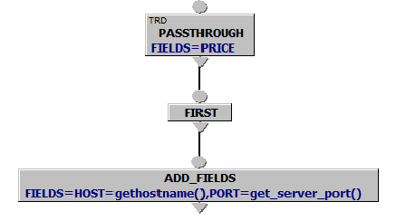

Specifying an explicit server
These Symbols
Through this OTQ
Outputs

