Slide 1
OneTick Training
Multi-Stage queries.
(aka Running a query to decide which data to include in your “real” query)

Slide 2
Multistage queries.
Up to now we have explicitly entered symbols into the “Security list” window of the GUI.
In the real world we more usually apply some logic to the total symbol universe to decide which symbols to process.
We do this by running a query that outputs a list of symbols (stage 1) and using the output of this query as the symbol list for our actual query (stage 2). We can do this with more than 2 stages, hence Multistage Queries.

Slide 3
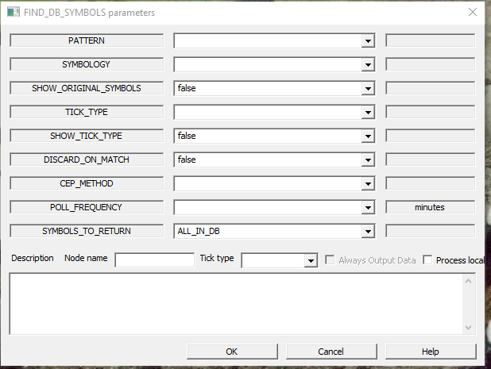
FIND_DB_SYMBOLS.
In the simplest form we have a Stage 1 which retrieves a symbol list using the FIND_DB_SYMBOLS EP…
PATTERN
% means “All Symbols”
Z% means all symbols starting with “Z”.
_Z% means all symbols where the second character is “Z”.

Slide 4
FIND_DB_SYMBOLS.
In the simplest form we have a Stage 1 which retrieves a symbol list using the FIND_DB_SYMBOLS EP…
TICK_TYPE Parameter
Blank means “Any and all tick types”. Setting this to (e.g) TRD would only return symbols that have a TRD tick in the day range of the query.

Slide 5
FIND_DB_SYMBOLS.
In the simplest form we have a Stage 1 which retrieves a symbol list using the FIND_DB_SYMBOLS EP…
TICK_TYPE of the EP
You can put anything here. We only need it to ensure that the query is syntactically OK.

Slide 6
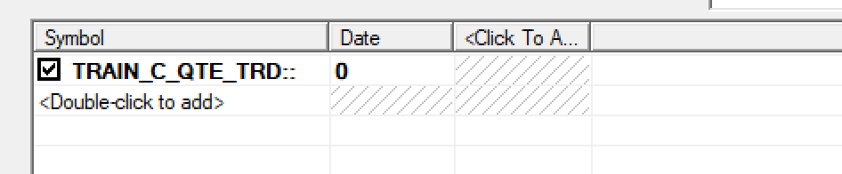
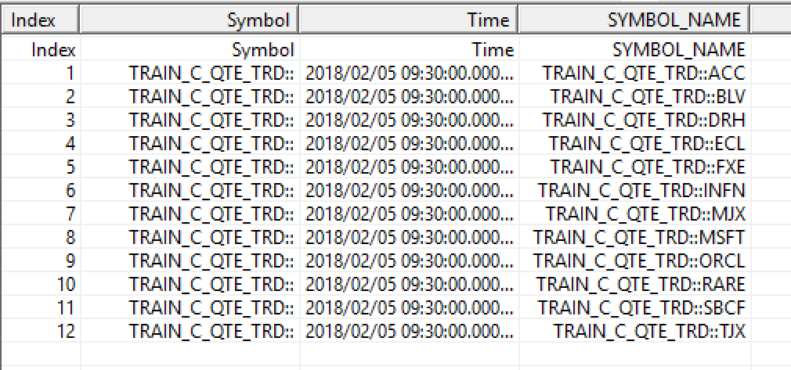
FIND_DB_SYMBOLS.
We now save this query with a symbol of <database_name>:: (or better still $DB:: so we can use it generically).
When we run it we see..

Slide 7
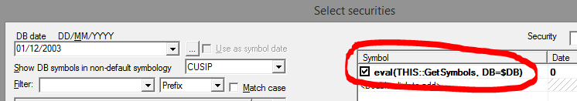
Getting Symbols from stage 1.
“eval” is a OneTick function that executes a query and returns its results.
In this case it is returning a series of ticks containing a SYMBOL_NAME field.
“THIS::” means look in the current otq file for the GetSymbols query. This could also be a full path or a path relative to OTQ_FILE_PATH.
DB=$DB means we are passing the database name as a parameter to GetSymbols so we can run it for any database. Maybe we should pass the
TICK_TYPE as a parameter as well.

Slide 8
Other stage 1 queries.
As well as FIND_DB_SYMBOLS any method can be used to produce a list of symbols to be queried by a subsequent stage. The only requirement is that the symbol appears in a column called SYMBOL_NAME.
Such methods include: querying a csv file (via the CSV_FILE_LISTING EP) , querying an external db (via the ODBC_QUERY EP) or running any OneTick query that returns SYMBOL_NAME.

Slide 9

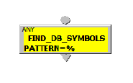
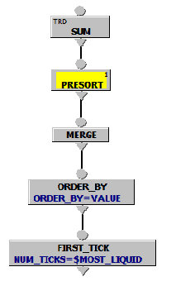
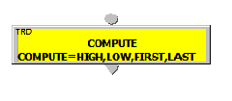
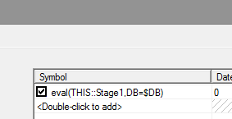
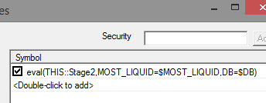
More than 2 stages.
Stage 1 gets all symbols
Stage 2 finds most liquid symbols *
Stage 3 analyses most liquid symbols
PRESORT in stage 2 gets symbols from stage 1
Stage 3 gets symbols from stage 2
* Don’t worry about Presort/Merge. We cover this later

Slide 10
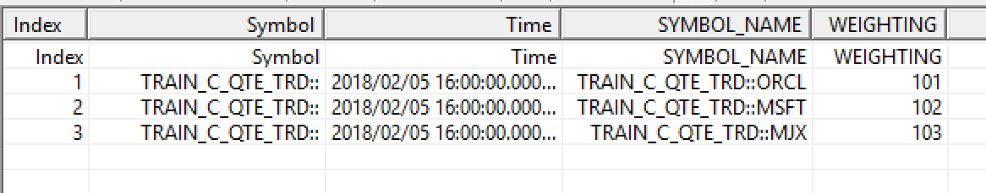
Symbol parameters.
As well as the special value of SYMBOL_NAME, a query can provide any other data to be available to subsequent queries. For example: A query returning…

Slide 11
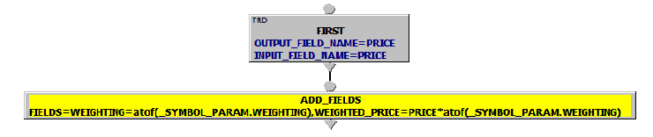
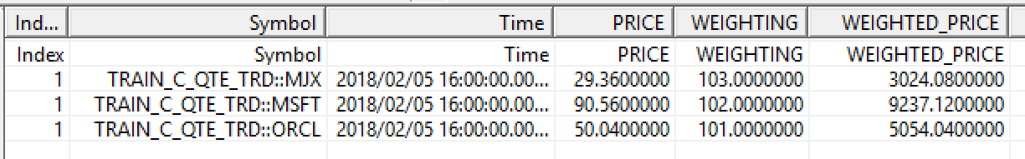
Symbol parameters.
..when used as an “eval”-ed source of symbols would also provide a value in _SYMBOL_PARAM.WEIGHTING for each symbol.
Note that symbol params are strings and may need casting.

Slide 12
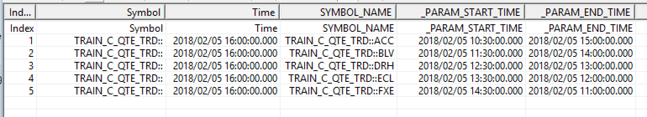
Parameter dates.
A special case of Symbol Parameters are _PARAM_START_TIME and _PARAM_END_TIME.
This stage 1 would create queries in stage 2 that run for different start and end times for each symbol.

Slide 13
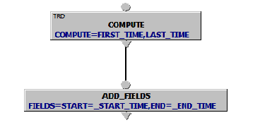

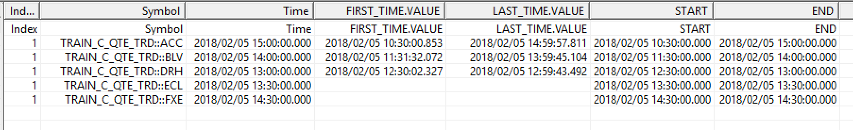
Parameter dates.
This query
Using this Stage 1 to get the symbol list on the previous slide
Will produce this output

Slide 14
Multistage queries and CEP.
Dynamic Symbol lists.
Symbol lists retrieved via CSV_FILE_LISTING and FIND_DB_SYMBOLS can be changed during a CEP query to add or remove symbols or modify symbol parameters.
This is documented in:
Help->Event Processor Guide ->Multistage Queries

Slide 15
Multistage queries and CEP.
Dynamic Symbol lists.
Symbol lists retrieved via CSV_FILE_LISTING and FIND_DB_SYMBOLS can be changed during a CEP query to add or remove symbols or modify symbol parameters.
This is documented in:
Help->Event Processor Guide ->Multistage Queries
Dynamic symbol lists cannot be used for bound symbols. But the new (Mar 2018) MERGE_NONBOUND_SYMBOLS EP overcomes this limitation. This is discussed further when we look at bound symbol lists in module 15.

Slide 16
Exercise.
Write a query which shows TRD data in
Database TRAIN_C_QTE_TRD
For query period 20180205 09:30-16:00 NY
BUT only include symbols which are AT LEAST 4 characters long (If you get it right you should see results for 5 symbols)
Hint: IN FIND_DB_SYMBOLS an underscore “_” matches exactly one character. A percent “%” matches zero or more characters.

