Slide 1
OneTick Training
Input and Output EPs

Slide 2
Input & Output
Updating an existing database “DB/” EPs.
Writing to a database.
Writing to or reading from a OneTick Raw file.
Writing to or reading from delimited text files.
Executing SQL over ODBC.
Getting data from a URL

Slide 3
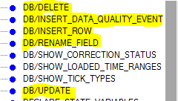
Direct DB access – “DB/” EPs
EPs are available to do all of these.
Users can only execute these Eps if explicitly permissioned to modify a target database in the TickServer’s Access Control File.
Changes are made in the “Corrections” segment of the database. So:
Designed for limited volumes (See KB-37).
(Optionally) overwritten on database reload.
Used by SQL “INSERT/DELETE/UPDATE”.

Slide 4
WRITE_TO_ONETICK_DB
Uses the same API as data loaders. So has the same characteristics – Expects to add to the end of a daily time-series with Append=true – Recreates and reloads the whole day if false.
Requires permissioning of write access in Access Control.
Is buffered – i.e writes all ticks on query completion. So NOT useful for CEP applications.

Slide 5
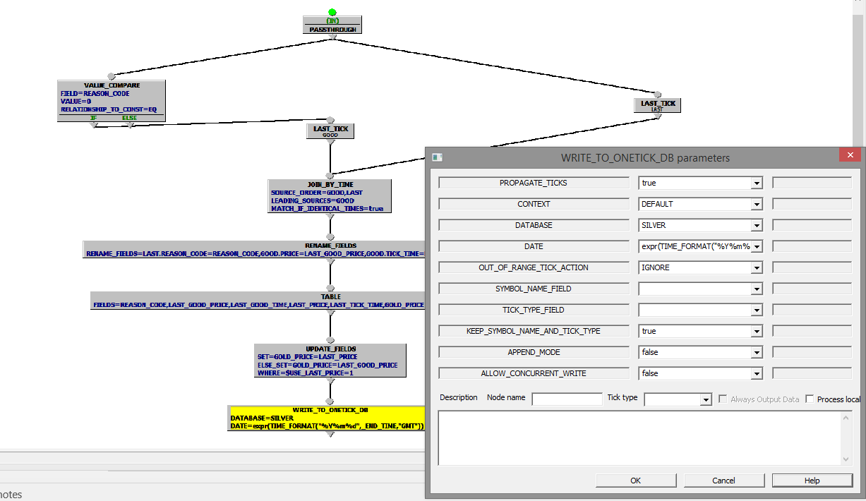
WRITE_TO_ONE_TICK_DB
Example:
Insert data for last tick and last good tick into a “Silver” staging DB

Slide 6
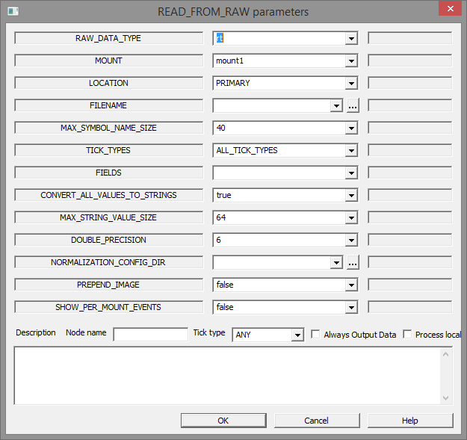
READ_FROM_RAW
Requires permissioning of the EP in Access Control.
For RT format can either provide raw fid-value data or normalized data.
Can be specified using filepath or database/mount details.
Example…
Security set to <Database name>::
Using locator to find raw data for date-range for mount1/PRIMARY
Looking at un-normalised RT data.
Treat all values as strings.

Slide 7
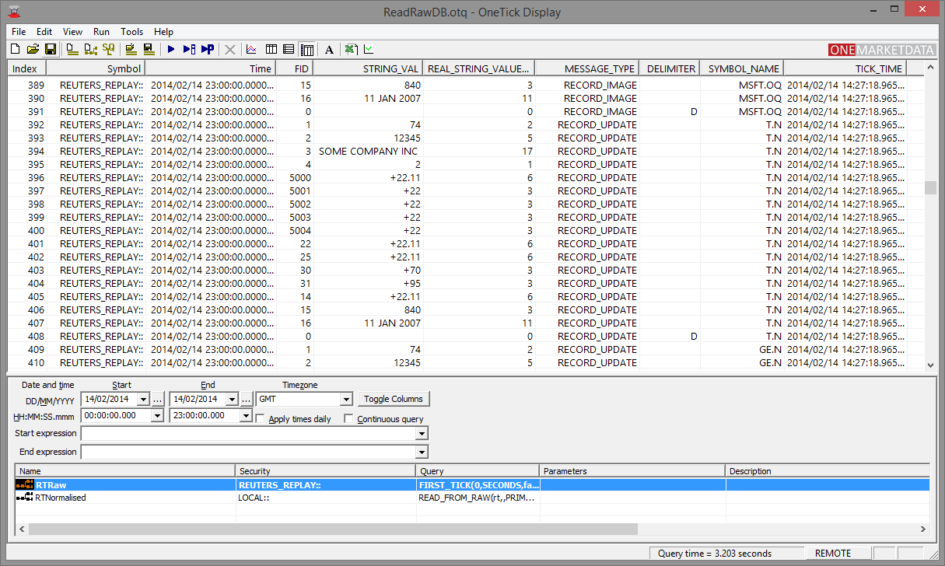
READ_FROM_RAW (cont) ….Outputting….

Slide 8
WRITE_TO_RAW
Requires write permissioning of the database in Access Control.
Writes Native format raw data to specified database/mount/location(PRIMARY or BACKUP).
Unbuffered. So can be used in CEP queries to provide a real-time stream of raw data. Common business case is to provision a real-time OCHL bars database….
CEP query on database MARKET_DATA with WRITE_TO_RAW of OCHL to database BARS.
Native Memory loader loads raw BARS data into database with RawDB Feed Handler.
Users have CEP access to real-time OCHL data.
End of day reload using OTQ_query_loader to include corrections.

Slide 9
WRITE_TEXT
Allowed by default. Can be restricted to specific users and output directories using Access Control.
Highly configurable for field order, delimiter, binary/text etc. etc. See docs for details.
Writes to specified output file(s). Placeholder available in file names for: Symbol, Database, date, start-time, end-time tick type.
Can be un-buffered (FLUSH=true). With un-buffered output can be used as a source for real-time ascii loaded data.
Output file path is on the server unless “Process locally” is checked (which would require a client side license). Consider using utility text_reporter.exe if client side text output is required.

Slide 10
CSV_FILE_LISTING and CSV_FILE_QUERY
Both read text from delimited ascii files into ticks.
What’s the difference ?
LISTING uses “Symbol” to specify filename(s).
QUERY has the filename as a parameter and filters only lines where SYMBOL_NAME=the current symbol and (optionally) a TIMESTAMP column is within the query window. A header describing the columns must be present.

Slide 11
CSV_FILE_LISTING and CSV_FILE_QUERY
Both:
Are allowed by default but can be prohibited using Access Control.
Can be run in CEP mode (with LISTING thus allowing dynamic updates to the symbol list – See help on Multistage Queries).
Allow contents to be provided as an EP parameter.
Allow use of the special “LOCAL::” db.

Slide 12
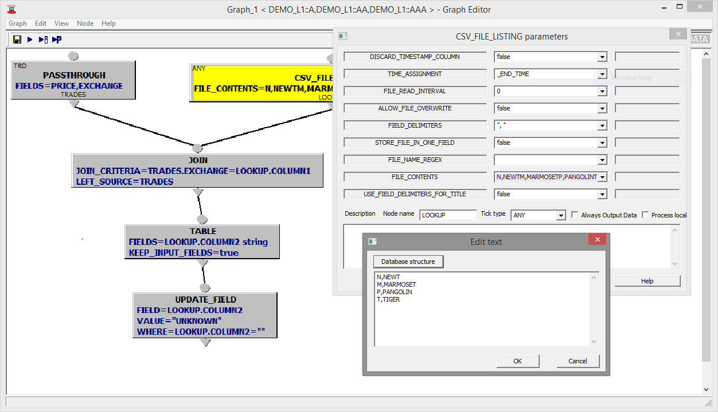
CSV_FILE_LISTING example
Expand each TRD with a lookup on EXCHANGE. Set to UNKNOWN if no match found.

Slide 13
ODBC_QUERY
Needs to be explicitly included using
LOAD_ODBC_UDF=true
SQL parameter allows placeholders for:
_SYMBOL_NAME
_START_TIME
_END_TIME
SQL parameter is a constant string NOT an expression so only really useful for SELECT sql (although interesting possibilities with JOIN_WITH_QUERY suggest themselves).
WRITE_TO_ODBC allows writing a stream of ticks to an ODBC database, with optional transaction control.

Slide 14
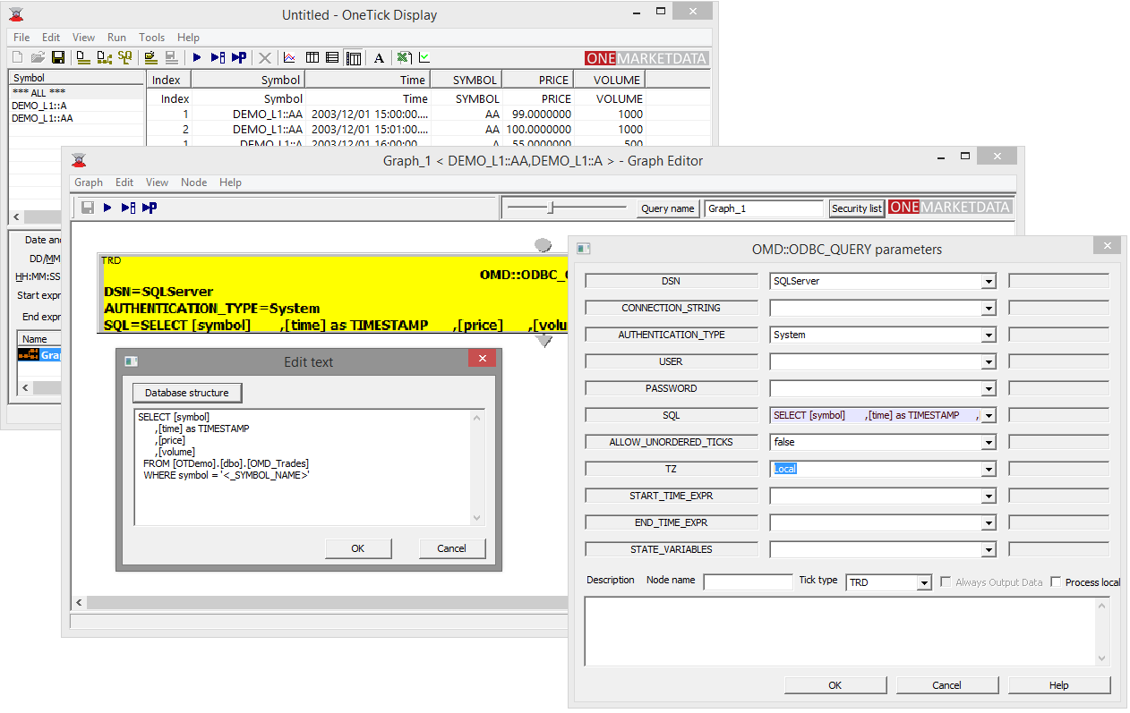
ODBC_QUERY
Example:
Query data for current symbol from a SQLServer DB.

Slide 15
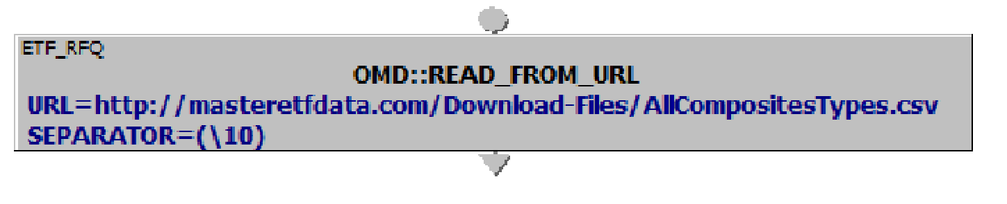
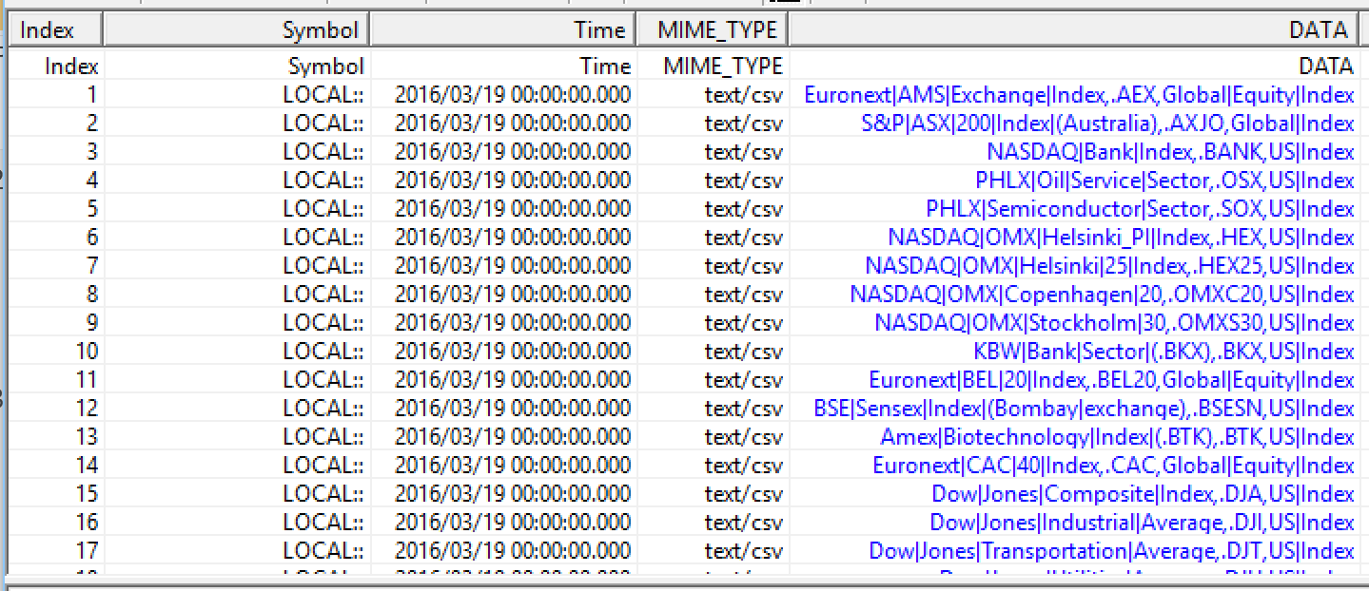
READ_FROM_URL

