Slide 1
OneTick Training
Programming in otq.

Slide 2
Programming in OTQ.
Just like other programming environments, the OneTick GUI provides facilities and tools to help debug and optimise your code. Also, just as in any other language, it is possible to write inefficient and unmaintainable code.
In this section we will introduce some of the tools and programming suggestions to help you produce efficient and maintainable queries.

Slide 3
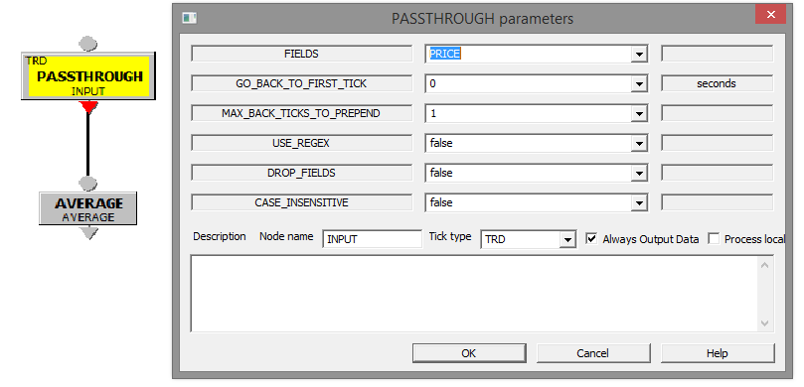
Debugging – Intermediate output.
All Eps can be set to output their ticks by selecting “Always Output Data”

Slide 4
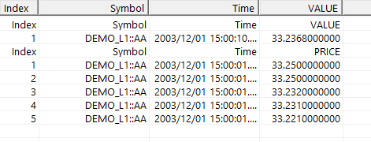
Debugging – Intermediate output.
All Eps can be set to output their ticks by selecting “Always Output Data”. In this case producing 2 output streams.
Note ! Setting “Always Output Data” may not work if the query is being run by a calling query that only expects one output stream !

Slide 5
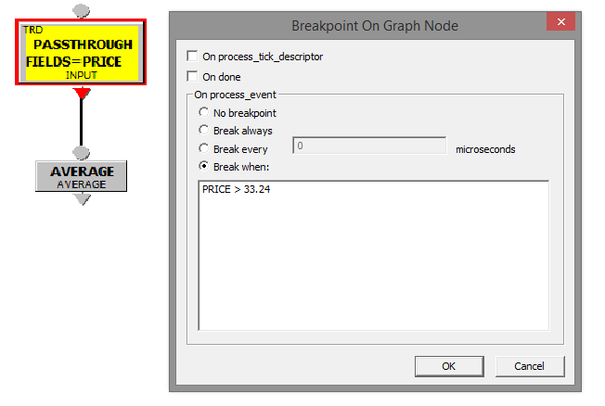
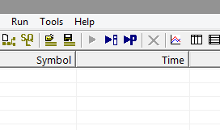
Debugging – Break and watch.
Breakpoints can be set in Eps. This includes conditional breaks based on field values.
When breakpoints are set you must use “Run in separate window”

Slide 6
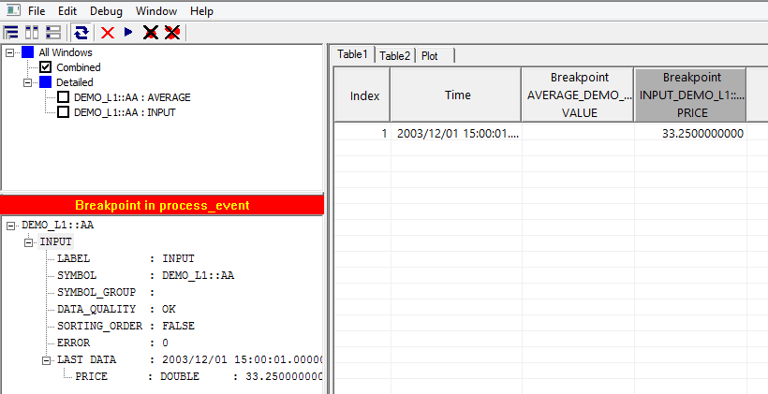
Debugging – Break and watch.
Breakpoints can be set in Eps. This includes conditional breaks based on field values.
Name your nodes. If you don’t LABEL will be the EP type. And you may have 20 ADD_FIELD Eps !

Slide 7
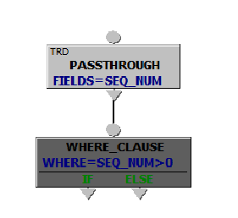
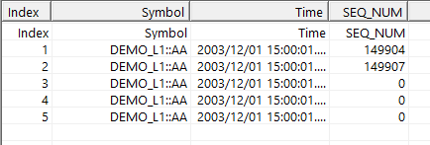
Debugging – Commenting out.
Sometimes you want to analyse an OTQ by removing one or more EPs. You can do this with “Right-click – Comment Out”.

Slide 8
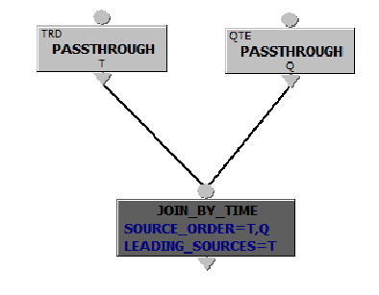
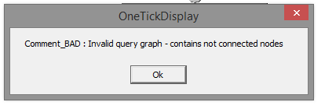
Debugging – Commenting out.
Commenting out must make sense. Or this can happen…

Slide 9
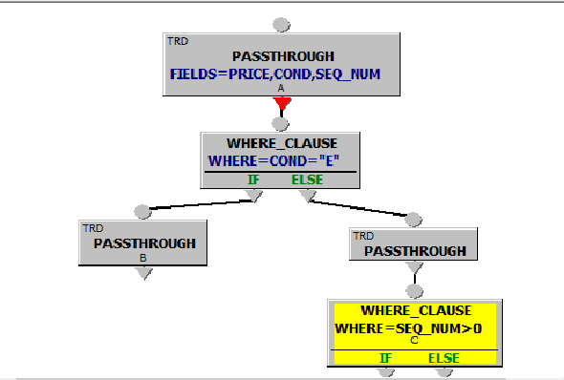
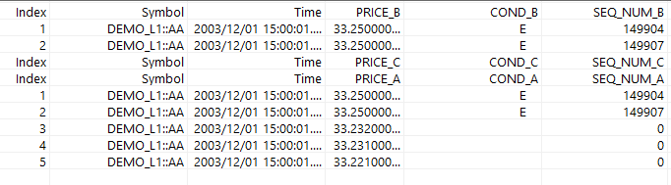
Debugging – Commenting out.
Commenting can have results that aren’t immediately intuitive…

Slide 10
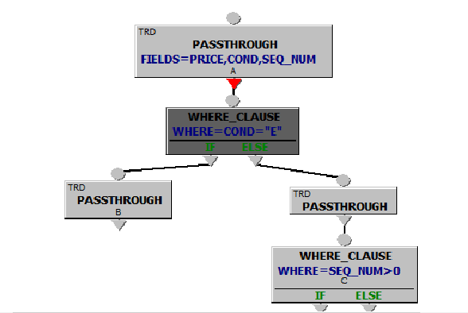
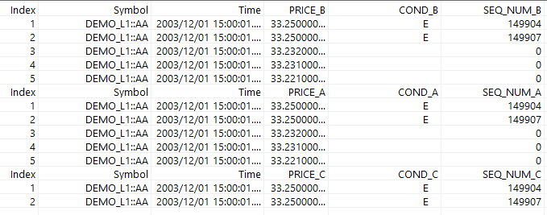
Debugging – Commenting out.
Commenting can have results that aren’t immediately intuitive…

Slide 11
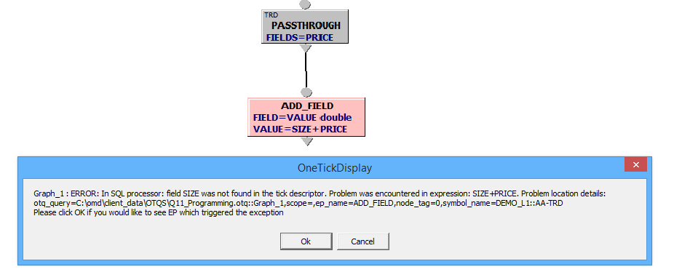
Debugging – Error messages.
These DO contain useful information. READ THEM…
The EP that caused the error will turn a fetching shade of pink.

Slide 12
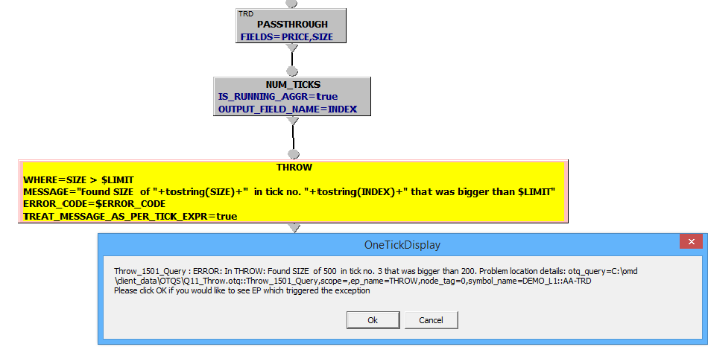
Debugging – Forcing errors.
The THROW EP allows you to force an error.

Slide 13
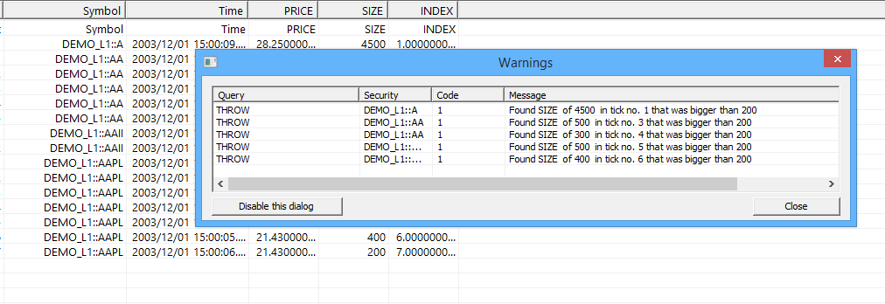
Debugging – Forcing errors.
Or propagate a warning and continue

Slide 14
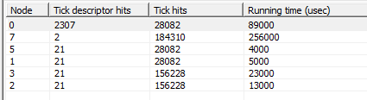
Profiling.
The GUI includes a profiler. Very useful for figuring out where the work’s being done (and therefore where it’s worth looking for optimisations)…
Run the profiler with the button. It’ll show usage as a table…
And as a graph….

Slide 15
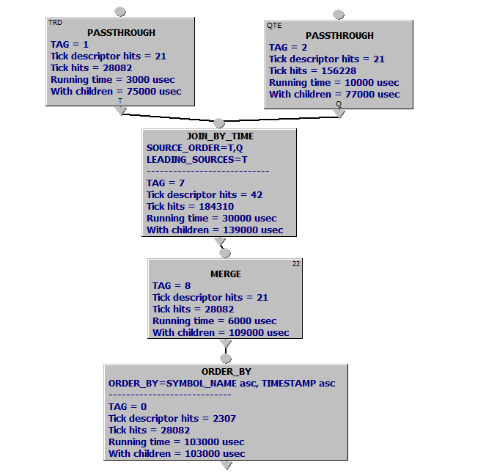
Profiling.
Compare
With

Slide 16
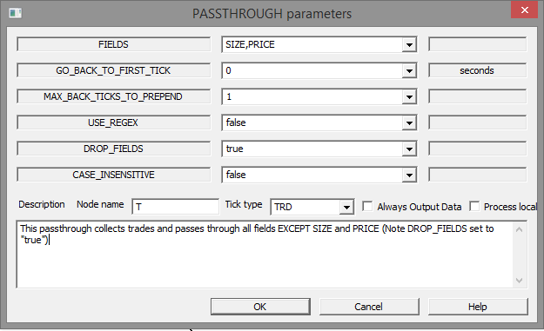
Documenting.
As with any programming language the more comment – the better. OneTick allows comment in 3 places…
Event Processor

Slide 17
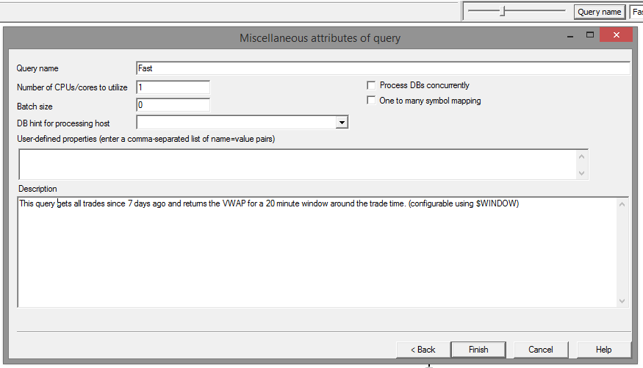
Documenting.
As with any programming language the more comment – the better. OneTick allows comment in 3 places…
Query
(from the Query name button)

Slide 18
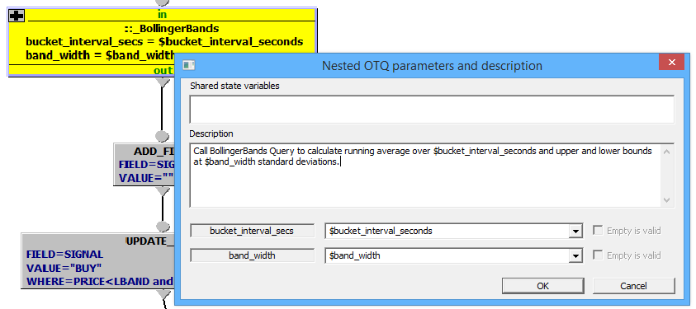
Documenting.
As with any programming language the more comment – the better. OneTick allows comment in 3 places…
Nested Query

