Slide 1
OneTick Training
Functions expressions and parameters

Slide 2
EP Parameters
EP parameters are expressions. These can be..
Fixed expressions, evaluated at “compile time”. These cannot contain references to tick fields.
Examples: INTERVAL in aggregators (and other aggegrator parameters.
Per-tick expressions that CAN use data from the tick stream.
Example: VALUE in an ADD_FIELD

Slide 3
EP Parameters: Fixed expressions
can be..
Literals eg:
INTERVAL=1
GROUP_BY=EXCHANGE
Enumerated values eg:
IS_RUNNING_AGGR=true/false
BUCKET_INTERVAL=SECONDS/DAYS/...
Expressions – As long as they can be resolved at “Compile time”

Slide 4
EP Parameters: Fixed expressions
Expressions – As long as they can be resolved at “Compile time”
For these you can use the special “expr()” function containing an expression made up of:
Literals
Functions (we’ve seen some of these but more later)
Special fields that apply to the whole query e.g:
_START_TIME and _END_TIME
_SYMBOL_NAME
Query parameters
_SYMBOL_PARAMS (if we haven’t covered these yet, we will)

Slide 5
EP Parameters: Fixed expressions
Examples:
Aggregate (in this case SUM) creating a fixed number of output ticks regardless of start and end time...
Using $PARAMS
Using _SYMBOL_PARAMS
(Note use of the atol function to convert the symbol param from a string to a long)

Slide 6
EP Parameters: Variable expressions
Just like fixed expression but
Don’t need to be wrappered in an “expr()” function.
Can also use data from fields in the current tick (or in past or future ticks with [indexing] ) and state variables.
Examples:
Update a TRD with its value, last and next price and day:

Slide 7
EP Parameters: Functions
There are about 75 of these
categorised in the help
(Help/OneTickEventProcessorGuide/Built-on Event Processors/Calalog of Built-in functions) as:
Date/Time functions
Math function
Misc functions
String functions
Join functions
We won’t go through all of these. We’ve seen some and we’ll see more.

Slide 8
EP Parameters: Functions
But we’ll look at 2 here that are VERY useful.

Slide 9
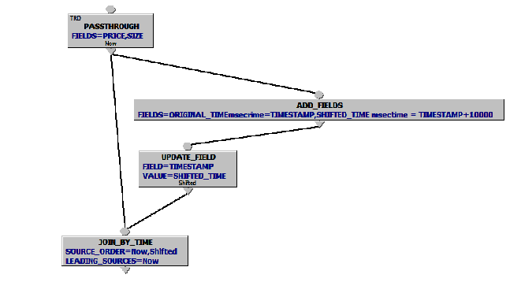
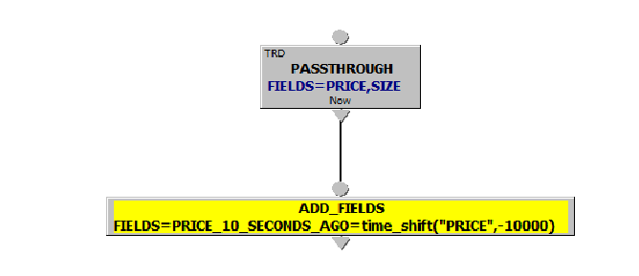
EP Parameters: Functions
But we’ll look at 2 here that are VERY useful.
The time_shift() function.
In the old days, before May 2013, if you wanted to compare data with data N seconds before or after (and you may have many values for N) .
You had to do something like this: But now you can do this:

Slide 10

EP Parameters: Functions
But we’ll look at 2 here that are VERY useful.
The case() function (we briefly saw this earlier today).
This is like the case function in many languages. It allows you to execute one of a list of expressions based on the result of an expression. In its simplest form it is like an “if” function in other languages. X=if(boolean,expression1,expression2)

Slide 11
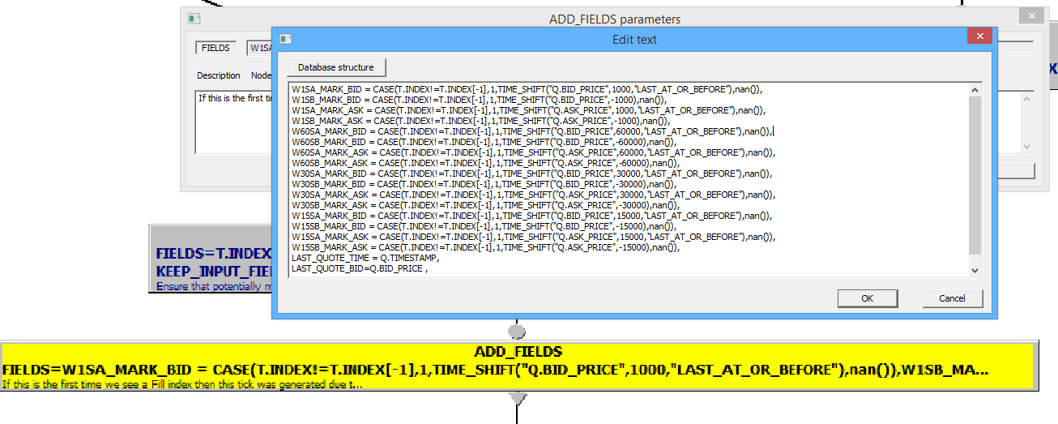
EP Parameters: Functions case()
But we can have multiple cases:
And we can use it to avoid expensive calculations when not needed. (Don’t worry – We’re looking at this later)

Slide 12
EP Parameters: The eval() function
This function is used to return the result of a query. It has 3 main uses:
The first two of these will be covered elsewhere..
In the symbol list. Running a “Stage 1” query to return a list of symbols and (optionally) symbol parameters to provide the symbols for this query.
To populate a tick set to use (e.g) as a lookup table
But it can also be used in an expression setting the value of a field or state variable....

Slide 13
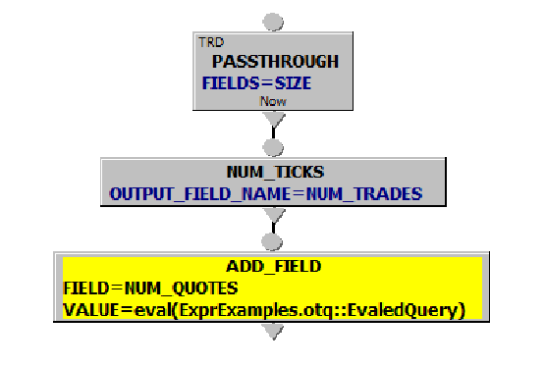
EP Parameters: The eval() function
Here’s our first query...

Slide 14
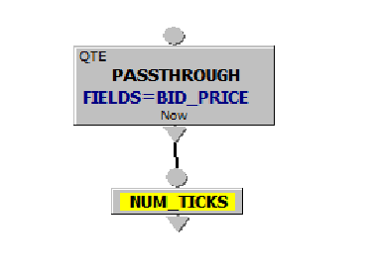
EP Parameters: The eval() function
It calls a second query (that outputs one tick with 1 field)...

Slide 15
EP Parameters: The eval() function
Using an “eval” function (we could use “THIS:: instead of an otq file name)...

Slide 16
EP Parameters: The eval() function
Previous example used “eval()” to return a value.
It can also be used to return an expression, thus allowing creation of expressions on the fly.
In this example we are using an “eval()” to generate COMPUTE and ADD_FIELDS expressions according to the contents of an external file.

Slide 17
EP Parameters: Using EPs as functions
Any filter EP (one that has “If” and “Else” outputs can be used as a function).

Slide 18
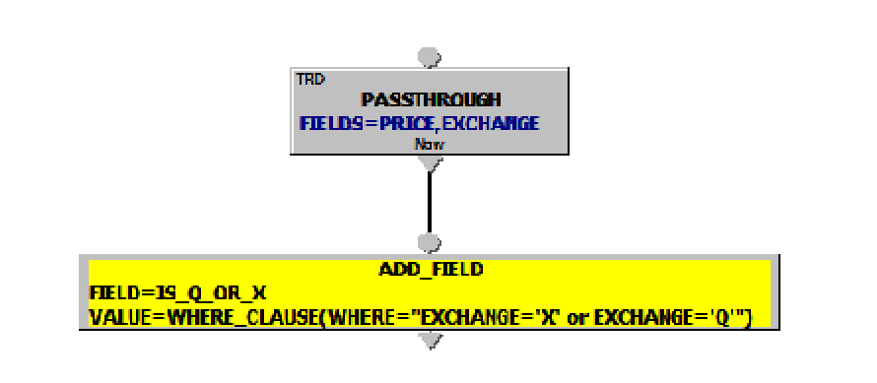
EP Parameters: Using EPs as functions
Any filter EP (one that has “If” and “Else” outputs can be used as a function). This...

Slide 19
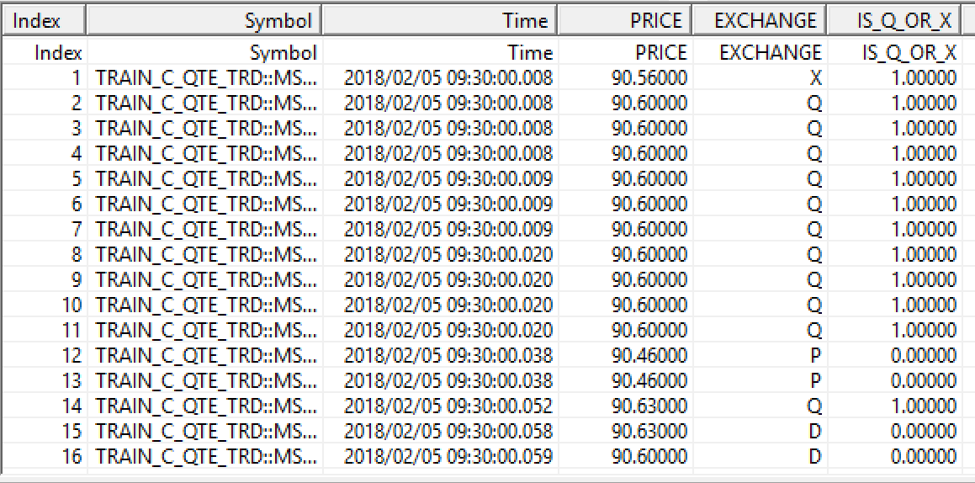
EP Parameters: Using EPs as functions
Any filter EP (one that has “If” and “Else” outputs can be used as a function). Outputs this...

Slide 20
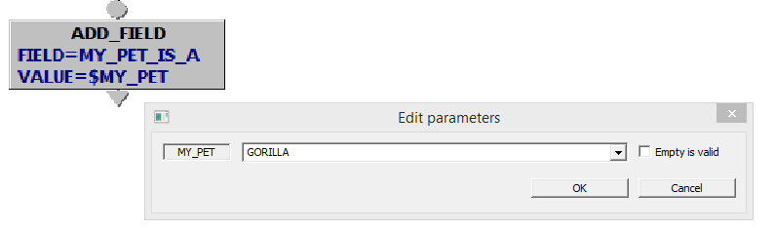
Query Parameters:
We’ve seen these and will see lots more. They are simply placeholders for literal text that is replaced at run time with the current parameter value. But note that they are just replaceable text. So with this.....
We would be setting MY_PET_IS_A to the value of a field called GORILLA. We probably want....

Slide 21
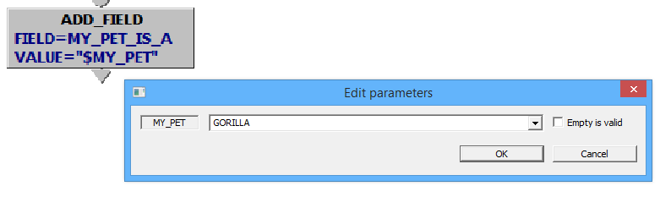
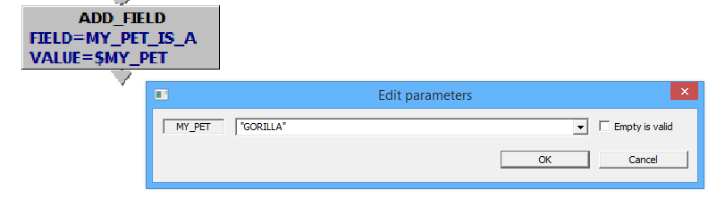
Query Parameters:
Or

Slide 22
Symbol Parameters:
These are parameters that can be attached to each processed symbol and retrieved in a query. We’ll be looking at these much more in the “Multistage query” section (unless we already have).

