Slide 1
OneTick Training
Tick sets

Slide 2
Tick Sets
Allow storage of a set of ticks with unique values of given fields (also referred to as key fields).
Declared using the DECLARE_STATE_VARIABLES EP.
Insert ticks into tick sets using UPDATE_TICK_SETS EP
Delete ticks from tick sets using CLEAR_TICK_SET and ERASE_FROM_TICK_SET functions
Access ticks from a set using functions FIND and FIND_BY_NAMED_KEYS
Values of fields from a tick set (except key fields) can be changed using UPDATE_FIELD and UPDATE_FIELDS Eps
Query or aggregate across a tick set using DUMP_TICK_SET Ep

Slide 3
Tick Sets
Useful for….
Creating lookup tables.
Answering questions such as
“For this exchange (the exchange in this tick) what was the last price”. i.e lookup previous state of the tick stream for a given key.
“Across all exchanges which is currently offering the best bid/ask”. i.e aggregating across the current values (state) for all keys.

Slide 4
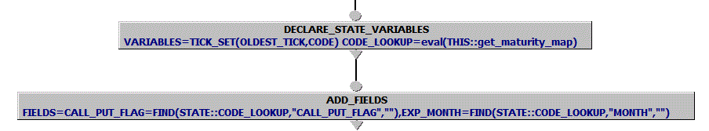
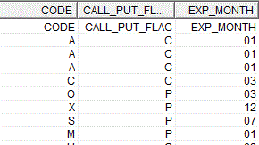
TICK_SETS: Lookup tables
In the example below, we declare STATE:: variable CODE_LOOKUP of type TICK_SET
CODE_LOOKUP is populated with eval(…) expression by running query get_maturity_map from the same otq file (“THIS::”)
ADD_FIELDS uses FIND function to get CALL_PUT_FLAG and EXP_MONTH from CODE_LOOKUP based on 1 letter code (from NANEX symbology)

Slide 5
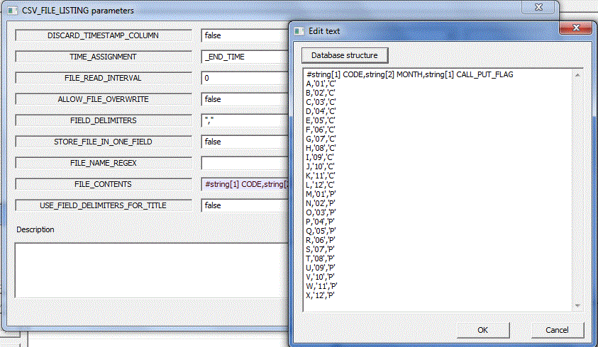

State Variables: TICK_SETS
THIS::get_maturity_map query uses CSV_FILE_LISTING to read the map
⬅ Note use of FILE_CONTENTS parameter that allows to generate text file contents right in GUI or via query parameter
In this case set Security list symbol to LOCAL::

Slide 6
State Variables: TICK_SETS
THIS::get_maturity_map query uses CSV_FILE_LISTING to read the map
A different example here
lookup table
table lookup
⬅ Note use of FILE_CONTENTS parameter that allows to generate text file contents right in GUI or via query parameter
In this case set Security list symbol to LOCAL::

Slide 7
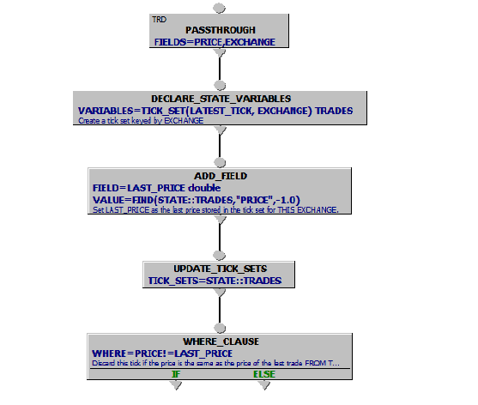
State Variables: TICK_SETS
Using TickSets to keep track of state by a given key.
Retrieve Trades
Declare TickSet
Find last price from this exchange.
Update TickSet
Only output where price has changed for this exchange.

Slide 8
State Variables: TICK_SETS
Using Tick sets to keep track of highest or lowest so far.
We have quote data containing:
Quote source (Exchange)
Bid and ask price
For each quote tick we want to know:
What are the current best bid and ask ?
Who is currently providing the best quotes on each side ?
When were those best quotes issued ?

Slide 9
State Variables: TICK_SETS
Using Tick sets to keep track of highest or lowest so far.
We have quote data containing:
Quote source (Exchange)
Bid and ask price
For each quote tick we want to know:
What are the current best bid and ask ?
Who is currently providing the best quotes on each side ?
When were those best quotes issued ?
No pictures – Easier to look at the query….

Slide 10
State Variables: TICK_SETS
May not be what you want !.
If you have a use case that wants to look at changing states by key or create a lookup table of ticks then the following EPs may be useful.
CREATE_CACHE. Along with READ_CACHE loads the results of a query into a persistent cache.
SAVE_SNAPSHOT. Along with READ_SNAPSHOT saves a persistent copy of current state by key.

