Slide 1
OneTick Training
OTHER DATA
Corrections and Cancellations
Reference Data

Slide 2
Corrections and Cancellations
A OneTick time series can contain corrections and cancellations to previous data.
Mostly seen in TRD data streams.
These are stored in a special database segment with TICK_STATUS and DELETED_TIME controlling behaviour (see the Data Modelling guide for details).
The CORRECT_TICK_FILTER EP is used to control whether corrections and cancellations are applied.
See the Data Modelling guide for full details.

Slide 3
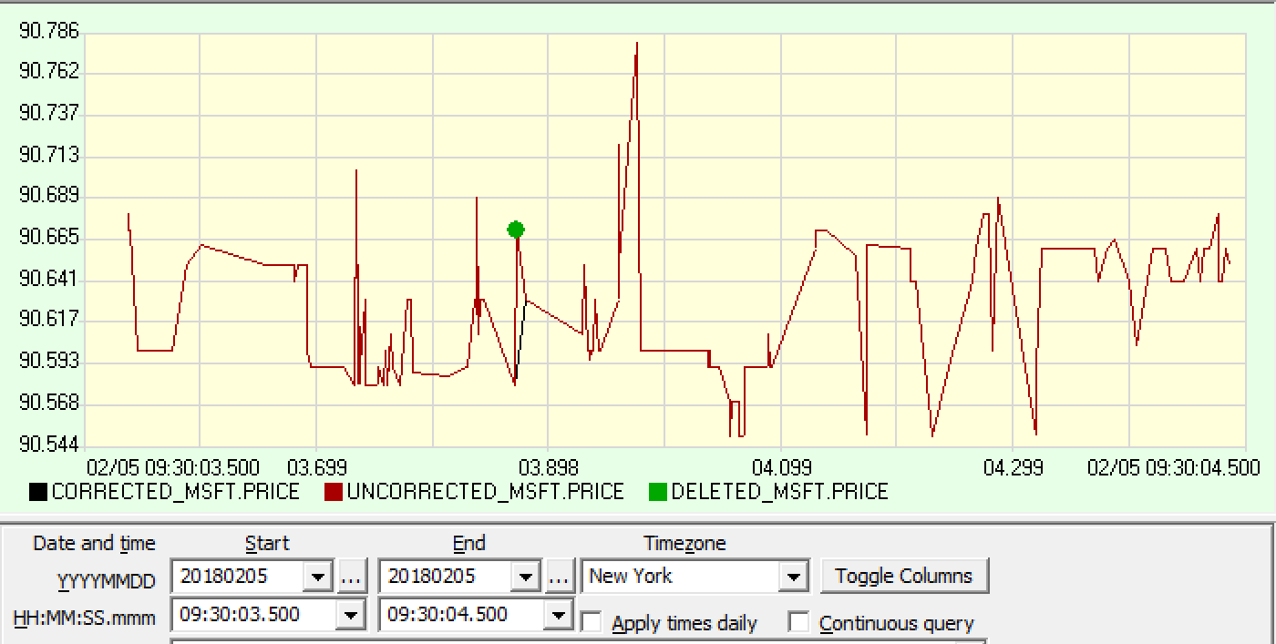
Corrections and Cancellations
Here’s an example:

Slide 4
Reference Data
A OneTick implementation may contain a special Reference Data database.
This can contain:
Symbol name history
Symbology mappings (e.g RIC to ISIN to SEDOL… )
Corporate actions (dividends, splits, mergers…)
Continuous contract definitions (e.g a synthetic symbol to show the “near contract” for a futures contract regardless of time ).
Calendars specific to exchanges, symbols or geographies.
Symbol currency
Primary exchange definition

Slide 5
Reference Data
All of this is documented in the Reference Data Guide

Slide 6
Reference Data
All of this is documented in the Reference Data Guide
ADVERT !!!!
If you want reference data and don’t have it you can buy it from us for most markets. Talk to your Account Manager

Slide 7
Reference Data: Some examples
Symbology
Every database has an associated symbology, defining the symbol type that the data is actually stored under. Examples are RIC,BBG,NYSE,ISIN etc.
We have data where symbols are stored using the TRAIN symbology. We have our own symbology OURS where, for example, Oracle Inc. common stock uses symbol III instead of ORCL.
To use this symbology we would specify Oracle as:
OURS::TRAIN_C_QTE_TRD::III
<Optional Symbology::>DB::Symbol<in other symbology>
This syntax can be used wherever a symbol is specified. It can be seen in the GUI Security List…

Slide 8
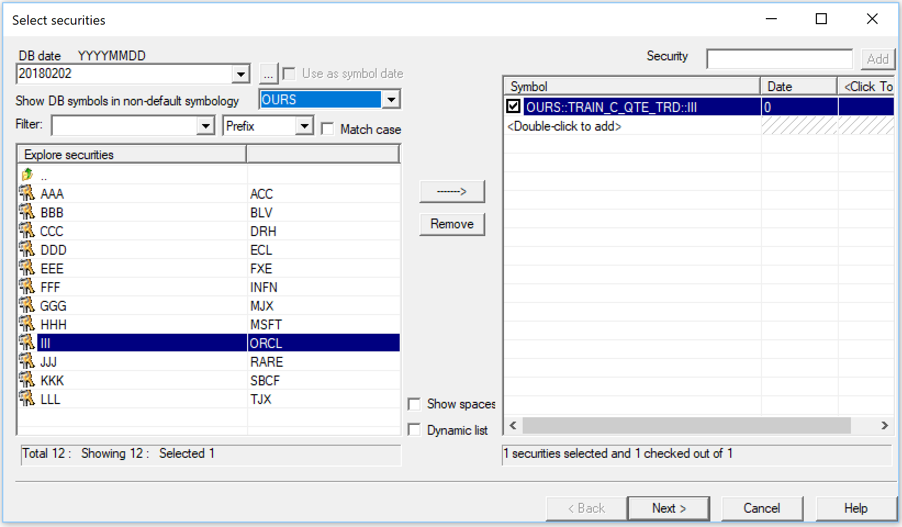
Reference Data: Some examples
Symbology

Slide 9
Reference Data: Some examples
Symbology
..and can be used in appropriate Event Processors to map from one symbology to another in:
FIND_DB_SYMBOLS
FIND_SNAPHOT_SYMBOLS
CSV_FILE_QUERY
QUERY_SYMBOLS
And this EP can be use to interrogate symbology
SYMBOLOGY_MAPPING
(Note a symbol_date – often needed when using refdata)

Slide 10
Reference Data: Some examples
Calendars
Calendars can be of 3 types:
Named Calendars
Per Exchange Calendars
Per Symbol Calendars
Our example uses a named calendar called FRED
Here we look at the calendar
And here we use it to flag trades as out-of-hours

Slide 11
Reference Data: Some examples
Corporate actions
In this example the generous guys at Oracle have declared a cash dividend on 5 successive days:
Here’s what the reference data looks like:
Here’s what the adjusted price looks like adjusted before the dividend dates:
And here after the dividend dates:

