Slide 1
OneTickDashboard – Basics

Slide 2
OneTickDashboard – Pre requisites
Open Jira KB-272

Slide 3
OneTickDashboard – Pre requisites
Open Jira KB-272
Navigate to the Training FTP site

Slide 4
OneTickDashboard – Pre requisites
Open Jira KB-272
Navigate to the Training FTP site
Download:LondonApr2018/OMD_Train.zip

Slide 5
OneTickDashboard – Pre requisites
Open Jira KB-272
Navigate to the Training FTP site
Download:LondonApr2018/OMD_Train.zip
Unzip into your C:\ directory

Slide 6
OneTickDashboard – Pre requisites
Open Jira KB-272
Navigate to the Training FTP site
Download:LondonApr2018/OMD_Train.zip
Unzip into your C:\ directory
This will give you access to all of the queries and data used in the example. You may need to copy the data elsewhere if you do not have a local development license.

Slide 7
OneTickDashboard – Pre requisites
You should have a knowledge of the OneTick query language and, to follow the guided example, be able to open a OneTick GUI with access to the following databases:
DEMO_L1
FULL_DEMO_L1
TRAIN_C_QTE_TRD (optional if you have not installed the data from the zip file).

Slide 8
OneTickDashboard – Basics
Creates Dashboards

Slide 9
OneTickDashboard – Basics
Creates Dashboards
Which can retrieve and/or store data from OneTick queries

Slide 10
OneTickDashboard – Basics
Creates Dashboards
Which can retrieve and/or store data from OneTick queries
In a controlled environment

Slide 11
OneTickDashboard – Basics
Creates Dashboards
Which can retrieve and/or store data from OneTick queries
In a controlled environment
Using a wide variety of graphical and tabular formats for visualisation

Slide 12
OneTickDashboard – Basics
Creates Dashboards
Which can retrieve and/or store data from OneTick queries
In a controlled environment
Using a wide variety of graphical and tabular formats for visualisation
Dashboards can be interactive

Slide 13
OneTickDashboard – Basics
Creates Dashboards
Which can retrieve and/or store data from OneTick queries
In a controlled environment
Using a wide variety of graphical and tabular formats for visualisation
Dashboards can be interactive
Lets look at some examples

Slide 14
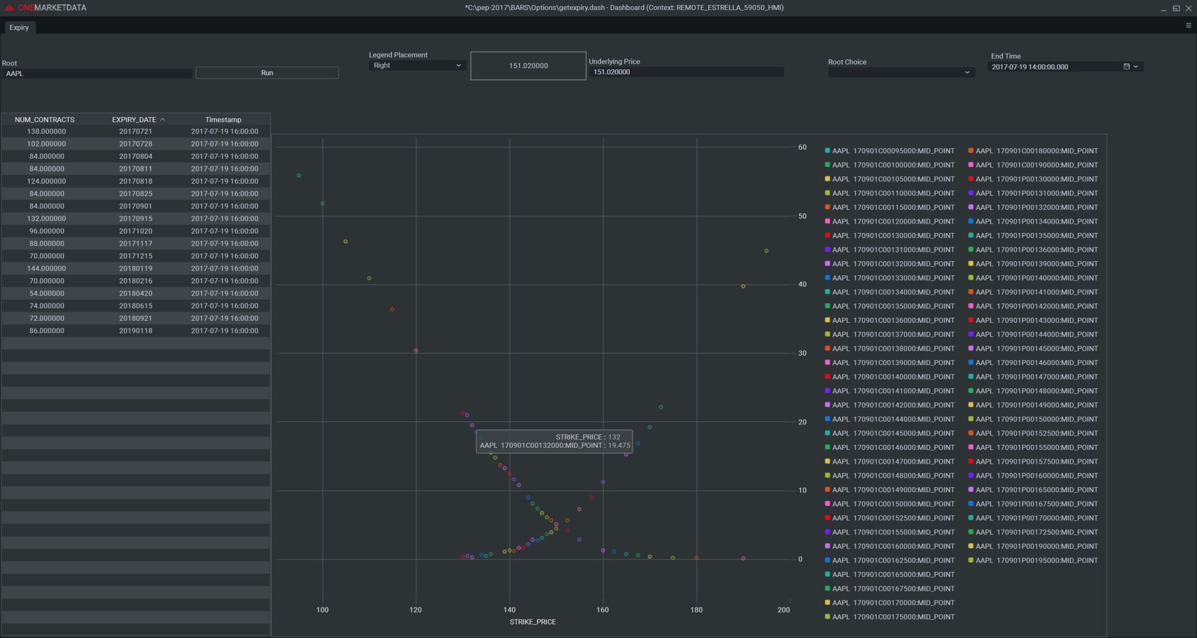
Example: OPRA AAPL Scatter

Slide 15
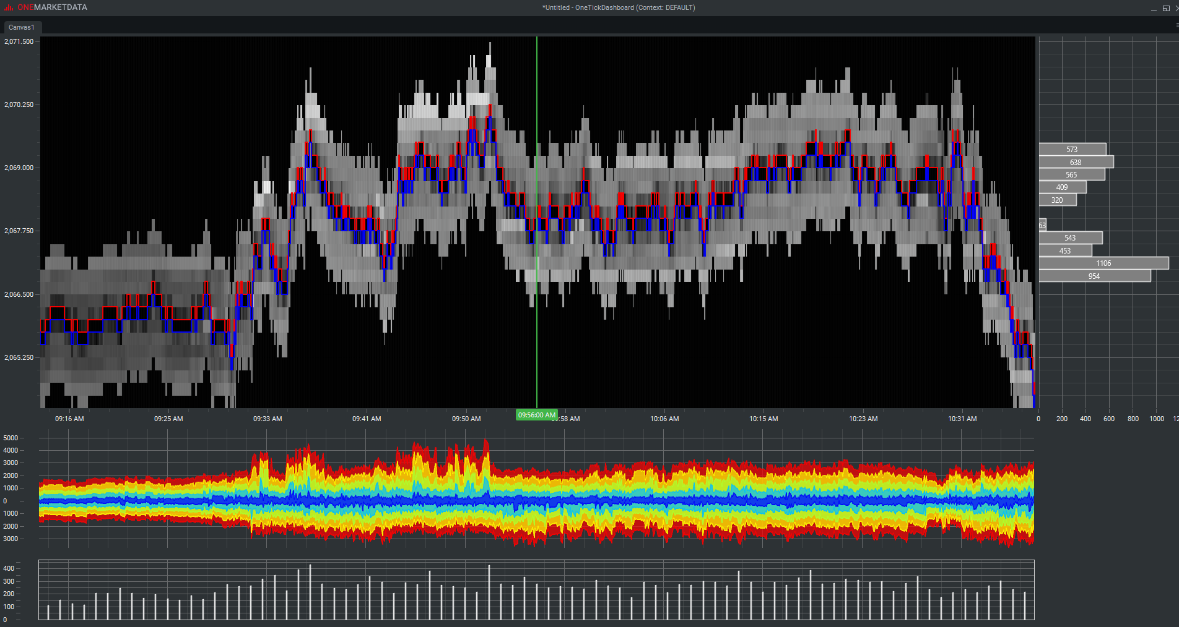
Example: Orderbook

Slide 16
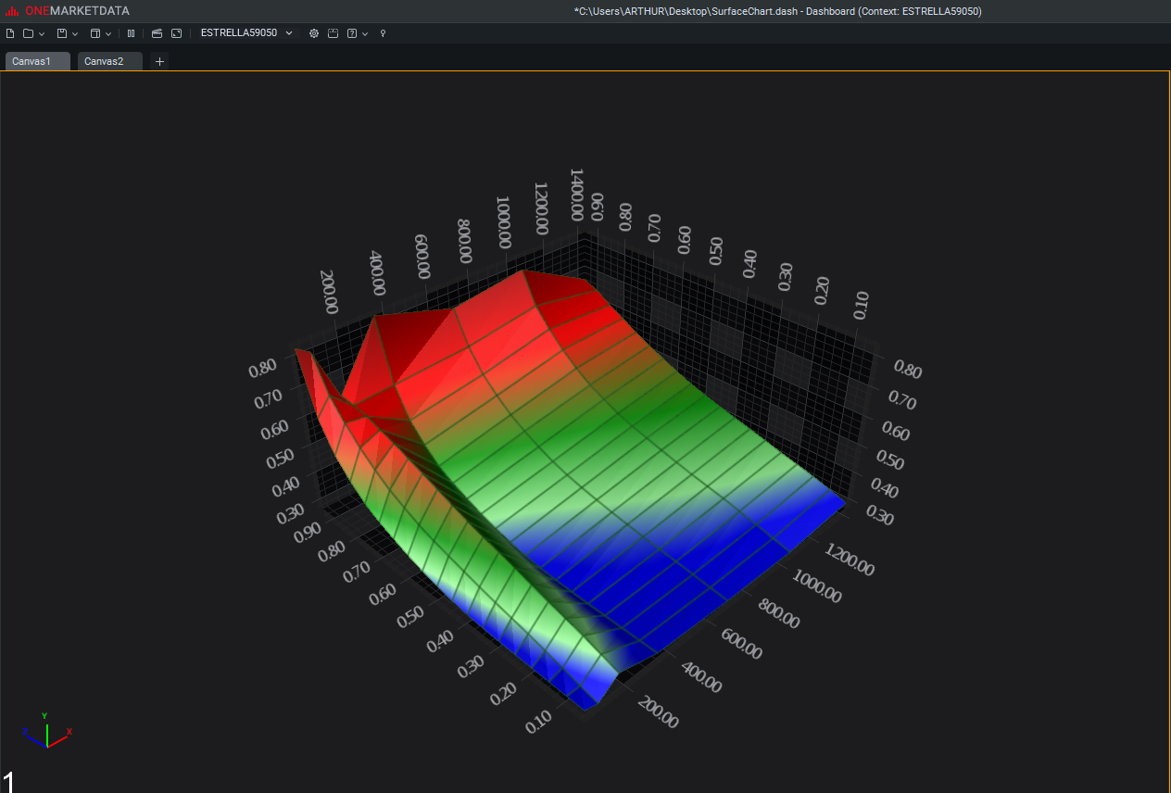
Example: Swaps Prototype 3-D

Slide 17
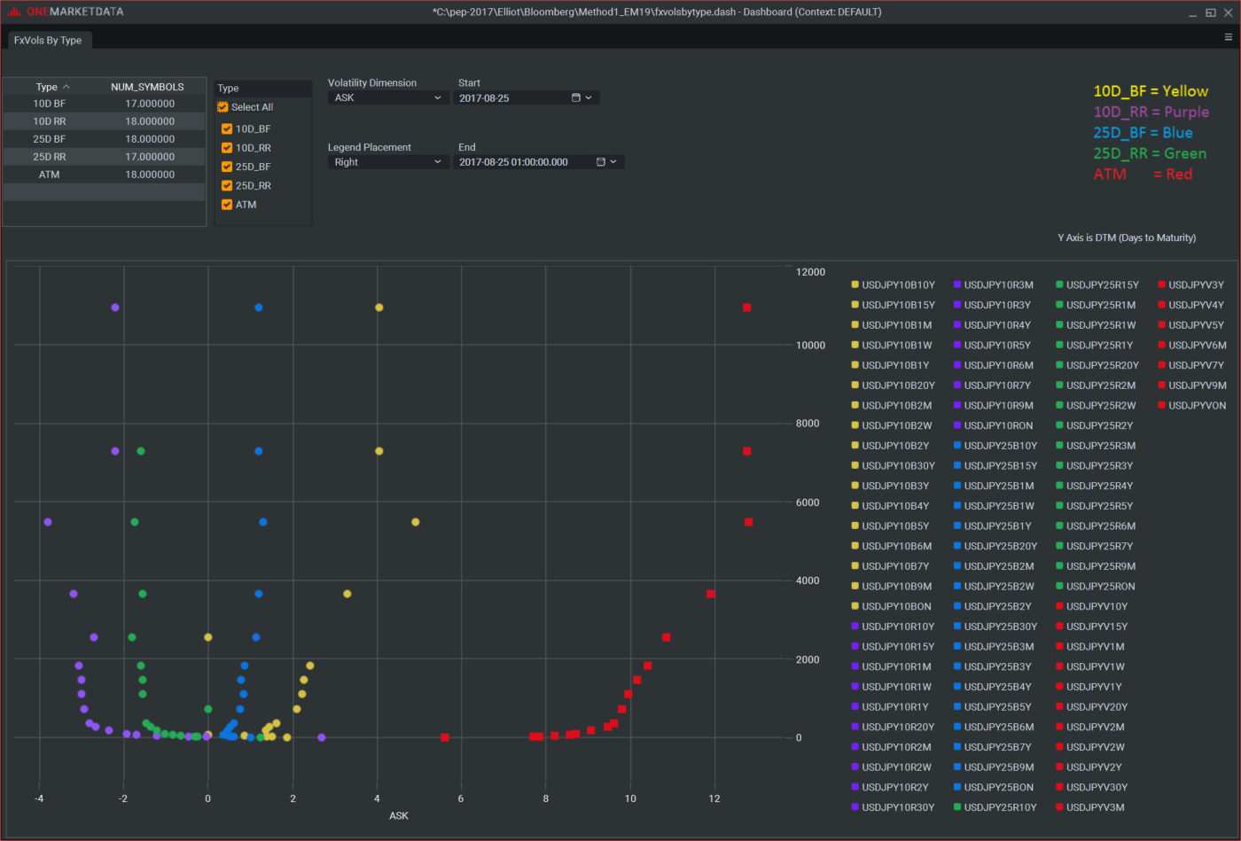
Example: FX Volatility Skews

Slide 18
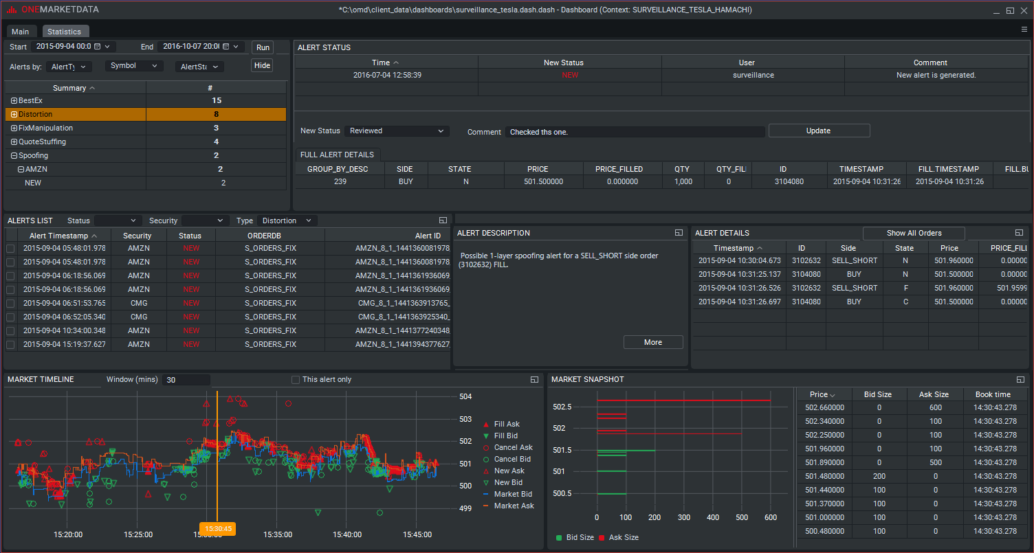
Example: Surveillance Product
Notes:
When we get this one I do a quick guided tour of how it implements the workflow using a variety of widgets, poiunt out the multiple tabs etc. But not too much as we revisit this in its live Web version later.

Slide 19
OneTickDashboard – Basic concepts
Notes:
Building up to:
OneTick queries (otq files)
Widgets (Canvases,Buttons, charts, grids, inputs….)
Widget properties (Chart type, text orientation, captions….)
Series (Data returned from your queries)
Messages (passed between widgets to control actions)

Slide 20
OneTickDashboard – Basic concepts
5 Basic ideas behind building a dashboard.

Slide 21
OneTickDashboard – Basic concepts
5 Basic ideas behind building a dashboard.
OneTick queries (otq files)

Slide 22
OneTickDashboard – Basic concepts
5 Basic ideas behind building a dashboard.
OneTick queries (otq files)
Widgets (Canvases,Buttons, charts, grids, inputs….)

Slide 23
OneTickDashboard – Basic concepts
5 Basic ideas behind building a dashboard.
OneTick queries (otq files)
Widgets (Canvases,Buttons, charts, grids, inputs….)
Widget properties (Chart type, text orientation,captions….)

Slide 24
OneTickDashboard – Basic concepts
5 Basic ideas behind building a dashboard.
OneTick queries (otq files)
Widgets (Canvases,Buttons, charts, grids, inputs….)
Widget properties (Chart type, text orientation,captions….)
Series (Data returned from your queries)

Slide 25
OneTickDashboard – Basic concepts
5 Basic ideas behind building a dashboard.
OneTick queries (otq files)
Widgets (Canvases,Buttons, charts, grids, inputs….)
Widget properties (Chart type, text orientation, captions….)
Series (Data returned from your queries)
Messages (passed between widgets to control actions)

Slide 26
OneTickDashboard – Lets build one !
The dashboard Builder tool is the same as the Dashboard Windows runner tool. It uses a similar start up script to that used for the GUI.
So lets start up
C:\OMD_train\client_data\scripts\run_onetick_dash.bat
..\client_data\scripts\run_one_tick_dash.bat
Notes:
For the next, maybe, 45 minutes you are going to be building a dashboard with your students following your evey move to build the same thing. So you better be pretty comfortable with building it. A pre-built version is available as FetchPricesBase.dash in client_data/Dashboards.

Slide 27
OneTickDashboard – Let’s build one !
Our example dashboard will do the following:
User selects from available databases
User selects from available dates for selected database
User selects from available symbols in selected database on selected date
User presses a “Fetch data” button.
A chart is displayed with the following:
Line chart of best bid and ask, and market trade prices
Bar chart of 15 minute bucketed volume as % of daily volume.

Slide 28
OneTickDashboard – Let’s build one !
We need a design document…

Slide 29
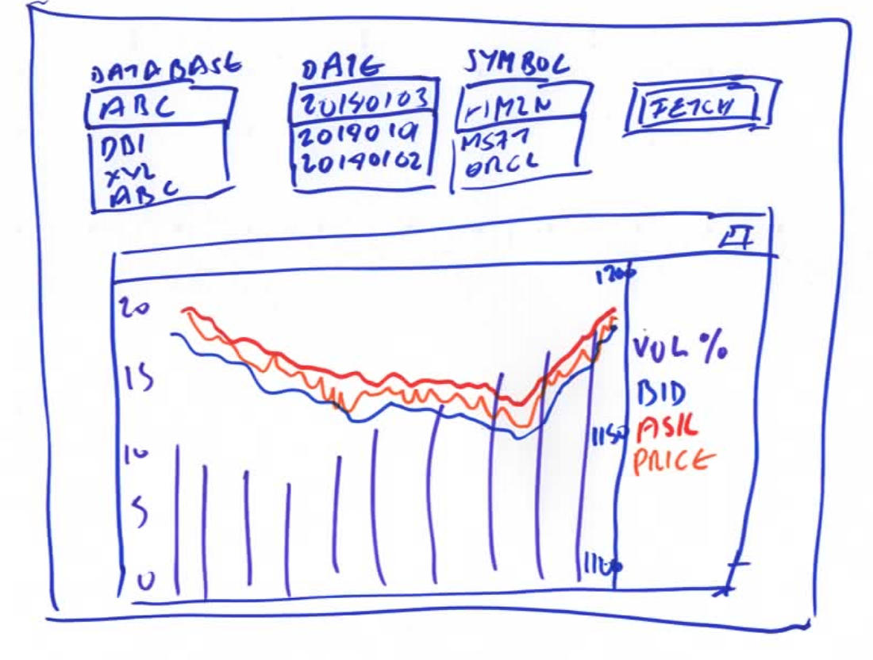
OneTickDashboard – Lets build one !
We need a design document…

Slide 30
OneTickDashboard – Lets build one !
We need a design document…
Dropdowns

Slide 31
OneTickDashboard – Lets build one !
We need a design document…
Dropdowns

Slide 32
OneTickDashboard – Lets build one !
We need a design document…
Dropdowns

Slide 33
OneTickDashboard – Lets build one !
We need a design document…
Dropdowns

Slide 34
OneTickDashboard – Lets build one !
We need a design document…
Dropdowns
A Button

Slide 35
OneTickDashboard – Lets build one !
We need a design document…
Dropdowns
A Button
A Chart

Slide 36
OneTickDashboard – Let’s build one !
…and some OneTick queries…
Fetch available databases
Fetch available dates for a given database
Fetch available symbols for a given database on a given date
For a given database, symbol and date:
Fetch best bid and ask prices
Fetch market trade prices
Fetch 15 minute volumes
Queries are in…
C:\OMD_train\client_data\otqs\DashQueries
GetDailyForSymbol.otq and GetDates.otq
Notes:
Make sure to emphasise the frequent use of start/end expressions and multiple output queries in Dashboard facing otq.

Slide 37
OneTickDashboard – Lets build one !
…and some OneTick queries…
Fetch available databases
Fetch available dates for a given database
Fetch available symbols for a given database on a given date
For a given database, symbol and date:
Fetch best bid and ask prices
Fetch market trade prices
Fetch 15 minute volumes
Queries are in…
C:\OMD_train\client_data\otqs\DashQueries
GetDailyForSymbol.otq and GetDates.otq
The Fetch dates query runs with “apply times daily” and a wide date range so is in a separate otq. But doesn’t actually need to be.
Notes:
Make sure to emphasise the frequent use of start/end expressions and multiple output queries in Dashboard facing otq. We look at multiple outputs when we discuss “series” a bit more later.

Slide 38
OneTickDashboard – Let’s build one !
No more slides for a bit….

Slide 39
OneTickDashboard – Let’s build one !
No more slides for a bit….
Just follow me….

Slide 40
OneTickDashboard – Let’s build one !
And you should have something like this….

Slide 41
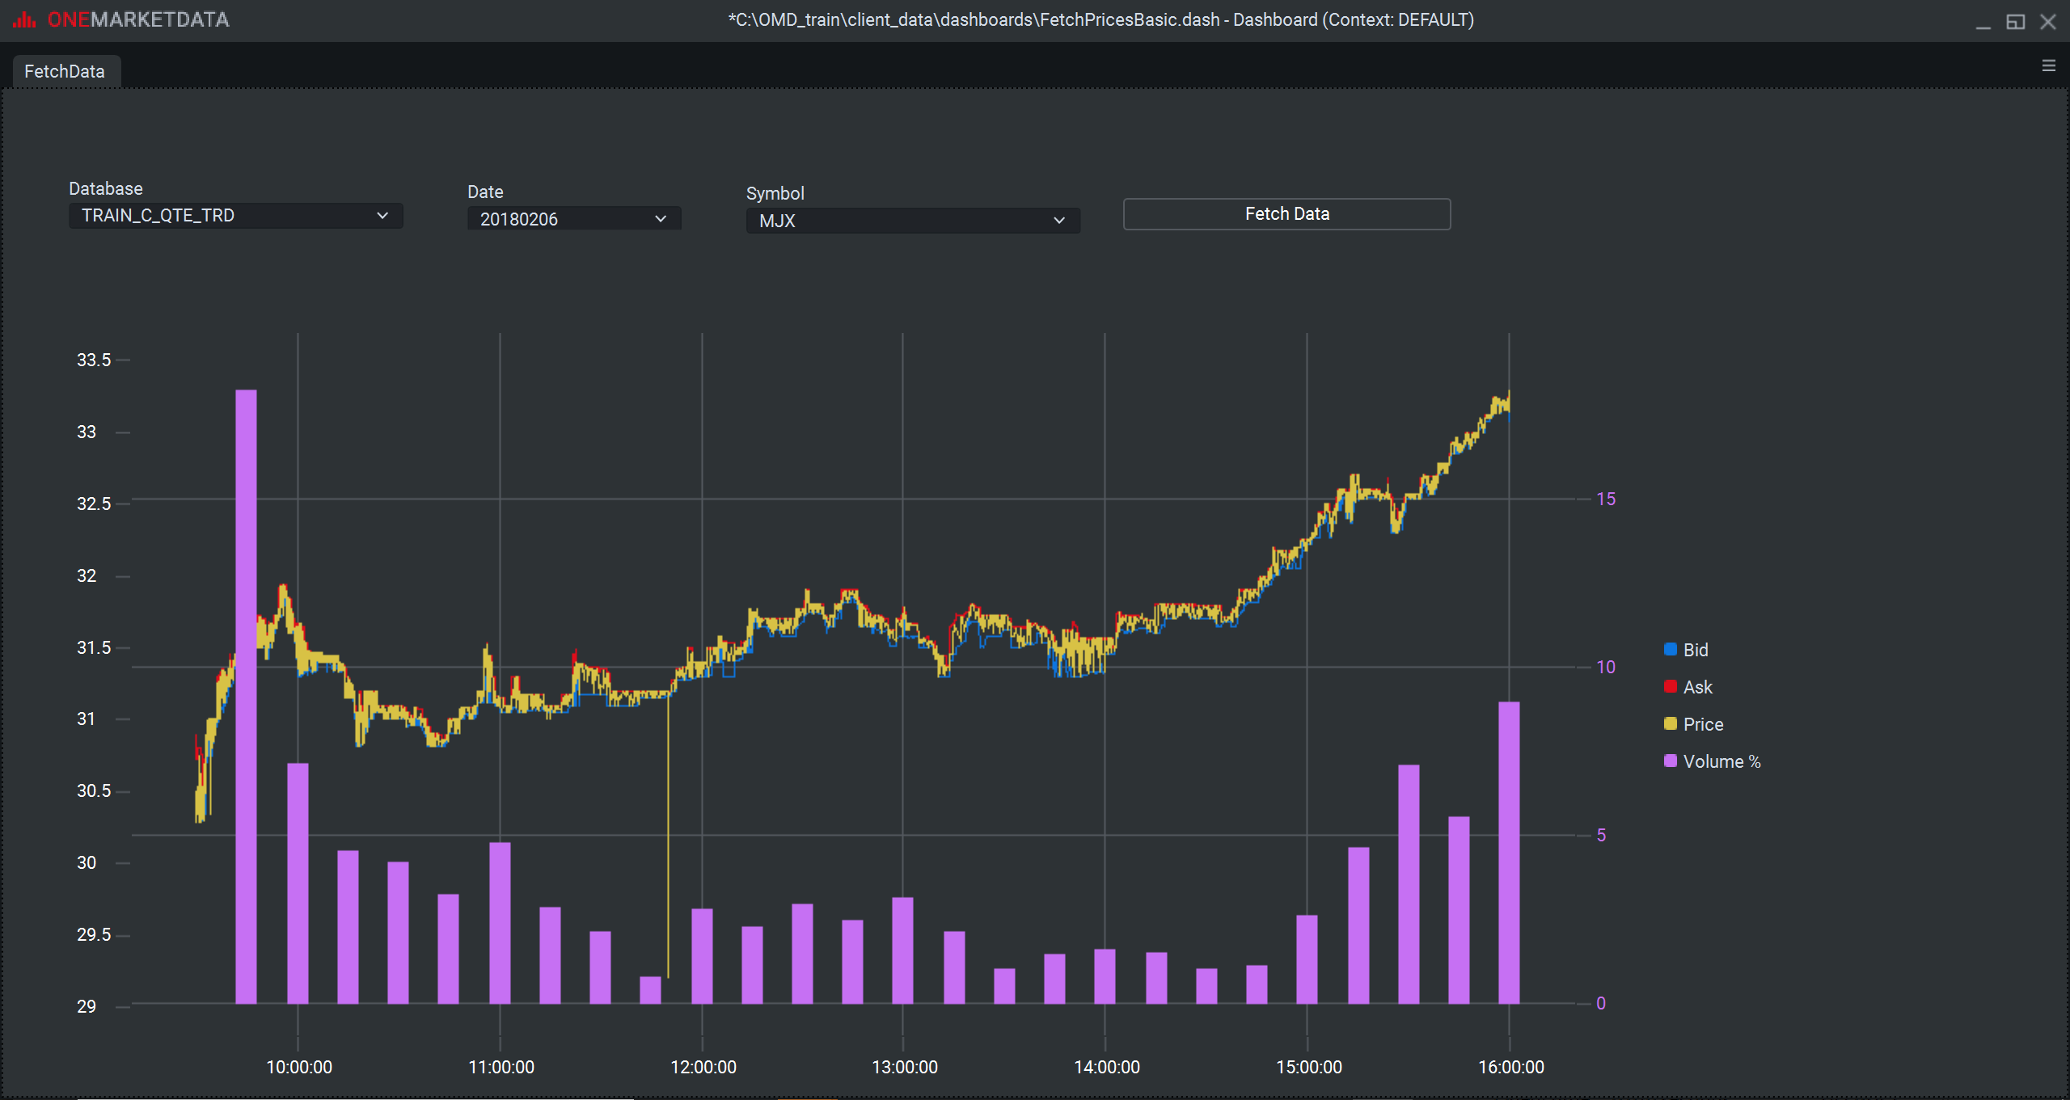
OneTickDashboard – Let’s build one !

Slide 42
OneTickDashboard – Let’s build one !
Here it is if we didn’t get round to finishing it.

Slide 43
OneTickDashboard – Let’s build one !
Here it is if we didn’t get round to finishing it.
And here with a few more bells and whistles:
A pie chart of volume/exchange
The Chart in a expandable tab widget
Displays of raw data in tabs
A floating filter window for the raw TRD data
Checkbox for Vertical selector (shows exposure of widget property)
Help tips

Slide 44
OneTickDashboard – A real example
At this point your presenter will give you a guided tour of a more complex, real world example.
Notes:
Replace this slide with your own. Mine links to the SilverGold dashboard to show an interactive dashboard and paremeterisation from a grid row to “drill down”.

Slide 45
OneTickDashboard – Thoughts on design
There are often multiple ways of doing things.
Look at this requirement…

Slide 46
OneTickDashboard – Thoughts on design
For 20180207 09:00-16:30 NY
For any one or more symbols selected from all available on that date
Plot %age change in price from open over the day
So something like this…..

Slide 47
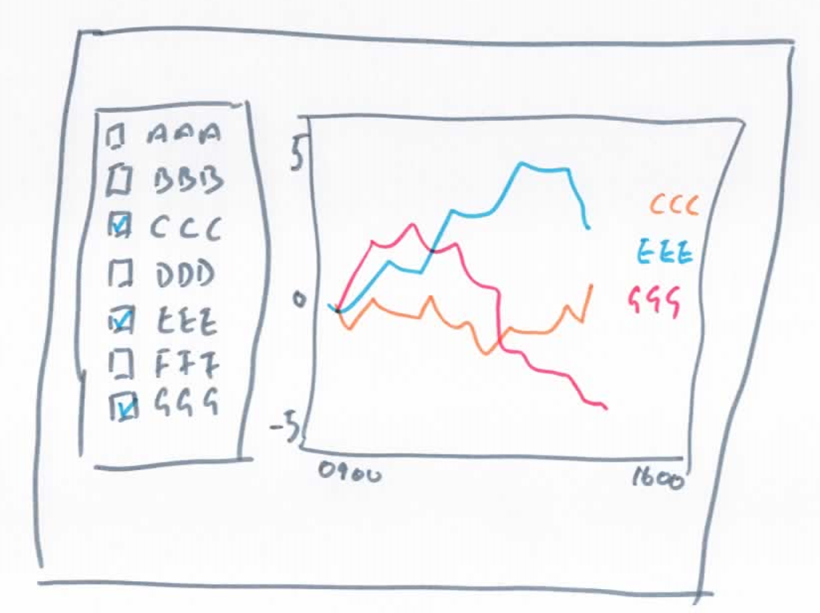
OneTickDashboard – Thoughts on design
Here’s a sophisticated spec

Slide 48
OneTickDashboard – Thoughts on design
How many ways can we do this ?
Notes:
Building up to “retrieve all required in one go”, “retrieve as specified”, “retrieve all possible and filter”

Slide 49
OneTickDashboard – Thoughts on design
How many ways can we do this ?
Add our symbols to a list when selected. Query data for all selected symbols.

Slide 50
OneTickDashboard – Thoughts on design
How many ways can we do this ?
Add our symbols to a list when selected. Query data for all selected symbols.
Query when we select a symbol.

Slide 51
OneTickDashboard – Thoughts on design
How many ways can we do this ?
Add our symbols to a list when selected. Query data for all selected symbols.
Query when we select a symbol.
Query for ALL symbols and filter only those we select.

Slide 52
OneTickDashboard – Thoughts on design
How many ways can we do this ?
Add our symbols to a list when selected. Query data for all selected symbols.
Query when we select a symbol.
Query for ALL symbols and filter only those we select.
Probably lots of other ways. But let’s just look at these 3 and discuss pros and cons. This example also lets us explore “series”.

Slide 53
OneTickDashboard – Thoughts on design
Here’s another example
showing how series can be named.
Query results named using query parameters.
Query results named using grid fields.
Query result name defaults to 1,2,3… but query Output name is set dynamically in the query.

Slide 54
OneTickDashboard – Thoughts on design
One query. Many series
As we discussed earlier, it’s very common with dashboard queries to have multiple named outputs from a single query as the Dashboard treats them as separate series.
Here’s an example….
Query
Dash
Notes:
Also mention that otq allows dynamic node naming via expr() and possibly the SPLIT_QUERY_OUTPUT ep to transform data from “keyed on symbol” to “keyed on specified field(s)”.

Slide 55
OneTickDashboard – And CEP
Not much to say.
As with any OneTick client application, running a realtime query is really no different to running a historic query.
There is a special form of the Grid widget that updates in place and may be useful.
Here’s an example:

Slide 56
OneTickDashboard – And CEP
But it may be that you don’t need true CEP at the front end for a visual application. Polling may be adequate and more efficient.
We often use a background CEP task that updates a OneTick SNAPSHOT along with a Dashboard query that interrogates the SNAPSHOT periodically using the Timer widget.

Slide 57
OneTickDashboard – Deployment
Dashboards can be saved in view mode only (F5 to toggle between edit mode and view mode)
Dashboards with or without loaded data. (Remember to save without data and possibly set checkboxes and pulldowns etc. to default state before saving).
Can be run via OneTickDashboard.exe (with the –f parameter. See here for other parameters )
Can be published onto a Web Server (HTML5).
Security, permissioning and authentication:
Just like any other OneTick client application
Plus Web Server capabilities if deployed on web. Plus hand coded dash/data logic (e.g Solutions workflow)

Slide 58
OneTickDashboard – Deployment
This is what the fancy version of our example looks like in a browser *.
Web deployment is pretty straightforward.
Documented here:
* If your presenter has Apache Tomcat installed, has remembered to start the server, and Java is enabled in the default browser

Slide 59
OneTickDashboard – Deployment
And here’s a test/demo version of our Surveillance solution on a remote server..
Notes:
http://25.31.110.79:50051/web_dashboard/?dash=surv. USES a Hamaci IP address. Make sure you know user/pass to access this up front for. E.g. user “solprod”. Ask Solutions if you don’t.

Slide 60
OneTickDashboard – Help and support
The Help menu item on the Dashboard (or F1) takes you to a comprehensive document on building dashboards, including some worked examples.
Useful FAQ document:
..\one_market_data\one_tick\docs\OneTickDashboardFAQ.html
The FAQ points to copious examples demonstrating all of the widgets, with annotations. These and others are in
..\one_market_data\one_tick\otqlib\dash_examples
Our normal help via Jira and support@onetick.com are always available.

